Slide 1
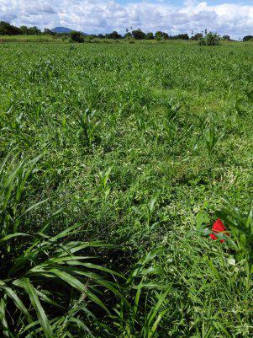
REMOTE SENSING
Remote sensing in Agriculture

Slide 2
WHAT IS REMOTE SENSING
Remote Sensing can also be said to be the art and science of acquiring information about the earth surface without having any physical contact with it.This is mainly done by observing and recording of reflected and emitted energy.

Slide 3
COMPONENTS OF REMOTE SENSING
ENERGY SOURCE
RADIATION AND ATMOSPHERE
INTERACTION WITH THE TARGET
RECORDING OF ENERGY BY THE SENSOR
TRANSMISSION, RECEPTION, PROCESSING
INTERPRETATION AND ANALYSIS
APPLICATION

Slide 4
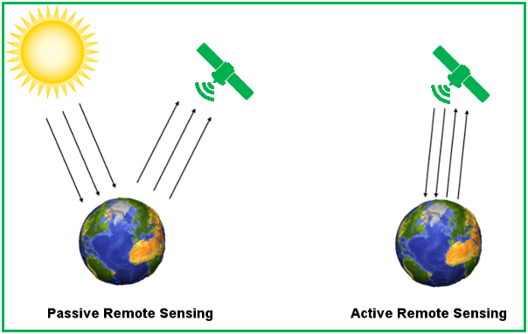
TWO TYPES OF REMOTE SENSING
ACTIVE
PASSIVE

Slide 5
APPLICATION OF REMOTE SENSING IN AGRICULTURE
CROP IDENTIFICATION
SOIL MAPPING
CROP-TYPE CLASSIFICATION
CLIMATE CHANGE MONITORING
PEST AND DISEASE CONTROL

Slide 6
THANK YOU
IT'S MY PLEASURE TALKING TO YOU

