Slide 1

Decomposition Methods for Solving Scheduling Problems using Answer Set Programming
Mohammed M. S. El-Kholany, MSc.
Supervisors:
Prof. Dr. Martin Gebser
Assoc. Prof. Dr. Konstantin Schekotihin
Production Systems Research Group
Department of Artificial Intelligence and Cybersecurity
Alpen-Adria-Universität Klagenfurt, Austria

Slide 2

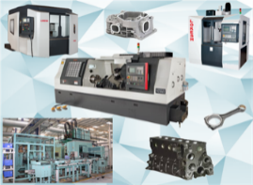

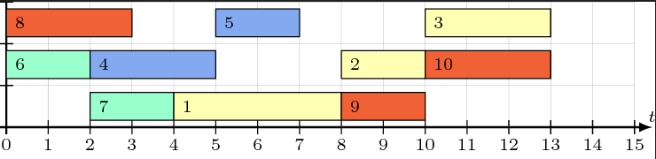
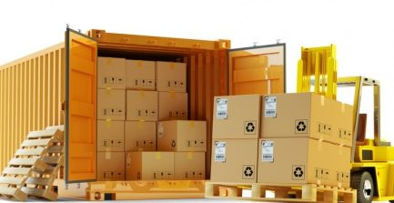
Production Systems
Customized products and delivery deadlines make efficient production management highly complex
Challenges related to machines and resources' availability are raised
Scarcity Problem
Limited Resources
High Demands
Production

Slide 3











Job-shop Scheduling with 4 jobs & 3 machines
Conjunctive arc:
Disjunctive arc:
1,1
$$4$$
1,2
$$3$$
1,3
$$2$$
2,1
$$1$$
2,2
$$4$$
2,3
$$4$$
0
*
$$3$$
3,1
$$3$$
3,2
$$2$$
3,3
$$1$$
4,1
3
4,2
$$3$$
4,3

Slide 4












Decomposition for Job-shop Scheduling
Conjunctive arc:
Disjunctive arc:
1,1
$$4$$
1,2
$$3$$
1,3
$$2$$
2,1
$$1$$
2,2
$$4$$
2,3
0
$$4$$
*
$$3$$
3,1
$$3$$
3,2
$$2$$
3,3
$$1$$
4,1
$$3$$
4,2
$$3$$
4,3

Slide 5
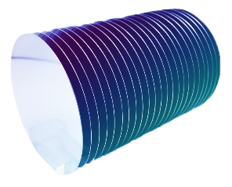

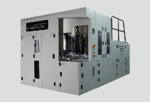
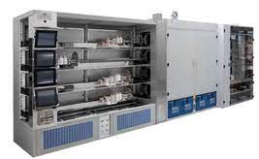
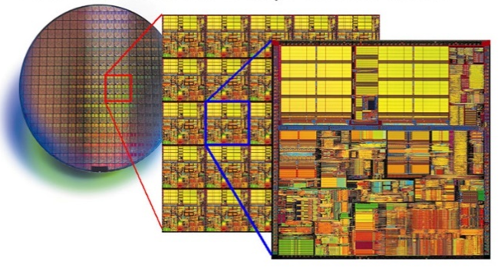
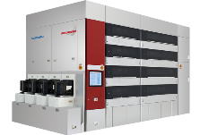
Semiconductor Manufacturing System
Tool Groups
Lots
Group_1
Group_M
Product
Group_2

Slide 6
Summary
Decomposition methods and multi-shot solving for Job-shop Scheduling
Model scheduling for Semiconductor Manufacturing Testbed (SMT2020)
Additional features to integrate
Machine Maintenance
Machine Setup
Batching
Global scheduling on small-scale datasets
Decomposition strategies and multi-shot solving for large-scale instances

