Slide 1

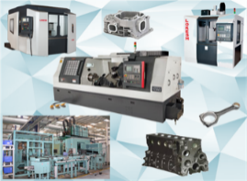

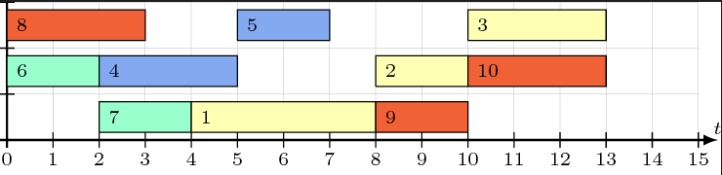



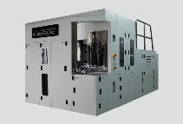
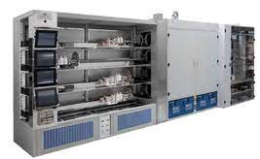
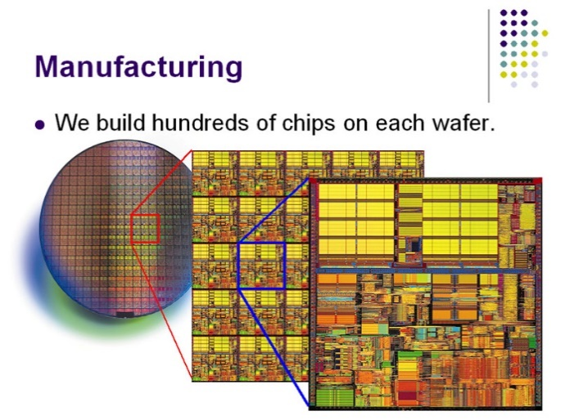
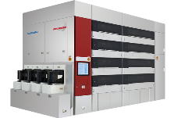























Decomposition Methods for Solving Scheduling Problems using Answer Set Programming
Mohammed M. S. El-Kholany, Martin Gebser, Konstantin Schekotihin
Alpen-Adria-Universität Klagenfurt, Austria
Production Systems
Customized products and delivery deadlines make efficient production management highly complex
Challenges related to machines and resources’ availability are raised
Scarcity Problem
Limited Resources
Production
High Demands
Job-shop Scheduling with 4 Jobs & 3 machines
Decomposition for Job-shop Scheduling
Conjunctive arc:
Disjunctive arc:
Conjunctive arc:
Disjunctive arc:
1,1
$$4$$
1,2
$$3$$
1,3
1,1
$$4$$
1,2
$$3$$
1,3
$$2$$
$$2$$
0
2,1
$$1$$
2,2
$$4$$
2,3
$$4$$
*
0
2,1
$$1$$
2,2
$$4$$
2,3
$$4$$
*
3,1
$$3$$
3,2
$$2$$
3,3
$$3$$
3,1
$$3$$
3,2
$$2$$
3,3
$$3$$
4,1
3
4,2
$$3$$
4,3
$$1$$
4,1
$$3$$
4,2
$$3$$
4,3
$$1$$
Semiconductor Manufacturing System
Summary
Tool Groups
Decomposition methods and multi-shot solving for Job-shop Scheduling
Model scheduling for Semiconductor Manufacturing Testbed (SMT2020)
Additional features to integrate
Machine Maintenance
Machine Setup
Batching
Global scheduling on small-scale datasets
Decomposition strategies and multi-shot solving for large-scale instances
Lots
Group_1
Group_M
Product
Group_2

