Slide 1
World Bank ETL Pipeline for ECOWAS Agriculture & Food Security
Pricepally Assessment
By: Adewunmi Olaniyi

Slide 2
PROJECT BRIEF
Developed an Apache Airflow DAG that extracts data from a public API, transforms and cleans the data to make it analysis-ready for data scientists and analysts, and loads the processed data into a database with comprehensive

Slide 3
PROBLEM STATEMENT
Bee-Agro Allied lacks an automated system to collect and process agricultural, economic, and demographic data for West Africa. Without a robust data pipeline, the organization cannot efficiently support reporting and predictive modeling for food supply, economic access to food, and population-driven demand, hindering data-driven decision-making in the region.

Slide 4
PROPOSED SOLUTION
Use World Bank API as a reliable, free, standardized source for agricultural, economic, and demographic indicators across ECOWAS countries.
Build an automated ETL pipeline with Apache Airflow to extract data via API calls, transform, ensure data quality and load clean records into PostgreSQL.
Provide analysts and data scientists with a wide-format dataset optimized for easy SQL querying, visualization, and predictive modeling to support strategic decision-making.

Slide 5
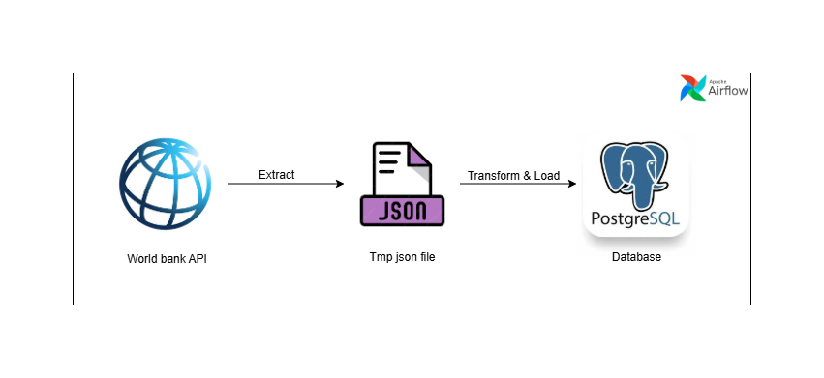
ARCHITECTURE OVERVIEW

Slide 6
TECHNOLOGIES USED
Python – ETL business logic
Postgresql – database for storage
Airflow – orchestration and scheduling
Docker + docker compose – reproducible local setup

Slide 7
WORKFLOW PROCESS
JSON Normalization: Extract nested indicator values from World Bank API responses and convert to flat pandas DataFrames with country, year, indicator, and value columns.
Wide Format Pivot: Reshape data from long to wide format where rows represent country-year combinations and columns represent individual indicators, enabling intuitive cross-indicator analysis.
Column Standardization: Rename all column headers for SQL compatibility and apply consistent naming conventions across the dataset for maintainability.

Slide 8
WORKFLOW PROCESS CONT’D
Data Validation: Apply Pandera schema validation to enforce data types, check value ranges (e.g., valid year ranges), identify missing required fields, and ensure data integrity before loading to the database
Alert Notification: Email notifications of failed task after retries for quick response to failure.

Slide 9
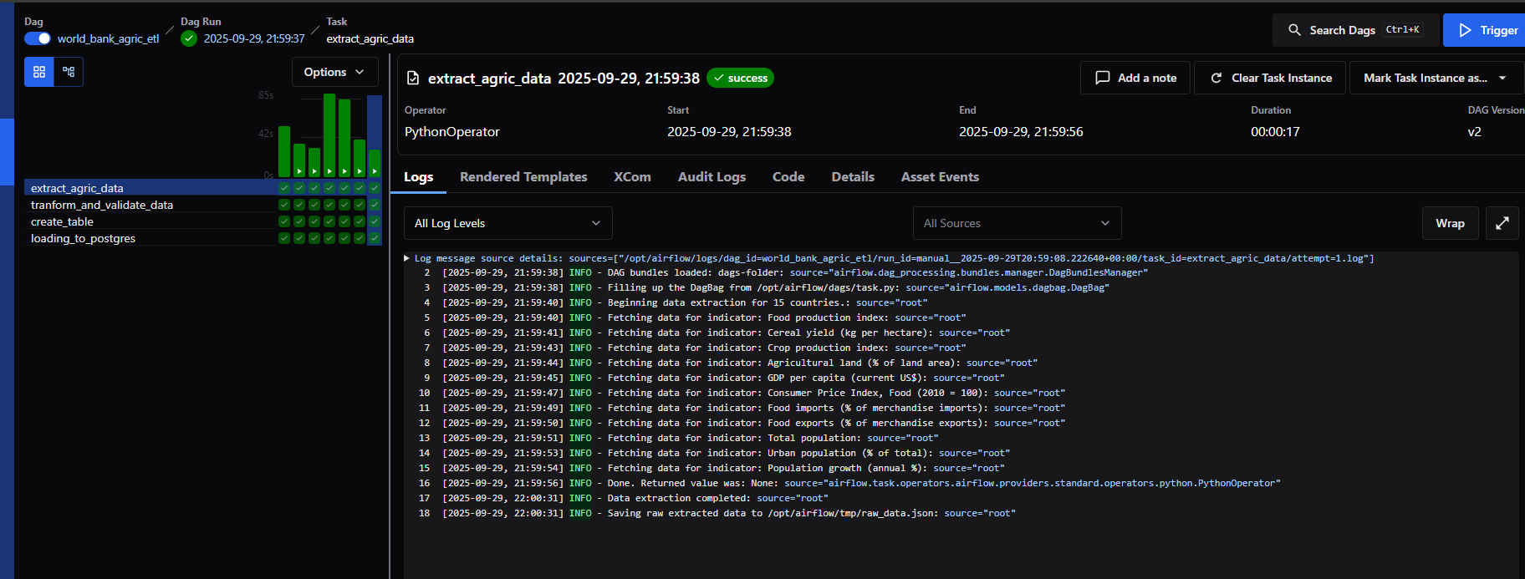
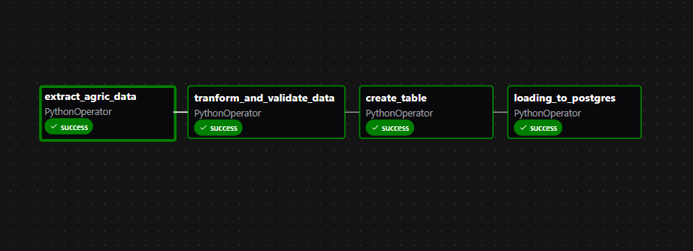
Dag View of successful runs

Slide 10
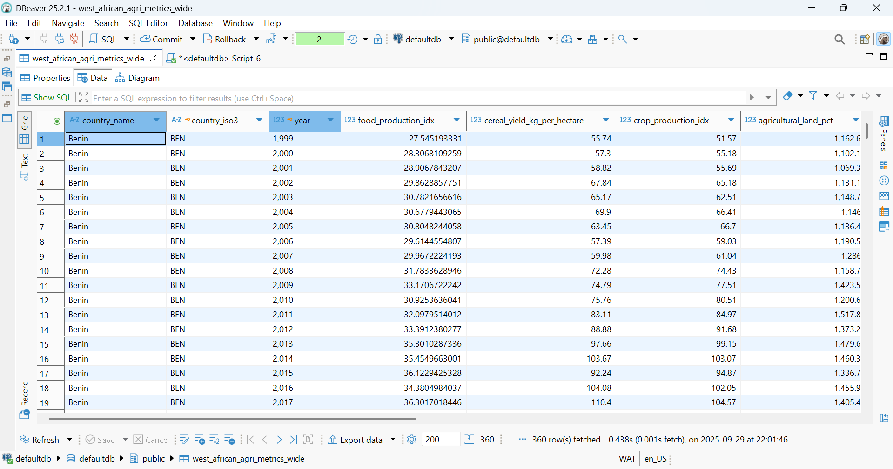
Database Data View

Slide 11
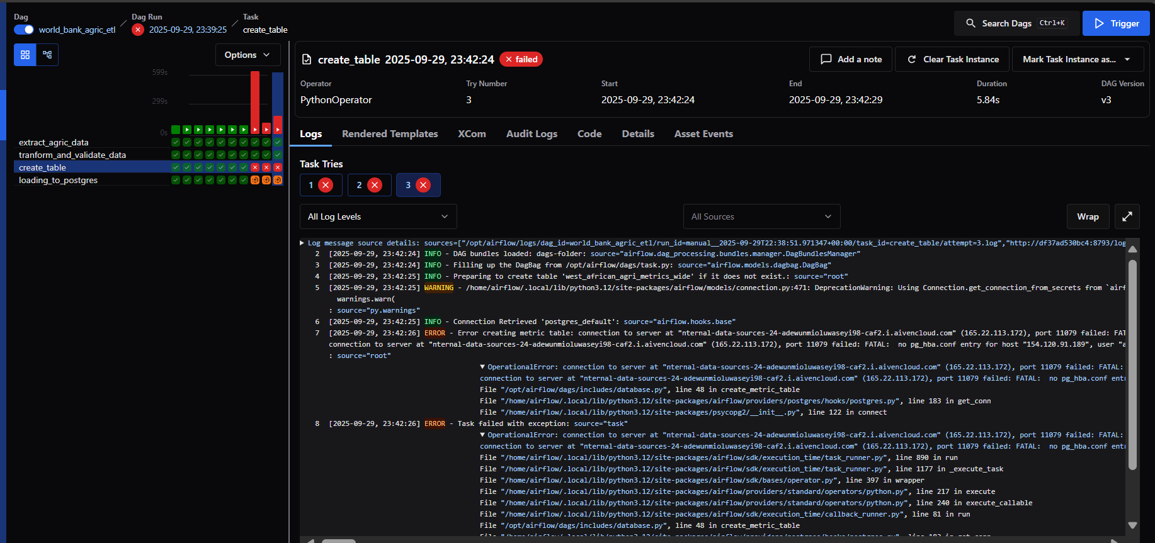
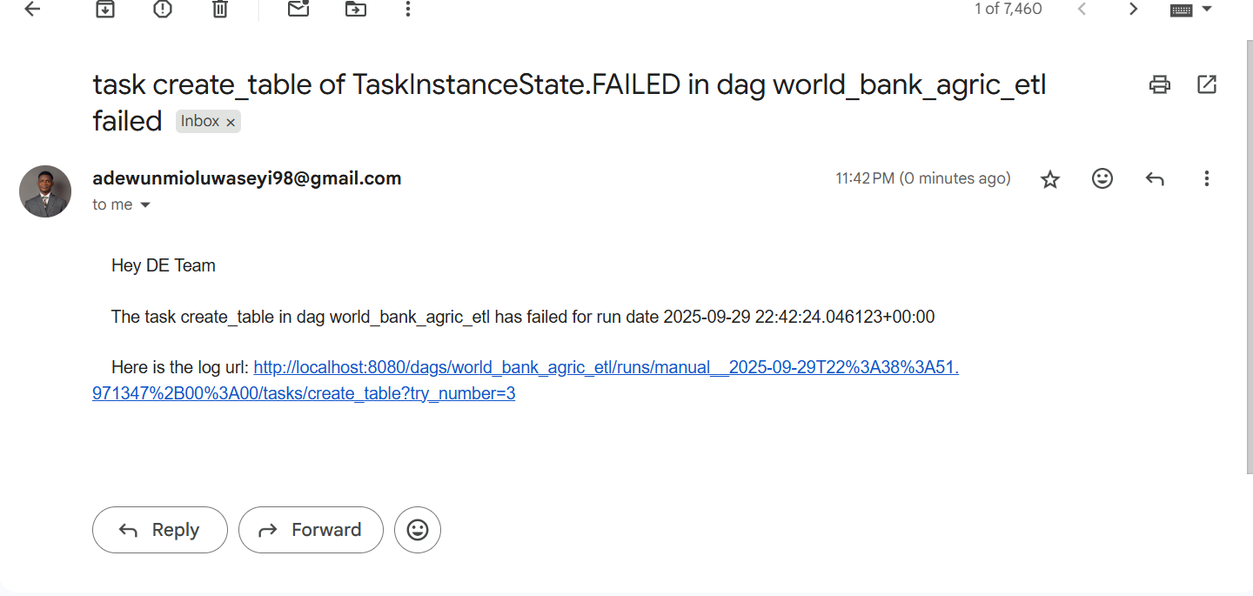
Failed Task and Notification

Slide 12
Thank you

