Slide 1
A Structure Editor For PAL Constraints
Anton An
July 18, 2001

Slide 2
What is PAL?
Protégé Axiom Language
A superset of first-order logic
To express constraints on a knowledge base
To make logical queries about the contents of a knowledge base

Slide 3
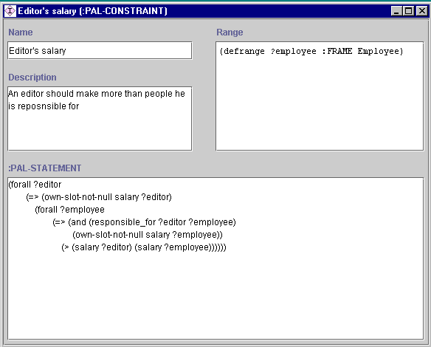
PAL Constraint Editor

Slide 4
A simple editor is not enough
Writing first-order logic statements is a daunting task for novel users
It is very hard to memorize all the predicates and functions
A simple editor provides no help for users

Slide 5
Solution: A Structure Editor
Use the Top-Down approach
Provide context-sensitive help in both Statement and Range widget
Include handy editing features

Slide 6
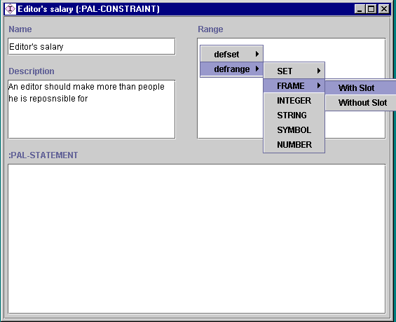
Define variables

Slide 7
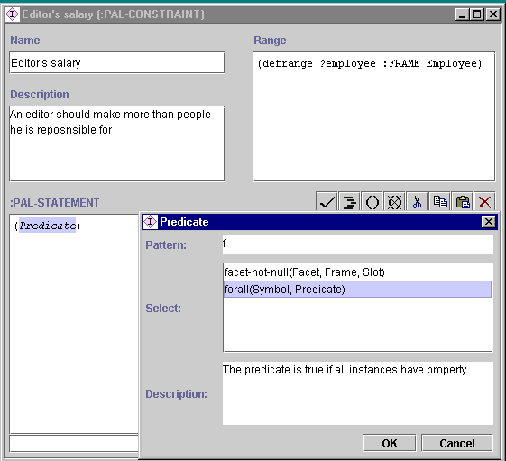
Construct PAL statement

Slide 8
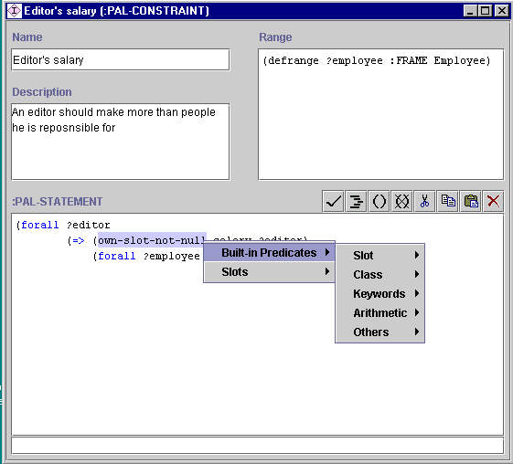
Context-sensitive menu

Slide 9
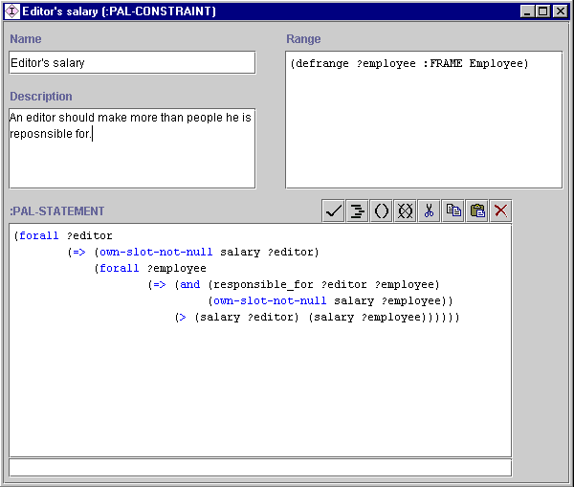
Completed constraint

Slide 10
Direct editing
Experienced users might want to edit constraints directly
Can use the structure editor as an enhanced text editor
Can always resort to the help provided by the structure editor when in doubt
Syntax checking to ensure correctness

Slide 11
Evaluation
More user friendly than the old editor
Provide both syntactic and semantic help
Recursive construction help novel users
Handy features for experienced users

