Slide 1



Using Protégé for Automatic
Ontology Instantiation
Harith Alani, Sanghee Kim, David Millard, Mark Weal,
Paul Lewis, Wendy Hall, Nigel Shadbolt
7th International Protégé Conference
Notes:
In this talk I will describe a project named artequakt, it gets its name from 3 other prjs, artiste, equator, and akt. Artequakt bridges between these 3 projects in the sence that people from all 3 are working on it.
We wanted to build artequakt as a proof of concept, so we had no funding for it, but now trying to bid for funding, so if anyone of u have some money to spend on projects, please listen to the talk and see me afterwards!

Slide 2
ArtEquAKT
Aims:
  Use NLT to automatically extract relevant information about the life and work of artists from online documents
  Feed this information automatically to an ontology designed for this domain
  Generate stories by extracting and structuring information from the knowledge base in the form of biographical narratives

Slide 3
Motivation
The knowledge is out there!
  Available on the web, buried in text documents, not understood by machines!
Semantic annotation might help
  Annotations are rare
  In the near future, annotations will probably not be rich or detailed enough to support the capture of extended amounts of content
Knowledge extraction
  There will always be a need for tools that can locate and extract specific types of knowledge, and store it in a KB for further inference and use

Slide 4
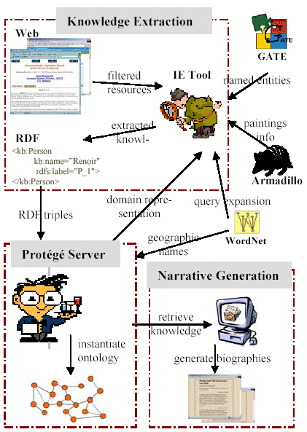
Architecture

Slide 5
ArtEquAKT Ontology
Based on the Conceptual Reference Model (CRM) ontology
Developed by CIDOC and promoted as an ISO standard
CRM models the concepts and relationships used in cultural heritage documentation
CRM is extended in ArtEquAKT to cover the life and work of artists

Slide 6
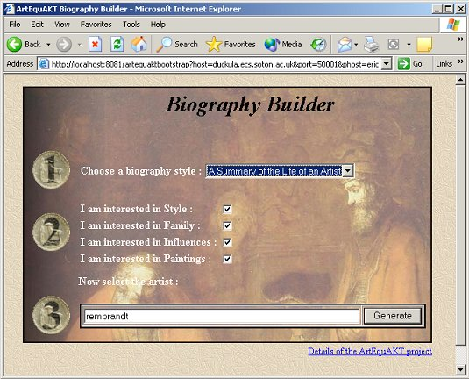
User Interface

Slide 7
Search and Filter Documents
Documents are selected following these steps:
  Query search engine (Google) with the given artist name
  Calculate the similarity of the returned documents to some example documents about artists
  Apply some heuristics (e.g. minimum paragraph length) to filter out documents containing mainly tables or hyperlinks
  Send the remaining documents to the information extraction process

Slide 8
Knowledge Extraction Component

Slide 9
Knowledge Extraction Process
Input HTML
Rembrandt Harmenszoon van Rijn
was born on July 15, 1606, in
Leiden, the Netherlands.
Apple Pie Parser
l
o
Rembrandt
noun
o
Syntactic Analysis
T
n
was
verb
o
i
t
c
a
r
t
x
E
e
g
d
e
l
w
o
Subject:
Rembrandt Harmensoon van Rijn
n
Verb:
born
K
Object:
on July 15, 1606 … Netherlands
GATE
t
k
Tense:
past
a
Rembrandt
person
u
q
Artequakt Ontology
e
t
July 15,
date
r
1606
A
date_of_birth
Date
Netherlands
location
Person
Relation Formulation
WordNet
place_of_birth
Place
Leiden
city
Output RDF
Netherlands
country

Slide 10
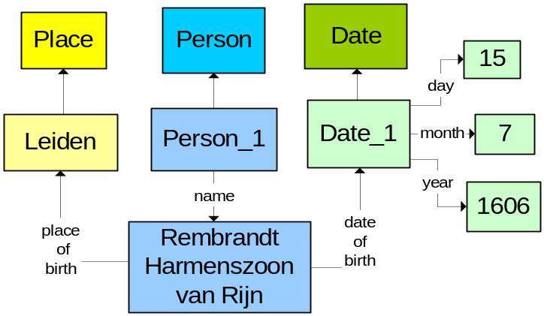
Extraction Output
<kb:Person rdf:about="&kb;Person_1"
kb:name=“Rembrandt Harmenszoon van Rijn"
rdfs:label="Person_1">
<kb:date_of_birth rdf:resource="&kb;Date_1"/>
<kb:place_of_birth rdf:resource="&kb;Place_1"/>
<kb:has_information_text rdf:resource="&kb;Paragraph_1"/>
</kb:Person>
<kb:Date rdf:about="&kb;Date_1"
kb:day=“15"
kb:month=“7"
kb:year="1606"
rdfs:label="Date_1">
</kb:Date>
<kb:Place rdf:about="&kb;Place_1"
kb:name=“Leiden"
rdfs:label="Place_1"/>
</kb:Place>
Send the identified triples to the ontology server:
1. Person_1 Rembrandt …
2. Person_1 15 July 1606
3. Person_1 Leiden
“Rembrandt Harmenszoon van Rijn was born on July 15, 1606, in Leiden, the Netherlands”
RDF
extracted triples
add to KB
name
date_of_birth
place_of_birth

Slide 11
Knowledge Management Component

Slide 12
Knowledge Management Process
Provide guidance to the extraction process
Receives extracted knowledge in RDF format
Instantiate the ontology with the given knowledge triples (add to the KB)
Consolidation the knowledge
Verify inconsistencies
Ontology server providing a set of inference queries

Slide 13
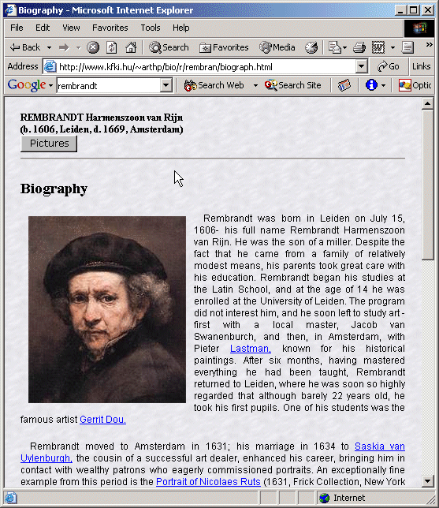
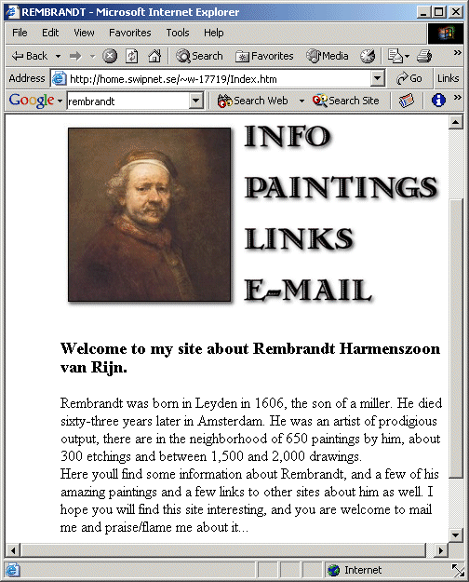
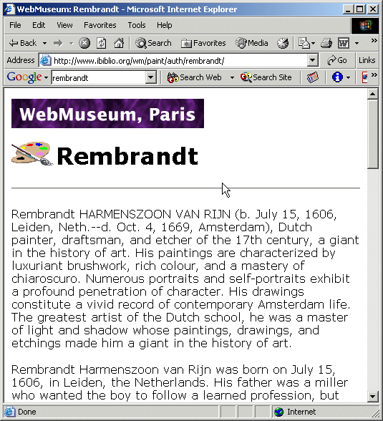
Knowledge Consolidation

Slide 14
Types of Duplication
Rembrandt
Rembrandt van Rijn
duplicate
instances of the same artist
15 July 1606
dob
1606
Leiden
1606
Leiden
Rembrandt van Rijn
Rembrandt
Rembrandt
pob
Leiden
duplicate attribute values
synonym
1606
Leyden
15 July 1606
Leiden
Leyden
Rembrandt
Rembrandt van Rijn
duplicate instances and attribute values
1606
Leyden
15 July 1606
Leiden

Slide 15
Consolidation Procedure
Unique Name Assumption
  e.g all “Rembrandts” are merged
  Not fool-proof, but works well in this limited domain
Information Overlap
  Merge similarly named artists if they share specific attribute values
  e.g. Rembrandt, and Rembrandt Harmenszoon share a date of birth and a place of birth
Merge less specific information into more detailed ones
  This is mainly performed for dates and places
    e.g 1606 is merged into 15/7/1606; Netherlands is merged into Leiden
  Place names are expanded with WordNet
    Synonyms: Leiden = Leyden
    Holonyms (part of): Leiden is part of The Netherlands
    What if there is more than one Leiden? How do we know which to select?
      Use the specificity variation of the given place for disambiguation
      e.g. we are here looking for a Leiden that is related to the Netherlands
Notes:
Shared place name: when dealing with two possible places of birth; Leiden and Holland, we can rely on the fact that these two are related, which leads us to the fact that the Leiden in hand is the one located in Holland.

Slide 16
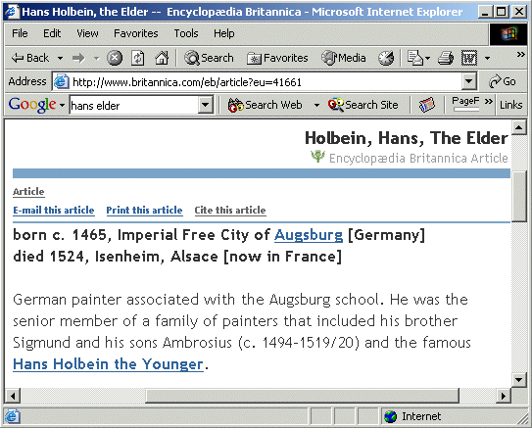
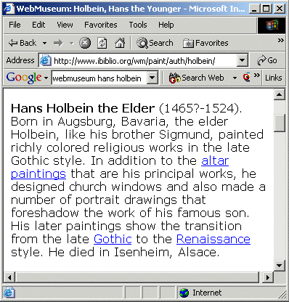
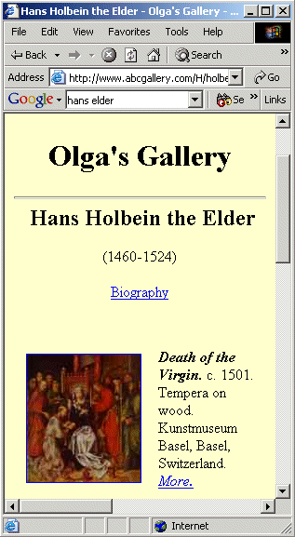
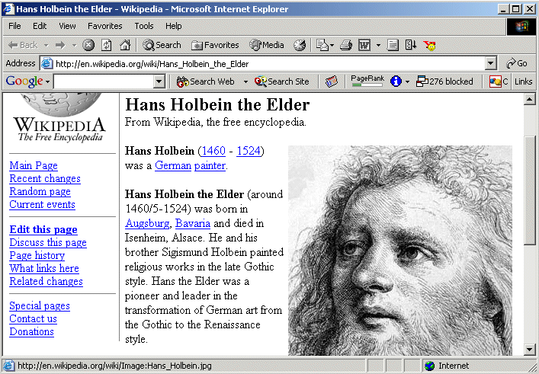
Verifying Inconsistencies

Slide 17
Verifying Inconsistencies
We don’t aim for “the right answer”, but for some sort of a confidence value
But which answer is more likely to be the correct one?
  Trust: certain sources can be more trusted than others, but how do we judge that?
  Frequency: certain facts might be extracted more often than others
  Extraction: some extraction rules are more reliable than others!

Slide 18
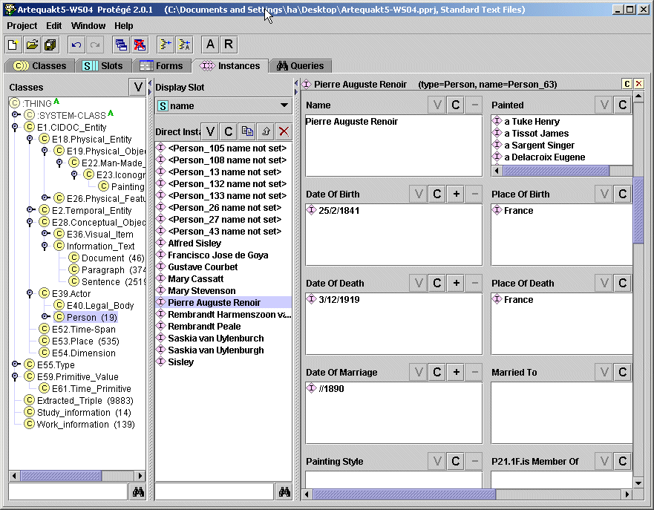
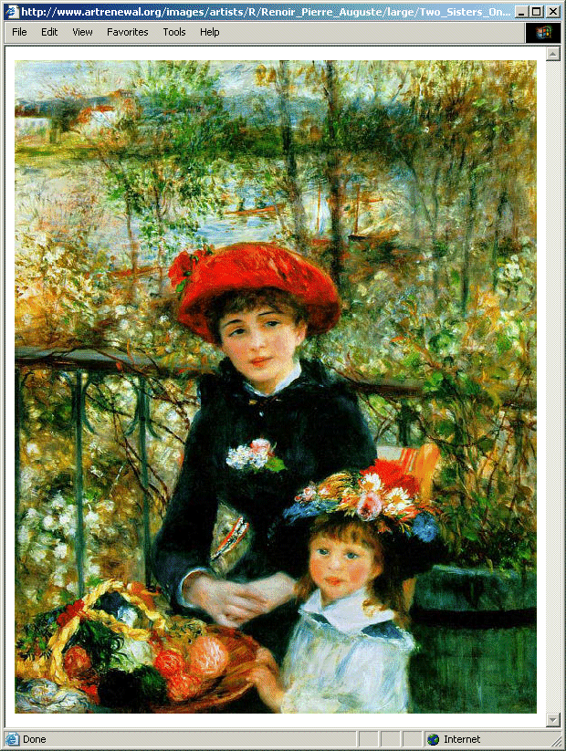
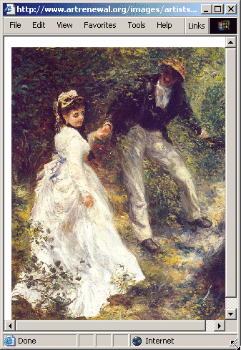
Instantiated Ontology

Slide 19
Narrative Generation Component

Slide 20
Narrative Generation
Intro paragraph :
DOB + place
Level of Detail (LoD)
1
2
Paragraph with DOB and Place
Rembrandt Harmenszoon van Rijn was born on July 15, 1606, in Leiden, the Netherlands. His father was a miller who wanted the boy to follow a learned profession, but Rembrandt left the University of Leiden to study painting.
Sequence
1
2
Best option is to have one paragraph that contains both pieces of information
LoD
LoD
1
2
1
2

Slide 21
FOHM Template
Intro paragraph :
DOB + place
Level of Detail (LoD)
1
2
Otherwise need a sequence of two fragments (DOB and place).
Either use a paragraph for each fragment, or construct out of raw facts
Sequence
1
2
LoD
LoD
1
2
1
2
DOB
Constructed sentence:
Rembrandt was born on July 15, 1606.

Slide 22
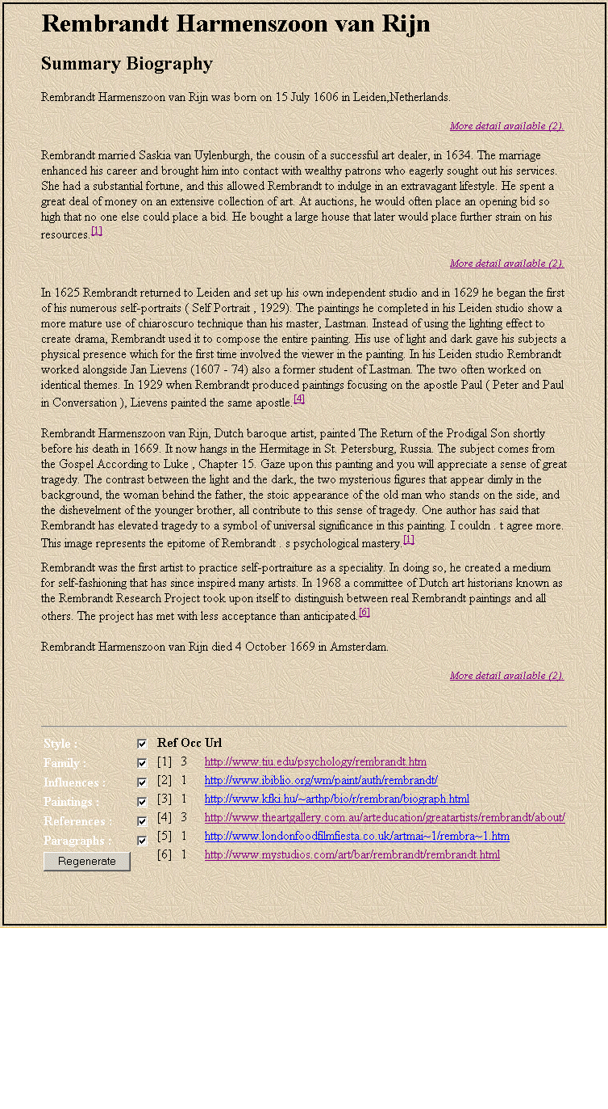
Example Biography

Slide 23
ArtEquAKT Challenges
Extraction
  Some fact are too complex to extract
  Rule based IE is not always sufficient
  Mapping of ontology terms to those in the text is unreliable (better for the ontology editor to include synonymous terms)
Generation
  A much wider range of facts should be extracted to be able to generate the biographies from scratch
  Narrative construction may require richer semantic support (e.g. ontology of narrative)
  Generation is not error free. We rely on people’s ability to parse and understand text
  Difficult to track what facts has been included in the biography if these facts have not bee identified
Consolidation
  Unreliable if the facts are extracted incorrectly
  Could be inaccurate with spars information
  Geographical expansion can be wrong for places with same names
Planning a bid for a second generation of ArtEquAKT
  Entirely ontology driven
  Domain independent
  Much better text generation

Slide 24
Questions you may want to ask!
So does this system work with other domains?
Why bother with biographies anyway! There are many out there already!
Why extract knowledge, then use whole paragraphs in your biographies?!
Did you evaluate any of this?
What kind of knowledge did you manage to extract?
What did you say that Armadillo thing does?
How can we get GATE to recognise different entities?
How much rubbish does your system extract?
Can we use this system?! ….. please?
How would you like me to fund you? cash or check?

