Slide 1
Embracing Change
Financial Informatics and
Risk Analytics
Mark D. Flood
Senior Financial Economist
Federal Housing Finance Board
The views expressed are those of the author and do not necessarily reflect official positions of the Federal Housing Finance Board or the U.S. Department of the Treasury.

Slide 2
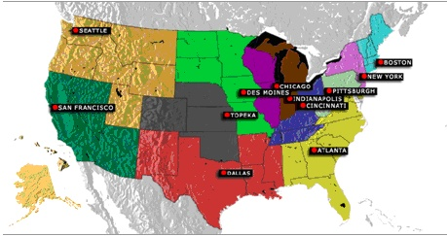
Federal Home Loan Banking System
12 regional Federal Home Loan Banks (FHLBs)
  Owned by members (8000 banks and thrifts)
  ca. $1,000,000,000,000 in aggregate assets
  ca. 100,000 complex financial contracts
  ca. 4.50% capital

Slide 3
Managing Risk
Analysis requires data and models
Unstable metadata, due to:
  financial innovation
  model risk
  strategic policy evolution
Flexibility is the central requirement

Slide 4
Model Risk
Data input risk
Estimation risk
Model selection risk
Implementation risk
Method
#1
Model
#1
Analytics
#1
Market data
.
.
.
.
.
.
.
.
.
Position data
Method
#j
Model
#k
Analytics
#n

Slide 5
Scalability of Metadata
Stovepipe topology Numeraire topology
Source systems
Analytics systems
Source systems
Analytics systems
a₁
a₁
s₁
s₁
a₂
a₂
s₂
s₂
N
a₃
a₃
s₃
s₃
a₄
a₄
Cost = (m + n)k_{spec} + (mn)k_{map} Cost = k_{N} + (m + n)k_{spec} + (m + n)k_{map}

Slide 6
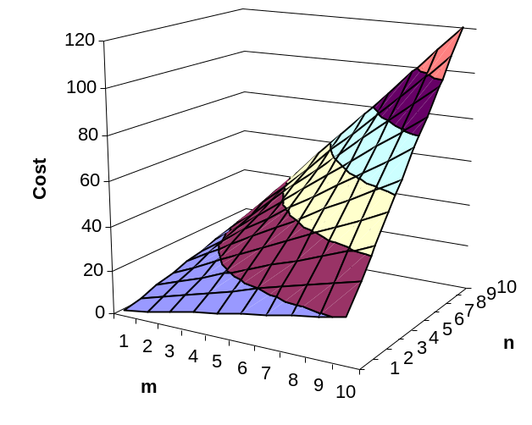
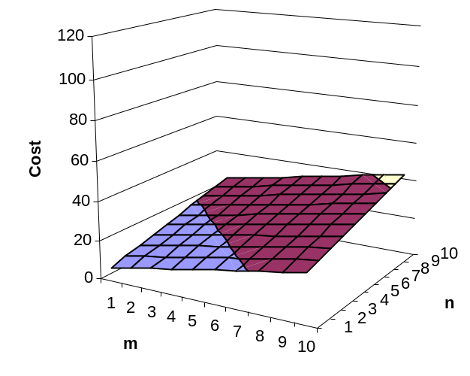
Scalability of Metadata
Stovepipe topology Numeraire topology

Slide 7
Implementing a Solution
Requirements:
  Flexible
    Auto-generate all significant outputs from metadata
  Scalable
    Use the numeraire architecture
  Practical
    Use production-quality tools available today
  Portable
    Design is self contained and independent of platform

Slide 8
Implementing the Numeraire
Source systems
Analytics systems
Market data
a₁
Market 1
Data integration
s₁
Market 2
Analysis
a₂
Numeraire
▪
▪
▪
Analytics 1
s₂
N
Analytics 1
a₃
Position data
Analytics 2
s₃
Portfolio 1
▪
▪
▪
a₄
Portfolio 2
▪
▪
▪
Numeraire topology Numeraire component design

Slide 9
Implementing the Numeraire
Market Data
Vendor
data 1
GUI
Vendor
data 2
Market
Data
Manager
Data Integration
Analysis
Vendor
data 3
(etc...)
Market
data
(preliminary)
Ontology
editor
Metadata Manager
Version
control repository
Analytics package 1
pass data
Market
data
(formatted)
GUI
Data
Mapping Manager
Database
Analytics package 2
pass data
Position Data
Position
data
(formatted)
Portfolio
system 1
GUI
Analytics package 3
(etc…)
pass data
Portfolio
system 2
Position
Data
Manager
Portfolio
system 3
(etc...)
Position
data
(preliminary)
LEGEND
Bespoke (user-maintained) system components
Licensed (third-party) system components
Data

Slide 10
Ontology for Flexible Metadata
Four-layer metamodel architecture
Description logics
Frame-based knowledge representation
{
User-
maintained
with an
ontology editor
Ontological structure
Meta-metamodel
TBox
Classes
Ontology instance
Metamodel
ABox
Instances
Generated SQL-DDL,
XSD, etc.
Metadata
Model
Financial data
Data
Information

Slide 11
Implementing Flexible Metadata
Metadata Manager
<< infrastructure >>
ontology
Ontology editor
<< application >>
Ontological structure
ontology
instance
Version control repository
<< datastore >>
numeraire
store
XSLT processor
<< infrastructure >>
1..*
source spec.
config
input
Client GUI
<< application >>
1..*
target spec.
artifacts
output
style
1..*
spec2artifact.xslt
1..*

Slide 12
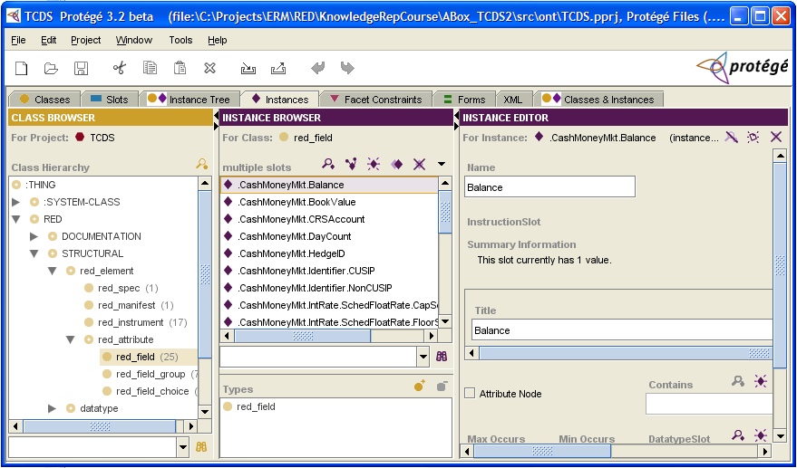
Really implementing it

Slide 13
Thank you.

