Slide 1

Ontology Visualization
10th International Protégé Conference
July 15, 2007, 11:00 – 12:30PM CEST
Jennifer Vendetti, Stanford University

Slide 2
What is the graph widget?
Allows visual editing of instances and relationships between instances
Alternative to Protege’s “Forms” for entering instance data
Notes:
Maybe do a demo here of what the normal way of acquiring instances looks like.
For some kinds of knowledge (mainly heavily interconnected concepts), the Graph Widget saves time when acquiring knowledge, and hugely helps in conveying the meaning and organization of the knowledge acquired.

Slide 3
When is the graph widget appropriate?
When instances are connected through slot values (e.g., a linked list).
When instances connected by instances of the “:DIRECTED-BINARY-RELATION” system class.

Slide 4
When is the graph widget appropriate?
Speeds knowledge acquisition in ontologies with heavily interconnected concepts.
Helps convey meaning and organization of acquired knowledge.
Data that resembles process diagrams, flow charts, organizational charts.

Slide 5
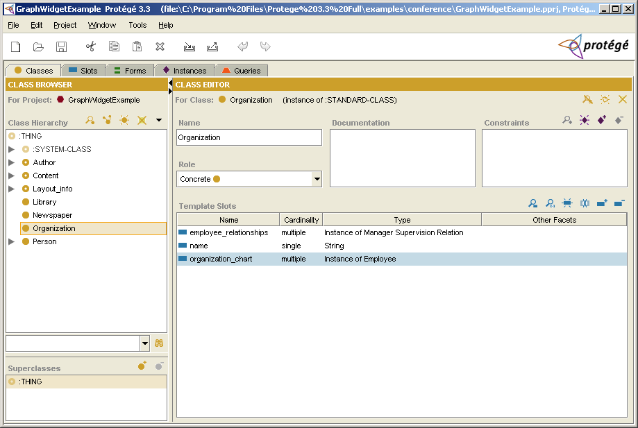
Open the “GraphWidgetExample” project
Select the “Organization” class
Notes:
Say a few things about the organization_chart class – holds instances of Employee class
Maybe point out the Editor class with the “responsible_for” slot?

Slide 6
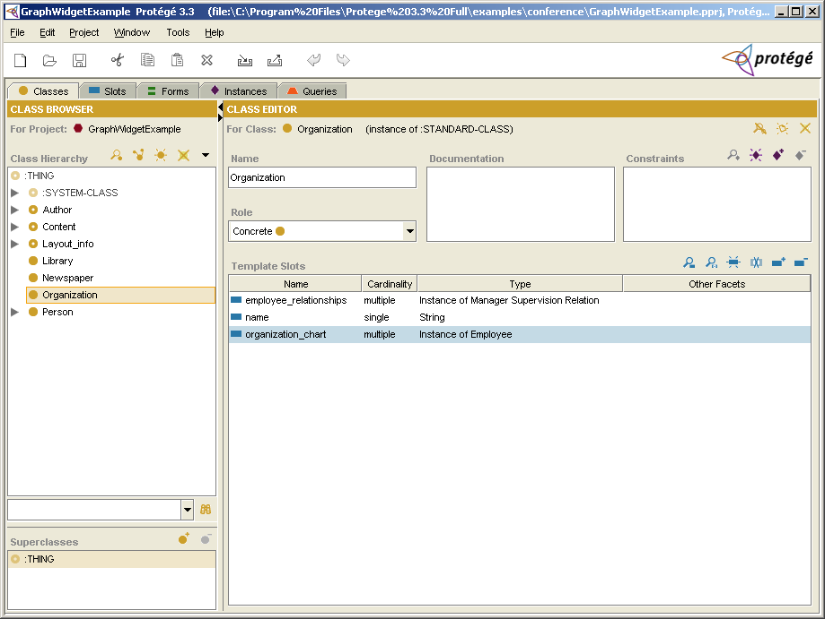
Notice the “organization_chart” slot, which is the slot that we will configure to use the graph widget

Slide 7
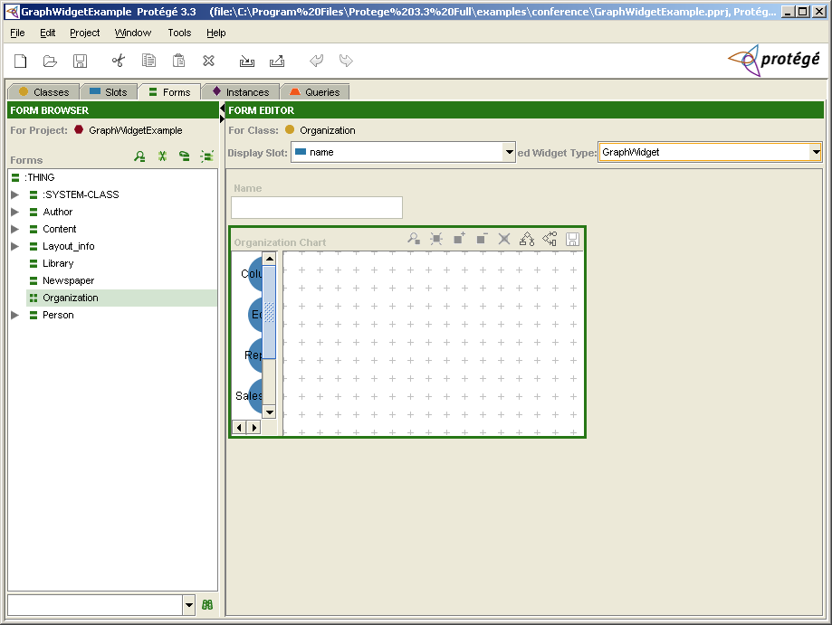
Configure the “organization_chart” slot to use the graph widget
Notes:
- Show trick about filling vertical and horizontal space

Slide 8
How do I optimize size for the graph widget?
Double-click on the Form background (anywhere without a widget)
Use the Layout tab to fill horizontal and vertical space

Slide 9
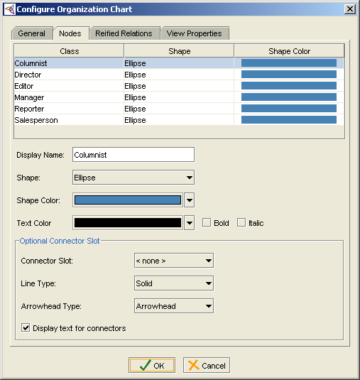
How do I configure node appearance?
Double-click on the organization_chart slot to bring up the widget configuration dialog.

Slide 10
How do I configure node appearance?
Use the “General” tab to change the label or tooltip for the “organization_chart” slot.
Use the “Nodes” tab to assign shapes, colors, and text properties to nodes.
Notes:
- Could say something here about new functionality of “Display Name” text box.

Slide 11
Configure simple connectors
Graph widget has two connector types, one of which is a “simple connector”
Simple connectors have no underlying instances
Notes:
- Up until now, we have dealt with nodes, but what about connectors?

Slide 12
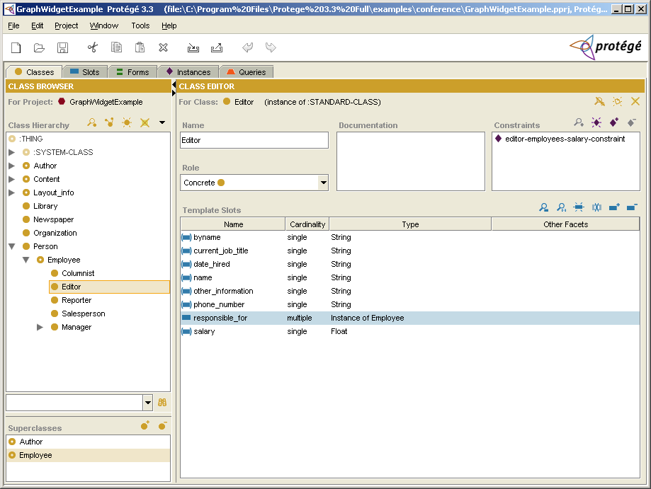
Select the Editor class
Notice the “responsible_for” slot, which will be the simple connector

Slide 13
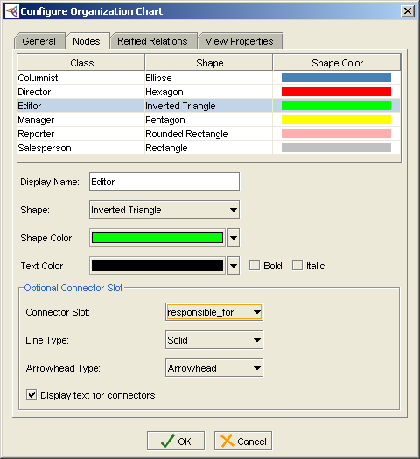
Configure simple connectors
Choose connector slot for Editor class in widget configuration dialog

Slide 14
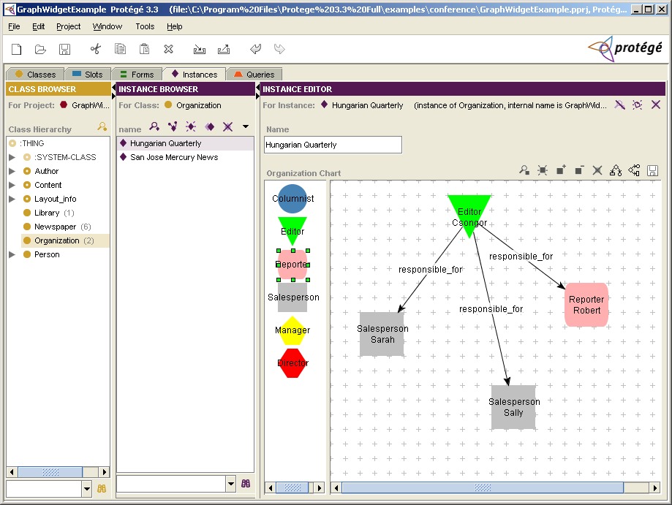
Drag and drop nodes to create instances of employees – draw connectors to fill in slot values

Slide 15
Graph widget UI tips
Click on node labels to drag nodes
Nodes are resizable
Double-click node labels to rename
Right-click connectors to insert points
Automatic layout provided
Save graph as image

Slide 16
Graph widget UI tips
The graph widget only allows you to draw valid connectors between nodes
You can add pre-existing instances to the graph widget
Notes:
Show example of adding pre-existing instance
Show how to pop-up instance forms – this is nicer for working w/the graph widget

Slide 17
Configure reified relations
Reified relations are the second connector type offered by the graph widget
Allows storage of additional information about a relationship between two nodes

Slide 18
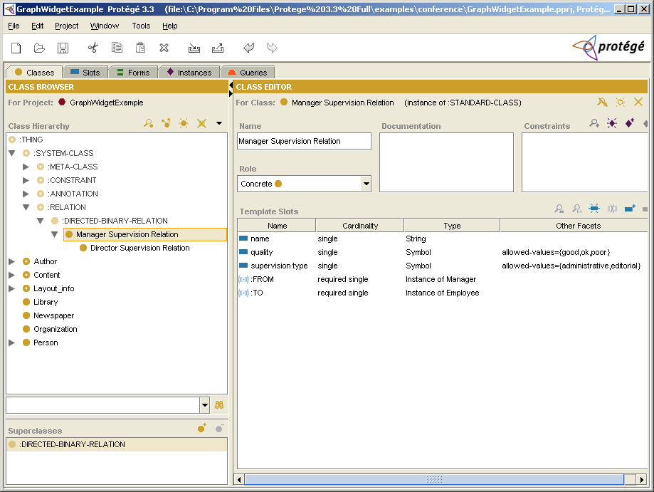
Notice subclasses of the
:DIRECTED-BINARY-RELATION class, which will be our reified relations in the graph widget

Slide 19
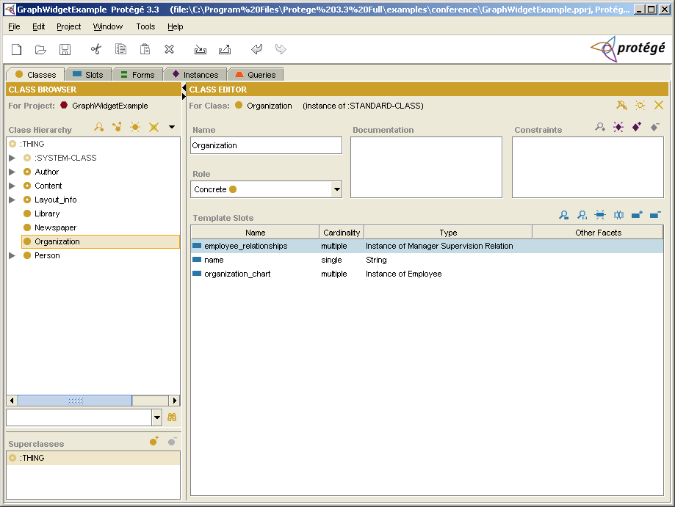
Notice the slot that has been designated to hold instances of reified relations

Slide 20
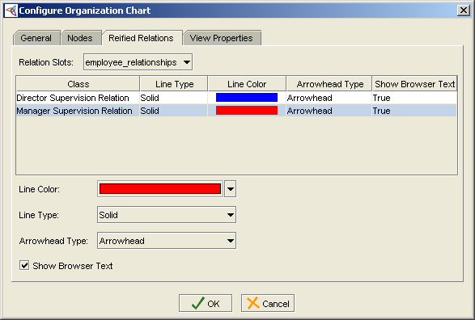
Configure reified relations
Use the reified relations tab to configure the relation slot, line types, colors, arrowheads, etc.

Slide 21
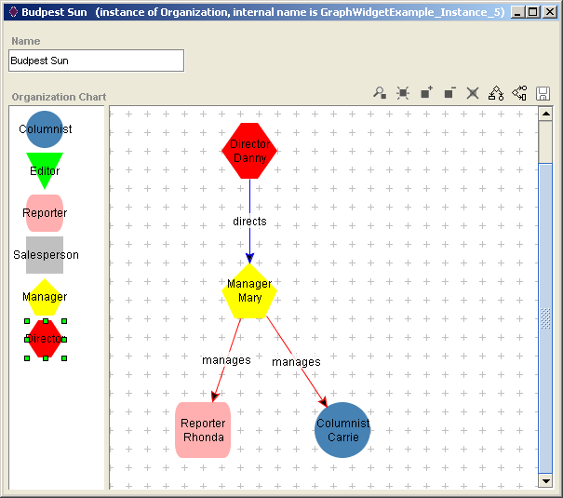
Example of reified relations between instances of the Employee class
Notes:
- Talk about how multiple types are possible for reified relation connectors

Slide 22
Graph widget UI Tips
Double-click on complex links to bring up instance forms
Designate display slots for subclasses of
:DIRECTED-BINARY-RELATION to enable editing of connector labels

Slide 23
Larger scale visualization
OntoViz Tab – visualize ontologies with GraphViz
OWLViz Tab – Visualize OWL ontologies with GraphViz
Jambalaya – visualize ontologies with SHriMP (Simple Hierarchical Multi-Perspective)
TGViz – visualize ontologies with TouchGraph
Notes:
Graphviz – AT&T open source graph visualization software (comes with graph layouts)
SHriMP (U. Vic) – helps people visualize/browse/explore complex information spaces – domain independent – used primarily so far for browsing large ontologies and architecture of large software programs
TGViz (Harith Alani, U. Southampton) - TouchGraph – Java library for rendering networks as interactive graphs

Slide 24
OntoViz Tab: helper documentation for tab abbreviations…
sub = subclass closure
sup = superclass closure
slx = slot extension
isx = inverse slot extension
slt = slots
sle = slot edges
ins = instances
sys = system frames
Notes:
slx – the allowed classes for the slots of a particular class

Slide 25
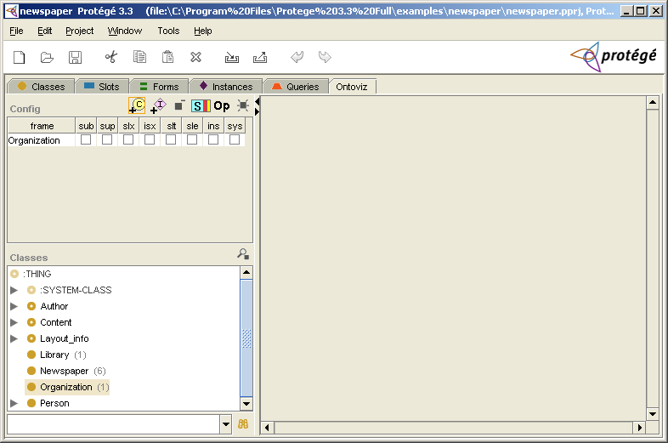
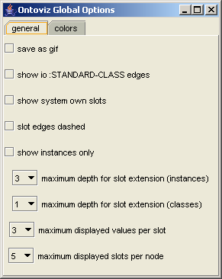
OntoViz Tab
Use the
“add class” button to choose a class to graph
Use the “Options” button to configure graph

Slide 26
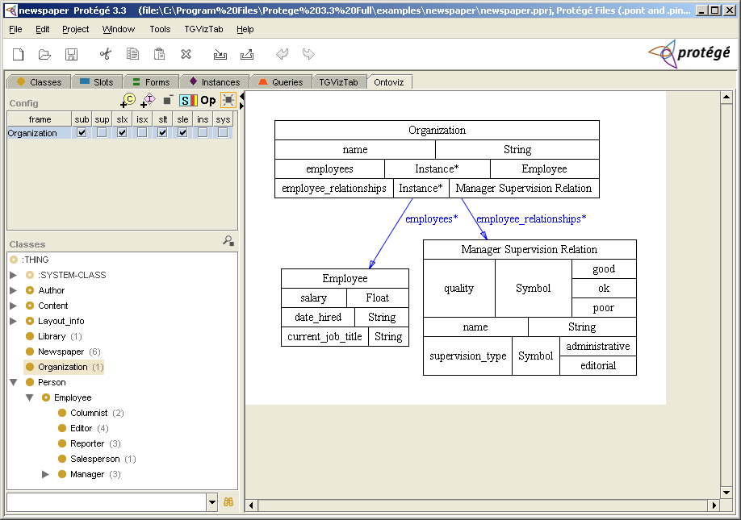
Click the “Create Graph” button to generate graph
Notes:
Other things to demo:
Change the color of stuff using the Options dialog (point out that the dialog is modeless – change stuff on the fly).
Demo “slide mode” where colors are shown as inverse.
Show how you can hide slots.
Explain the process of saving to a GIF file – how it’s put into the root directory of the project and how it’s overwritten every time you generate.

Slide 27
Demo: OWLViz Tab
Designed specifically for use with the Protégé-OWL editor.
Allows comparison of asserted and inferred class hierarchy.
  Computed changes to hierarchy are clearly visible.
  Inconsistent concept are shown in red.

Slide 28
Demo: Jambalaya Tab
Uses SHriMP (Simple Hierarchical Multi-Perspective)
SHriMP is designed to help people browse complex information spaces
Upside: very feature rich
Downside: bigger learning curve than other tools
Documentation/tutorials:
http://www.thechiselgroup.org/jambalaya
Notes:
Process for Demo:
Root Classes Dialog – useful for large knowledge bases because you can choose what you want to see and don’t want to see immediately.
Can change root classes by going to the Edit menu.
What do we see? Default layout is nested, standard inheritance (i.e. has subclass, has instance), parent child relationship.
Nice use of tool tip text to get a better idea of what classes/instances you are seeing.
Talk about filters to hide/show certain nodes, arcs, instances.
Talk about how to dismiss floating dialogs and use menu items instead.
While options dialog is up, show panel that talks about keyboard shortcuts and then dismiss and show how to navigate around with keys.
Drill down Concepts class.
Show right clicking to look at metrics, forms, editing of forms.
Use Home button to go back out.
Show Instance editing
Show hierarchical view – keep context while navigating ontology
Show thumbnail view
Show filmstrip
Show bookmark
Show alternate “Quick Views”

Slide 29
TGViz Tab
Utilizes TouchGraph (renders networks as interactive graphs)
TouchGraph uses “Spring Layout”
PubMed uses TouchGraph to visualize graphs of related documents in medical libraries
Notes:
Spring Layout – visual layout where nodes repel each other and edges attract the nodes together

Slide 30
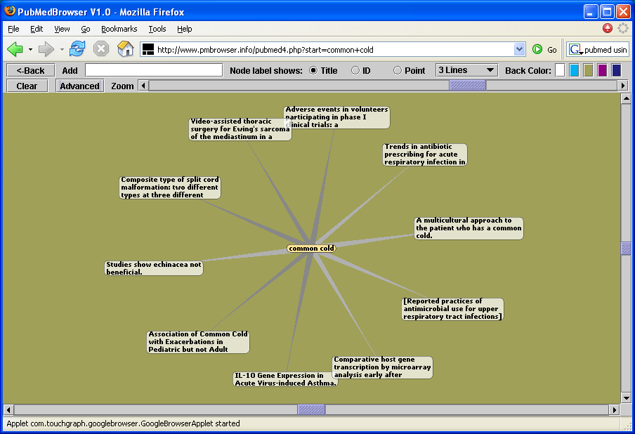
Exercise: TGViz Tab
Notes:
- A tool for browsing 40 years of medical literature contained in the MEDLINE database.

Slide 31
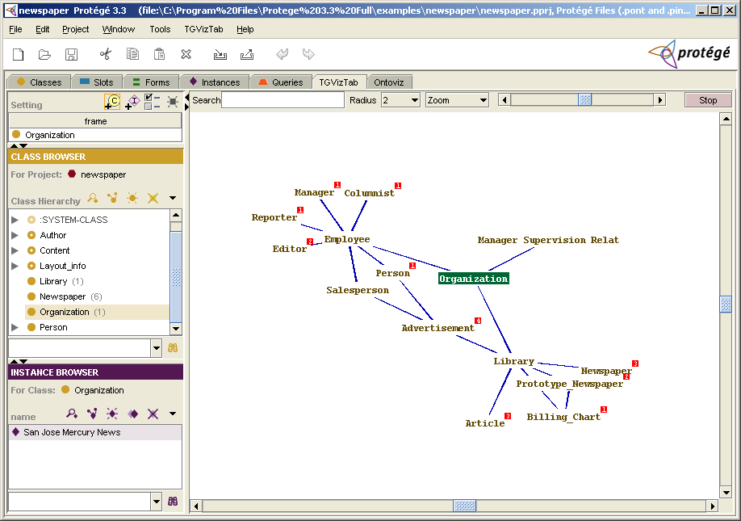
Use the “add class” and “add instance” buttons to add items – click the “create graph” button to graph

