Slide 1
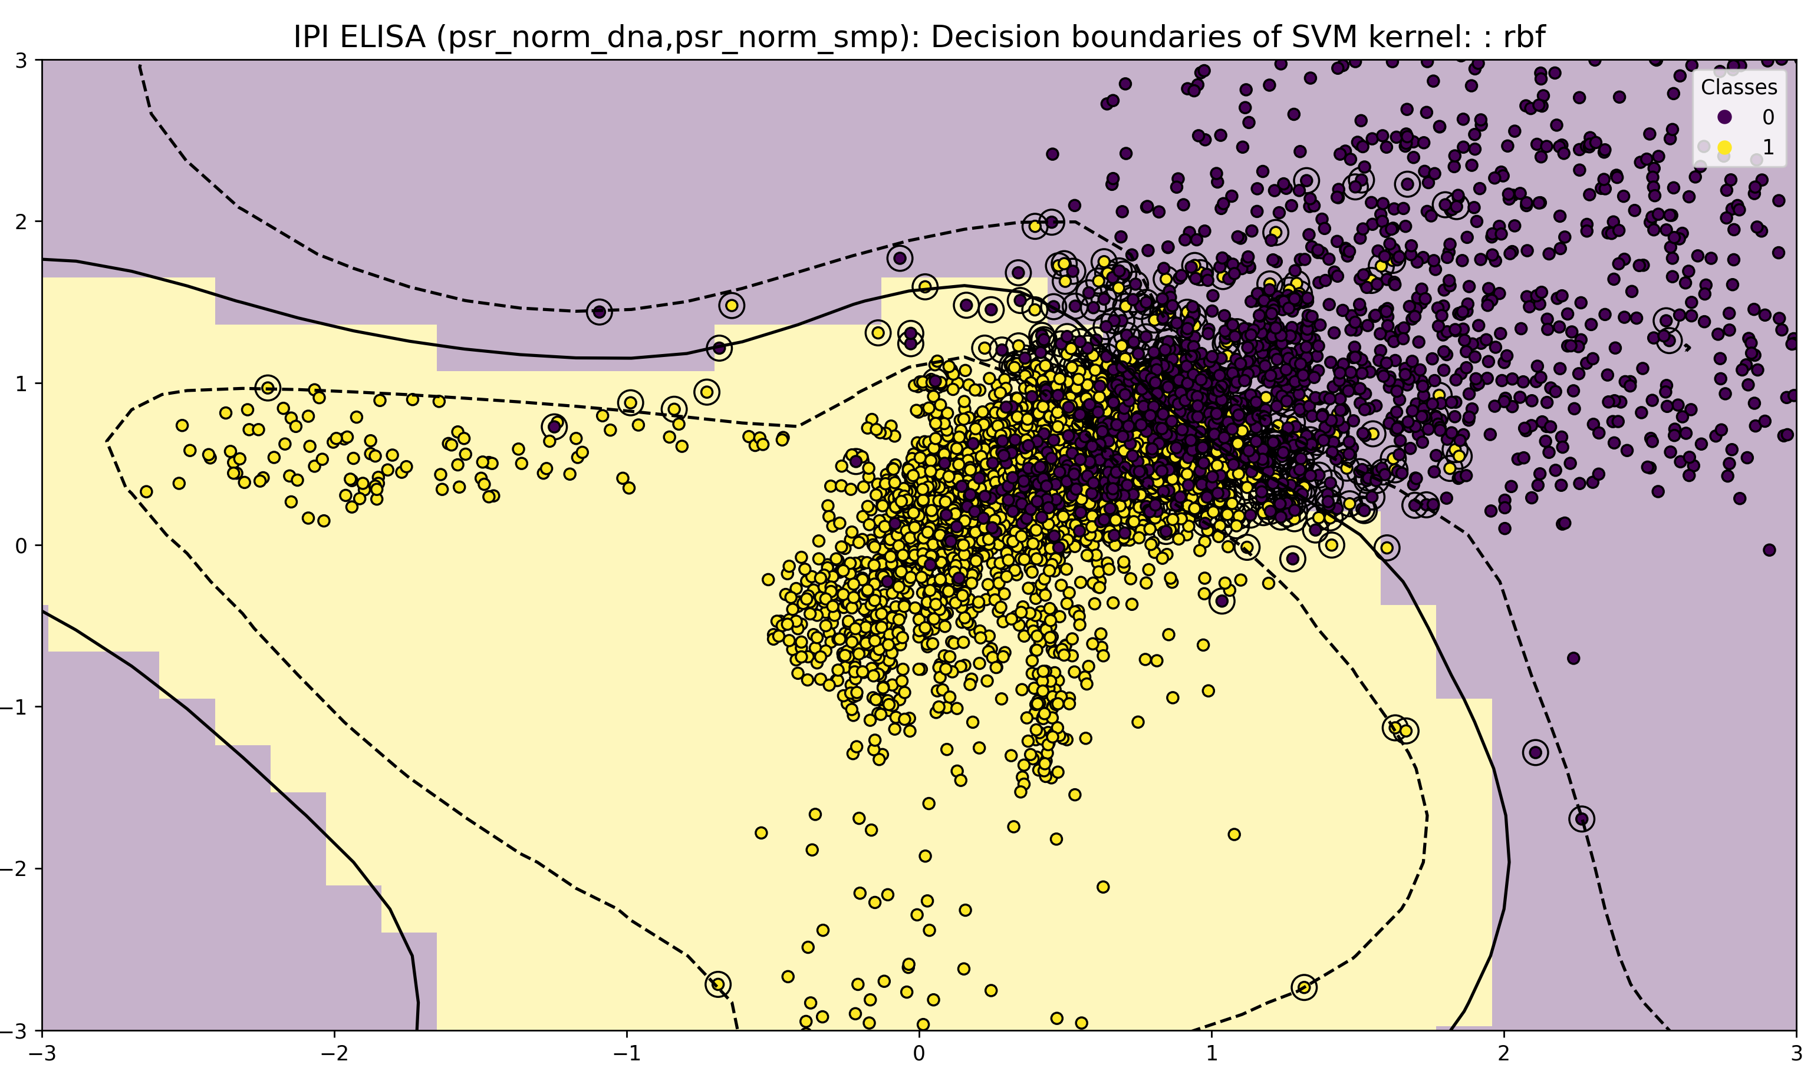
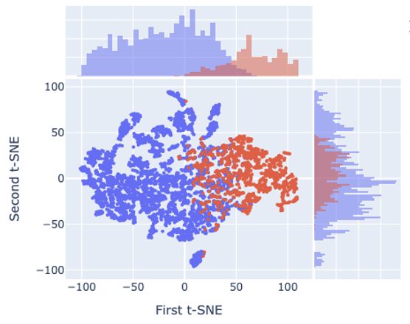
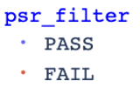
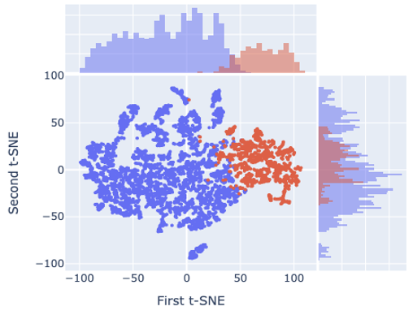
Suppl Fig. 1 | Boundary modeling and denoising using Support Vector Machine (SVM) and t-SNE. (a–b) SVM/t-SNE of raw data showing overlap. (c) Improved separation after filtering.
a. IPI PSR-Elisa data before before filtering
b. IPI PSR-Elisa data before filtering
c. IPI PSR-Elisa data after denoising by random

