Slide 1
TransformerOneHot
Dual-Branch Transformer for Antibody Developability Prediction
Architecture · Hyperparameters · Integrated Gradients Interpretation
Supplementary Methods

Slide 2
Architecture
Dual-branch transformer with CDR3-guided cross-attention

Slide 3
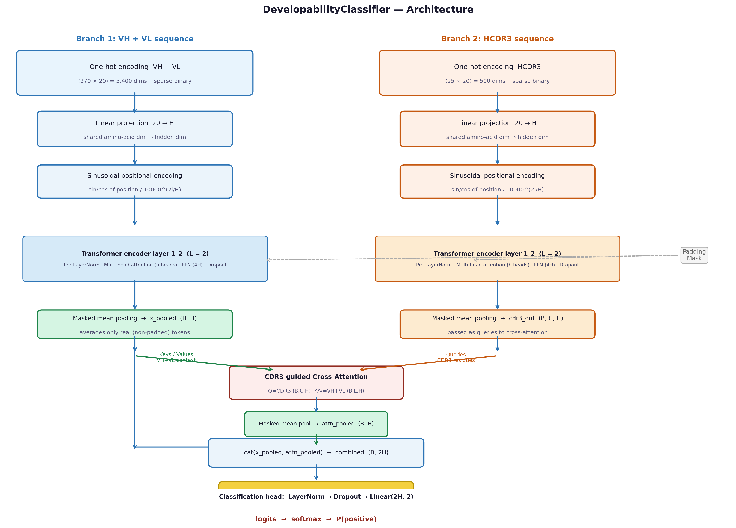
Model Architecture Overview
IPI Antibody Developability Platform — TransformerOneHot

Slide 4
Input: One-Hot Encoding
Branch
Max length
Matrix
Flat dims
VH + VL (Branch 1)
135 + 135 = 270
270 × 20
5,400
HCDR3 (Branch 2)
25
25 × 20
500
Total per sample
—
295 × 20
5,900
Amino acid alphabet: ACDEFGHIKLMNPQRSTVWY (20 characters)
Key advantage: exact amino acid identity preserved at every position → enables position-resolved Integrated Gradients attribution
IPI Antibody Developability Platform — TransformerOneHot

Slide 5
Architecture Components
Linear Projection
Masked Mean Pool
20 → H
Σ(x·m)/Σ(m)
Projects one-hot to hidden dim H
Averages real tokens only — key for IG
Sinusoidal Pos Enc
Cross-Attention
PE(pos,2i)=sin(…)
Q=CDR3, K/V=VH+VL
Injects position order into embeddings
CDR3 residues query full chain context
TransformerEncoder
Classification Head
Pre-norm, L layers
LayerNorm→Drop→Linear
MHA + FFN + Dropout per layer
cat(x_pool, attn_pool) → 2 logits
IPI Antibody Developability Platform — TransformerOneHot

Slide 6
Hyperparameters
Validated configurations for 11k and 245k antibody datasets

Slide 7
Model & Training Hyperparameters
Parameter
n ≈ 11k (PSR/SEC)
n ≈ 245k (public)
Notes
hidden_dim
64
256
head_dim = H / num_heads
num_heads
4
8
head_dim 16 → 32
num_layers
2 per branch
4 per branch
max depth for 100–270 token seqs
dim_feedforward
256 (4×H)
1024 (4×H)
standard FFN ratio
dropout
0.40
0.15
scales inversely with n
weight_decay
1 × 10⁻³
1 × 10⁻⁴
L2 regularisation
learning rate
2 × 10⁻⁴
8 × 10⁻⁴
linear batch-size scaling
batch size
64
256
loss
label_smooth ε=0.1
label_smooth
balanced data (pos ≈ 50%)
total params
~220k
~6.6M
20× and 27× params/sample
IPI Antibody Developability Platform — TransformerOneHot

Slide 8
Training Workflow
CDR3-stratified K-fold · early stopping · threshold optimisation

Slide 9
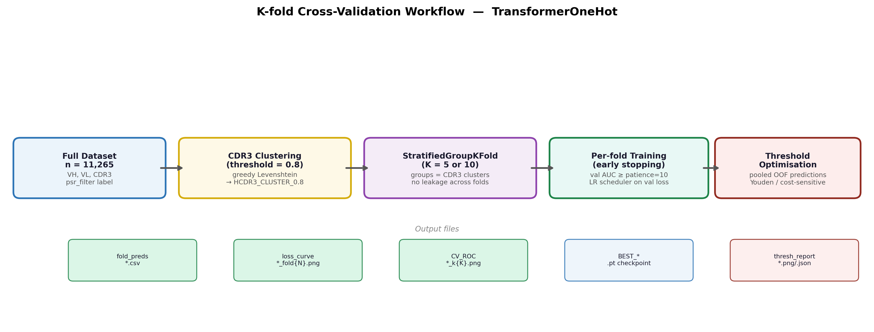
K-Fold Cross-Validation Workflow
CDR3 clustering (θ=0.8) → StratifiedGroupKFold → no CDR3 leakage → per-fold early stopping on val AUC → pooled OOF threshold optimisation
IPI Antibody Developability Platform — TransformerOneHot

Slide 10
Integrated Gradients
Position-level attribution for sequence interpretation

Slide 11
Integrated Gradients — Method
IG_i(x) = (x_i − x'_i) × ∫[α=0→1] (∂F(x' + α(x−x')) / ∂x_i) dα
Baseline x' = all-zero one-hot matrix (no amino acid present) F = P(class 1 = developable)
Approximation:
n_steps = 200 Riemann steps (50 for screening, 1000 for publication)
Implementation:
Captum IntegratedGradients with zero baseline
Aggregation:
Sum |IG| across amino acid dim (axis −1) → scalar per position
Critical dependency:
Masked mean pooling (FIX-A) ensures padding positions have zero gradient
Outputs:
Per-position importance (VH/VL) + HCDR3 residue heatmap
IPI Antibody Developability Platform — TransformerOneHot

Slide 12
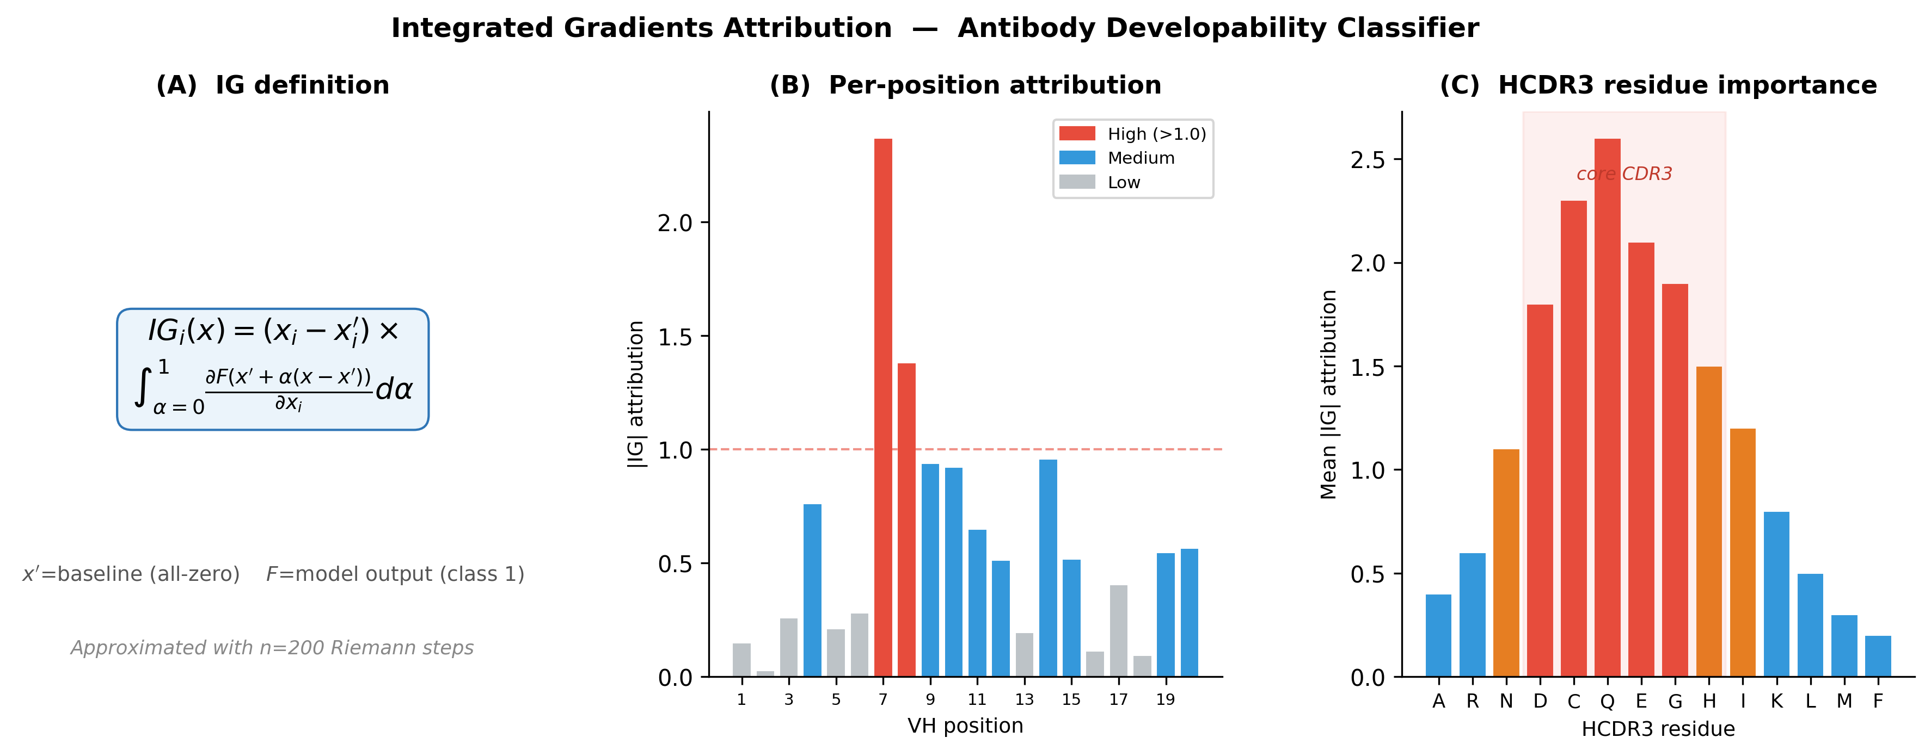
IG Attribution — Examples
(A) IG formula (B) Per-position VH attribution (C) HCDR3 residue importance
IPI Antibody Developability Platform — TransformerOneHot

Slide 13
Output Files — Naming Convention
kfold_{target}_{lm}_transformer_onehot{db}_k{K}.log
Full console log of each kfold run
fold_preds_{target}_{lm}_transformer_onehot{db}_fold{N}_k{K}.csv
Per-fold OOF predictions
loss_curve_{target}_{lm}_transformer_onehot{db}_fold{N}_k{K}.png
Val loss + val AUC per fold
CV_ROC_{target}_{lm}_transformer_onehot{db}_k{K}.png
Aggregate ROC curve across all folds
BEST_{target}_{lm}_transformer_onehot{db}_k{K}_fold{F}.pt
Best fold checkpoint (embedded threshold)
thresh_report_{target}_{lm}_transformer_onehot{db}_k{K}.png/json
Threshold analysis (all methods)
thresh_stability_{target}_{lm}_transformer_onehot{db}_k{K}_auto.png
Fold-level threshold consistency
train_{target}_{lm}_transformer_onehot{db}.log
Training log
train_curve_{target}_{lm}_transformer_onehot{db}.png
Train/val learning curves
IPI Antibody Developability Platform — TransformerOneHot

Slide 14
Summary
1
Dual-branch architecture
Independent transformers for VH+VL (branch 1) and HCDR3 (branch 2)
2
CDR3-guided cross-attention
HCDR3 residues query full chain context; position-level signals preserved
3
Masked mean pooling (FIX-A)
Padding excluded from aggregation and IG gradient path — clean attributions
4
IG interpretation
200-step Integrated Gradients → per-position and per-CDR3-residue importance
5
Regularised for small n
dropout=0.4, weight_decay=1e-3, label_smooth — prevents CDR3 memorisation
6
CDR3-stratified validation
StratifiedGroupKFold on Levenshtein clusters — honest generalisation estimate

