Slide 1
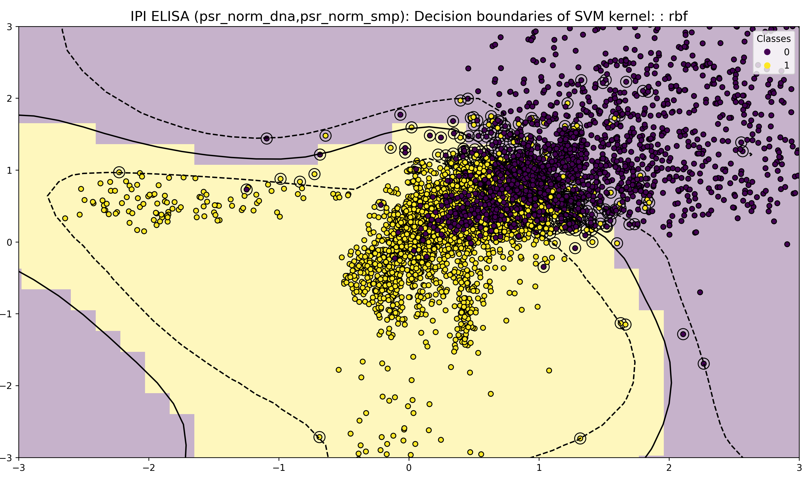
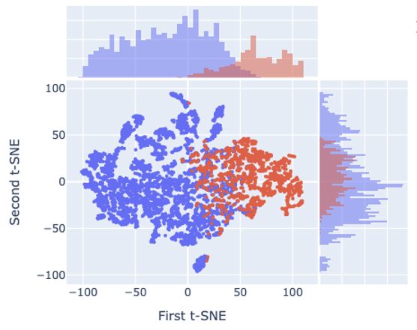
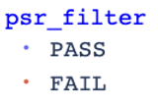
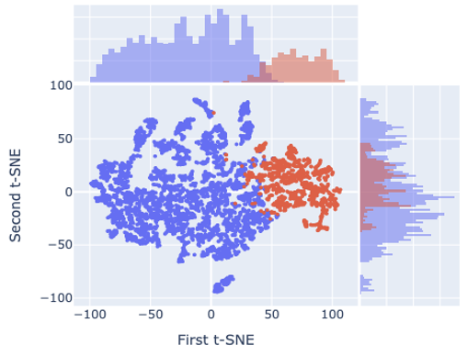
Supplementary Fig. 1 | PSR-ELISA label quality control: SVM decision boundary modelling and t-SNE visualisation.
a. IPI PSR-Elisa data before before filtering
c. IPI PSR-Elisa data after denoising by random

Slide 2
Supplementary Fig. 2 | TransformerLM architecture
Fixed-length PLM embedding → 2-token Pre-LN Transformer → P(Pass)
PLM embedding
Fixed hyperparameters
e.g. AntiBERTa2-CSSP (1,024-dim)
hidden_dim
128 (always — PLM head, not a re-learner)
Input projection
num_heads
8 → head_dim = 16
Linear(emb_dim → 128) · LayerNorm · Dropout
batch_size
32 (flat minima, better generalisation)
lr
1 × 10⁻⁵ (matched to batch = 32)
2-token sequence [CLS, embed]
FFN
512 (4 × hidden_dim)
CLS: learnable (init trunc-normal σ = 0.02)
Pre-LN
norm_first=True (stable at small batch)
Transformer encoder (Pre-LN)
Auto-scaled parameters
2 layers (n < 50k) or 3 layers (n ≥ 50k) · 8 heads · FFN = 512 · dropout*
dropout*
0.45 − 0.30 × d_norm (d_norm = samples/emb_dim)
num_layers
2 (n < 50k) or 3 (n ≥ 50k)
CLS token → h (128-dim)
epochs
55 → 15 scaled by n_norm
weight_decay
0.001 (n < 50k) → 0.0005 (n ≥ 50k)
patience
7 (n < 50k) → 5 (n ≥ 50k)
Classification head
10-fold SGKF · IPI PSR (n = 11,265 · AntiBERTa2-CSSP) Mean AUC = 0.957 ± 0.008 Best fold AUC = 0.968 · Youden threshold t = 0.441 Mean best epoch = 26
LayerNorm · Dropout · Linear(128 → 2)
P(Pass) · P(Fail) — softmax
⚙ YAML-configurable / auto_scale_config()
dropout*: 0.45 → 0.10 scaled by d_norm = n / emb_dim
epochs: 55 → 15 scaled by n_norm = dataset size
loss: auto-selected (ce / weighted_ce / focal / label_smooth)
Priority: YAML override > auto_scale > built-in defaults
Schematic of the TransformerLM classifier. A fixed-length protein language model (PLM) embedding is projected by a Linear(emb_dim → 128) block (LayerNorm + Dropout), then combined with a learnable CLS token (truncated normal initialisation, σ = 0.02) to form a 2-token input sequence [CLS, embed]. The sequence passes through a Pre-Layer Normalisation (Pre-LN) Transformer encoder producing a CLS token representation that feeds a classification head (LayerNorm → Dropout → Linear(128 → 2)) producing P(Pass) and P(Fail) via softmax. Dashed line: automatic export of the 128-dimensional CLS hidden state as a task-specific embedding CSV for downstream clustering or t-SNE. *Dropout (0.10–0.45) and epoch ceiling (15–55) are scaled automatically by auto_scale_config() using two axes: n_norm (log-scaled dataset size) and d_norm (samples per embedding dimension). All other hyperparameters are fixed across all PLMs and dataset sizes. All parameters are configurable via YAML without code modification (priority: YAML override > auto_scale > built-in defaults).

Slide 3
Supplementary Fig. 3 | CNN architecture
Flat PLM embedding treated as 1D signal · dilated residual blocks · AdaptiveMaxPool
PLM embedding (B, emb_dim)
Architecture details
kernel_size
5 (all Conv1d layers)
Unsqueeze → (B, 1, emb_dim)
dilation
1, 2, 4 → receptive fields 5, 9, 17
channels
1 → 128 → 256 → 256
ResidualBlock 1 (dilation = 1)
shortcut
projection (≠ dims) or identity
Conv1d 1 → 128 · k=5 · BatchNorm · GELU · shortcut
pooling
AdaptiveMaxPool1d(1) → 256-dim
BatchNorm
inside every residual block
activation
GELU throughout
ResidualBlock 2 (dilation = 2)
†drop_last
True (prevents BN crash at batch_size=1)
Conv1d 128 → 256 · k=5 · BatchNorm · GELU · shortcut
ResidualBlock 3 (dilation = 4)
Why CNN + TransformerLM ensemble?
Conv1d 256 → 256 · k=5 · BatchNorm · GELU · shortcut
CNN extracts multi-scale convolutional features with global max-pooling. TransformerLM uses CLS-guided attention. Both operate on the same PLM embedding but through structurally different computational paths: prediction errors are partially uncorrelated, making them ideal ensemble partners. A simple 0.5 / 0.5 score average is expected to yield AUC ≈ 0.970–0.975.
AdaptiveMaxPool1d(1) → (B, 256)
max activation per channel · automatic feature selection
10-fold SGKF · IPI PSR (n = 11,265 · AntiBERTa2-CSSP) Mean AUC = 0.966 (folds 1–4) Converges in 9–12 epochs (vs 12–29, TransformerLM) Ensemble → AUC ≈ 0.97+
FC head
Dropout · Linear(256 → hidden*) · BN · GELU · Dropout · Linear(hidden* → 2)
P(Pass) · P(Fail) — softmax
⚙ YAML-configurable / auto_scale_config()
hidden_dim*: 64 – 256 scaled by d_norm (n / emb_dim)
dropout: 0.10 – 0.45 scaled by d_norm
batch_size, epochs, lr: scaled by n_norm
loss type: auto (balanced / imbalanced dataset)
Schematic of the 1D residual CNN classifier. A PLM embedding vector (B × emb_dim) is unsqueezed to (B, 1, emb_dim) and processed by three dilated residual blocks (dilations 1, 2, 4; kernel_size = 5) capturing multi-scale patterns at receptive fields of 5, 9, and 17 positions. Each block applies two Conv1d layers with BatchNorm1d and GELU activation, with a projection shortcut where channel dimensions change. AdaptiveMaxPool1d(1) collapses the feature map to a 256-dimensional vector by selecting the maximum activation per channel — input-conditioned feature selection robust to PLM embedding dimension ordering. The FC head applies Dropout → Linear(256 → hidden*) → BatchNorm1d → GELU → Dropout → Linear(hidden* → 2). †drop_last=True prevents BatchNorm receiving a single-sample batch (undefined variance). Dashed line: penultimate-layer hidden state exported as CSV. *hidden_dim (64–256) and dropout (0.10–0.45) are scaled automatically by auto_scale_config() from d_norm (samples per embedding dimension). All parameters are configurable via YAML without code modification.

Slide 4
Supplementary Fig. 4 | TransformerOneHot: Architecture and Integrated Gradients
Dual-branch one-hot Transformer · CDR3-guided cross-attention · position-resolved IG attribution
a Forward pass
Branch 1 — VH + VL
Branch 2 — HCDR3
VH + VL one-hot
HCDR3 one-hot
270 × 20 = 5,400 dim
25 × 20 = 500 dim
Sinusoidal PE
Sinusoidal PE
Transformer encoder
(Pre-LN)
Transformer encoder
(Pre-LN)
N layers · 8 heads · FFN*
N layers · 8 heads · FFN*
Mean pool → x_pooled (H)
Mean pool → cdr3_pooled (H)
K, V →
CDR3-guided cross-attention
← Q
x_pooled
(bypass)
Q = cdr3_pooled · K, V = x_full (all VH+VL positions)
Concatenate [ x_pooled ‖ attn_out ] (2H)
Classification head
LayerNorm · Dropout · Linear(2H → 2)
P(Pass) · P(Fail) — softmax
IG target = P(Pass)
b Integrated Gradients attribution (backward through network)
∂F/∂x₁
(branch 1)
IGᵢ(x) = (xᵢ − x̄ᵢ) × ∫₀¹ ∂F(x̄+α(x−x̄))/∂xᵢ dα
∂F/∂x₂
(branch 2)
uniform AA reference · F = P(Pass) · 200 steps · target = class 1
VH+VL attribution vector
270 positions · sum over AA dim
HCDR3 attribution vector
25 positions · sum over AA dim
c Outputs
Population-level IG profiles
P(Pass) / P(Fail)
Per-antibody outputs
Bar chart: top 60 positions
(VH+VL: purple · HCDR3: teal)
HCDR3 residue heatmap (1×25)
TIFF · auto-generated
Configured decision threshold
0.5 in reported analyses
Scores CSV exported
Waterfall plots (300 DPI TIFF)
IG attribution per residue
CDR3 mutagenesis heatmap
selected scored antibodies
⚙ Reported checkpoints: 4 layers · hidden_dim 128 · 8 heads · FFN 512 · dropout 0.38 · IG: uniform AA reference · 200 steps · all parameters configurable in YAML
Legend on next page

Slide 5
Supplementary Fig. 4 | Legend
(a) Forward pass. Branch 1 encodes the concatenated VH + VL sequence as a one-hot position × amino acid matrix (270 × 20 = 5,400 dimensions). Branch 2 independently encodes HCDR3 (25 × 20 = 500 dimensions). Both branches apply sinusoidal positional encoding and independent Pre-LN Transformer encoder stacks, then mean-pool to x_pooled and cdr3_pooled respectively. CDR3-guided cross-attention integrates the branches: cdr3_pooled provides the query (Q) and the full VH+VL sequence provides keys and values (K, V). An x_pooled bypass (dotted line) feeds x_pooled directly to the concatenation step in parallel with the cross-attention output. The concatenated (2H)-dimensional vector feeds a classification head (LayerNorm → Dropout → Linear(2H → 2)) producing P(Pass) and P(Fail) via softmax. (b) Integrated Gradients attribution. Integrated Gradients (IG) computes the path integral of gradients from a padding-safe, length-matched uniform amino-acid reference to the actual input along a straight line, approximated with 200 integration steps; attribution target = class 1 (P(Pass)). The reference assigns 1/20 to every amino-acid channel at observed positions and zero only at true padding positions. The coral arrow entering section b at the centre denotes P(Pass) as the IG attribution target. Gradients branch left (∂F/∂x₁, purple) to Branch 1 and right (∂F/∂x₂, teal) to Branch 2, propagating backward (upward arrows) through their respective encoder stacks. Summing attributions over the amino acid dimension yields a VH+VL position importance vector (270 raw sequence positions, purple box) and an HCDR3 position importance vector (25 raw sequence positions, teal box). (c) Outputs. Classification: P(Pass) scores thresholded at the configured decision threshold (0.5 in the reported analyses). Population-level IG profiles (fed by VH+VL attribution vector): ranked bar chart of the top 60 positions with VH+VL positions coloured purple and HCDR3 positions teal, and a 1 × CDR3_length HCDR3 residue importance heatmap accumulated as mean absolute IG attributions across all antibodies. Per-antibody outputs (fed by HCDR3 attribution vector): individual IG waterfall plots and CDR3 in silico mutagenesis heatmaps assembled into PowerPoint files (300 DPI TIFF). These outputs are generated by the dedicated delphi_interpretability.py workflow; exact internal and public reproduction commands are documented in paper/documentation/IG_REPRODUCTION.md. *The reported PSR and SEC checkpoints use four layers, hidden_dim 128, eight attention heads, FFN 512, dropout 0.38, and a maximum HCDR3 length of 25. Parameters remain configurable through YAML. SGKF, stratified group k-fold; PE, positional encoding; Pre-LN, pre-layer normalisation; IG, Integrated Gradients; PPT, PowerPoint.

Slide 6
Supplementary Table 1 | MLAbDev architecture comparison
All models share a consistent public python API · YAML-configurable · auto_scale from data
Model
Input encoding
Key mechanism
Interpretability
Regression
TransformerLM
PLM embedding
480–1,024-dim
2-token Pre-LN Transformer
hidden=128 batch=32 lr=1e-5
auto: dropout, epochs
CDR3 mutagenesis
hidden state CSV export
No
CNN
PLM embedding
480–1,024-dim
Dilated residual blocks
BatchNorm · AdaptiveMaxPool
kernel_size=5
CDR3 mutagenesis
hidden state CSV export
No
TransformerOneHot
VH+VL + HCDR3
one-hot (no PLM)
5,400 + 600 dims
CDR3-guided cross-attention
dual-branch Pre-LN Transformer
auto: N, hidden, dropout
Integrated Gradients
position-resolved (270+30)
CDR3 mutagenesis
No
Random Forest
k-mer · biophysical
one-hot · PLM
auto-detected
1,000 trees · OOB
FeatureBuilder
HCDR3-stratified SGKF
SHAP TreeExplainer
waterfall PPT
CDR3 mutagenesis
Yes
XGBoost
k-mer · biophysical
one-hot · PLM
auto-detected
Gradient boosting
auto classification / regression
HCDR3-stratified SGKF
SHAP TreeExplainer
waterfall PPT
CDR3 mutagenesis
Yes
⚙ All architectures: YAML-configurable without code modification
auto_scale_config() / auto_detect_config(): hidden_dim, dropout, batch, epochs, lr from n_samples × embedding_dim
Priority: YAML override > auto_scale > built-in defaults | YAML values applied as hard ceilings over auto-scaled values
Configurable: loss (ce/weighted_ce/focal/label_smooth) · threshold (Youden/F2/cost matrix) · SHAP top_n · mutagenesis N · DPI · PPT toggle
Consistent public API: train() · kfold_validation() · predict_proba() · predict() · save() · load() HCDR3-stratified group cross-validation · Youden threshold embedded in checkpoint · hidden-state CSV export · PowerPoint interpretability output (300 DPI TIFF)
Comparison of the four ML architectures implemented in MLAbDev. All architectures share a consistent public API and are configurable via YAML without code modification. auto_scale_config() (neural architectures) and auto_detect_config() (tree architectures) scale hyperparameters from dataset size (n_norm axis) and data density (d_norm = samples per embedding dimension axis). YAML values are applied as hard ceilings over auto-scaled defaults. Random Forest and XGBoost additionally support regression mode for continuous biophysical targets (e.g. PSR normalised score, SEC monomer percentage); task is detected automatically from the label distribution. HCDR3-stratified group cross-validation (Levenshtein 80% identity clusters) is used throughout to prevent sequence leakage. SGKF, stratified group k-fold; PLM, protein language model; SHAP, SHapley Additive exPlanations; IG, Integrated Gradients; PPT, PowerPoint; DPI, dots per inch.

