Slide 1
PROTEUS: Structured document editor based on archetypes
Amador Durán, José María Delgado
IR
September 2024

Slide 2

Introduction
When we write technical documents, we must…
ensure content cohesion.
control dependencies within the document's elements.
speed up repetitive task.

Slide 3
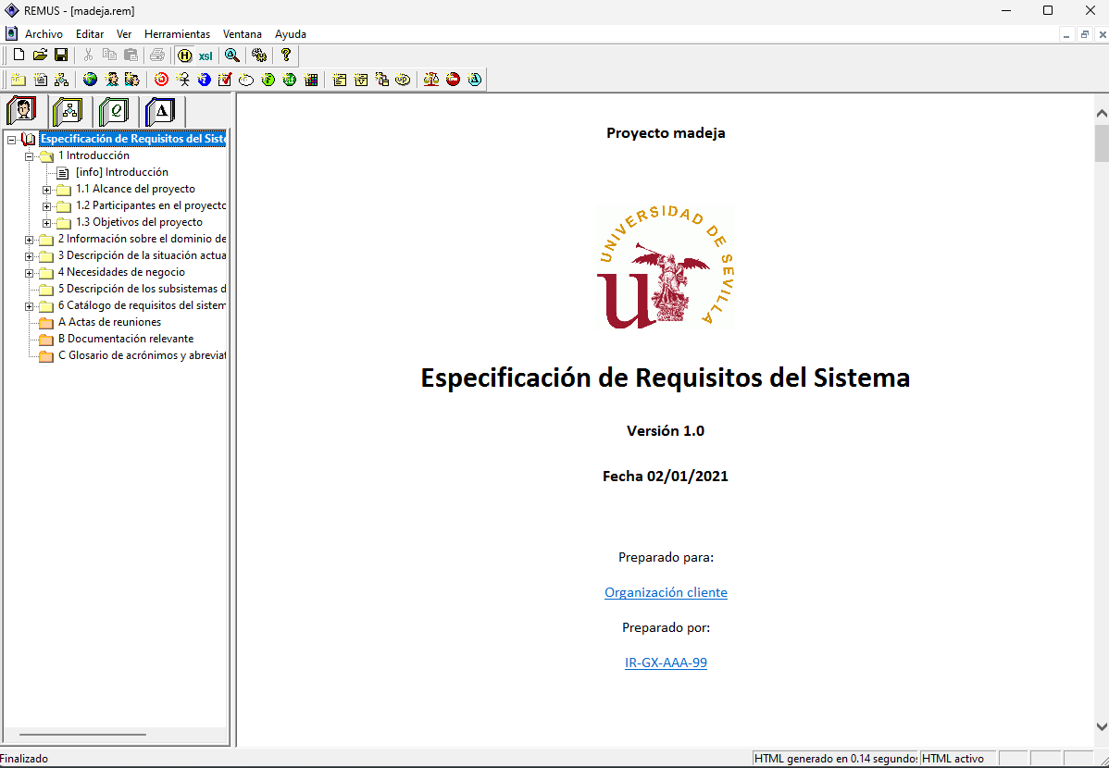
Introduction
REM (REMUS) previously used by IR students

Slide 4
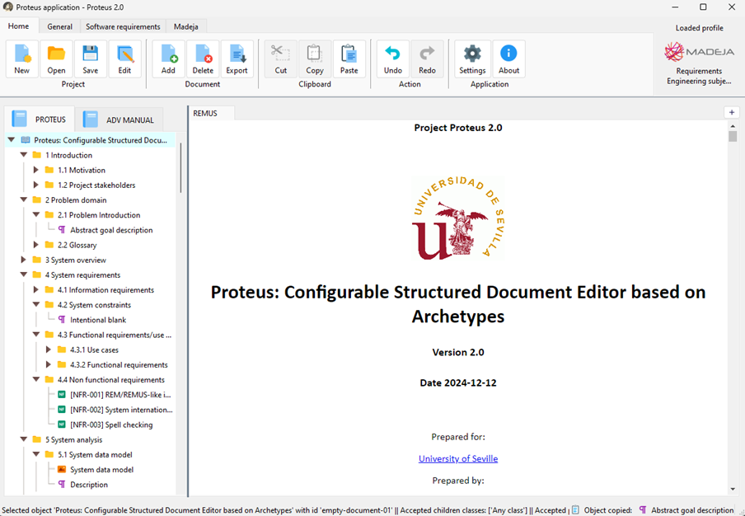
PROTEUS
It is a meta-tool that can be adapted to any problem domain.

Slide 5
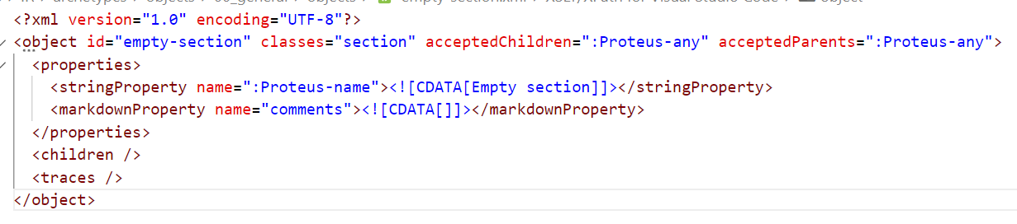
Archetypes
An archetype is a project, document or object that can be cloned.
They are grouped in archetype repositories.

Slide 6
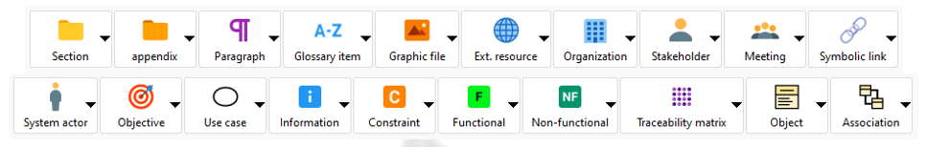
Object archetypes
Objects are the PROTEUS core elements (paragraphs, sections, etc.)
Objects archetypes are pre-filled objects that can be cloned into the documents.

Slide 7
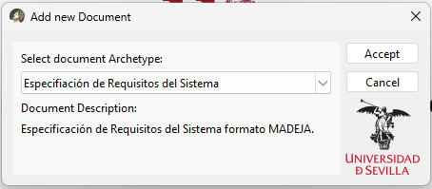
Document archetypes
A document is a group of objects.
Documents archetypes are preconfigured with objects.

Slide 8
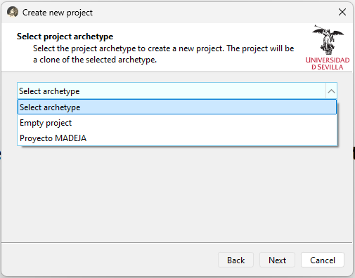
Project archetypes
A project is a group of documents.
Projects are stored in a directory with a specific folder structure.
Project archetypes provide preconfigured documents and objects

Slide 9
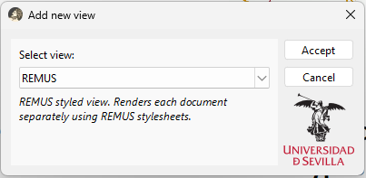

XSLT templates
They transform XML code into any other markup language.
In PROTEUS, every set of XSLT templates is a document view.

Slide 10
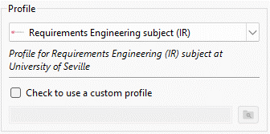
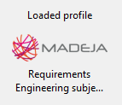
Profiles
A profile is a group of views, an archetype repository and additional resources like assets and plugins.
Each profile is design to be used in a specific problem domain.
Profiles are shipped with the application, but they can also be loaded from a system directory.

Slide 11

Installation (Windows, Linux and MacOS)
Source code is available on GitHub (https://github.com/Josdelsan/Proteus).
Python 3.11.x is required.
Run the startup script (proteus.bat in Windows and proteus.sh in Linux/MacOS

Slide 12
Additional steps that may be necessary
For Windows users
Allow unrestricted scripts execution to activate a Python virtual environment. Run a Powershell window as administrator and execute this command: Set-ExecutionPolicy -Scope CurrentUser Unrestricted
For Linux and MacOS users
Python package python3-venv must be installed.
Linux users might need to restart ibus via ibus restart command.

Slide 13
Once installed
The script will take longer the first time due to dependencies installation.
Execute the script to run PROTEUS.
Script cannot be moved from the source code folder, but a shortcut can be created.

Slide 14

Updating
Star the repository on GitHub so you do not miss any update.
When a new commit is made in the main branch, just perform a pull of the latest changes.
If the script is not working, delete proteus_env directory

Slide 15
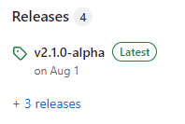
Installation for dummies (only Windows)
Go to PROTEUS GitHub page and check releases.
Each release comes with a portable version of the app.
Portable version is slower but does not required Python installed.

Slide 16
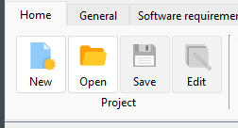
Start using PROTEUS
Create a new project from MADEJA project archetype.
Modify the new project and documents information.
Start filling the sections by cloning archetypes from General and Software Requirements sections.

Slide 17




Working together
PROTEUS is compatible with version control software like git.
Avoid using shared file system like Google Drive or OneDrive if working simultaneously.

Slide 18
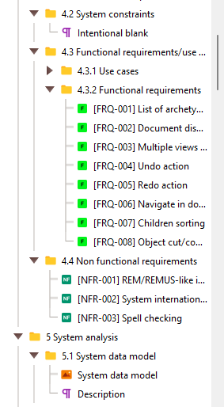
Avoiding git conflicts
Conflicts appear when working
on the same document branch
(same section and its children).
Setup the sections and add
more object later.
Pull the lastest changes before
start working

Slide 19

Common conflicts
Multiple users add objects to the
same parents.
Editing the same object.
Editing an object that has been
deleted.

Slide 20
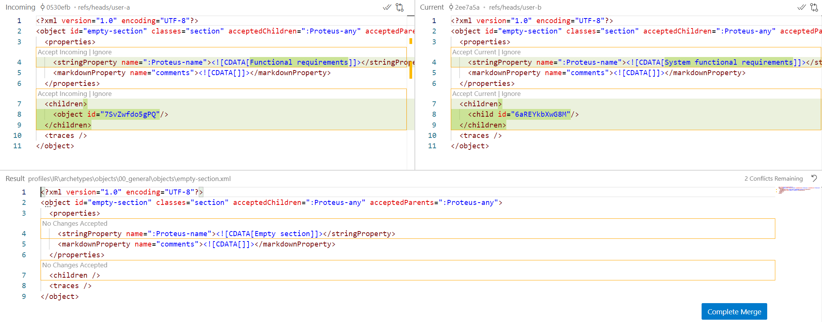
Resolving conflicts (example)
Visual Studio Code merge editor helps us resolving conflicts.

Slide 21
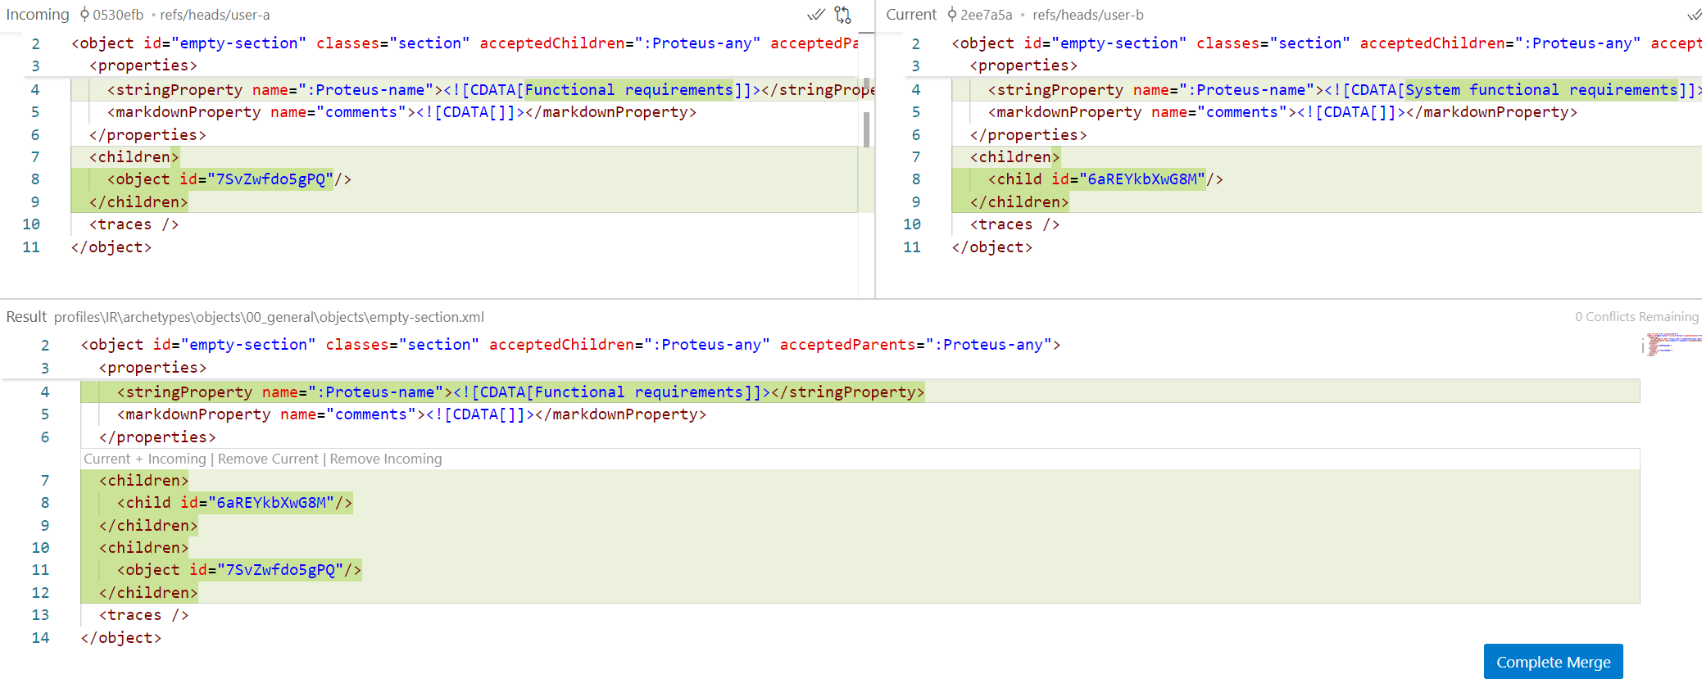
Resolving conflicts (example)
Accept one of the incoming changes.

Slide 22

Resolving conflicts (example)
Children tag was duplicated when a change from both incoming and current was accepted.

Slide 23
I tried resolving a conflict and I broke something
Everything is safe thanks to version control software so keep calm.
Revert the merge commit and start again.
Use online resources (AI chatbots and developers forums) if you struggle with git commands.
Main
Pull latest changes
and resolve conflicts
Merge commit
Local changes

Slide 24
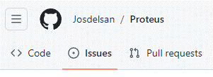

Report an issue
If you encounter any issue (bug) when using PROTEUS, please report by creating an issue on GitHub (English language mandatory).

Slide 25
Report an issue
If PROTEUS crashes, It will create a crash log report in the execution directory (source code folder).
Include final part of the report in the issue description as code block.
Make sure to describe the issue in an organized way with detail (precondition, what triggered the issue, error message, screenshots, etc).

Slide 26

Comments, suggestions, questions?
Course related things
please refer to:
PROTEUS related things
please refer to:
Amador Durán Toro
amador@us.es
Departamento de Lenguajes y Sistemas Informáticos
E.T.S. Ingeniería Informática, Universidad de Sevilla, España
José María Delgado Sánchez
jdelgado8@us.es
Departamento de Lenguajes y Sistemas Informáticos
E.T.S. Ingeniería Informática, Universidad de Sevilla, España

