Slide 1
Software Onboarding Transformation
Topic Deep Dive & Implementation Roadmap
11 governance topics. Current state assessment, detailed recommendations, and 30/60/90/120-day roadmaps for each. Grounded in 9 stakeholder sessions, 30+ interviews, and 16 identified process gaps.
6-9 mo
Current Cycle
19 days
Target Cycle
11
Topic Areas
16
Gaps Identified
Software Onboarding Transformation -- v2
Confidential

Slide 2
Executive Summary
Nine discovery sessions with 30+ stakeholders revealed an end-to-end process taking 6-9 months, routing through 18 sequential committees, and accepting requests from 5+ disconnected channels.
Intake Consolidation
Parallel Evaluation
3-Pathway Routing
70% faster
18 -> 5
~30 day
Single gateway replaces 5+ channels. Completeness gate eliminates 40%+ rework.
Sequential committees replaced with 5 concurrent streams.
Vendor Affinity pathway for low-risk advisor tools.
6-9 mo
End-to-End Duration
18
Sequential Committees
5+
Intake Channels
60+
AI Queue Items
2
Legal Partners
~80
REA Questions
Software Onboarding Transformation -- v2
Confidential

Slide 3
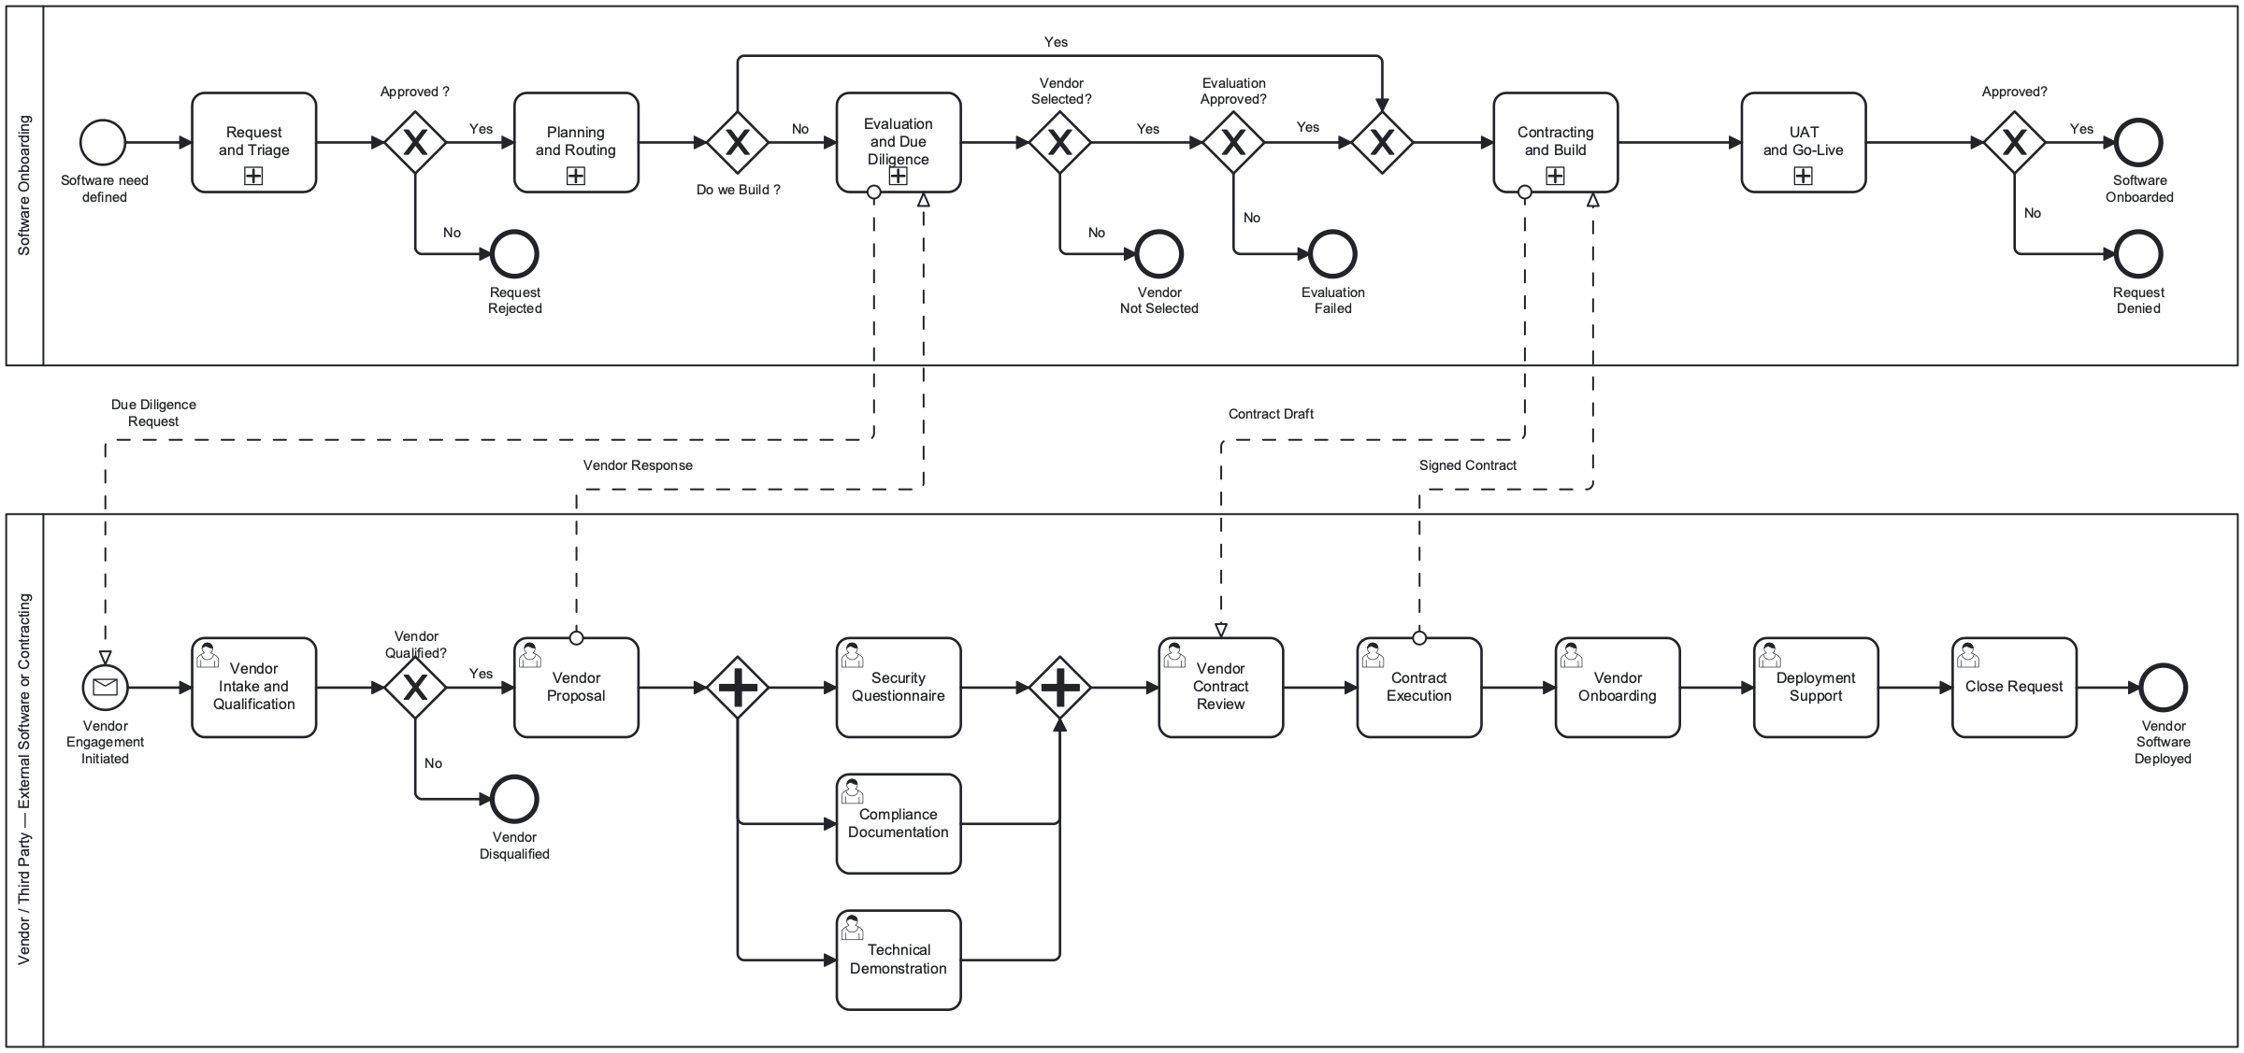
End-to-End Workflow -- Pain Point Overlay
The 5-phase lifecycle with red callouts marking the biggest pain points at each stage, validated by stakeholder interviews.
SP1: Intake
SP2: Planning
SP3: Eval & DD
SP4: Contracting
SP5: Go-Live
5+ channels, ~80 Q form, no pre-screen
No prioritization, binary Buy/Build only
18 sequential committees, no security baseline
2-3 mo contracting, 2 legal partners, no rework loop
No conditional approval, no ownership tracking
Software Onboarding Transformation -- v2
Confidential

Slide 4
Implementation Roadmap -- 30/60/90/120 Days
Phased approach: planning and consolidation first, then progressive automation aligned to stakeholder urgency and gap priorities.
Days 1-30: Plan & Consolidate
Days 31-60: Quick Wins
Days 61-90: Structural Changes
Days 91-120: Optimize
Zero automation -- define standards
First measurable cycle time reduction
Pathway routing and parallel evaluation
Advanced automation and measurement
Map and deduplicate intake fields across 5+ channels
Define prioritization scoring formula
Define security baseline controls (3-tier)
Map 18 committees to 5 parallel streams
Define Vendor Affinity pathway rules
Establish deal-killer no-go list
Executive alignment and sign-off
Deploy unified intake form (GAP-1)
Implement completeness quality gate (GAP-9)
Deploy deal-killer pre-screen (GAP-16)
Add status notifications at phase boundaries (GAP-7)
Implement prioritization scoring (GAP-2)
Add mandatory ownership assignment (GAP-14)
Deploy 3-pathway routing (GAP-11)
Implement progressive forms (GAP-3)
Deploy tiered security assessment (GAP-12)
Restructure SP3: 5 parallel streams
Add finance rework loop (GAP-4)
Implement conditional approval (GAP-13)
Deploy workload visibility dashboard (GAP-10)
Implement AI fast-track pathway (GAP-6)
Deploy exception routing (GAP-8)
Implement pre-onboarding idea funnel (GAP-15)
Measure before/after metrics
Executive reporting on cycle time reduction
Software Onboarding Transformation -- v2
Confidential

Slide 5
Day 30 -- Process Improvements & Consolidations
The first 30 days focus entirely on planning artifacts. No automation deployed -- but these decisions unlock everything that follows.
Intake Field Inventory
Prioritization Formula
Security Baseline Definition
Map every question across ServiceNow, REA (~80 Q), AI forms, Power Apps, email. Deduplicate. Define minimum viable fields for unified intake.
Define quantitative scoring: business impact, strategic alignment, urgency, risk tier, capacity. Draft OB-DMN-5 decision table.
Define 3-tier control hierarchy: Baseline (automated), Elevated (automated + manual), Major (full assessment + pen test).
Committee Consolidation Plan
Vendor Affinity Rules
Executive Alignment
Map all 18 committees to 5 parallel evaluation streams. Identify which reviews can run simultaneously. Draft communication plan.
Define 3rd pathway criteria: no org cost, advisor-direct purchase, vendor partnership program. Update OB-DMN-2 routing table.
Present discovery findings and roadmap to executive sponsors. Confirm committee consolidation. Assign owners to every Day 60 deliverable.
Software Onboarding Transformation -- v2
Confidential

Slide 6
SP1: Request & Triage
1. Intake
Initial request capture, portfolio review, and solution discovery. The front door to the entire onboarding lifecycle.
Software Onboarding Transformation -- v2
Confidential

Slide 7
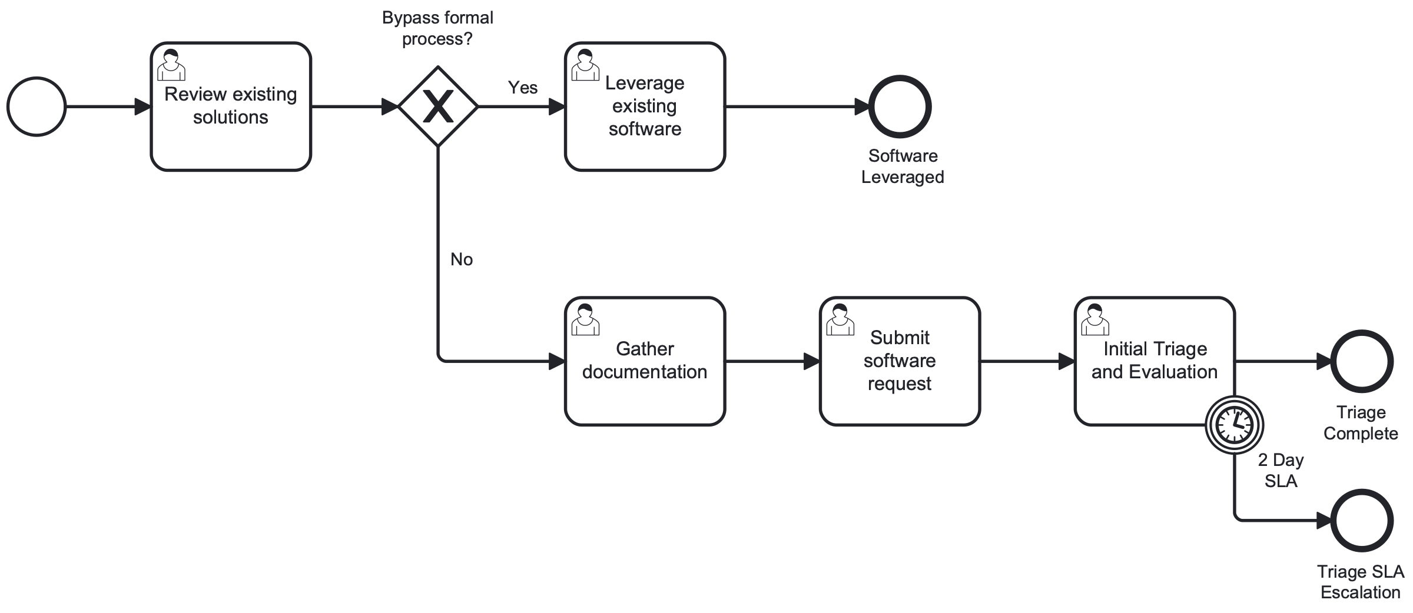
Intake -- Current State
Channel | System | Issue
TBC Intake | ServiceNow | Inconsistent compliance
REA Form | ~80 questions | Frequently completed incorrectly
AI Use Case | Separate form | 2 forms at different stages
Rapid Risk | Power Apps | Used as onboarding workaround
Email/Chat | Unstructured | No tracking
Critical: Business partners submit same information to multiple teams
Critical: Multiple groups run independent programs, seeking fastest path
High: REA form frequently filled out incorrectly -- even experienced users struggle
"Multiple business cases submitted on a single form."
-- Legal Director
Software Onboarding Transformation -- v2
Confidential

Slide 8
Intake -- Recommendations
Unified Intake Gateway (GAP-1)
Completeness Quality Gate (GAP-9)
Single entry point absorbs all 5+ channels. Dynamic routing by request type: Standard, AI, Exception, Vendor Partnership. Eliminates duplicate submissions.
Automated screening before human review. AI-assisted pre-screening validates minimum viable fields, problem statement quality, and risk flags.
Deal-Killer Pre-Screen (GAP-16)
Existing Portfolio Check
DMN-driven check against managed no-go list. Certain AI models are complete no-gos -- reject immediately with explanation rather than consuming weeks.
Before formal intake, check if existing solution satisfies the need. Route to 'Leverage Existing' -- avoid the entire onboarding process for duplicates.
Day 30
Day 60
Day 90
Day 120
Map all intake fields
Deduplicate questions
Define minimum viable fields
Draft deal-killer no-go list
Deploy unified intake form
Activate completeness gate
Deploy deal-killer pre-screen
Redirect all channels
Progressive form strategy
AI-assisted pre-screening
Form analytics: completion rates
Exception routing live
Pre-onboarding idea funnel
Measure: form completion %, rejection rate
Software Onboarding Transformation -- v2
Confidential

Slide 9
SP2: Planning & Routing
2. Prioritization
Backlog ranking, pathway selection, and resource allocation. The missing link between intake and evaluation.
Software Onboarding Transformation -- v2
Confidential

Slide 10
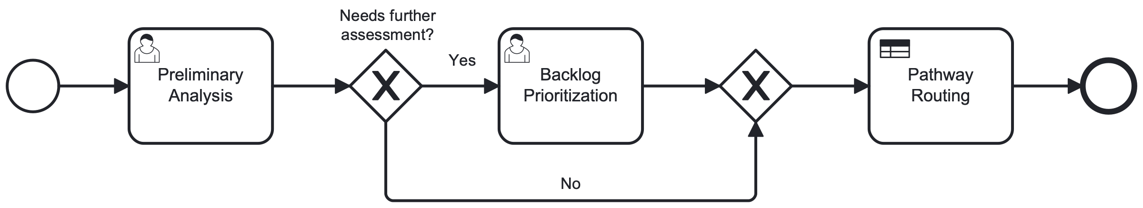
Prioritization -- Current State
Critical: No formal prioritization standard or formula
"Teams horse trade internally before involving Legal."
Critical: No force-ranking mechanism across the enterprise
-- Process Manager
"Competing initiatives across the organization with no arbitration."
High: Each requestor views their request as most important
-- Procurement Lead
High: Auto-approval for low-risk items not supported -- all follow same heavyweight process
"Prioritization can be partially driven by scoring intake form responses."
-- Governance Specialist
Software Onboarding Transformation -- v2
Confidential

Slide 11
Prioritization -- Recommendations
DMN-Driven Scoring (GAP-2)
3-Pathway Routing (GAP-11)
New OB-DMN-5: inputs = business impact, strategic alignment, urgency, risk tier, capacity. Output: P1/P2/P3 priority score. Replaces 'horse trading' with objective ranking.
Replace binary Buy/Build gateway with tri-state routing: Buy, Build, Vendor Affinity. OB-DMN-2 expanded. Right-sized governance per pathway.
Low-Complexity Bypass
Transparent Queue Position
SP2 gateway: requests that don't need full evaluation skip directly to pathway routing. Auto-approval for low-risk, low-complexity items.
Requestors see their position in the ranked backlog. Status notifications at every transition. Data-driven capacity decisions.
Day 30
Day 60
Day 90
Day 120
Define scoring formula
Draft OB-DMN-5 table
Get governance sign-off
Define VA criteria
Deploy scoring in SP2
Publish queue position
Status notifications
3-pathway routing live
OB-DMN-2 updated with VA
Low-complexity bypass active
Measure: queue wait time
Refine scoring weights
Executive reporting
Software Onboarding Transformation -- v2
Confidential

Slide 12
SP3-SP4: Evaluation & Contracting
3. Funding / Finance
Financial analysis, budget authorization, and TCO/ROI assessment. Establishes fiscal justification before commitments.
Software Onboarding Transformation -- v2
Confidential

Slide 13
Funding / Finance -- Current State
Critical: Formal denial sends request back to beginning -- even for minor corrections
Role | RACI
Finance | R/A -- performs TCO, ROI, NPV
Business | C -- provides business case and financial inputs
Governance | C -- authorizes budget
Procurement | C -- procurement routing
Oversight | I -- informed of financial decisions
High: Cannot reroute coding matrix issues to FP&A -- must email outside system
High: Cannot make minor cosmetic corrections independently
Medium: Vendor partnership products require no funding but validation still required
"Formal denial sends request back to beginning of process."
-- Finance Representative
Software Onboarding Transformation -- v2
Confidential

Slide 14
Funding / Finance -- Recommendations
Finance Rework Loop (GAP-4)
Vendor Affinity Bypass
Add correction loop in SP4: minor issues loop back to correction task without formal denial. Only substantive issues restart the process.
VA products (no org cost) skip funding validation entirely. OB-DMN-2 VA output bypasses Task_FinancialAnalysis in SP3 and negotiation in SP4.
FP&A Integration
Progressive Financial Data
Direct routing to FP&A for coding matrix issues within the process -- no external email required. Automated routing based on correction type.
SP1: budget estimate only. SP2: strategic alignment. SP3: full TCO/ROI model. No financial question appears in more than one form.
Day 30
Day 60
Day 90
Day 120
Map financial questions
Define correction vs. denial
Identify FP&A routing rules
Progressive fields in form
FP&A routing path defined
Finance rework loop deployed
VA bypass active
Automated FP&A routing
Measure: restart rate
Average correction cycle time
VA bypass metrics
Software Onboarding Transformation -- v2
Confidential

Slide 15
SP3: Evaluation & Due Diligence
4. Sourcing
Vendor landscape assessment, vendor selection, and risk evaluation. Includes procurement execution and due diligence.
Software Onboarding Transformation -- v2
Confidential

Slide 16
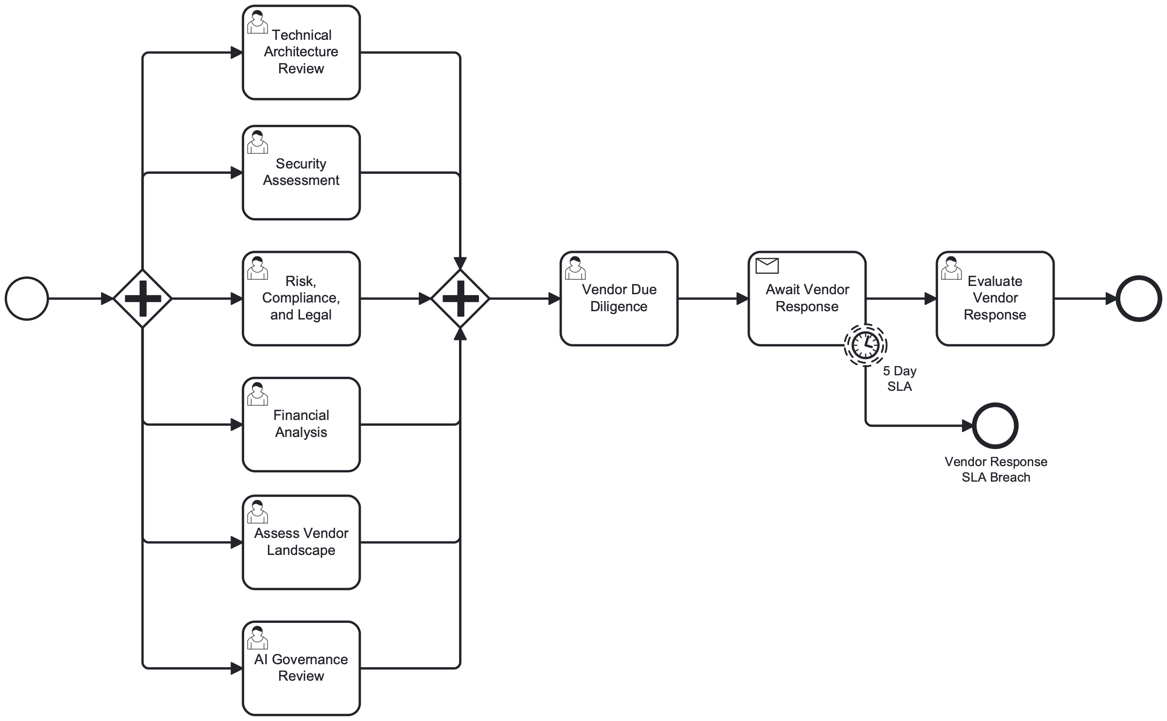
Sourcing -- Current State
Critical: Business partners bypass sourcing, arriving with pre-selected vendors
"Same use case presented to multiple committees sequentially."
High: Sourcing team makes quasi-legal decisions due to legal bottleneck
-- Business Representative
"Architecture teams assessing financials. Financial teams assessing architecture."
High: Solutions underutilized -- multi-million dollar tools used for 1/3 of capabilities
-- Technical Lead
Critical: 18 sequential committee reviews -- meetings 5+ weeks apart
Software Onboarding Transformation -- v2
Confidential

Slide 17
Sourcing -- Recommendations
5 Parallel Evaluation Streams
Vendor Affinity Reduced Scope (GAP-11)
Replace 18 sequential committees with 5 concurrent streams: Tech Architecture, Security, Risk/Compliance/Legal, Financial/TCO, Vendor Landscape.
VA pathway: skip financial analysis and vendor landscape assessment. Compliance review and security assessment only -- right-sized due diligence.
Vendor DD via Message Flow
Post-Purchase Utilization Tracking
Structured cross-pool communication: DD request sent to vendor pool, vendor responds with evidence. 5-day SLA timer on response.
Post-onboarding includes utilization review tasks. Prevents multi-million dollar tools being used for 1/3 of capabilities. Annual review.
Day 30
Day 60
Day 90
Day 120
Map 18 committees to 5 streams
Define concurrent review rules
Get committee chair buy-in
Pilot parallel evaluation
Vendor DD template standardized
5 parallel streams operational
VA reduced scope deployed
5-day SLA timers active
Measure: eval cycle time
Post-purchase utilization
Vendor response SLA
Software Onboarding Transformation -- v2
Confidential

Slide 18
SP3: Evaluation & Due Diligence
5. Cybersecurity
Security assessment, vulnerability management, and security architecture review. The "secure by design" gap.
Software Onboarding Transformation -- v2
Confidential

Slide 19
Cybersecurity -- Current State
Critical: No defined "secure by design" standard at the organization
"AI technologies still in formation; no public standards for securing new tech."
Critical: Teams don't know minimum security controls; enforcement 'fairly loose'
-- AI Security Lead
"MCP technology didn't exist 18 months ago -- new tech requires new baselines."
High: Only a fraction of systems covered by identity management
-- AI Security Lead
High: End-of-year compliance failures common; PII in uncontrolled systems
High: Security tools also contain AI -- circular dependency for approvals
Software Onboarding Transformation -- v2
Confidential

Slide 20
Cybersecurity -- Recommendations
Tiered Security Baseline (GAP-12)
Time-Bound Risk Acceptance (GAP-13)
Automated Baseline Checks
DMN-driven assessment level based on risk tier + data classification + AI component: Baseline: Automated checks only Elevated: Automated + manual review Major: Full assessment + pen test
"Company wants product by Q2 but security controls not ready until Q3." Conditional approval with monitoring timer. Auto-escalation if conditions not met by expiry.
Baseline tier runs as service task in Automation lane -- no human review needed. Only Elevated/Major route to manual review. Reduces security team workload.
Day 30
Day 60
Day 90
Day 120
Define 3-tier control hierarchy
Map requirements per tier
Security Lead sign-off
Document baseline checklist
Draft DMN table for routing
Tiered assessment deployed
Automated baseline active
Conditional approval in SP5
Measure: review cycle time
Baseline automation rate
Conditional monitoring
Software Onboarding Transformation -- v2
Confidential

Slide 21
SP3-SP4: Evaluation & Build
6. Enterprise Architecture (Buy Only)
Architecture review, integration planning, and technology standards compliance. Ensures software fits the enterprise landscape.
Software Onboarding Transformation -- v2
Confidential

Slide 22
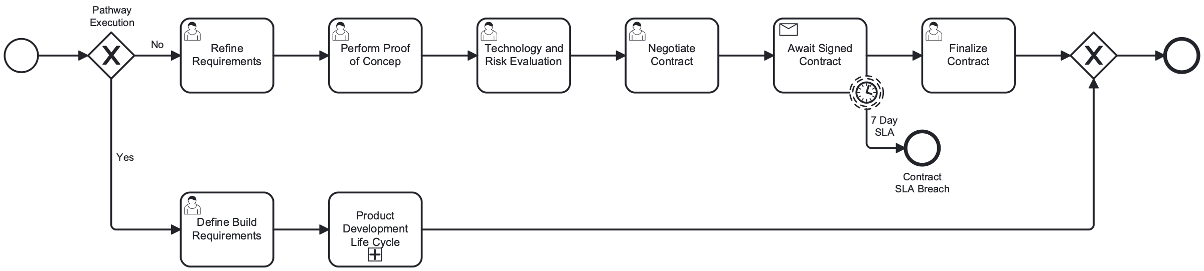
Enterprise Architecture -- Current State
High: Architecture review group recently reduced in staffing
Task | Sub-Process
Technical Architecture Review | SP3
Perform Proof of Concept | SP4
Technical Risk Evaluation | SP4
Vendor Technical Demo | Vendor Pool
Vendor Deployment Support | Vendor Pool
High: Architecture teams assessing financials (outside their expertise)
High: Integration costs beyond initial purchase not captured in Buy/Build binary
"Some 'buy' scenarios also require 'build' -- AI tool generating emails needs compliance capture integration."
-- Product Director
Software Onboarding Transformation -- v2
Confidential

Slide 23
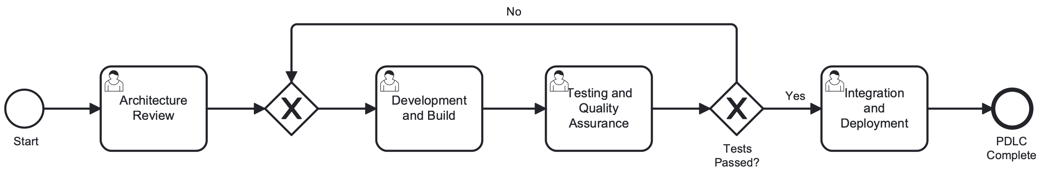
Enterprise Architecture -- Recommendations
Integration Governance for Buy Path
PDLC for Build Path
When Buy pathway identifies integration work, trigger SP4 Task_DefineBuildReqs. Hybrid buy+build pattern captured explicitly.
Build pathway enters nested PDLC: Architecture Review, Development, Testing & QA, Integration Testing. Retry loop on test failures.
Focused Review Scope
Architecture teams review architecture only -- no financial assessment. Financial analysis runs in parallel, not through architecture review.
Standards Compliance Checklist
Automated technology standards check before PoC. DMN-driven: integration patterns, data flow, security architecture fit.
Day 30
Day 60
Day 90
Day 120
Define Buy path checklist
Document integration triggers
Clarify review scope
Architecture decoupled from financial
Standards checklist documented
Integration governance active
PDLC for Build path
Parallel review enforced
Measure: review cycle time
Integration cost capture rate
PoC success rate
Software Onboarding Transformation -- v2
Confidential

Slide 24
Cross-Cutting: SP1-SP5
7. Compliance
Regulatory compliance review, legal assessment, and data protection obligations across the full lifecycle.
Software Onboarding Transformation -- v2
Confidential

Slide 25
Compliance -- Current State
Regulation | Scope
OCC 2023-17 | Third-party risk management
GDPR / CCPA | Data processing and privacy
SOX 302/404 | Internal controls, financial reporting
DORA | Digital operational resilience
EU AI Act | AI system risk classification
NIST CSF 2.0 | Cybersecurity framework
Critical: No consistent standard for what requires escalation
High: End-of-year compliance failures common; PII in uncontrolled systems
High: Different teams have varying risk acceptance thresholds
"Information trickles through various processes instead of arriving complete upfront."
-- Legal Director
Compliance review appears in all 5 phases plus the Vendor Pool -- highest breadth of any governance topic.
Software Onboarding Transformation -- v2
Confidential

Slide 26
Compliance -- Recommendations
Phase-Boundary Quality Gates
DMN-Driven Escalation
Regulatory Traceability
Every phase transition validates compliance prerequisites before allowing the request to advance. Prevents incomplete information from cascading.
Risk tier determines escalation: Minimal = single approver, Limited = committee quorum, High = full advisory board. OB-DMN-3 routes automatically.
Every task carries regulatory annotations via Camunda properties. Audit trail links decisions to OCC, GDPR, SOX, DORA requirements.
Day 30
Day 60
Day 90
Day 120
Map regulations to phases
Define escalation criteria
Document quality gates
Phase-boundary gates active
Compliance notification
OB-DMN-3 routing deployed
3-tier review operational
Regulatory annotations
Compliance audit trail
Measure: failure rate
Traceability dashboard
Software Onboarding Transformation -- v2
Confidential

Slide 27
SP3: Evaluation & Due Diligence
8. AI Governance
AI and ML risk classification, model validation, and bias assessment. The highest-urgency domain with 60+ items in queue.
Software Onboarding Transformation -- v2
Confidential

Slide 28
AI Governance -- Current State
Critical: Overly restrictive AI addendum causes extended vendor negotiations
"AI should be treated as the first use case with planned expansion afterward."
Critical: AI tools perceived as taking too long -- stakeholders want AI-first solutions
-- Product Director
"'Crawl, walk, run' messaging rejected -- clear target state needed."
High: 60+ items in AI governance queue
-- Product Director
High: AI process involves 3 separate committees
"Need to communicate non-starter models/vendors early to prevent wasted effort."
High: Multiple tools submitted for same function -- no AI strategy alignment
-- Business Representative
Software Onboarding Transformation -- v2
Confidential

Slide 29
AI Governance -- Recommendations
AI Fast-Track Pathway (GAP-6)
Deal-Killer Pre-Screen for AI (GAP-16)
AI tools run AI Gov Review + Security Assessment only. Pre-defined AI risk posture reduces decision latency. Target: 2-week end-to-end vs. 6-9 months.
Known no-go AI models/vendors rejected at intake. Enterprise Risk Management red/green light decision matrix in SP1. Prevents wasted review cycles.
Streamlined AI Addendum
3-Committee Consolidation
Working with outside firm to redefine AI stipulations. Predefined scenarios get streamlined approval; complex cases get full review. Reduces vendor pushback.
AI Risk Working Group, AI Cyber Review, AI Risk Review, AI Governance Committee consolidated into single AI Governance Review task in SP3.
Day 30
Day 60
Day 90
Day 120
Define AI risk posture
Build AI no-go list
Define fast-track criteria
Map 4 AI committees to 1
AI deal-killer active
Committee consolidation communicated
AI fast-track piloted
Streamlined addendum drafted
AI fast-track operational
Measure: queue depth
Target: 2 weeks
Software Onboarding Transformation -- v2
Confidential

Slide 30
Cross-Cutting: SP1-SP4
9. Privacy (Legal)
Data protection impact assessment, data classification, and cross-border transfer compliance. GDPR/CCPA obligations throughout the lifecycle.
Software Onboarding Transformation -- v2
Confidential

Slide 31
Privacy -- Current State
High: Different teams have varying risk acceptance thresholds for data handling
Task | Phase | Privacy Relevance
Gather Requirements Docs | SP1 | Data classification
Preliminary Analysis | SP2 | Data flow identification
Risk, Compliance & Legal | SP3 | DPIA, cross-border review
Refine Requirements | SP4 | DPA drafting
Perform PoC | SP4 | Data handling validation
High: PII found in uncontrolled systems -- end-of-year compliance failures
High: AI, offshoring, and subcontracting requirements create rework when discovered late
Medium: AI-related requests add complexity with evolving privacy guidance
Software Onboarding Transformation -- v2
Confidential

Slide 32
Privacy -- Recommendations
Early Data Classification
Progressive Privacy Disclosure
AI Privacy Triggers
SP1 intake captures data classification at submission: PII, PHI, financial data, public. Classification drives automated routing of privacy review requirements.
SP1: basic data type. SP2: data flow direction. SP3: full DPIA when warranted. SP4: DPA terms. No privacy question repeated across phases.
When AI component detected: automatic cross-border data assessment, training data provenance check, and model card review. Integrated into AI Gov branch.
Day 30
Day 60
Day 90
Day 120
Define data classification
Map privacy questions per phase
Document DPIA triggers
Data classification in intake
Automated privacy routing
Progressive privacy fields
AI privacy triggers active
DPIA automation
Measure: rework rate
DPIA completion time
Cross-border compliance
Software Onboarding Transformation -- v2
Confidential

Slide 33
SP4: Contracting & Build
10. Commercial Counsel
Contract negotiation, SOW/MSA drafting, redlining, and execution. The 2-3 month bottleneck with only 2 legal partners.
Software Onboarding Transformation -- v2
Confidential

Slide 34
Commercial Counsel -- Current State
Critical: Contracting alone takes 2-3 months
Task | Owner
Negotiate Contract Terms | Contracting Lane (R/A)
Finalize and Execute Contract | Contracting Lane (R/A)
Vendor Contract Review | Vendor Pool
Vendor Contract Execution | Vendor Pool
Critical: Only 2 legal partners handling all vendor contracts
Critical: CLM system requested for 5-6 years without funding
High: Sourcing team makes quasi-legal decisions due to legal bottleneck
"Contract lifecycle management system requested for 5-6 years without funding."
-- Vendor Risk Lead
Software Onboarding Transformation -- v2
Confidential

Slide 35
Commercial Counsel -- Recommendations
Finance Rework Loop (GAP-4)
Vendor Affinity Streamlined Contracting
Minor corrections loop back without formal denial. Only substantive contractual issues require process restart. Saves weeks per correction cycle.
VA pathway: compliance review + contract execution only. Skip negotiation (pre-approved terms). 5-day contracting SLA vs. 2-3 months.
Contract Execution via Message Flow
Template-Based Contracting
Structured cross-pool communication: draft to vendor, vendor redlines, signed contract returned. 5-day SLA timer with escalation.
Pre-approved MSA/SLA templates for common vendor types. Standard terms for VA products. Custom negotiation reserved for High risk only.
Day 30
Day 60
Day 90
Day 120
Document contract templates
Define correction criteria
Define VA contracting scope
Template library established
Vendor message flow standardized
Rework loop active in SP4
VA contracting deployed
5-day SLA timers
Measure: contracting cycle time
Redlining iterations
Template usage rate
Software Onboarding Transformation -- v2
Confidential

Slide 36
Cross-Cutting: Full Lifecycle
11. Third-Party Risk Management
Vendor lifecycle management, ongoing monitoring, and concentration risk. The thread that runs through every phase -- highest task count of any governance topic.
Software Onboarding Transformation -- v2
Confidential

Slide 37
TPRM -- Current State
Critical: No authoritative source for app/technology ownership
Role | State
Business Owner | Reasonably well-identified
Vendor Owner | Identified by risk team (team of 6)
Product Owner | Weakly tracked; often differs from requester
Critical: Incomplete CMDB -- unclear who owns support, requirements, lifecycle
High: Tech owner identification less rigorous than business owner identification
High: Single vendor spanning 10+ business units, each requiring separate assessment
High: 1,200+ institutions requiring documentation and compliance tracking
TPRM touches 13 tasks across all 5 phases + Vendor Pool -- highest task count of any governance topic. Governance lane is R/A.
Software Onboarding Transformation -- v2
Confidential

Slide 38
TPRM -- Recommendations
Mandatory Ownership Assignment (GAP-14)
Vendor-Level Aggregation
SP5 Task_AssignOwnership: required Business, Technical, Support Owner fields before close. Feeds CMDB. Annual ownership validation.
When vendor spans 10+ BUs, aggregate vendor-level compliance artifacts. Separate request-level evaluation from vendor-level due diligence.
Risk Tier Drives Monitoring Cadence
Status Visibility for All Stakeholders (GAP-7)
OB-DMN-1 risk tier determines post-onboarding monitoring: High = quarterly, Limited = semi-annual, Minimal = annual. Automated SLA timers.
Real-time status at every phase transition. Requestors, risk team, and oversight all see current position. Portfolio view.
Day 30
Day 60
Day 90
Day 120
Define ownership fields
Document aggregation rules
Map monitoring to risk tier
Ownership assignment in SP5
Status notifications deployed
Vendor aggregation deployed
Risk-based monitoring cadence
Workload dashboard
Measure: ownership completeness
Vendor DD reuse rate
Software Onboarding Transformation -- v2
Confidential

Slide 39
Next Steps
Discovery complete. 11 topic areas assessed. 16 gaps identified and prioritized. The 30/60/90/120-day roadmap begins with planning and consolidation -- zero automation in the first 30 days.
1. Executive Alignment (Week 1)
Review discovery findings with executive sponsors. Confirm committee consolidation approach. Assign owners to each Day 30 deliverable.
2. Standards Definition (Weeks 2-3)
Intake field inventory, prioritization scoring formula, security baseline controls, Vendor Affinity pathway rules, deal-killer no-go list.
3. Quick Wins Target (Day 60)
Unified intake, completeness gate, deal-killer pre-screen, status notifications, prioritization scoring, ownership assignment.
4. Full Operation (Day 120)
3-pathway routing, 5 parallel evaluation streams, AI fast-track, workload dashboard, before/after metrics. Target: 90%+ improvement.
Software Onboarding Transformation -- v2
Confidential

