Slide 1
Software Onboarding Process Transformation
Discovery Findings, Recommendations, and Implementation Roadmap
Based on 14 stakeholder interviews across Architecture, Product, Security, Risk Management, Vendor Management, Finance, Legal, and Compliance teams. Covering 11 governance domains with actionable 30/60/90/120-day implementation plans.
14 Stakeholder Sessions
11 Governance Domains
16 Gap Findings
120-Day Roadmap
KPMG Confidential
March 2026

Slide 2
Executive Summary
The software onboarding process spans 6 to 9 months end-to-end, driven by 18 sequential committees, 5+ disconnected intake channels, and critical resource bottlenecks in Security and Legal. The START initiative (9 months old) created centralized awareness but did not integrate underlying team processes.
6-9 mo
18
335
75 days
60+
CURRENT E2E CYCLE
COMMITTEES
ASSESSMENTS/YEAR
DD INTERNAL REVIEW
AI QUEUE ITEMS
Biggest Challenges
Sequential Reviews
Requester Burden
Resource Crisis
Requesters present to ARB, TBC, AI Governance, and DART sequentially. Each committee 5+ weeks apart.
DART formation falls entirely on the requester, who must contact 5-6 teams independently.
2 people negotiate 30+ contracts/month. Security is #1 SLA bottleneck. "Half a person" owns START.
Highest-ROI Investment Areas
Parallel Evaluation
Unified Intake + Deal-Killer
Contract Automation
Replace 18 sequential committees with 5 parallel evaluation streams.
Consolidate 5+ channels. Block non-starters at day 1.
Automate contract review for the 2-person team handling 30+/month.
KPMG Confidential
March 2026

Slide 3
End-to-End Workflow: Current Pain Points
1 Intake
2 Prioritize
3 Funding
4 Sourcing
5 Cyber
6 EA
7 AI Gov
8 Legal
9 Contract
5+ channels
No formula
Locked forms
75d review
#1 bottleneck
2wk ARB
60+ queue
2 people
Up to 1.5yr
Critical Bottlenecks
What the Organization Does Well
Contract Negotiation: 2 people / 30+ contracts monthly [CRITICAL]
Architecture Governance
Security Review: "Biggest bottleneck... reason our SLA takes 2 weeks" [CRITICAL]
Dedicated Facilitator pre-screens artifacts, manages follow-ups. Most disciplined team.
Sequential Committees (18): Same presentation repeated 3-4 times [CRITICAL]
DART Formation: Requester manages 5-6 teams independently [CRITICAL]
AI Governance Queue: 60+ items, 3 separate committees [HIGH]
TPRM Due Diligence
Business Council Quorum: 2-3 of 8-10 members attend [HIGH]
Reduced DD from 144 to 75 days. Output doubled to 335 assessments/year.
Acquisition 2.0
Brings all teams together at start. Collective go/no-go at first tollgate.
KPMG Confidential
March 2026

Slide 4
Implementation Roadmap: 30 / 60 / 90 / 120 Days
Days 1-30: Consolidate
Days 31-60: Automate
Days 61-90: Optimize
Days 91-120: Scale
Unified intake form (replace 5+ channels) Deal-killer pre-screen gate Completeness quality gate Committee scope definition 3-pathway routing: Buy/Build/Enable Prioritization scoring formula Status notification at transitions Concierge role definition
Parallel evaluation (replace sequential) Automated DART formation Progressive forms Contract review automation pilot Security tiered assessment AI governance consolidation Finance rework loop Workload visibility dashboard
AI fast-track pathway (2-week target) Enable pathway live Time-bound conditional approvals Mandatory ownership assignment NDA-first gate enforcement Automated security baselines Self-service mini-RFP tools SLA enforcement + escalation
Pre-onboarding idea funnel Full workload dashboard Exception routing for rapid RA Post-onboarding utilization tracking Distributed pod model pilot Annual ownership validation Process mining / CI Executive KPI reporting
60-70%
18 to 5
3 Pathways
Day 1
Cycle Time Reduction
Sequential to Parallel
Buy/Build/Enable
Non-Starter ID
KPMG Confidential
March 2026

Slide 5
Intake
Initial request capture, portfolio review, and solution discovery.
KPMG Confidential
March 2026

Slide 6
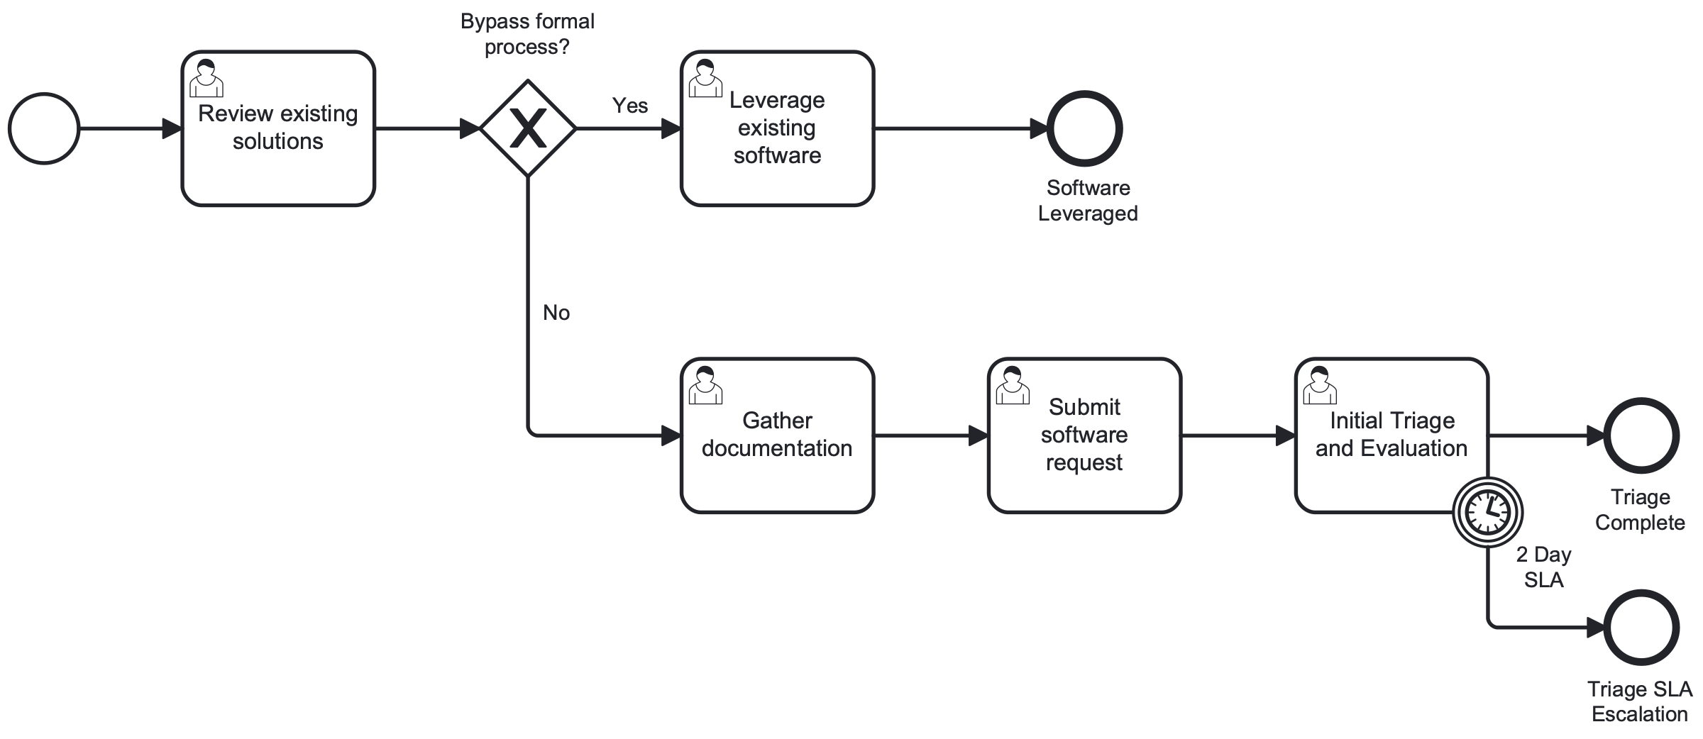
SP1: Request and Triage
Request capture, existing solution review, bypass routing for leveraged software, initial triage with 2-day SLA timer, and DMN-driven pathway routing.
KPMG Confidential
March 2026

Slide 7
Intake: Current State
5+ disconnected entry points
Requester confusion
ServiceNow START, AI Use Case form, AI Governance form, Rapid Risk Assessment (Power Apps), email/chat.
First-time requesters struggle with complexity. Forms discovered ad hoc.
Forms require multi-disciplinary expertise
Process bypasses are common
RAE form has 80 questions. Business partners frequently cannot complete accurately.
Technology teams especially prone to bypassing standard processes.
No completeness validation
START created awareness
Incomplete submissions cascade, causing rework when requirements surface late.
ServiceNow central intake (9 months old) prevents work on unapproved initiatives.
"The process never solved the step of a requester who's never been through onboarding having to work with 5-6 teams through independent processes."
-- Vendor Management Lead
RACI: R/A Business | C Governance, Compliance
KPMG Confidential
March 2026

Slide 8
Intake: Recommendations and Roadmap
Unified Intake Gateway
Deal-Killer Pre-Screen
Single entry point absorbing all channels. Dynamic routing by request type. Eliminates 4 redundant channels
DMN-driven no-go check at submission. Block non-starters immediately. Saves 100% downstream effort on non-starters
Completeness Quality Gate
Request Classification
AI-assisted pre-screening validates minimum fields before SME routing. Eliminates rework from late requirements
Automated: Defined Need, Forced Update, or Speculative. Right-sizes governance. Matches effort to complexity
30 Days
60 Days
90 Days
120 Days
Deploy unified intake form Implement deal-killer checklist Define minimum fields Retire redundant channels
Progressive form logic AI-assisted completeness scoring Integrate feedback platform
Self-service mini-RFP tools Auto-classification (DMN) Shift-left: questions upfront
Pre-onboarding idea funnel Threshold-based escalation Full intake analytics
KPMG Confidential
March 2026

Slide 9
Prioritization
Backlog ranking, pathway selection, and resource allocation.
KPMG Confidential
March 2026

Slide 10
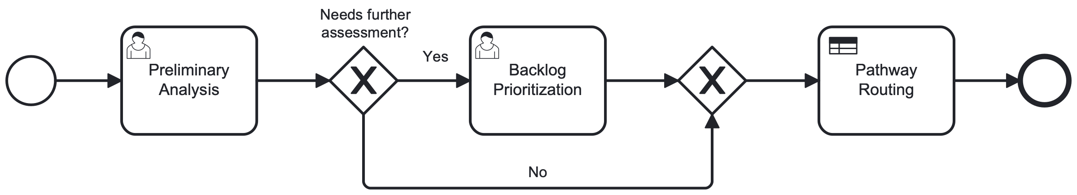
SP2: Planning and Routing
Preliminary analysis, backlog prioritization, DMN-1 risk tier classification, DMN-2 pathway assignment. Unacceptable risk routes to rejection.
KPMG Confidential
March 2026

Slide 11
Prioritization: Current State
No formal prioritization formula
'Whoever screams loudest' gets priority
Teams 'horse trade' internally. No force-ranking mechanism across the enterprise.
EVP support pushes other reviews down. No SLA enforcement possible.
Business Council quorum failures
All requests follow same heavyweight process
Monthly meetings draw 2-3 of 8-10 members. Evolved to email voting.
No auto-approval for low-risk. No de-prioritization guidelines.
Capacity management disconnected
Governance Specialist sees path forward
PI planning allocates to roadmap; exceptions create unanticipated workload.
Scoring intake responses can drive prioritization. Standards must be defined upfront.
"If you set up repercussion for SLA not achieved, what's the solution? There's no real effective prioritization."
-- Security Architect
RACI: R/A Governance | C Business, Finance, Technical Assessment
KPMG Confidential
March 2026

Slide 12
Prioritization: Recommendations and Roadmap
Quantitative Scoring Formula
3-Pathway Routing: Buy/Build/Enable
DMN-driven: business impact, strategic alignment, urgency, risk tier, capacity. Replaces subjective horse trading
Enable (Vendor Affinity) skips funding validation, reduces evaluation scope. 30-day turnaround for Enable vs 6-9 months
Tiered Governance Depth
Capacity-Aware Scheduling
Risk tier determines intensity. Low-risk gets streamlined review. Frees 40%+ reviewer capacity
Integrate team capacity into routing. Display queue depth at submission. Sets realistic expectations
30 Days
60 Days
90 Days
120 Days
Define scoring formula Implement 3-pathway routing Publish criteria Queue transparency
DMN decision table Capacity integration pilot Auto-routing for low-risk
Enable pathway live AI fast-track pathway SLA enforcement
Full portfolio dashboard Predictive wait times Continuous calibration
KPMG Confidential
March 2026

Slide 13
Funding / Finance
Financial analysis, budget authorization, and TCO assessment.
KPMG Confidential
March 2026

Slide 14
Funding / Finance: Current State
Formal denial restarts entire process
Financial form outdated and locked
Cannot reroute coding matrix issues to FP&A. Minor corrections require full restart.
Shows 2024 in 2026. Password unknown (owner left). Downloaded, completed offline.
Enable pathway forced through funding
Business case required multiple times
Vendor Affinity products require no org investment but process demands justification.
Redundancy across intake forms all describing the same business case.
"There's redundancy on what all these intake forms are... they're all describing what is the business case."
-- Product Manager
RACI: R/A Finance | C Governance, Procurement | I Oversight
KPMG Confidential
March 2026

Slide 15
Funding / Finance: Recommendations and Roadmap
Finance Rework Loop
Enable Pathway Bypass
Correction pathway for coding matrix issues. Minor fixes route to FP&A directly. Eliminates weeks of rework
DMN detects 'no org investment' and bypasses financial gates entirely. Removes friction for zero-cost tools
Modernized Financial Form
Consolidated Business Case
Dynamic digital version replacing locked form. Pre-populate from intake data. Single source of truth
One business case at intake, enriched progressively. No repeated justification. 60%+ form burden reduction
30 Days
60 Days
90 Days
120 Days
Replace locked form Define Enable bypass rules Map financial data flow
Finance rework loop Pre-populated fields Conditional fields per pathway
Automated TCO/ROI calc Finance dashboard integration
Full financial lifecycle Budget forecasting integration
KPMG Confidential
March 2026

Slide 16
Sourcing
Vendor landscape, risk evaluation, due diligence, and procurement.
KPMG Confidential
March 2026

Slide 17
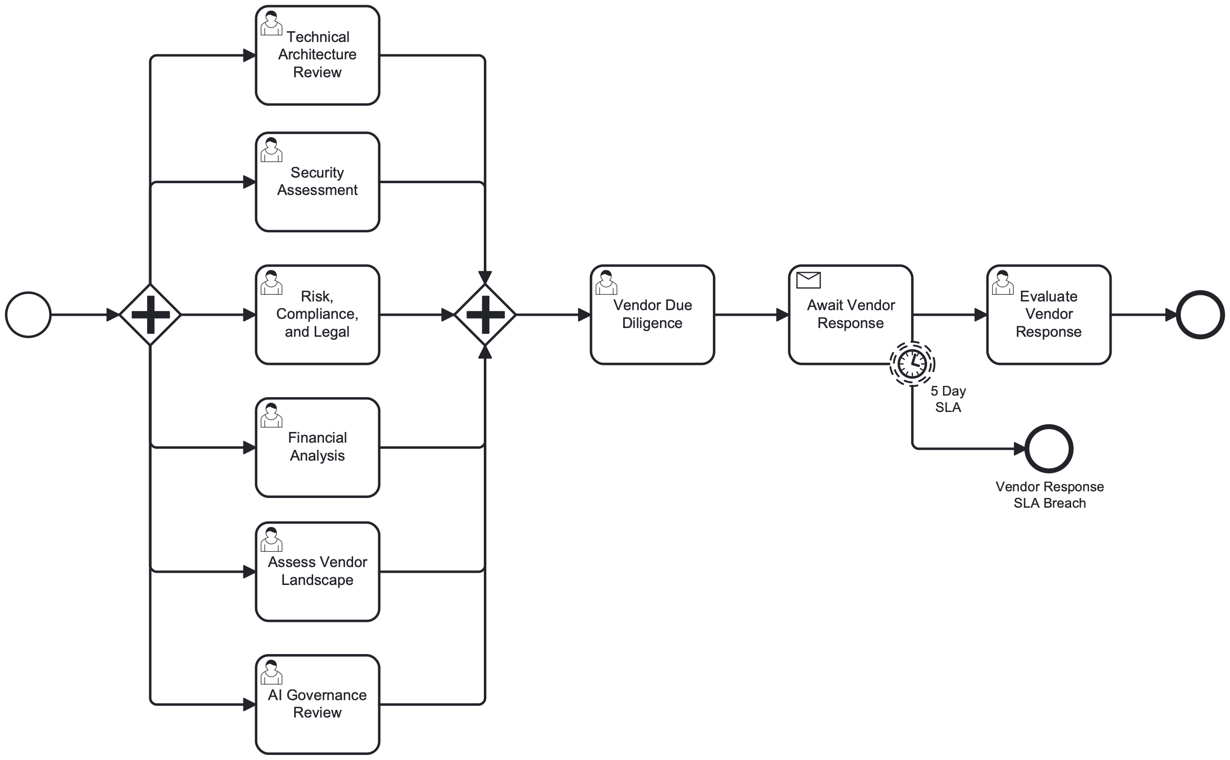
SP3: Evaluation and Due Diligence
5 parallel evaluation streams (Tech Architecture, Security, Risk/Compliance/Legal, Financial Analysis, Vendor Landscape) with 5-day SLA and vendor DD integration.
KPMG Confidential
March 2026

Slide 18
Sourcing: Current State
RAE: 80 questions, 28-29 day actual vs 14 day target
DD: 830 questions, 75 day internal review
Internal questionnaire assigns inherent risk tier and determines DD level.
Down from 144 days. Vendor completion 30 days (ahead of 42-day target).
'Sourcing doesn't source'
NDA timing disagreement
They manage contract lifecycle. True sourcing falls on requesters.
Legal and Security want NDA first. Other teams disagree. No consistent policy.
TPRM performance improving
OneTrust deployed for risk tracking
Output doubled to 335 assessments/year. Team of 8 reducing timelines.
API connections between Ariba and Oracle. Risk assessment foundation exists.
"That's a fantastic idea that should be in the slides."
-- Risk Management Lead, on shift-left strategy
RACI: R Procurement | A Governance | C Compliance | I Oversight
KPMG Confidential
March 2026

Slide 19
Sourcing: Recommendations and Roadmap
NDA-First Gate
Shift-Left: Self-Service Mini-RFP
Enforce NDA execution before detailed vendor engagement. Protects IP, aligns Legal and Security
Structured RFP tools before formal onboarding. Maintains competitive leverage. Better vendor selection
Tiered Due Diligence
Vendor-Level Aggregation
Risk tier determines DD depth. Low-risk: automated only. High: full 830-question. 60% DD cycle time reduction for low-risk
Single vendor spanning 10+ BUs shares compliance artifacts. Eliminates redundant assessments
30 Days
60 Days
90 Days
120 Days
NDA-first enforcement Risk-tiered DD matrix Vendor de-duplication
Mini-RFP templates Abbreviated DD for low-risk OneTrust optimization
Vendor artifact sharing Automated landscape scan AI-assisted routing
Full self-service portal Competitive intelligence Vendor performance scoring
KPMG Confidential
March 2026

Slide 20
Cybersecurity
Security assessment, vulnerability management, and architecture review.
KPMG Confidential
March 2026

Slide 21
SP3: Security Assessment Stream
Security assessment runs as one of 5 parallel streams in SP3. Tiered approach: automated baseline, elevated manual review, or full penetration testing based on risk tier.
KPMG Confidential
March 2026

Slide 22
Cybersecurity: Current State
'Security is our biggest bottleneck'
'I need three of me right now'
Primary reason ARB SLA takes 2 weeks. Understaffed security architecture.
Request volume increasing, especially AI reviews. Cannot scale with current staffing.
No 'secure by design' standard
3x vendor contact for AI
Teams don't know minimum controls. Enforcement 'fairly loose.'
Tech risk, cybersecurity, and TPRM each contact vendor independently.
Zero automation
Multiple security platforms
All routing manual. No workflow integration. Dependency on individual knowledge.
Each addresses specific control requirements. Different security needs covered.
"Security is our biggest bottleneck... They are the reason our SLA takes two weeks."
-- Architecture Lead
RACI: R/A Technical Assessment | C Governance, Compliance
KPMG Confidential
March 2026

Slide 23
Cybersecurity: Recommendations and Roadmap
Tiered Security Assessment
Consolidated Vendor Contact
DMN-driven. Baseline: automated. Elevated: auto+manual. Major: full+pen test. 70% handled by automated baseline
Single coordinated engagement replacing 3 independent contact points. Eliminates 2/3 vendor touchpoints
Security Baseline Definition
Parallel Evaluation
Minimum controls published. Baseline, elevated, and major hierarchies. Clear expectations for all
Security concurrent with Architecture, Compliance, Financial reviews. Eliminates 4-8 weeks sequential waiting
30 Days
60 Days
90 Days
120 Days
Define 3-tier framework Consolidate vendor contact Document baselines
Automated baseline checks Parallel evaluation AI stream consolidation
Full tiered assessment Automated pen test scheduling Security SLA enforcement
Security posture dashboard Continuous monitoring Risk-based resource allocation
KPMG Confidential
March 2026

Slide 24
Enterprise Architecture
Architecture review, integration planning, and standards compliance.
KPMG Confidential
March 2026

Slide 25
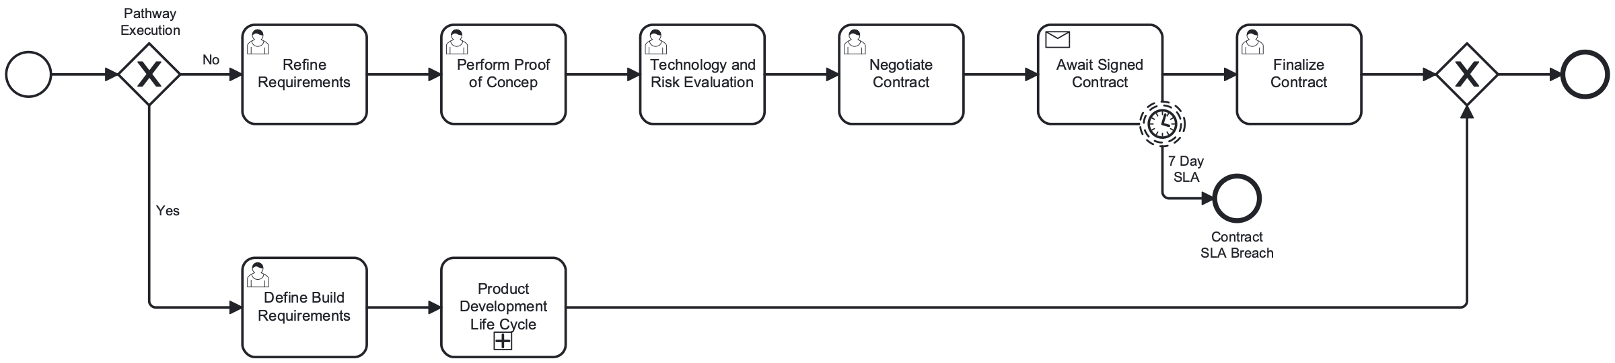
SP3-SP4: Architecture Review Lifecycle
Architecture review spans evaluation (SP3) through contracting (SP4). Governance Facilitator pre-screens artifacts, manages follow-ups, and runs ARB and SDRB.
KPMG Confidential
March 2026

Slide 26
Enterprise Architecture: Current State
Governance Facilitator role (model for E2E)
ARB: 2-week SLA. SDRB: same-day
Pre-screens artifacts, manages follow-ups. Runs ARB and SDRB.
Structured workflow with JIRA integration. Most disciplined team.
AI tooling adoption
HLD/PSS/SDD complexity
Cursor AI for diagrams. Custom agent scans designs for pattern conformance.
Requesters confused about which artifact path applies to their situation.
Committee overlap with TBC
Domain-funded model constraints
Present to ARB, then TBC, then AI governance. Overlapping scope.
'If they want us to pursue all that work, they need to fund us appropriately.'
"I like how you're running your shop."
-- Consulting Team, on Architecture governance
RACI: R/A Technical Assessment | C Governance
KPMG Confidential
March 2026

Slide 27
Enterprise Architecture: Recommendations and Roadmap
Scale Governance Facilitator Model
Define Clear Committee Scope
Blueprint for E2E 'quarterback.' Expand concierge across all domains. Proven model reduces requester burden
Architecture questions by architects only. TBC: business case. AI Gov: AI risks. Eliminates redundant presentations
Simultaneous Engagement Model
Domain-Based Auto-Assignment
All major voting players engaged simultaneously when request comes in. Architecture Lead's own proposal
Automated routing by requesting domain. EA leader to architect by bandwidth. Reduces triage, balances workload
30 Days
60 Days
90 Days
120 Days
Document scope boundaries Define concierge role Map domain routing
Simultaneous engagement pilot Automated domain routing Consolidated artifacts
Concierge operational Cross-committee enforcement AI pattern conformance
Full parallel model Architecture metrics Workload resource planning
KPMG Confidential
March 2026

Slide 28
Compliance
Regulatory compliance review across OCC 2023-17, GDPR/CCPA, SOX, DORA.
KPMG Confidential
March 2026

Slide 29
Compliance: Current State
End-of-year compliance failures
Multiple teams assess independently
PII found in uncontrolled systems. Enforcement 'fairly loose.'
Risk, Legal, Privacy, Compliance each conduct own review without shared findings.
No standardized business case definition
Contract deviations not reportable
TBC overlaps financial review. Architecture assessing financials.
No structured format. Unknown compliance status for older contracts.
Regulatory awareness improving
OneTrust for risk documentation
Teams recognize OCC 2023-17, DORA, EU AI Act requirements.
Control gap documentation and risk acceptance tracking. Audit trail foundation.
RACI: R/A Compliance | C Governance, Oversight
KPMG Confidential
March 2026

Slide 30
Compliance: Recommendations and Roadmap
Consolidated Compliance Stream
Regulatory Annotation Framework
Single review combining Risk, Legal, Privacy, Compliance. Shared findings. One review instead of four
Every task mapped to applicable regulations. Auto compliance artifact generation. Audit-ready documentation
Contract Deviation Tracking
Compliance Quality Gates
Structured format in OneTrust. Automated alerting for expiring risk acceptances. Full visibility into contract risk
Phase-boundary checks. Automated validation of required artifacts. Prevents downstream failures
30 Days
60 Days
90 Days
120 Days
Map regulatory requirements Define consolidated stream Deviation template
Shared findings database Auto compliance artifacts Phase quality gates
Full regulatory annotation Deviation dashboard Expiry alerts
Compliance analytics Regulatory change mgmt Audit readiness reporting
KPMG Confidential
March 2026

Slide 31
AI Governance
AI risk classification, model validation, and the most urgent governance challenge.
KPMG Confidential
March 2026

Slide 32
SP3: AI Governance Stream
AI governance runs as a parallel evaluation stream in SP3. Consolidates 3 committees to 1, with fast-track pathway targeting 2-week turnaround for pre-approved risk postures.
KPMG Confidential
March 2026

Slide 33
AI Governance: Current State
60+ items in queue
3 separate AI committees
Multiple tools for same function. No alignment to AI strategy.
Working Group, Cyber Review, Risk Review, plus Governance Committee. Sequential.
Overly restrictive AI addendum
3 additional AI questionnaires 'snuck up'
Extended vendor negotiations. External firms push back on AI terms.
Risk Management Lead 'really annoyed they exist.' Merging underway.
Vendors contacted 3x for AI
No consistent escalation standard
Tech risk, cybersecurity, TPRM each contact independently.
Unclear if adding models to packages = new use case.
"It's an ever-changing world that's different every other day... there needs to be some type of standardization."
-- Risk Management Lead
RACI: R/A AI Review | C Technical Assessment, Compliance | I Governance
KPMG Confidential
March 2026

Slide 34
AI Governance: Recommendations and Roadmap
Consolidate 3 AI Committees to 1
AI Fast-Track Pathway
Single AI review stream. Cross-functional representation in one meeting. Eliminates months of sequential queuing
Pre-defined risk posture. AI+Security in parallel only. 2-week target. 2 weeks vs 6-9 months
Unified AI Questionnaire
AI No-Go List
Merge 3 questionnaires. One vendor engagement. Distributed findings. 1 vendor contact instead of 3
Non-starter models/vendors communicated early. DMN red/green decisions at intake. Zero wasted effort on non-starters
30 Days
60 Days
90 Days
120 Days
Publish AI no-go list Define single AI stream Merge questionnaires
AI fast-track pilot Consolidated committee Unified vendor engagement
Pre-defined risk posture AI SLA targets (2 weeks) Auto classification
Full AI governance lifecycle Model inventory EU AI Act framework
KPMG Confidential
March 2026

Slide 35
Privacy
Data protection, classification, and cross-border transfer compliance.
KPMG Confidential
March 2026

Slide 36
Privacy: Current State
Privacy review embedded across teams
PII found in uncontrolled systems
Privacy SME participates in vendor risk, AI governance, compliance. No dedicated stream.
End-of-year compliance failures. Data classification not consistently enforced.
Different risk thresholds per team
Data questions could be answered earlier
Varying risk acceptance for AI privacy concerns. No unified classification.
Hosting, storage, transmission resolvable through proper sourcing events.
Privacy SME engaged across workstreams
GDPR/CCPA framework exists
Active participation demonstrates organizational awareness.
Challenge is consistent application during onboarding, not absence of policy.
RACI: R/A Compliance (Privacy) | C Governance, Business
KPMG Confidential
March 2026

Slide 37
Privacy: Recommendations and Roadmap
Data Classification at Intake
Privacy as Parallel Stream
Mandatory fields in unified form. Determines DPIA vs standard vs no PII. Right-sizes privacy effort from day one
Dedicated branch concurrent with security and compliance. Consistent, predictable timeline
Unified Privacy Risk Classification
Early Data Residency Screening
Single framework replacing team-by-team thresholds. DMN-driven. Eliminates inconsistent decisions
Validated at sourcing stage. Prevents late cross-border discoveries. Eliminates rework from late findings
30 Days
60 Days
90 Days
120 Days
Add classification to intake Define privacy triggers Map residency requirements
Parallel privacy stream Unified classification DPIA automation template
Cross-border validation Privacy-by-design checklist Automated PII detection
Privacy impact dashboard Regulatory monitoring Annual privacy audit
KPMG Confidential
March 2026

Slide 38
Commercial Counsel
Contract negotiation, SOW/MSA redlining, and vendor agreement execution.
KPMG Confidential
March 2026

Slide 39
SP4: Contracting and Build
Buy path: contract refinement, PoC, tech risk review, negotiation with 7-day SLA. Build path: requirements definition and PDLC sub-process. Both converge to finalization.
KPMG Confidential
March 2026

Slide 40
Commercial Counsel: Current State
'Dumpster Fire #1': 2 people, 30+ contracts/month
Contract negotiation: up to 1.5 years
Manual review sustained 4 years unsustainably. CLM requested 5-6 years, no funding.
Security exhibits drive longest negotiations. No reportable format for deviations.
Sourcing makes quasi-legal decisions
Only 2 legal partners for all contracts
Legal bottleneck forces sourcing beyond expertise. Creates risk.
Capacity hasn't scaled with growth.
NDA timing inconsistency
Ariba for contract workspace
Legal and Security want NDA first. Others disagree. No enforcement.
Platform exists for NDAs, registration, contracts. Not fully used.
"That team desperately needs automation... The firm needs them to be automated."
-- Risk Management Lead
RACI: R/A Contracting | C Finance, Governance, Compliance | I Oversight
KPMG Confidential
March 2026

Slide 41
Commercial Counsel: Recommendations and Roadmap
Contract Review Automation
Standardized Templates
AI-assisted for standard clauses, redlining, deviation detection. 50%+ reduction in manual review
Pre-approved MSA/SOW by vendor tier and risk. Reduces negotiation scope. Days instead of months
Parallel Contracting
Contract Deviation Register
Begin negotiation concurrent with due diligence, not sequentially. Compresses 2-3 month phase
Structured tracking with risk classification, expiry dates, automated alerts. Full visibility into contract risk
30 Days
60 Days
90 Days
120 Days
Template library Parallel contracting design Deviation format
Contract automation pilot AI redlining Deviation register
Full parallel contracting Automated deviation alerts Contract analytics
CLM system evaluation Historical remediation Vendor contract scoring
KPMG Confidential
March 2026

Slide 42
Third-Party Risk Management
Vendor lifecycle management, monitoring, and OCC 2023-17 compliance backbone.
KPMG Confidential
March 2026

Slide 43
TPRM: End-to-End Vendor Lifecycle
Cross-cutting TPRM journey spanning all 5 phases: intake risk screening, due diligence with OneTrust, contract controls, ongoing monitoring, and vendor performance scoring.
KPMG Confidential
March 2026

Slide 44
Third-Party Risk Management: Current State
System landscape fragmented
Process ownership vacuum
ServiceNow, Ariba, OneTrust, Oracle. Data in 4+ systems with manual PDF exports.
'Somebody needs to be empowered to say I own this.' START: 'half a person.'
4 people contacted same vendor on breach
Tech owner identification weak
No clear ownership for incident communication. Same questions repeated.
Business Owner tracked. Vendor Owner by TPRM team. Tech Owner weakly tracked.
DD performance improving dramatically
Shift-left strategy endorsed
144 days (2019) to 75 days. 335 assessments/year. Output doubled.
'That's a fantastic idea that should be in the slides.' Risk-based self-service.
"If we want this to really click... I can't have the architect review group being a critical portion with only two people."
-- Risk Management Lead
RACI: R/A Governance | C Procurement, Contracting, Technical, Compliance | I Oversight
KPMG Confidential
March 2026

Slide 45
Third-Party Risk Management: Recommendations and Roadmap
Empowered Process Owner
Mandatory Ownership Assignment
Dedicated strategic owner + 1 workflow manager + 2-3 PMs. Models Architecture Facilitator. Single accountability for E2E
Business, Technical, Support owners at onboarding. Annual validation. Feeds CMDB. Resolves #1 post-onboarding gap
Integrated System of Record
Incident Response Coordination
Connect ServiceNow, Ariba, OneTrust, Oracle. Eliminate manual PDF exports. Single source of truth across 4+ systems
Single vendor contact for incidents. Clear ownership matrix: who communicates, investigates, remediates. Prevents 4 people contacting same vendor
30 Days
60 Days
90 Days
120 Days
Define process owner role Ownership assignment form Incident communication matrix
Process owner appointment System integration reqs Mandatory ownership
OneTrust-Ariba-SN pilot Incident response playbook Annual validation design
Full integrated SoR TPRM analytics dashboard Concentration risk monitoring
KPMG Confidential
March 2026

Slide 46
Decision Framework and Analytics
DMN decision tables, RACI governance matrix, heatmap, and bottleneck analysis
KPMG Confidential
March 2026

Slide 47
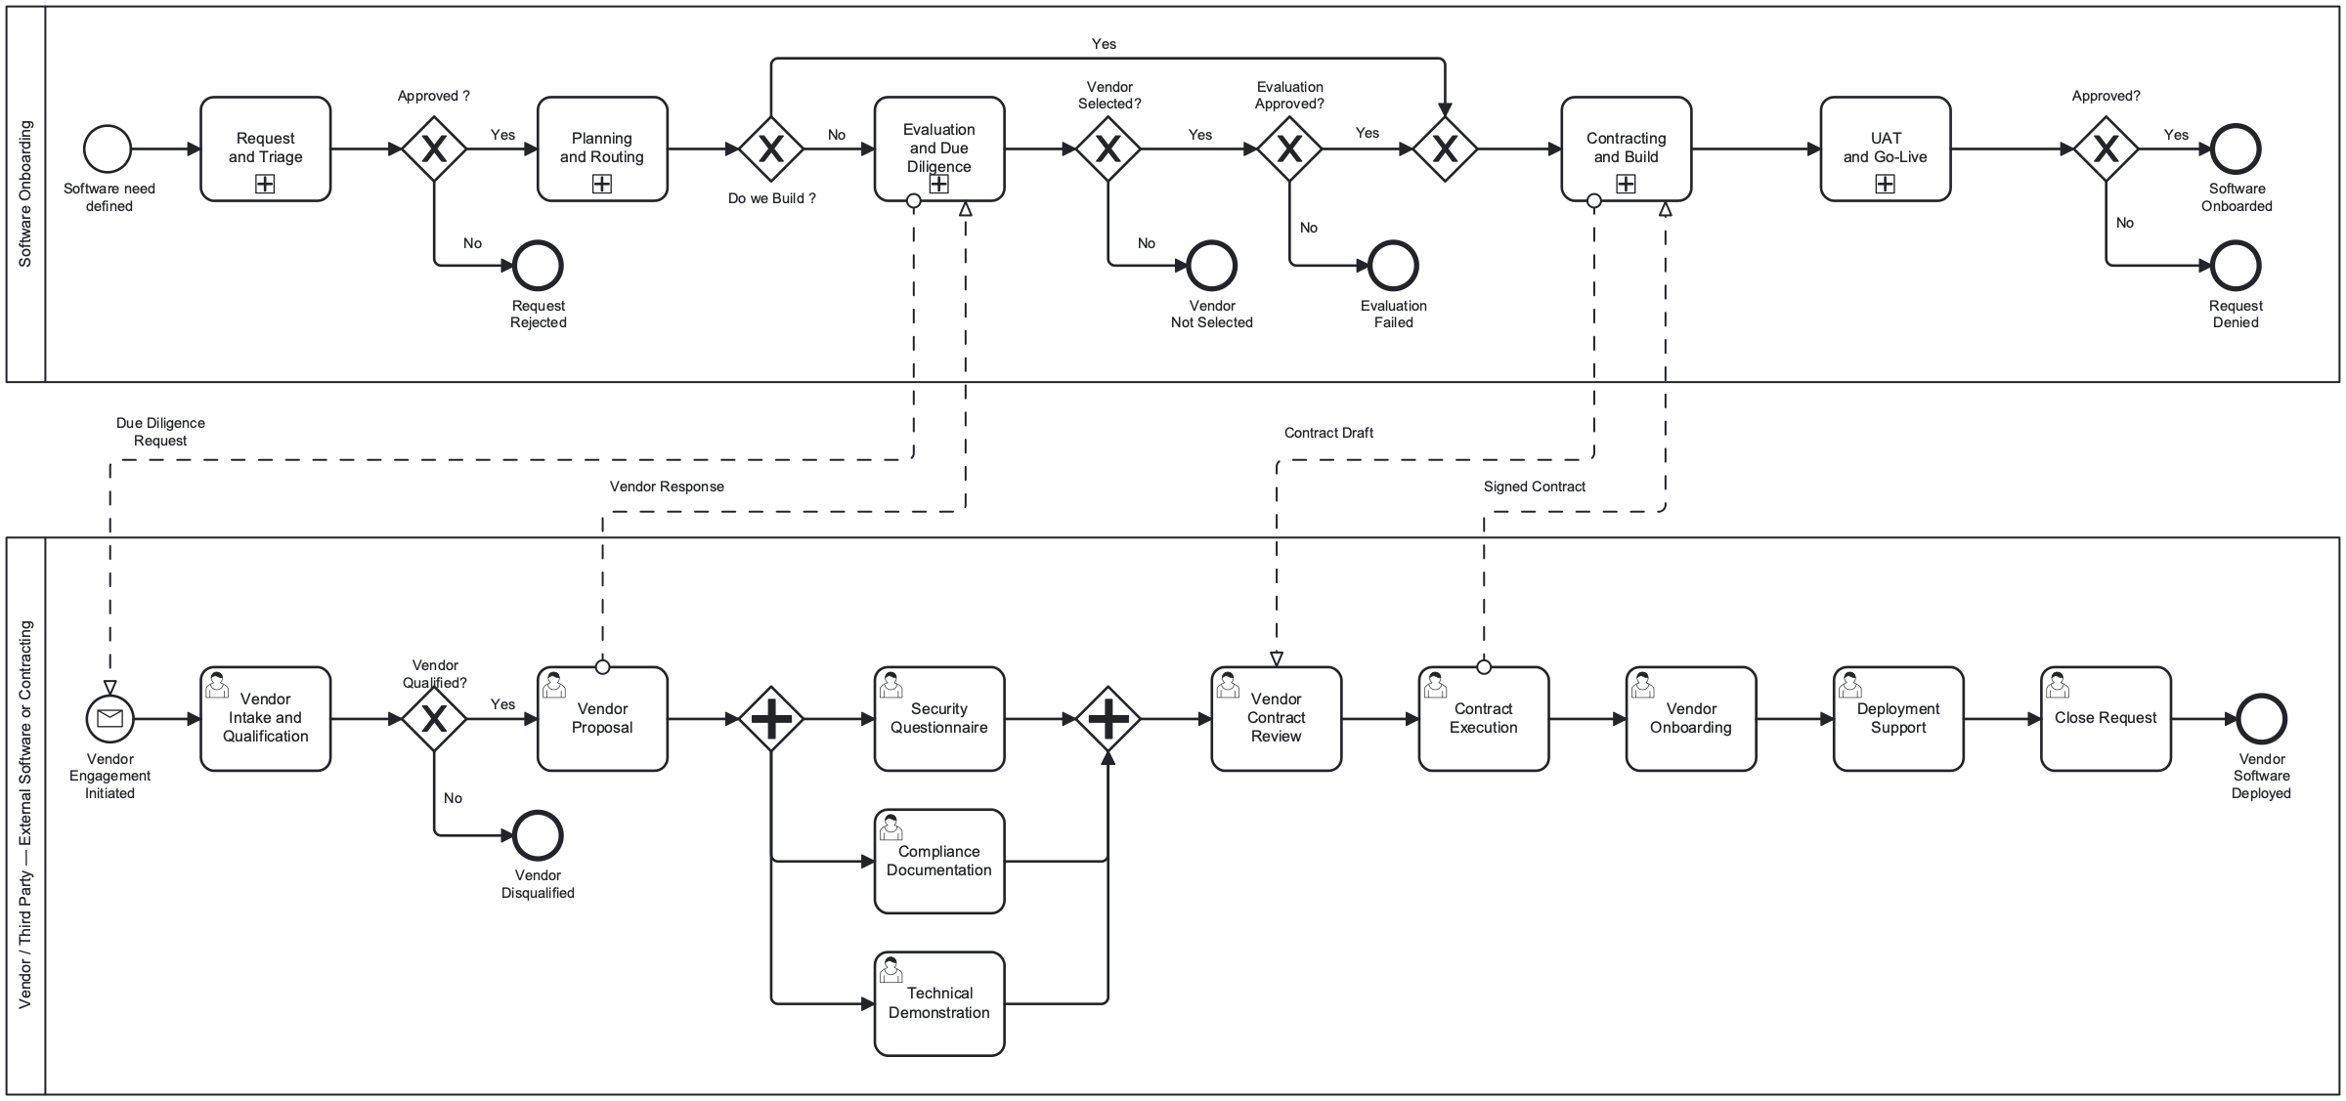
BPMN: End-to-End Orchestrator with Pain Points
Hierarchical 5-phase model: Request and Triage, Planning and Routing, Evaluation and DD, Contracting and Build, UAT and Go-Live. 3 decision gateways, vendor pool with message flows.
KPMG Confidential
March 2026

Slide 48
End-to-End Onboarding Process Flow
5-phase hierarchical BPMN 2.0 model with DMN-driven gateways, parallel evaluation, and SLA timers
SP1: Request and Triage
SP2: Planning and Routing
SP3: Evaluation and DD
SP4: Contracting and Build
SP5: UAT and Go-Live
Review, Gather, Submit, Triage
▶
Prelim Analysis, Backlog, DMN-1, DMN-2
▶
5 Parallel: Tech, Security, Risk, Finance, Vendor
▶
Buy: Negotiate, PoC Build: Reqs, PDLC
▶
UAT, Approval, Onboard, Notify, Close
SLA: 2 Days
SLA: 3 Days
SLA: 5 Days
SLA: 7 Days
SLA: 3 Days
4 DMN Tables
3 Decision Gateways
5 Parallel Streams
SLA Timers
Risk Tier, Pathway, Governance, SLA Breach
Build vs Buy?, Eval Approved?, Risk Acceptable?
Tech Arch, Security, Risk, Financial, Vendor
Non-interrupting boundary timers with DMN-4 escalation
Decision Model Notation (DMN) Integration: • OB-DMN-1 (Risk Tier): 5 inputs (Data Sensitivity, Regulatory Exposure, Operational Criticality, AI Complexity, 3rd-Party Dependency) → 4 tiers (Unacceptable, High, Limited, Minimal) • OB-DMN-2 (Pathway): 6 inputs including Existing Vendor Relationship → Fast-Track, Standard-Buy, Standard-Build, or Hybrid • OB-DMN-3 (Governance): Risk Tier + Pathway → Advisory Board (7d), Committee (5d), Fast Path (2d), or Auto-Approve (1d) • OB-DMN-4 (SLA Breach): Breached Phase + Days Beyond + Risk Tier → 4-level escalation ladder
KPMG Confidential
March 2026

Slide 49
RACI Matrix by Governance Topic
Topic | Business | Governance | Finance | Procurement | Contracting | Technical | AI Review | Compliance | Oversight | Automation | Vendor
Intake | R/A | C | C | - | - | - | - | C | - | - | -
Prioritization | C | R/A | C | - | - | C | - | - | - | - | -
Funding | - | C | R/A | C | - | - | - | - | I | - | -
Sourcing | - | A | - | R | - | C | - | C | I | - | R
Cyber | - | C | - | - | - | R/A | - | C | - | - | C
EA | - | C | - | - | - | R/A | - | - | - | - | C
Compliance | - | C | - | - | - | - | - | R/A | C | - | C
AI Governance | - | I | - | - | - | C | R/A | C | - | - | -
Privacy | C | C | - | - | - | - | - | R/A | - | - | -
Comm. Counsel | - | C | C | - | R/A | - | - | C | I | - | R
TPRM | - | R/A | - | C | C | C | - | C | C | C | C
R = Responsible | A = Accountable | C = Consulted | I = Informed | Finance = new functional area (split from Governance)
KPMG Confidential
March 2026

Slide 50
OB-DMN-1: Risk Tier Classification
UNIQUE | Phase 2
5 risk dimensions (1-10 scale each) determine risk tier. Unacceptable tiers terminate onboarding.
Data Sensitivity | Regulatory Exposure | Operational Crit. | AI Complexity | 3P Dependency | Risk Tier | Eligible?
≥ 9 | ≥ 9 | - | - | - | Unacceptable | No
≥ 9 | - | ≥ 9 | - | - | Unacceptable | No
- | ≥ 9 | ≥ 9 | - | - | Unacceptable | No
≥ 9 | - | - | ≥ 8 | - | Unacceptable | No
- | - | - | ≥ 9 | ≥ 9 | Unacceptable | No
≥ 7 | ≥ 7 | - | - | - | High | No
≥ 7 | - | ≥ 7 | - | - | High | No
- | ≥ 7 | - | ≥ 6 | - | High | No
- | - | ≥ 7 | - | ≥ 7 | High | No
[4..7) | [4..7) | - | - | - | Limited | Yes
[4..7) | - | [4..7) | - | - | Limited | Yes
- | [4..7) | [4..7) | - | - | Limited | Yes
- | - | [4..7) | [3..6) | [4..7) | Limited | Yes
< 4 | < 4 | < 4 | < 3 | - | Minimal | Yes
< 4 | < 4 | < 4 | - | < 4 | Minimal | Yes
KPMG Confidential
March 2026

Slide 51
OB-DMN-2: Pathway Routing | OB-DMN-3: Governance Routing
OB-DMN-2: Pathway Routing (UNIQUE, Phase 1)
OB-DMN-3: Governance Routing (UNIQUE, Phase 4)
Reuse | Build/Buy | Capacity | Strategic | TtV | Vendor? | Pathway
≥ 8 | Buy | - | - | ≥ 7 | true | Fast-Track
≥ 7 | Buy | - | ≥ 7 | ≥ 7 | true | Fast-Track
- | Buy | - | - | - | - | Standard-Buy
- | Build | ≥ 6 | - | - | - | Standard-Build
- | Hybrid | - | - | - | - | Hybrid
- | Build | < 6 | - | - | - | Hybrid
Risk Tier | Pathway | Review Body | SLA
Unacceptable | - | Rejected | -
High | - | Advisory Board | 7 days
Limited | Standard-* | Committee | 5 days
Limited | Fast-Track | Fast Path | 2 days
Minimal | Fast-Track | Auto-Approve | 1 day
Minimal | Standard-* | Fast Path | 2 days
OB-DMN-4: SLA Breach Escalation Routing (FIRST, Cross-Cutting) 4-level escalation ladder triggered by SLA timer boundary events: Level 1: Monitor — Dashboard alert to Process Owner (2+ days beyond SLA) Level 2: Notify-Sponsor — Email to Business Sponsor (3-5 days beyond) Level 3: Escalate-Governance — Priority reassignment by Governance Lead (5-10 days beyond) Level 4: Board-Alert / Auto-Reject — Advisory Board escalation or process termination (10-15 days beyond, High risk) Inputs: Breached Phase, Days Beyond SLA, Risk Tier Outputs: Escalation Action, Notification Target, Auto-Action
KPMG Confidential
March 2026

Slide 52
Governance Topic Coverage Across Onboarding Phases
Topic | SP1: Request & Triage | SP2: Planning & Routing | SP3: Eval & DD | SP4: Contract & Build | SP5: UAT & Go-Live | Vendor Pool
Intake | ✓ |  |  |  | ✓
Prioritization |  | ✓
Funding | ✓ | ✓ | ✓ | ✓
Sourcing |  |  | ✓ | ✓ |  | ✓
Cyber |  |  | ✓ | ✓ | ✓ | ✓
EA |  |  | ✓ | ✓ | ✓ | ✓
Compliance | ✓ |  | ✓ | ✓ | ✓ | ✓
AI Governance |  | ✓ | ✓
Privacy | ✓ | ✓ | ✓
Comm. Counsel |  |  |  | ✓ |  | ✓
TPRM | ✓ |  | ✓ | ✓ | ✓ | ✓
■ Primary (2+ tasks) ■ Secondary (1 task) □ No coverage
KPMG Confidential
March 2026

Slide 53
Onboarding Bottleneck Analysis: Before vs. After
■ Current State ■ Future State
Vendor Evidence Collection
15d
3d
Committee Scheduling
20d
5d
Contract Review / Redlining
18d
5d
Security Assessment Queue
12d
4d
AI Governance Backlog
10d
3d
75 Days → 20 Days
18 → 4 Committees
335 Assessments/Year
60+ AI Queue → 0
Total E2E cycle reduction
Consolidated governance
Automated intake pipeline
Dedicated AI governance lane
KPMG Confidential
March 2026

