Slide 1
User Task Inventory
Software Onboarding Process v17
51 user tasks across 8 phases

Slide 2
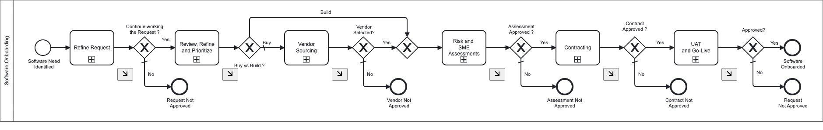
End-to-End Process Overview

Slide 3
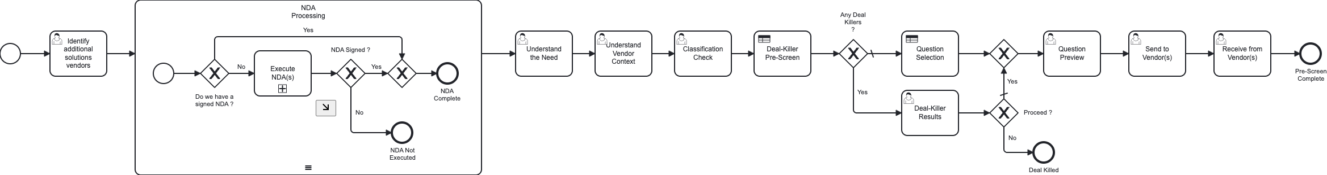
Process Model: SP0: Mini RFP Pre-Screening

Slide 4
SP0: Mini RFP Pre-Screening
Nested within SP1 — Self-service vendor pre-screening before formal intake
Process Step | Responsible Party | Description
Understand the Need | Quarterback | Requester describes business problem, urgency, and what capability they need. Collects problem statement, desired outcomes, and timeline.
Understand Vendor Context | Quarterback | Requester provides vendor/solution context — whether they have a vendor in mind, market awareness, and selection criteria.
Classification Check | Governance | Governance validates the auto-classification from intake data. Reviews risk tier, solution category, and confirms or overrides the system recommendation.
Deal-Killer Results | Quarterback | Displays OB-DMN-7 deal-killer pre-screen results (green/red flags). Requester reviews disqualifying criteria and decides whether to proceed or abandon.
Question Preview | Quarterback | Previews the dynamically selected RFP questions (from OB-DMN-8) before sending to vendor. Requester can review and confirm the question set.
Send to Vendor(s) | Quarterback | Requester confirms vendor contact details and triggers RFP transmission. Captures delivery method and vendor acknowledgment.
Identify Additional Solutions Vendors | Quarterback | When deal-killer flags are raised, requester identifies alternative vendors or solutions to consider instead.
7 tasks

Slide 5
Process Model: SP0: Vendor Response

Slide 6
SP0: Vendor Response
Vendor Pool — External vendor engagement tasks
Process Step | Responsible Party | Description
Receive from Vendor(s) | Vendor (External) | Vendor submits their RFP response, pricing, and supporting documentation.
Initial Evaluation of Redlines | Contracting | Legal/Contracting performs initial review of vendor contract redlines and terms that deviate from standard.
Flagged for Early Legal Review | Legal (Unassigned) | Escalation task when vendor response contains significant legal concerns requiring early counsel review.
3 tasks

Slide 7
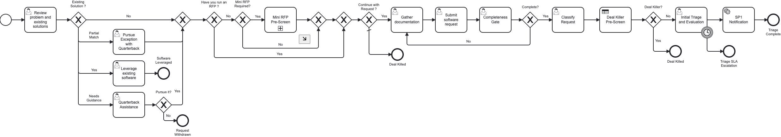
Process Model: SP1: Request & Triage

Slide 8
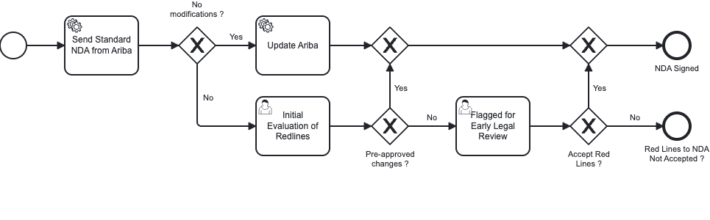
Process Model: SP1: Request & Triage

Slide 9
SP1: Request & Triage
Phase 1 — Intake, screening, and initial routing
Process Step | Responsible Party | Description
Review Problem and Existing Solutions | Quarterback | Requester reviews whether existing enterprise software already addresses the need. System shows current solution inventory; requester assesses fit (FullMatch/Partial/NeedsGuidance/NoMatch).
Quarterback Assistance | Quarterback | Facilitator provides coaching when requester is unsure about existing solutions. Advisory guidance to help navigate the portfolio — followed by a “Pursue it?” decision gateway.
Pursue Exception with Quarterback | Quarterback | When a partial match exists, the Quarterback helps the requester build a case for why a new solution is still needed despite existing options.
Leverage Existing Software | Quarterback | Requester documents decision to use an existing solution. Captures which solution, implementation plan, and expected timeline. Process ends here (“Software Leveraged”).
Gather Documentation | Quarterback | Requester assembles supporting documents — business case, requirements, vendor materials, budget justification, data classification details.
Submit Software Request | Quarterback | Formal submission of the software request. Collects business problem, urgency level, pathway preference, business criticality, estimated budget, data types involved, AI involvement flag, and submitter certification.
Initial Triage and Evaluation | Quarterback | Quarterback/Facilitator evaluates the request. Assesses strategic alignment, checks for duplicates, reviews concentration risk, resource availability, and preliminary risk indicators. Produces triage decision and priority assignment.
Classify Request | Governance | Governance classifies the request type (Defined Need / Forced Update / Speculative) with rationale. Determines which downstream pathway and evaluation depth is required.
Completeness Gate | Automation | Automated quality gate verifying all required intake fields are populated and documentation is sufficient before advancing to planning.
9 tasks

Slide 10
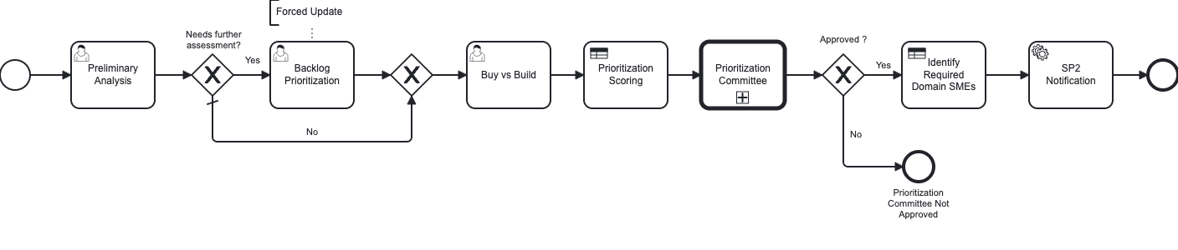
Process Model: SP2: Planning & Risk Scoping

Slide 11
SP2: Planning & Risk Scoping
Phase 2 — Business case, risk appetite, and pathway routing
Process Step | Responsible Party | Description
Preliminary Analysis | Governance | Business case and privacy screening. Collects market research summary, strategic alignment assessment, risk appetite alignment (Within/Borderline/Exceeds), preliminary cost/ROI estimates, budget source, DPIA requirement, capacity impact score, and whether full evaluation is needed.
Backlog Prioritization | Governance | Reviews request against the governance backlog. Assesses capacity, competing priorities, and assigns queue position. Determines if the request can proceed immediately or must wait.
Buy vs Build | Governance Team | Decision-support task where the governance team reviews pathway routing results and confirms whether the request follows a Buy, Build, or Hybrid pathway.
3 tasks

Slide 12
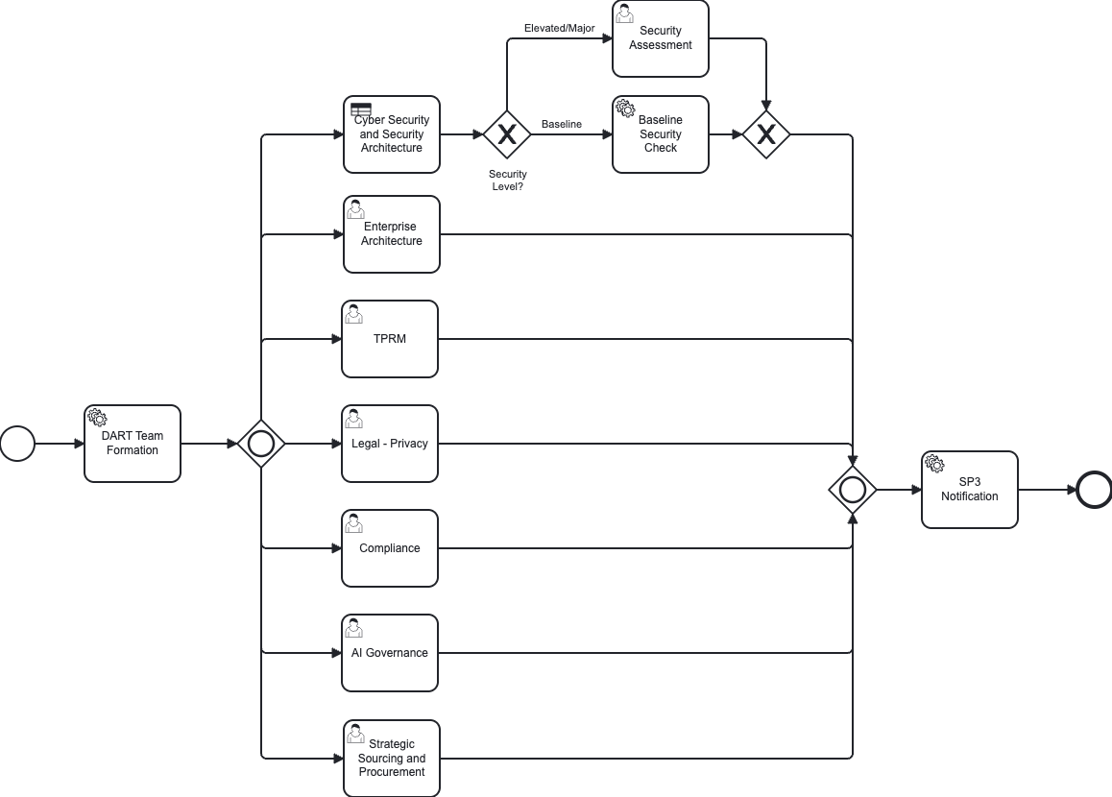
Process Model: SP3: Evaluation & Due Diligence

Slide 13
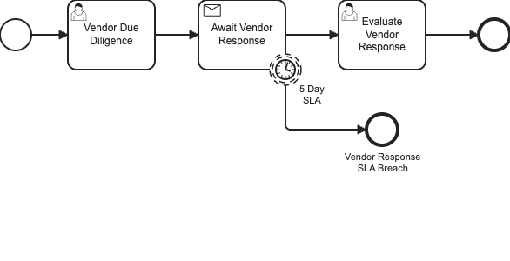
Process Model: SP3: Evaluation & Due Diligence

Slide 14
SP3: Evaluation & Due Diligence
Phase 3 — Parallel swarm evaluation across 9 domains
Process Step | Responsible Party | Description
Enterprise Architecture | Technical Assessment | [Parallel] Reviews technology stack compatibility, integration architecture, scalability, data flow patterns, and alignment with enterprise reference architecture. Runs concurrently with Security, AI Governance, TPRM, Compliance, Privacy, and Strategic Sourcing assessments.
Security Assessment | Technical Assessment | [Parallel] Cybersecurity posture evaluation. Collects security tier (1-6), encryption status, key management, MFA, privileged access, pen test dates, MTTP metrics, incident response plan, SOC 2/ISO 27001/PCI/FedRAMP certifications. Produces security risk rating and approval. Runs concurrently with other SME assessments.
AI Governance | AI Review | [Parallel] AI model risk classification review. Evaluates AI involvement, bias/fairness controls, model transparency, explainability, and alignment with SR 11-7 and EU AI Act requirements. Runs concurrently with other SME assessments.
TPRM | Governance | [Parallel] Third-Party Risk Management assessment. Identifies risks, scores probability/impact, defines mitigation strategies, and produces overall vendor risk rating. Runs concurrently with other SME assessments.
Compliance | Compliance | [Parallel] Maps applicable regulations to the solution. Reviews regulatory gaps, compliance status, and determines remediation requirements. Runs concurrently with other SME assessments.
Legal - Privacy | Compliance | [Parallel] Data Protection Impact Assessment (DPIA) and privacy review. Evaluates data handling, consent mechanisms, cross-border transfers, and retention policies. Runs concurrently with other SME assessments.
Strategic Sourcing and Procurement | AI Review | [Parallel] Market analysis and vendor competitive landscape assessment. Reviews vendor options, market maturity, switching costs, and procurement strategy. Runs concurrently with other SME assessments.
Vendor Due Diligence | Contracting | Comprehensive vendor assessment — financial health, references, customer satisfaction, operational resilience, sub-contractor dependencies, and contractual track record. Runs sequentially after parallel assessments complete.
Evaluate Vendor Response | Contracting | Scores and analyzes vendor RFP/proposal response. Gap analysis against requirements, pricing evaluation, and comparative vendor ranking. Runs sequentially after parallel assessments complete.
9 tasks

Slide 15
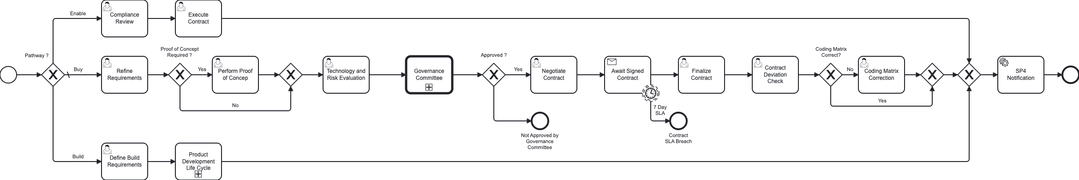
Process Model: SP4: Governance Review & Contracting — Buy Pathway

Slide 16
SP4: Governance Review & Contracting — Buy Pathway
Phase 4 (Buy) — Requirements refinement, POC, negotiation, and contract execution
Process Step | Responsible Party | Description
Refine Requirements | Quarterback | Detailed requirements refinement based on due diligence findings. Updates acceptance criteria, integration requirements, and performance expectations.
Perform Proof of Concept | Technical Assessment | POC execution and evaluation. Documents scope, test scenarios, results, and produces a go/no-go recommendation for full procurement.
Technology and Risk Evaluation | Technical Assessment | Technical risk assessment — evaluates tech debt, scalability risks, complexity, vendor lock-in, and architectural fitness.
Negotiate Contract | Contracting | Contract negotiation. Captures contract type (MSA/SOW/SaaS/License), term, total value, payment terms, SLA commitments, audit rights, data protection clauses, termination rights, liability caps, and regulatory provisions.
Finalize Contract | Contracting | Final contract review and signature preparation. Legal sign-off on all terms, execution readiness confirmation.
Execute Contract | Contracting | Formal contract execution — captures signatures, effective dates, and archives executed agreement.
Contract Deviation Check | Contracting | Documents and reviews any deviations from standard contract terms or organizational policy. Requires risk acceptance documentation.
Compliance Review | Compliance | Validates that governance controls and monitoring requirements are defined and implementable for the procured solution.
Coding Matrix Correction | Quarterback | Corrects financial coding and categorization for the procurement (GL codes, cost centers, asset classification).
9 tasks

Slide 17
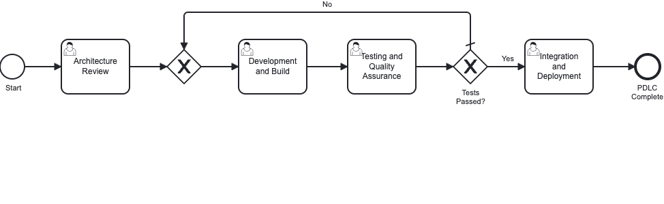
Process Model: SP4: Build Pathway & PDLC

Slide 18
SP4: Build Pathway & PDLC
Phase 4 (Build) — Custom development lifecycle
Process Step | Responsible Party | Description
Define Build Requirements | Quarterback | Defines build-specific requirements — architecture decisions, technology stack, timeline, resource needs, and security requirements for custom development.
Architecture Review | Technical Assessment | Design review of proposed architecture. Evaluates patterns, security posture, performance characteristics, and alignment with enterprise standards.
Development and Build | Technical Assessment | Tracks development progress. Collects sprint number, features completed, code review status, static analysis results, unit test coverage, SAST/secrets/dependency scan status.
Testing and Quality Assurance | Technical Assessment | QA gate — test coverage, defect tracking, regression testing, and quality metric thresholds.
Integration and Deployment | Technical Assessment | System integration testing, API validation, end-to-end testing, and deployment readiness assessment.
5 tasks

Slide 19
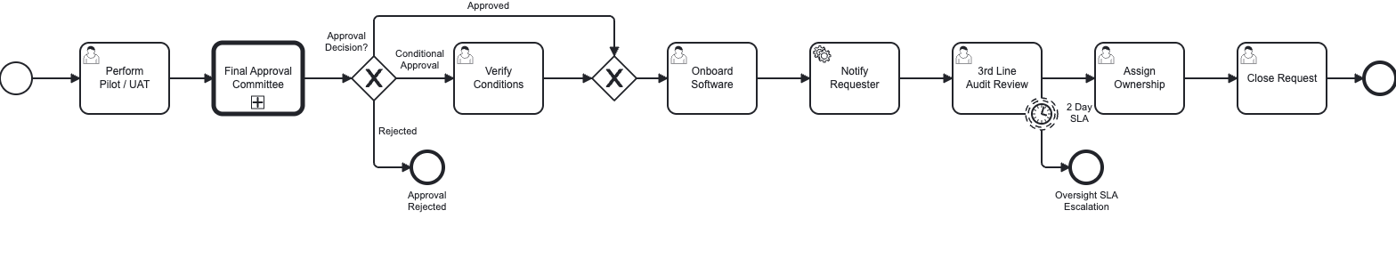
Process Model: SP5: UAT & Go-Live

Slide 20
SP5: UAT & Go-Live
Phase 5 — Acceptance testing, audit, onboarding, and closure
Process Step | Responsible Party | Description
Verify Conditions | Governance | Reviews and verifies that all governance conditions from prior approvals (conditional approvals, remediation items) have been satisfactorily addressed.
Perform Pilot / UAT | Quarterback | User acceptance testing execution. Collects test scenario counts (total/passed/failed), critical defects, pilot user count, pilot duration, user satisfaction score, training completion rate, and UAT sign-off from business owner.
3rd Line Audit Review | Oversight | Independent audit review by Internal Audit (3rd Line of Defense). Validates that governance controls are operating effectively and regulatory requirements are met. Approval gate.
Onboard Software | Automation | Technical onboarding — installation, configuration, data migration, access provisioning, and production readiness verification.
Assign Ownership | Governance | Assigns long-term operational ownership — names the operational owner, support team, escalation contacts, and ongoing monitoring responsibilities.
Close Request | Governance | Formal closure of the governance request. Captures lessons learned, archives documentation, and triggers operational handoff.
6 tasks

