Slide 1

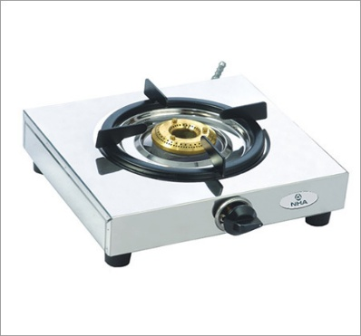
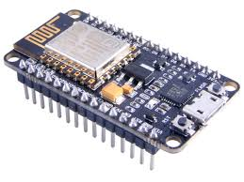


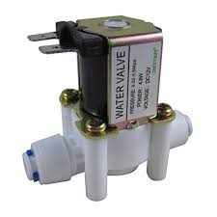

Welcome to the Presentation
WiFi
NodeMcu
Gas Stove
Solenoid Valve
Android App
Gas Wastage Protection
Temperature Sensor

Slide 2



Presented By
Morshed Khan
MD. Robiul Alam
February 13, 2018
MD. Jobaer
IoT Army of 300

Slide 3
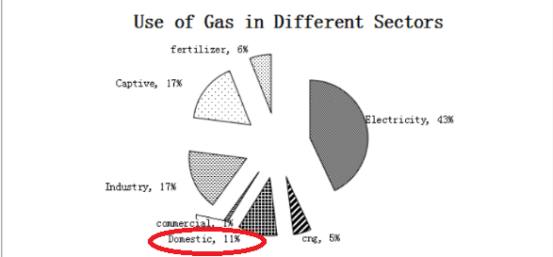
Motivations
About 20-25% of domestic gas are being wastage

Slide 4
Existing problems
Manual turn off.
Drying cloth on gas burner/stove.
Turn on long time without cooking time.
Gas burner use as heater.

Slide 5
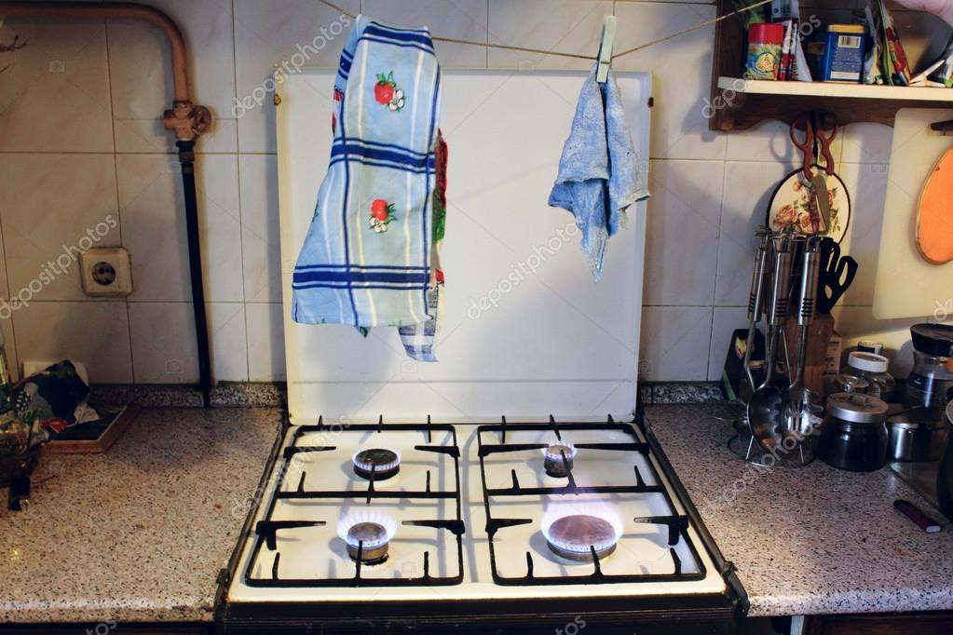
Drying Cloths

Slide 6
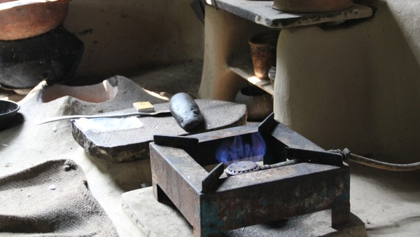
Remains ON for long time without using

Slide 7
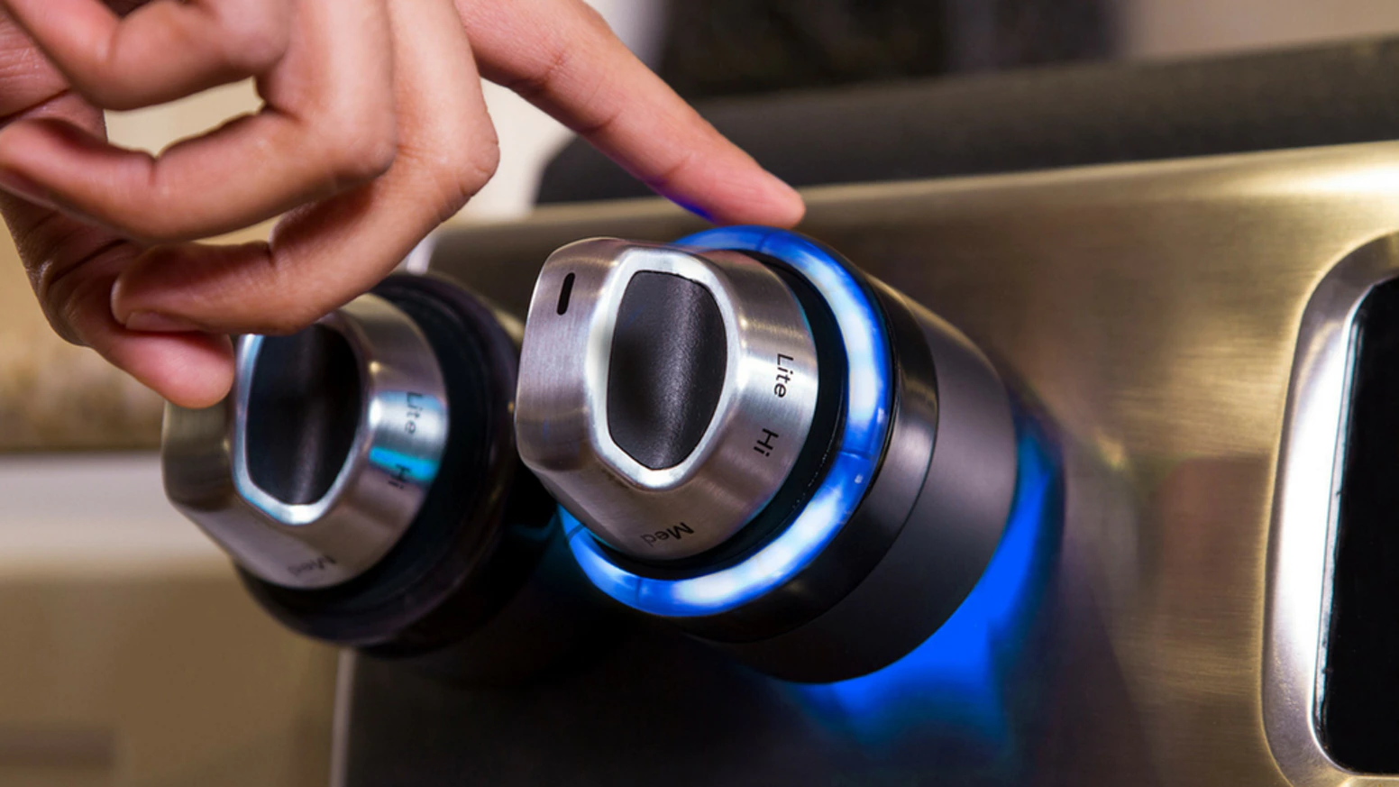
Existing Technologies INIRV Cost: $100-$200
Source : https://www.kickstarter.com/projects/157070440/inirv-react-make-your-home-smarter-and-safer?ref=profile_starred

Slide 8
Perceived Challenges
Making our old system smart
Object detection on the stove
Turning off the stove depending on object’s presence on stove
Making the stove Remotely controllable

Slide 9
features
Automatic turning off gas stove while there is no object on the stove
Control through mobile app
Remotely controllable if user forget to turn off and don’t remove the object from the stove
Set timer
Monitoring kitchen temperature

Slide 10
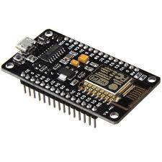
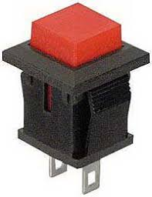

Hardware
NodeMcu
Solenoid Valve
Transistor switch
Temperature Sensor

Slide 11





Development Platform

Slide 12
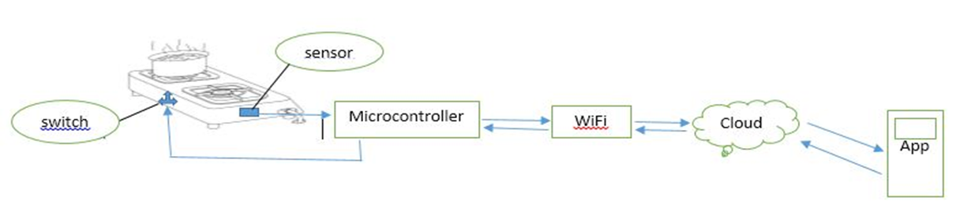
Technical Architecture

Slide 13
Block Diagram
UDP (Wi-Fi)
Sensor
Serial
MCU
Server
MongoDB
Serial
WiFi
Solenoid Valve
Mobile App
Python Flask
Data Analysis

Slide 14
Data flow diagram
Temperature Sensor
MCU
Server
Gas Use
Database

Slide 15
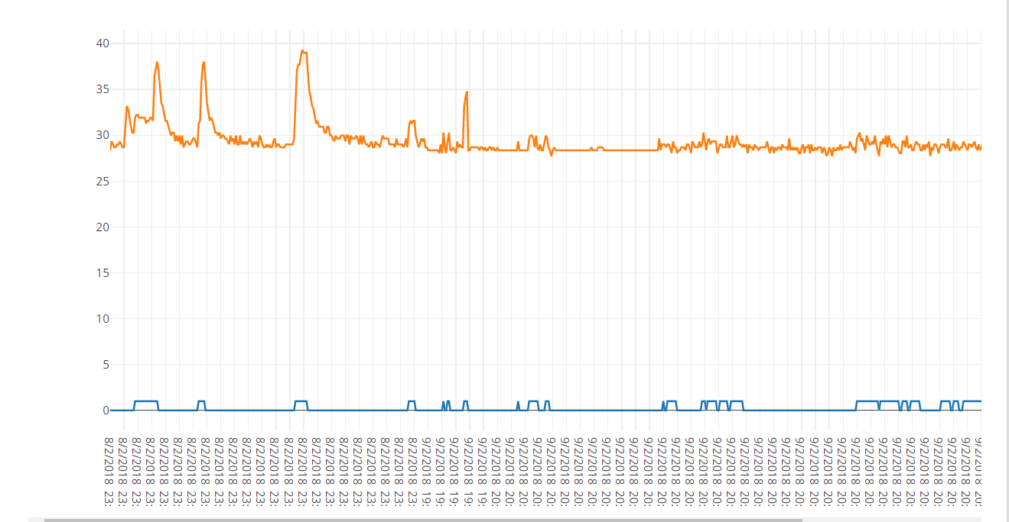
Data Analysis
Temperature
Use Status
Y label : Gas Status & Temperature
X label : Date & Time

Slide 16
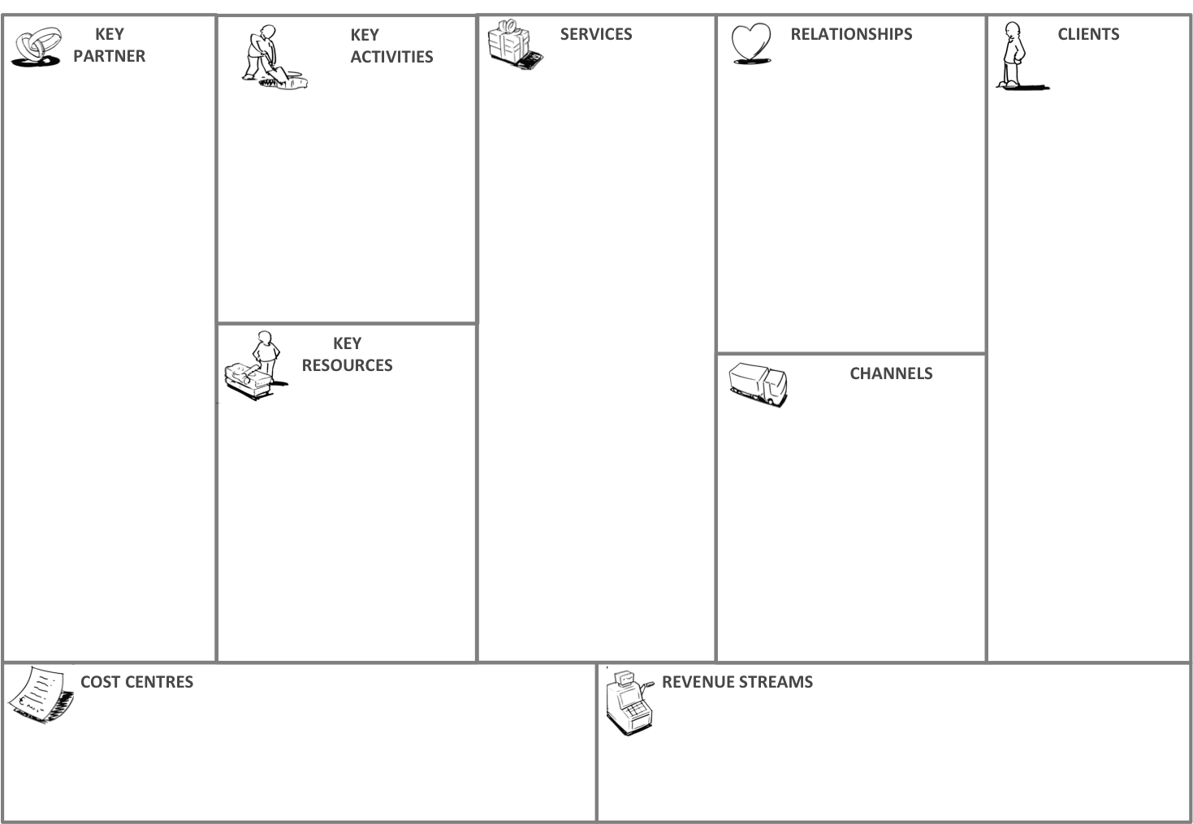
Business Model
Design
Mapping
Automatic turn off the gas stove
Govt./Gas suppliers And Households
Government
Installation
Automated, personalized
Remotely controllable over cloud
Households
Gas Companies
Equipments
Will optimize the use of gas
Cloud service
Mobile App
Wifi
Data
Equipments
installation
Government and private

Slide 17
Limitations
Making fire manually
Data lose in internet failure

Slide 18
Future Work
Automatic gas stove On & Firing
Kitchen security

Slide 19
Let’s enjoy the Demo

Slide 20
THANK
YOU
ALL

