Slide 1
FINAL PRESENTATION
The Difficulties of Scraping Dark-Web

Slide 2
INTRODUCTION
The purpose of our research was to find out the difficulties we face while scraping any data from Dark-Web. The unindexed portion of the Internet that is intentionally hidden and inaccessible by standard Web browsers is referred to as the Dark Web.The Dark Web is an encrypted network that utilizes the public Internet. Among the various overlay networks, such as Garlic Routing or Tunnel Routing, the most widely used one is Tor Routing, which was originally developed as part of a secure communication effort of the U.S. Naval Research Laboratory, to protect and anonymize trafﬁc by passing it through multiple layers of encrypted relays. The Dark Web is purposely hidden using a peer-to-peer (P2P) network and Dark Web
sites are primarily accessed using the Tor Browser, which is a user-friendly browser that protects the
anonymity of the user, and can be important for individuals seeking to overcome censorship, ensure
their privacy, or for criminals who seek to obfuscate their identity.

Slide 3
SYSTEM SET UP FOR DARK-WEB
According to the Tor Project’s Website, “Tor is free software and an open network that helps you defend
against trafﬁc analysis, a form of network surveillance that threatens personal freedom and privacy,
conﬁdential business activities and relationships, and state security”
Our experimentation began with the installation of the Tor browser, from torproject.org, on
a laptop. Prior to browsing Dark Web marketplaces we discovered the .onion URLs, for these
marketplaces, from Websites on the World Wide Web

Slide 4
SCRAPING THE DATA
A big part of our research was supposed to be the scraping of both the Surface and Dark Web, which later became the most frustrating part of our research as well. Many Web crawlers utilize the Python scripting language, often leveraging the command line cURL tool to open the target Web pages. As we knew the conventional methods of scraping was to use Python plugins. But as we soon found out, the use of python and cURL is a bit impractical. The Python http.client library module is what normally allows Python to be used for connecting to an http or https Website. This method works well on the regular World Wide Web but this library has no standard classes for handling Tor routing. The layered levels of encryption, and the selection/connection to intermediate Tor relays, are not available within Python. Lacking standard Tor libraries, within Python itself, the next option would be to use Python to leverage external http tools for the Tor access. For example, the “cURL” or “wget” tools are freely available command line utilities that can be used for http and https browsing.

Slide 5
Using a tool like cURL, it is possible to build a Tor wrapper around that command line tool, which would allow
cURL (or wget) to take advantage of the anonymization .However, even following the above process, which would allow
the use of cURL within a Tor wrapper, this process would still only provide (anonymized) access to the World Wide Web.
The Dark Web .onion sites, which are not resolvable via the standard Domain Naming System, would still be out of reach
Even if the .onion Domain Name System (DNS) lookup hurdle were overcome with somethinglike a “requests” library, the
marketplaces we investigated still presented the problem of CAPTCHA(Completely Automated Public Turing test to tell Computers and Humans Apart) authentication, which is basically an obscured phrase that can be deciphered by humans but (in theory) not by Automated bots. When using the Tor Browser natively, the browser provides the linkage between the CAPTCHA challenges and responses, and then leverages that authentication for the duration of the browser’s activity. By attempting to use the command line cURL utility, embedded in a Tor wrapper, the entire challenge/response process, and leveraging that authentication within an ongoing session, would need to be automated. The CAPTCHA system has been speciﬁcally designed to make this type of automation extremely difﬁcult.

Slide 6
SCRAPING THE DATA(contd.)
Scraping with Beautiful Soup:
Our frustrations began with trying to scrape the dark web with this method as this was ultimately a fruitless attempt. We began by trying to scrape it similarly we scraped Newegg. But we fell at the very first hurdle as the URL of the dark web sites were not supported with the URLOPEN method that we found was at the basis of most Beautiful Soup scrapings. As that wasn’t working, we tried out a few different methods like using python to set up TOR as a targeted browser. But we couldn’t get that to work either. This was the end of our efforts with Beautiful Soup and our first idea of how scraping the dark web was going to be like.

Slide 7
SCRAPING THE DATA(contd.)
Scraping with Scrapy:
This was the method that showed us that python was not the best for scraping the dark web. Python is best used to do work with http or https URLs. We could manipulate it a bit but it would still be fruitless. For example, the “URLOPEN” tool is a freely available command line utility that is widely used for http and https browsing. But we could use tool like cURL, to build a Tor wrapper around that command line tool, which can theoretically allow cURL to take advantage of the anonymization of Tor. However, even if we were successful in doing so, this process would still only provide (anonymized) access to the World Wide Web. The Dark Web .onion sites, which do not implement the standard Domain Naming System, would still be out of reach. With this devastating realization, we did not try further with scrapy as the main part was getting into the URL itself which we could not achieve in any capacity using python at all.

Slide 8
SCRAPING THE DATA(contd.)
Scraping with Selenium:
By changing Firefox configuration we were not able to scrape the dark web either. Typing about:config on the search bar and locating network.dns.blockDotOnion setting and changing its value to false, we were able to access dark web before from firefox with vpn turned on. Some .onion sites were blocked by firefox as users reported them as deceptive sites. So, we were not able to scrape any webpage via firefox. Then, we moved on to attempting to scrape dark webpage via chrome.The following message was shown below.

Slide 9
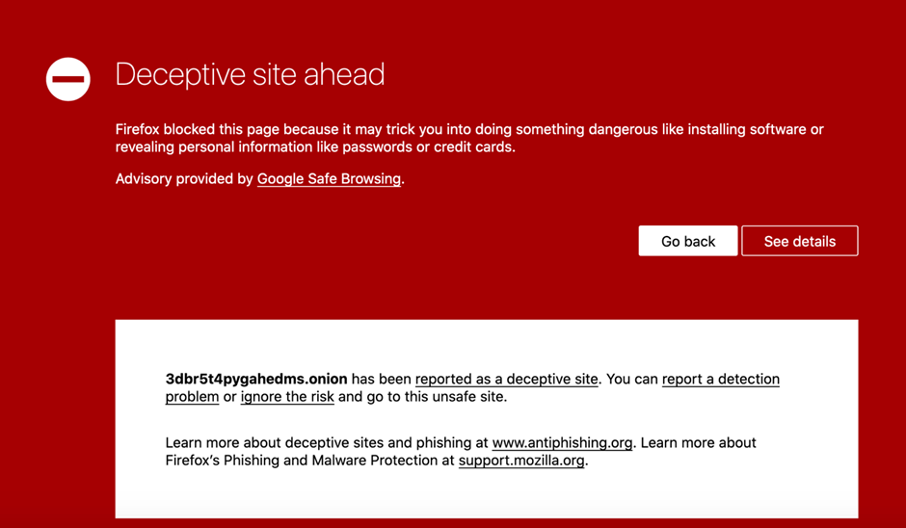
In case of other .onion sites, simply firefox couldn't connect to their server or retrieve their url. Firefox showed following messages.

Slide 10
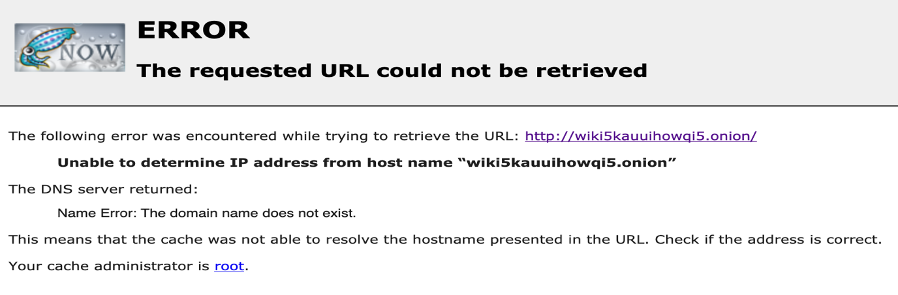
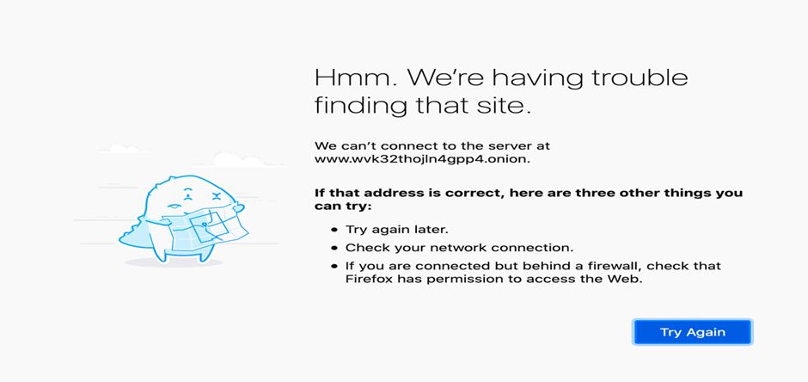
So, we were not able to scrape any webpage via firefox. Then, we moved on to attempting to scrape dark webpage via chrome.

Slide 11
Attempt to scrape using selenium webdriver:
We attempted to scrape dark webpage using selenium. We planned to access the dark web over tor network. Selenium webdriver can't work on tor browser so we used chrome web browser. To access tor network via chrome browser we used a chrome extension named Tor Control (Anonymity Layer). This extension allows to access tor network via other web browsers like chrome, firefox etc. To begin with, we installed a vpn software and selenium through mac terminal. On mac terminal, the command to install selenium was-
Then we installed the chrome extension from the following link-
https://chrome.google.com/webstore/detail/tor-control-anonymity-lay/kjoabfljeghcinlpjhdbdfbcflapkccm?hl=en-GB

Slide 12
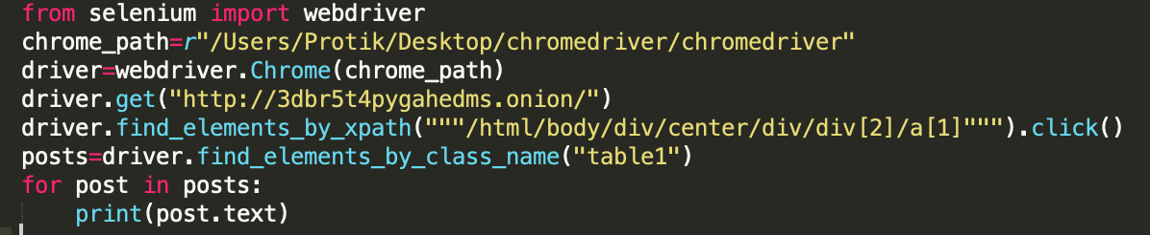
After that, we ran the VPN software, enabled the extension in the browser and tried running lines of python code to scrape data from a table of dark webpage. The following python code was executed-
We couldn't scrape the webpage because the .onion site couldn't be successfully reached. After running first 4 lines of code, browser opened a new window automatically and tried to load the dark webpage but after a while "This site can't be reached" message was shown in the chrome browser. We tried other sites but the responses were the same. From this we assumed that most probably the extension could not connect to the tor network properly. So the browser could not load .onion sites.

Slide 13
SCRAPING THE DATA(contd.)
Then we installed the chrome extension from the following link-
https://chrome.google.com/webstore/detail/tor-control-anonymity-lay/kjoabfljeghcinlpjhdbdfbcflapkccm?hl=en-GB
After that, we ran the vpn software, enabled the extension in the browser and tried running lines of python code to scrape data from a table of dark webpage.
We couldn't scrape the webpage because the .onion site couldn't be successfully reached. After running first 4 lines of code, browser opened a new window automatically and tried to load the dark webpage but after a while "This site can't be reached" message was shown in the chrome browser. We tried other sites but the responses were the same. From this we assumed that most probably the extension could not connect to the tor network properly. So the browser could not load .onion sites.

Slide 14
RESULTS
The surface web marketplaces have a lot of different designs which can be divided into many categories whilst the dark web marketplace mostly has the same layout.
A few of the surface web marketplaces have atrociously unorganized html files. On the other hand, the dark web marketplaces usually have quite a primitive layout which makes it quite organized.
Surface web marketplaces have confusing html files that makes it hard to scrape the html files themselves. But the dark web sites have encrypted domains that makes it hard to connect with the URL itself. Though it’s trivial html files make it seem very much possible to scrape it with any of the scraping tools.
The surface web marketplace (if not country based) has choices when it comes to currency. While the dark web only operates on crypto currency (bit coin).
For Surface Web, one can know and contact with the seller or buyer apart from internet but in dark web, the both party (Seller & buyer) remain undercover or anonymous.
The Surface Web’s sites stay for a long time but the dark web’s site frequently changes it addresses.

