Slide 1
MID PRESENTATION ON GROUP-3 RESEARCH
Group Members:
Md. Adban Akib Protik –1610523042
Sharara Sartaj –1620169042
S.M. Mahir Anowar –1621099042
Abu Emran Emon --1620435042

Slide 2
MID GOALS ACHIEVEMENT
From the beginning of the research our mid goal was to get into the deep web and accessing it. To achieve our goal we got into dark web marketplace. We saw trading of drugs, light arms and other illegal items. We got those dark web addresses from thehiddenwiki.org. We used free VPN software and TOR browser to access the deep web. We also accessed .onion sites from firefox browser which are by default not accessible. To enable accessing .onion top level domains, in the browser we typed about:config. There we located network.dns.blockDotOnion setting. We set the value of this setting to false. Thus firefox was able to access .onion domains with vpn turned on.

Slide 3
PROGRESS
The progress we have made according to our base mid goal was achieved as we have found multiple entry points of the deep web. We used free to use VPN software and the TOR browser to successfully browse the deep web. We also used Mozilla Firefox to enter with a smaller degree of success. But we found that to be a miniscule goal for the midpoint of our research in the end as the main task for us later became scraping the sites themselves. We hit a brick wall with python’s BeautifulSoup plugin. It was a confusing method of scraping and also opened our eyes to how disorganized a few major website’s html code is. We deemed it was a dead end anyway, as BeautifulSoup uses URLOPEN which doesn’t work with onion sites.

Slide 4
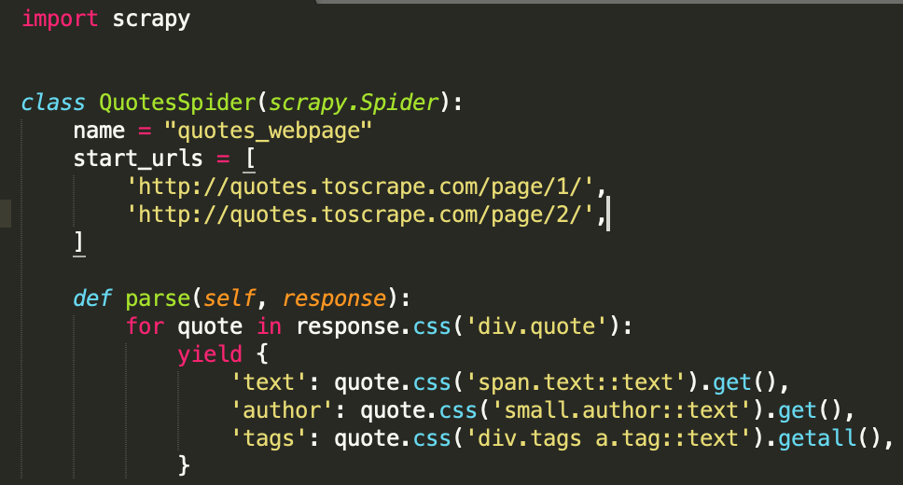
We turned our attention to the scrapy plugin and found minimal success as it was able to scrape a normal site. We couldn’t experiment with it too much further. Using scrapy we wrote a spider to crawl a site and extract data. The below code is of the spider's which is written in python. In the code we had attempted to extract data from two webpages of a site.

Slide 5
We used command line to start a scrapy project and to export scraped data as .csv file.
The below screenshot is from mac command line where we typed a command to start a scrapy project.
This below command is to export scraped data as .csv file.

Slide 6
FINAL GOAL
As we went deeper into the research on this subject, we found not many people were successful in scraping the deep web, let alone analyze the scraped data. This leads us to believe our initial final goals to be a bit challenging. But, we believe we can collect the data without scraping it. So, we are planning to collect all the data we need to put forth a decent enough comparison of the dark web markets and the surface web markets. But at the same time, we want to present a method of scraping the deep web that actually works. With onion sites being able to run via Mozilla Firefox, we are trying to scrape it using the Selenium IDE. We do not know what success we are going to achieve but if it fails, we are going to try our level best to find other solutions as well.

Slide 7
THANK YOU!!!

