Slide 1
CSE299 ReSEARCH ON WEB SCRAPING FROM DARK WEB
Group Members:
Md. Adban Akib Protik –1610523042
Sharara Sartaj –1620169042
S.M. Mahir Anowar –1621099042
Abu Emran Emon --1620435042

Slide 2
WEB SCRAPING
Web scraping is the process of large amount of data extraction from various websites. In the easiest way we scrap the data, clean the data and then use the data as per our need.
NECESSITY OF WEB SCRAPING
Marketing & Sales Intelligence companies use web scraping to fetch lead-related information.
Real Estate Tech companies use web scraping to fetch real estate listings
Price Comparison Portals use web scraping to fetch product and price information from e-commerce sites .

Slide 3
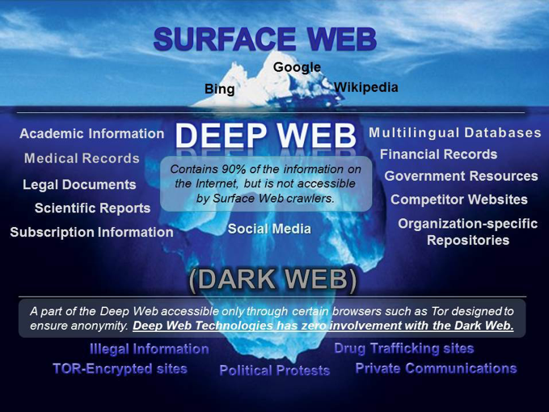
For our research we have decided to scrap the data from Dark-Web E-commerce sites. Basically we are going to research on how to access the data of Dark-Web. As we know Dark-Web is not indexed and been intentionally hidden and is inaccessible to normal web browsers. Once we can Scrap the data from Dark-Web; it will be very helpful to anybody to work with those huge amount of data. Later with those data we can create Models for different purposes like predicting price of products or anything.

Slide 4
Mid goals
We will try to get into a dark web's market where drugs, light arms and basic items are trading.
We have to know much about the websites they are using recently.
We will try multiple entry techniques and find the optimal ones.
We will familiarize ourselves with tor type browsers and IP bouncing.

Slide 5
Final Goals
If we get into the shady eCommerce sites, we will try and scrap the data.
We will try to scrap the data by using the best method we can find.
We will analyze the data and compare it to the data with normal eCommerce sites.
We will find similarities and differences between the sites, and complete our research.

Slide 6
THANK YOU !!

