Slide 1
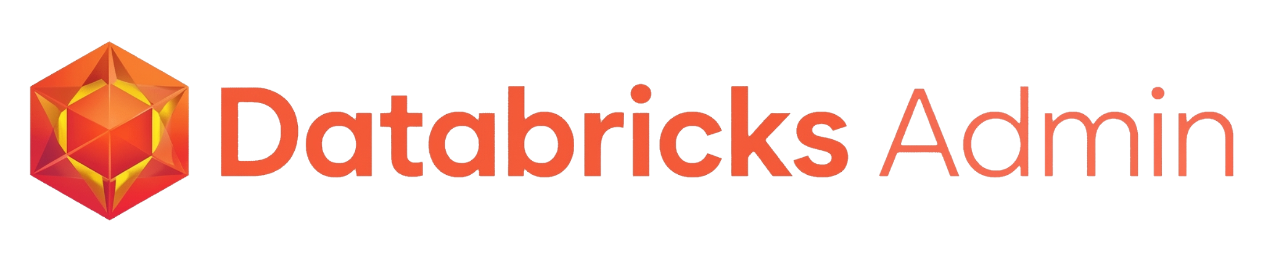

T1A Hackathon
2026-03-05
Maksim Pachkovskiy
Alexey Dmitriev

Slide 2



Overview
A single Streamlit dashboard deployed as a Databricks App that unifies cost monitoring, cluster management, and job auditing — accessible to everyone.
Databricks App
One-Click Actions
Built for Everyone
Not just a dashboard — runs inside Databricks with full API access for real-time data and actions.
Start/stop clusters, edit auto-termination, run/stop jobs — directly from the UI, no Databricks navigation.
Minimalistic UI that any business user, admin, or CEO can understand and act on immediately.

Slide 3

Why Databricks App
More diverse functionality
Abstraction Layer Over Changing UI
Do not be limited to the data stored in databricks tables. Use many tools such as Databricks API to create more comprehensive dashboards
Databricks UI changes frequently. Our app provides a stable, simplified interface that doesn't break when Databricks updates.
Act, not just monitor
Quick installation
Restart jobs, clusters or perform many other actions at the same time you see a problem.
Quick installation from Marketplace or GitHub

Slide 4
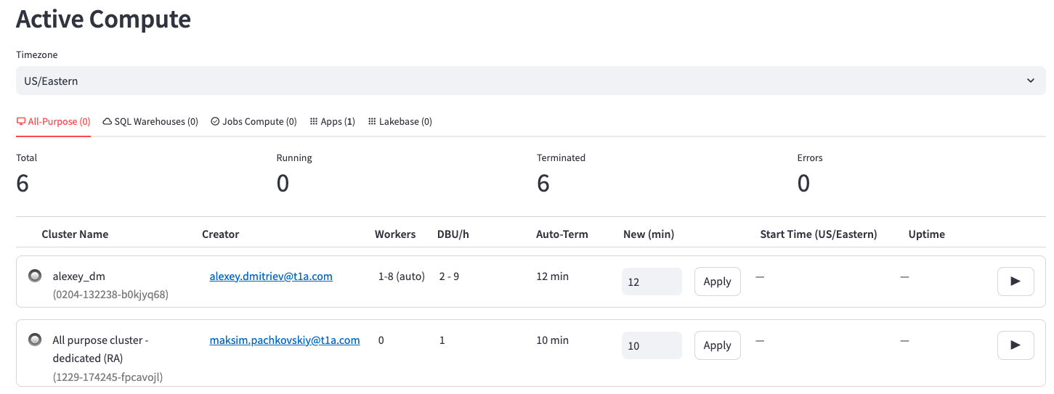

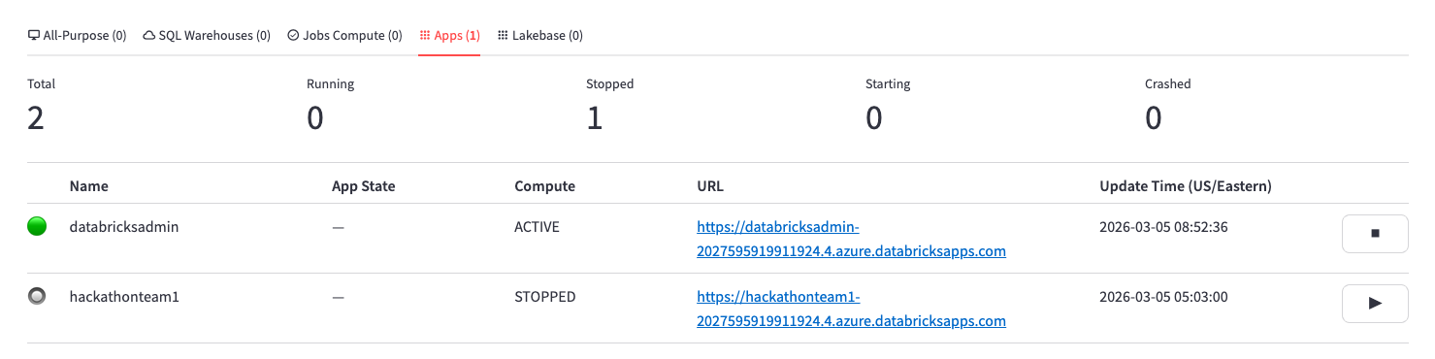
page1 - Active Compute
Make decisions quickly
Monitoring active computes online in one window
All-purpose Compute, SQL Warehouses
Check and edit auto-termination
Uptime and status monitoring
Start/stop inline
Jobs Compute, Apps, Lakebase
Fills real gaps in
Start/stop inline
No native auto-stop in Apps

Slide 5
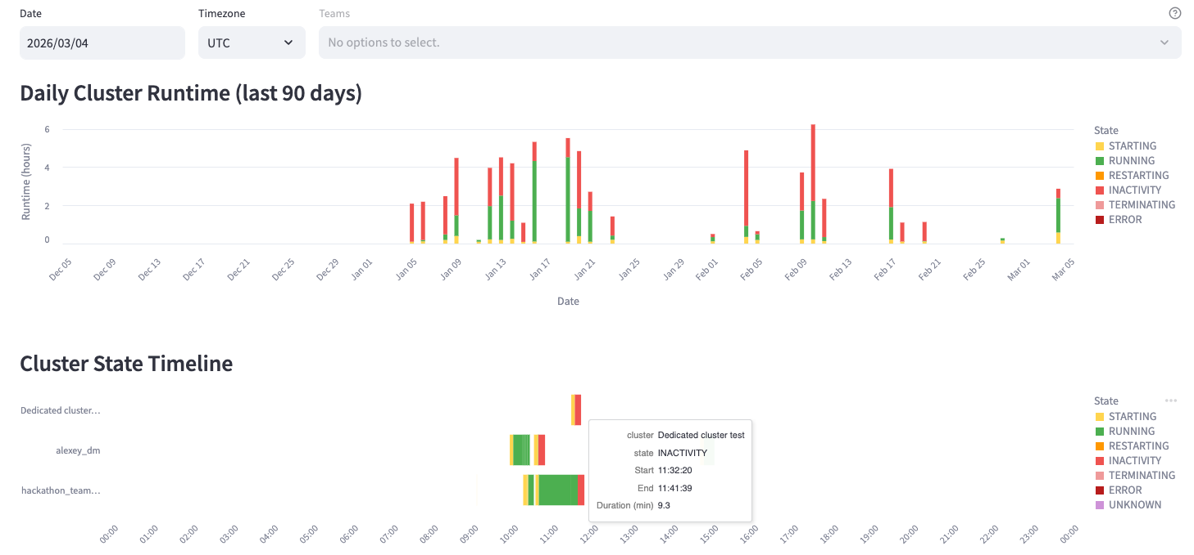
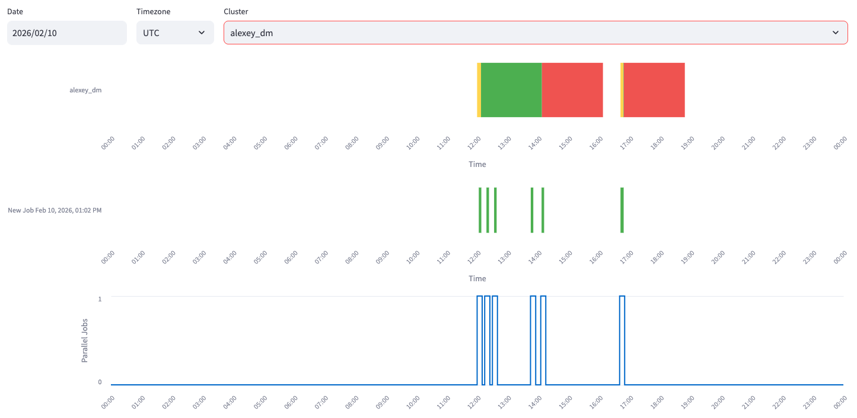

page2,3 - All-purpose Daily runs
Cluster state transitions for any day
Stacked bar chart of daily runtime — click any day to drill down
Detailed cluster analysis for the day
Plans:
Team-level filtering
Analysis of other user activity on the cluster
Notifications in Tims, Slack to the cluster owner

Slide 6
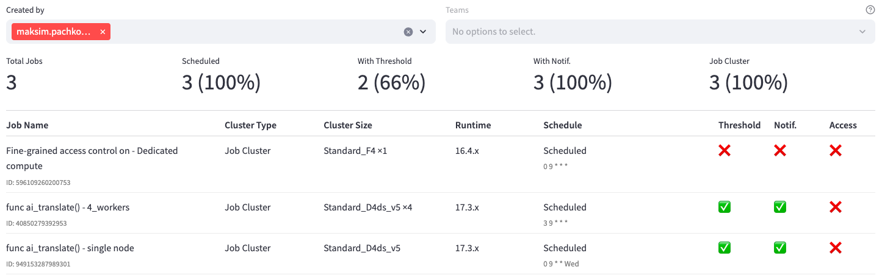
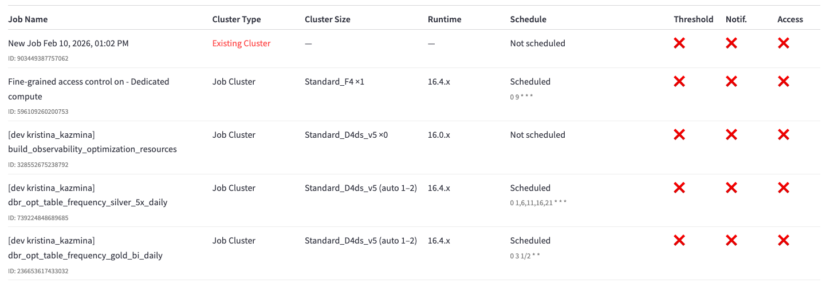
page4 - Jobs - Settings
Mass checking of all jobs at once:
Cluster type and size
Runtime version
Scheduled installation status
Threshold
Notifications
Access to the job
Plans:
Team-level filtering
Checking the path to the Notebook
Error notifications in Teams, Slack to the job owner

Slide 7
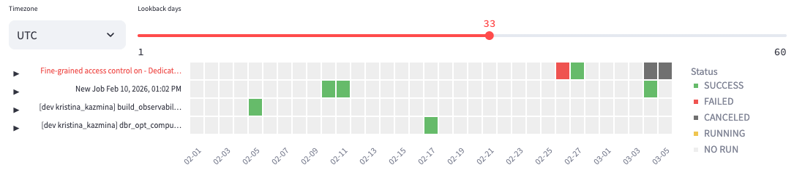
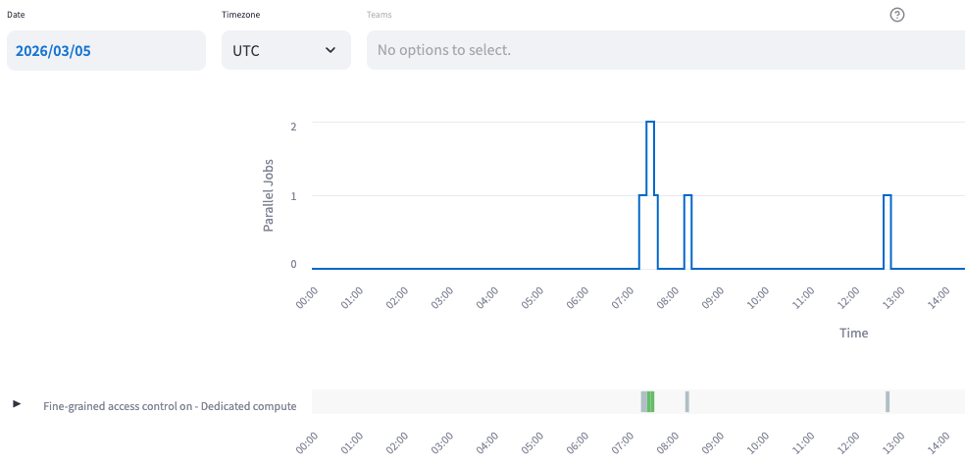
page5,6 - Jobs - Run history daily/hourly
Daily Monitoring Jobs
Run/stop many jobs in one window
Parallel Run Monitoring
Hourly monitoring
Easy to make decisions for time allocation
Plans:
Team-level filtering

Slide 8
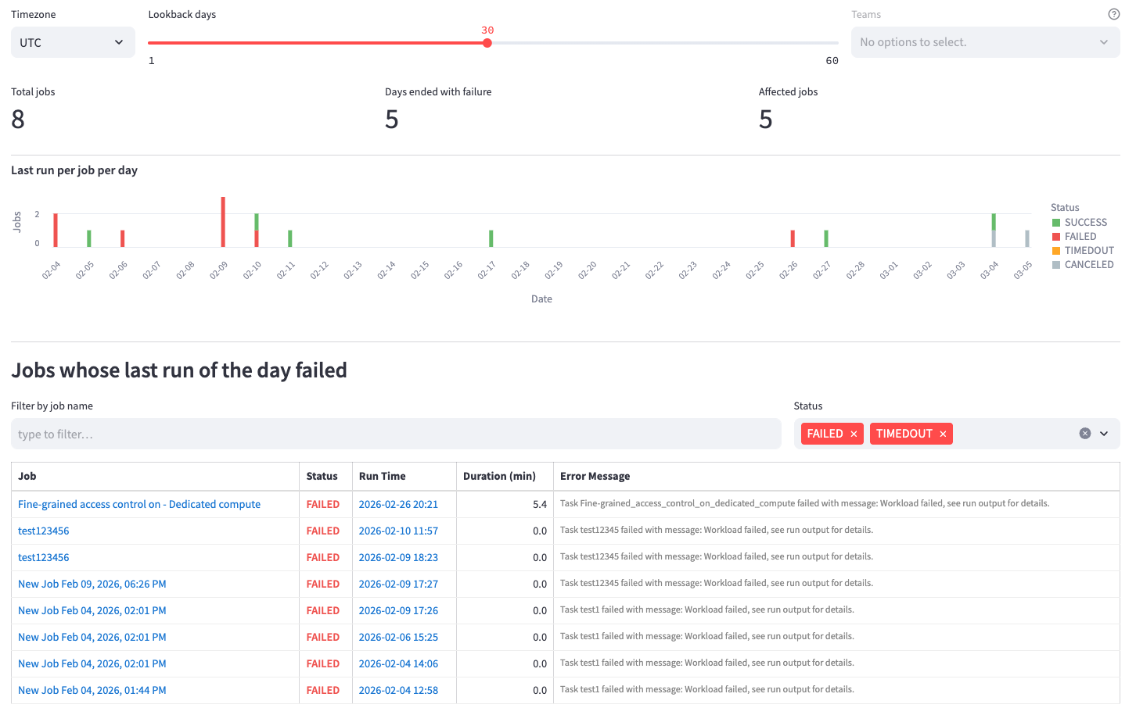
page7 - Jobs - Run history hourly
Monitoring common errors
Active links to jobs
Plans:
More statistical aggregation
Explaining errors with AI
Team-level filtering

Slide 9
Solution Quality
Fully Functional Prototype
Deployed as a live Databricks App — not a mockup. All 7 pages work with real workspace data via Databricks API.
Real-Time API Integration
Live cluster/job data, start/stop controls, and auto-termination management — all operational.
Robust Architecture
Streamlit + Databricks SDK. Handles timezone selection across 10 zones, 90-day lookback, cron parsing.
Production-Ready Foundation
Clean separation of pages, consistent UI patterns, and extensible design for planned features.

Slide 10
Idea / Innovation
We will be the first, besides Databricks itself, to publish Apps in the Marketplace
Key Insight: Databricks Apps > Databricks Dashboards
Apps have full API access — they can both monitor AND act on workspace resources, not just display table data.
Action-Oriented Monitoring
Goes beyond observation — users can start/stop clusters and edit settings directly. Monitoring + management in one place.
Abstraction Layer Over Changing UI
Databricks UI changes frequently. Our app provides a stable, simplified interface that doesn't break when Databricks updates.
Gap Filler: Apps Auto-Stop
Databricks Apps have no native auto-stop. Our dashboard surfaces this blind spot and lets admins monitor app compute state.

Slide 11
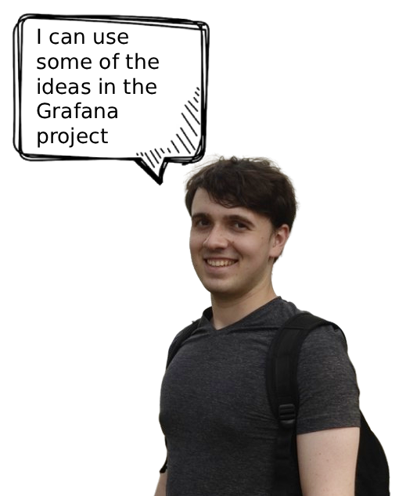

Real-World Usefulness
$$$
< 30s
Cost Savings
Incident Response
Stop forgotten clusters before they burn budget
Find and fix problems without navigating Databricks
Who Benefits from this solution?
Admins
Instant overview of all compute, one-click cost control
Data Engineers
Job failure analysis, schedule optimization, concurrency insights
Management
Clear cost visibility without needing Databricks expertise
Any Employee
Minimalistic UI — no training needed to understand status

Slide 12
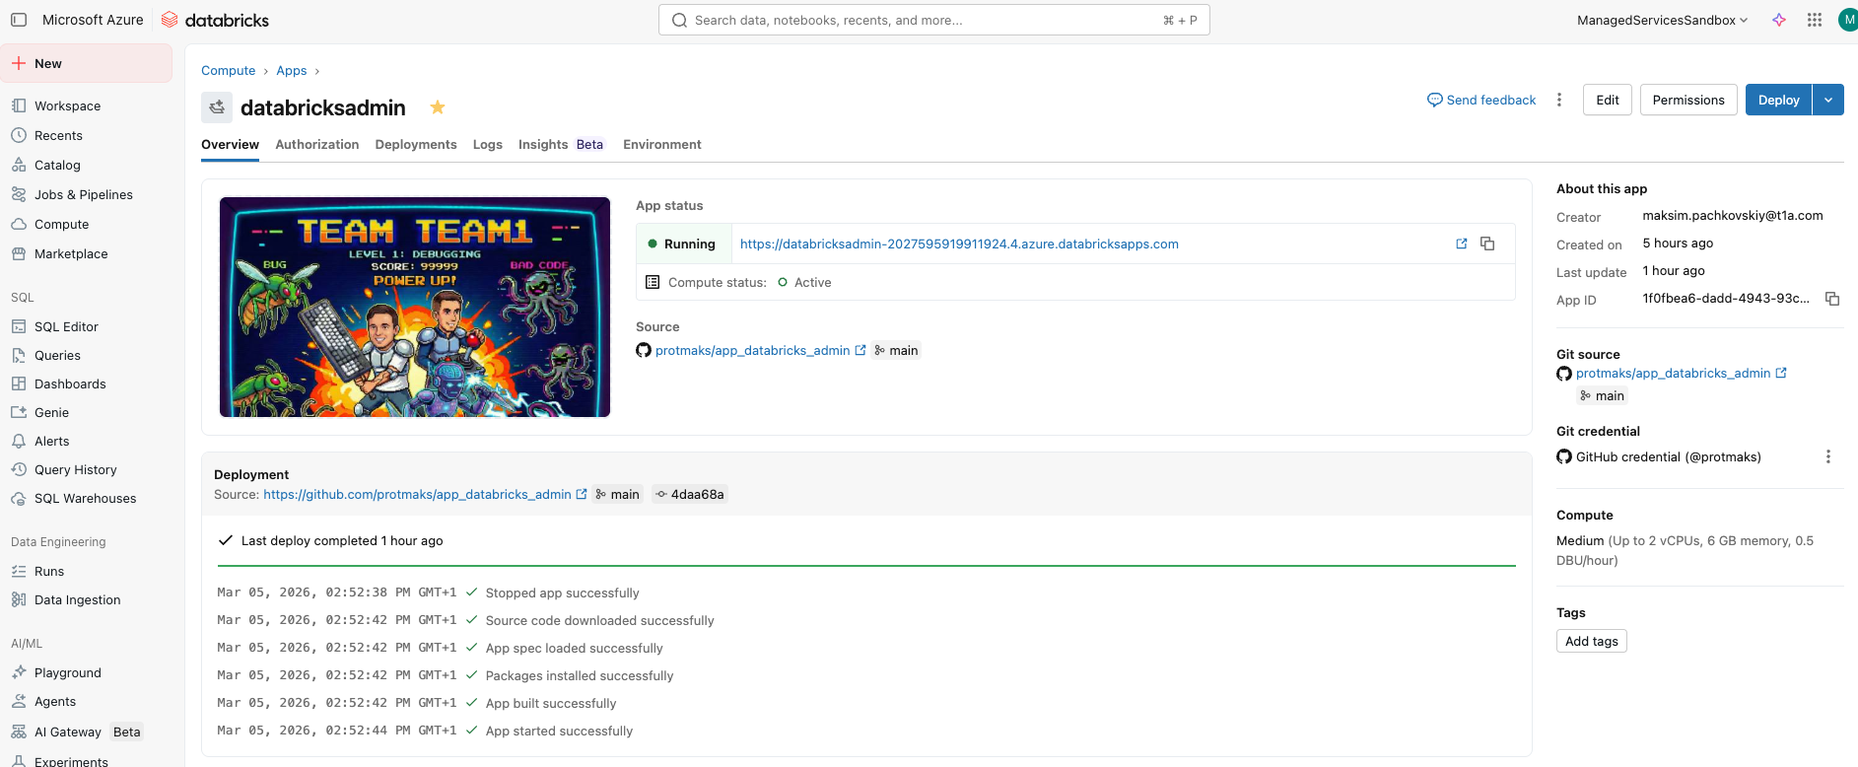
DEMO

