Slide 1



Kapil’s artificial Sushruta Heuristic Intelligentsia
Sourabh Tiwari Amrtya Srivastava
Deepak Soni Md. Shakeel Ahamad

Slide 2
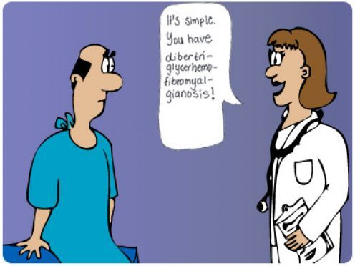
How bad are the things
India has a shortage of 6 lacs doctors, currently just one for 1300 people, with such an estimate its hardly possible to look after each and every patient.
Not many patient do get a cliché of what is told to them…
India ranked 67 th
among the
developing nations
in the case of
doctor-population
ratio.

Slide 3


Slide 4


Slide 5


Slide 6
        CONCLUSION
Digitalization- It replaces the paperwork from Doc’s desk, as everything will be on cloud so no worries of lost of prescription reports…
Hesitation- No hesitation in interaction between doctor and patient..
No longer waiting in queues for health check-ups!
Minimizing time and complexity at doctor’s as well as patients end…
Medicines and lab reports at your doorstep…
Wholesome medical E-library!
Special emergency panel which can call as well as track the live location of the ambulance…

Slide 7
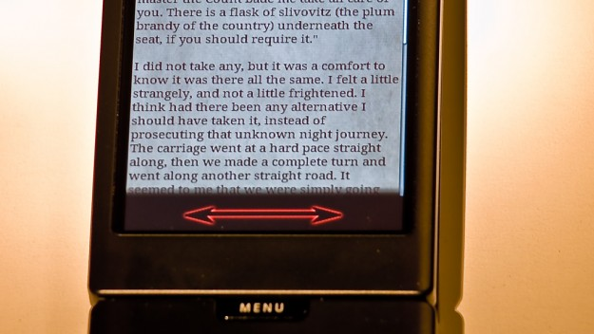
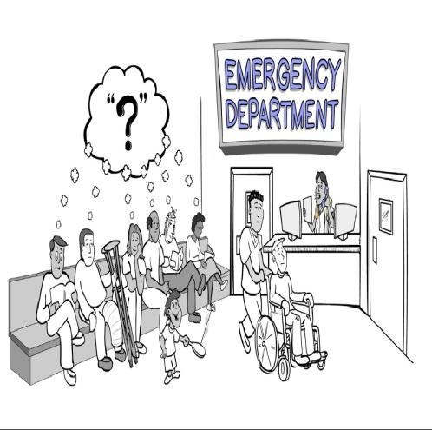
Potential Business Applications
Healthcare : Discount in Diagnostic Assistance, Lab reports, Prescriptions, appointment in Doctor’s fee…
Tech Support: Pharmacies and Physicians advertisements in medical E- library…
Makes it easier at user’s end to access medical reports without any hustle…

Slide 8
References
https://economictimes.indiatimes.com/industry/healthcare/
https://www.pharmatutor.org/pharma-news/doctors-population-in-India
https://www.ndtv.com/opinion? pfrom=home-mainnavgation
Auditor's Report Finds Declining Doctor-Patient Ratio:
https://www.youtube.com/watch?v=ZFsTP06m_hU
48

Slide 9


