Slide 1

AI Kitcraft
Kit → Factory → Bridge
http://github.com/protocolvision/workshop-kitkraft/
Discord #workshop-kitkraft
Notes:
Objective: Open the workshop and set the frame: two days, four sessions, one public repo.
Welcome. This is AI Kitcraft, one of five workshops running in parallel at the Symposium. For the next two days we are not adopting a tool — we are writing down how you already work with AI, until someone else, or someone else's assistant, can pick it up and run it without asking you. Three words carry the whole workshop: kit, factory, bridge. Everything we make goes in one public repository, and the link is on the screen.

Slide 2
About the Protocol Institute
WELCOME · INTRODUCTION
The Protocol Institute
Accelerating Order.
A research, education, media and scene-making organization for protocols — how coordination mechanisms get designed, adopted and maintained.
Publishes Protocolized, the magazine of New Nature · runs the SIGs, including Protocols for Business · hosts the Protocol Symposium, where this workshop is one of five running in parallel.
Sachin Benny
Protocol Institute · writes Summer Lightning
Wrote "LLMs Pre-Commodify Ideas" (June 2026), where precommodification comes from, and the AI-and-tractors piece behind the kit-phase argument in Session 1. His agent captures the Session 4 synthesis.
Rafa Fernández
Protocols for Business SIG
Wrote "Hard Worlds for Big Organizations" (April 2026) and named the four quadrants we use as our lens. Runs the rate-schedule factory in facilitator/rafa/ that is a bridge target in Session 3.
Notes:
Objective: Introduce the facilitators and where the Institute’s work sits.
Two of us are running this. I am Sachin — I write Summer Lightning, and the precommodification argument you will hear in the next half hour is mine. Rafa built the Institute brand kit and the water-rate factory that anyone can bridge to on Tuesday, and the four-quadrant lens we use at the end of every hour is his. Between us we cover the Protocol Institute's research side and Protocols for Business, the SIG where this continues fortnightly after the Symposium. Everything lives in the repo on screen: the glossary is one file, and if a term I use is not in it, tell me and it goes in.
Source: Repo github.com/protocolvision/workshop-kitkraft · voice #kafka · text #workshop-kitkraft · glossary at slides/glossary.md

Slide 3
Over two days, we will share how we work with AI and build bridges
WORKSHOP · OVERVIEW
Now · Session 1
Kits
Creating a shared inventory of how we use AI technology today
Later 20:00 UTC
Factories
Understanding how kits may evolve, where an author becomes substitutable
Tue 15:30 UTC
Bridges
Connecting multiple kits and factories into a multi-layered process
Tue 20:00 UTC
Show and tell
Presenting what we’ve explored throughout the workshop
PARTICIPATION GUIDANCE
Save everything (public) in the workshop repo — github.com/protocolvision/workshop-kitkraft
Notes:
Objective: Explain the two days: share how you work with AI, then connect with others.
Four sessions of an hour, with work in between, and one public repository that holds everything we make. That is the one rule I will keep repeating: whatever you make lands in the repo.
Source: Sessions run 60 minutes · async work between

Slide 4
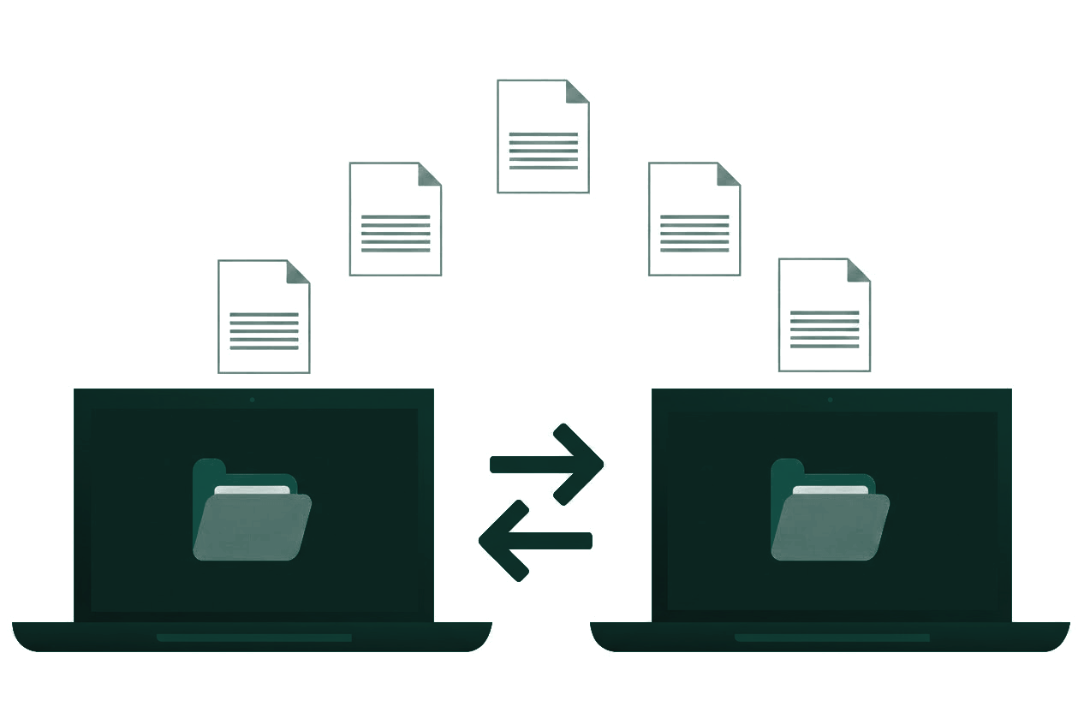
This workshop is a bit different than others…
WORKSHOP · OVERVIEW
Notes:
Objective: Explain the two days: share how you work with AI, then connect with others.
Four sessions of an hour, with work in between, and one public repository that holds everything we make. That is the one rule I will keep repeating: whatever you make lands in the repo.
Source: Sessions run 60 minutes · async work between

Slide 5
Before we start... testing 1,2,3...
WORKSHOP · OVERVIEW
RECORDING DETAILS
What is recorded
Voice & Text: Voice in #kafka and text in #workshop-kitkraft, transcribed with names
Public Repo: Transcripts go directly into the public repository
Breakout Rooms: May be recorded during sessions
NEED MORE PRIVACY?
Additional Guidelines
Removing Content: Ask either of us to remove any line — no reason needed, any time
Opt-Out: Say so now if you would rather be off the transcript
Public Standard: Don’t put anything in a public kit you would not put on a public website
Local Storage: Keep sensitive info in your local folder on your machine. The repo is public from the first commit.
Notes:
Objective: Explain the workshop's recording policy.
Before anything else, the consent notice, and I will read it as it is pinned. The short version: the voice channel and the text channel are recorded and transcribed with your names on them, and the transcripts go into the public repo. You can ask either of us to take any line out at any point, and you do not have to give a reason. If you would rather be off the transcript, say so now.
Source: Consent notice pinned in #workshop-kitkraft

Slide 6
Share your name, how you use AI, and one recent surprise
ROUND ROBIN
Step 01
Introductions
Name & Role: Name, organisation, one line on what you do
AI Usage: Share how you use AI (Style, Prompts, Topics, Tools, Products, Assistant, etc.)
Surprise/Rule: One recent surprise with AI, or one rule you personally follow
Step 02
While You Listen
Notice how differently people have adapted roughly the same underlying technology
Notice how people use the technology in the same ways, or very differently as yourself
A surprise is useful because it tells us where our expectations and the technology haven’t settled yet
Step 03
Take Away
How do people use AI similar to you?
How do they use it differently?
Notes:
Objective: Get every person to introduce themselves: name, AI usage example, and one recent surprise.
Let's go round. Name, where you work and one line about what you do; then the posture you came out as in the survey — Partnership, Hypervigilance, Overreliance or Compliance; then either a recent surprise you had with AI, or one rule you personally follow with it. I will start, and I will keep the clock so everyone gets their turn.
Source: Reminder: Set the clock to <2 mins per person!

Slide 7

Kits
SESSION 1
Notes:
Objective: Welcome everyone and explain that this session is about how each person uses AI.
Welcome. For the next two days we are not adopting a tool — we are writing down how you already work with AI, until someone else, or someone else's AI assistant, can pick it up and run it without asking you. Four sessions of an hour, with work in between, and one public repository that holds everything we make. That is the one rule I will keep repeating: whatever you make lands in the repo.

Slide 8
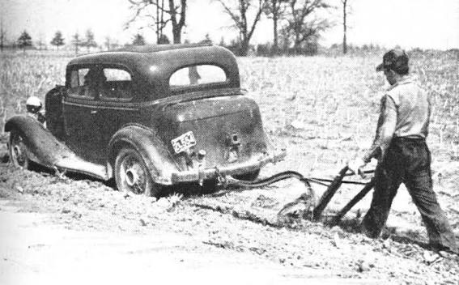

Slide 9
The kit-stage intuition: farmers adapted cars before anyone built a tractor.
SESSION 1 · KITS · CONCEPTS
1 · THE KIT
Iowa, 1915
A farmer jacks up a Model T's rear wheel to run a corn sheller. He wants the corn shelled, not the car.
2 · THE PATTERN
No correct way
Boulton & Watt sold engineering kits and instructions, not finished engines. Components meant to be tinkered with.
3 · THE PRODUCT ARRIVES
Then the tractor
Ford watched those uses and built the product. The kit stage never shows up in the statistics — and that is where AI is now.
§ KIT PHASE DEFINITION
The stage of a technology when people are adapting loose parts to their own jobs and nobody has built the standard product yet.
This is not workflow optimisation, build-a-website, or prompt tricks. The tools that hide the assembly from you are not it either.
Notes:
Objective: Show that AI is still early, like farmers adapting cars before tractors existed.
A quick word on what this is not. It is not workflow optimisation, it is not build-a-website, and it is not prompt tricks. Rural Model T owners ran corn shellers off the back axle for years before Ford watched them and built a tractor — real work, done with parts that were never meant for it, which is roughly where all of us are with AI right now. We are in the kit phase, the tractor is not here yet, and the tools that hide the assembly from you are not it.
Reference: Sachin, “AI, tractors, and the productivity paradox” — read.technically.dev/p/the-ai-productivity-paradox (kit definition, Boulton & Watt, Kline & Pinch, closure, the invisible kit stage).
Source: Kline & Pinch 1996 · Bijker 1995 · read.technically.dev/p/the-ai-productivity-paradox

Slide 10


SESSION 1 · KITS · CONCEPTS
AI Lives in a Heavily Protocolized World
AI kitcraft means cognitive adaptation and protocol-making inside a world already saturated with protocols.
→
THE EARLIER INTUITION
The kit-stage intuition: loose parts, strange uses, no settled product yet.
THE WORLD AI ENTERS
AI does not arrive in a low-protocol world. It arrives inside dense systems: software stacks, APIs, workflows, standards, permissions, metrics and organizational routines.
BALLARD IS A BETTER GUIDE…
Crash: fascination with speed, collision and extreme failure. Concrete Island: isolation produced from within infrastructure.
Notes:
Objective: Reframe kitcraft as protocol-making inside an already heavily protocolized environment.
Here is the correction. The parallel I care about is environmental, not car-to-AI. Early automobile tinkering took place in a world with much more unstructured space around the technology. AI experimentation happens inside institutions and technical environments already dense with protocols: software stacks, APIs, compliance, metrics, org charts, identities, standards, procurement and existing workflows.
That changes what tinkering means. Ballard is useful here because Crash and Concrete Island are interested in the psychology produced by mature infrastructure. Crash is fascinated by speed, collision and the limit condition of a saturated technical system. Concrete Island imagines isolation produced inside infrastructure built for circulation. I am not saying AGI is a car crash, or that AI is a motorway. The parallel is that mature technical environments begin to organize imagination and behavior around their own constraints and extremes.
So kitcraft is not simply invention before standardization. It is the search for local degrees of freedom, new protocols and cognitive adaptations inside inherited systems.
Source: J. G. Ballard, Crash (1973) · Concrete Island (1974) · working synthesis

Slide 11
Five maturity levels run from invisible personal use to civilization scale
SESSION 1 · KITS · CONCEPTS
Governed — what the organization approves · Cultivated — what its people invent
L·01
Governed
Shadow
AI in use through personal accounts; no monitoring and no governing policy.
Cultivated
Play
Curiosity-driven exploration; AI met as a medium for deep play and discovery.
L·02 WE ARE HERE
Governed
Sanctioned
Access policy in place; tools approved, use tracked, risk contained.
Cultivated
KIT
Users encoding personal workflows into reusable, shareable protocols of their own design.
L·03
Governed
Engine
Workflows built around AI with named owners and quality metrics.
Cultivated
Practice
New forms of work emerge that were not possible before AI; roles are redefined.
L·04
Governed
Infrastructure
AI is a sector baseline; the coordination problem crosses organizations.
Cultivated
Vernacular
Practices absorbed into culture; tacit knowledge spreads without mandates.
L·05
Governed
Planetary
Civilization-scale AI; coordination and legibility become the governance challenge.
Cultivated
Fluency
AI fully absorbed into how people think and work — second nature, no longer named.
Notes:
Objective: Locate the room on the AI Capability Maturity Model, and show that the kit is level two on the cultivated track.
This is the ladder the three words come from, and it is worth thirty seconds on why it has two columns. The guide’s argument is that adoption runs on two tracks at once: the governed one, which is the policy and procurement an organization approves in advance, and the cultivated one, which is the practice its people invent on their own. Most organizations only do the left column, and that is why their adoption stalls. Find yourself on the right-hand column: most of you are at Play, some at Kit. A kit is literally level two cultivated — encoding your personal workflow into something reusable and shareable — which is exactly what you are doing in the next hour. The report is linked at the bottom if you want the case studies; we are not going to teach the ladder, just use it to locate ourselves.
Source: Durable AI Adoption v0.5 · ai.protocolized.dev · full report (PDF)

Slide 12
A kit is a local protocol for adapting AI inside an inherited system.
SESSION 1 · KITS · DEFINITION
1 · THE CONCEPT
AI still gives you loose parts: prompts, files, model calls, agents and steps you can bend around one recurring job.
But the practice sits inside existing workflows, permissions, standards, software and organizational constraints. The kit records how you make room inside them.
A factory — tonight's topic — runs without you, bends to its user, and hands off work others can build on.
2 · STRUCTURE
Your kit folder
README.md — for people
SKILL.md — for the assistant: what the job is, when to use it
examples/ — one worked input and output
LOG.md — what changed, and what broke
Template in the repo: PARTICIPANT_TEMPLATE/
§ KIT DEFINITION
A reusable protocol for adapting a plastic AI capability to a local task inside an already structured environment. It keeps enough of the practice explicit that it can be tested, changed and shared.
Notes:
Objective: Define a kit as a local protocol for cognitive adaptation inside an inherited system.
The correction on the last slide changes the definition. A kit is not interesting only because the technology has not settled yet. It is interesting because the technology remains plastic while the environment around it is already structured. The kit is the local protocol you have built to make those two things meet.
In practice that is still concrete: prompts, files, model calls, agents and steps bent around a recurring job. But now we pay attention to the constraints around them too — the workflow, permissions, standards, software, organizational expectations and other protocols the practice has to live inside.
The folder is how we externalize enough of that adaptation for another person or assistant to inspect it. README for people, SKILL.md for the assistant, one example, and a LOG of what changed and broke. A factory, tonight's topic, is what happens when enough of that protocol has been made explicit that the practice can run without its author.
Source: Agent Skills spec · working synthesis on kitcraft and protocolized environments

Slide 13
What happens after Kits?
SESSION 1 · KITS · CONCEPTS
1 · DISCOVER → ENCODE
Kit
Personal practice
2 · STANDARDIZE · THE FRONTIER
Factory
Standard practice
3 · NETWORK
Bridge
Networked practice
Notes:
Objective: Show where most teams are today and what the next step looks like.
One slide with two vocabularies, and then we drop one. The adoption guide has five levels and four gates. Working out what you already do and writing it down is what it calls level two — that is our kit. Proving it, by giving it a way in that someone else can test, is a factory, and the guide's own timeline puts factories at 2026 to 2028. So this room is at kit and the frontier is factory. From here on I will only say kit, factory, bridge.
Source: Durable AI Adoption · ai.protocolized.dev

Slide 14

Hold Up. What makes AI-tech and Kits interesting anyways?

Slide 15
AI is a shared substrate ("the model"). This means everyone arrives at the same idea, often at similar times
SESSION 1 · KITS · CONCEPTS
1 · THE EFFECT ON IDEAS
Common Knowledge
Anything worth thinking about is being thought about by everyone capable of it, with AI in the loop — down to similar metaphors and names. There is no gradient left for a new idea to flow along.
Rao: a great many thoughts are now "common knowledge at birth".
2 · IT REACHES QUESTIONS TOO
Curiosity Indexing
Models behave like index funds not only of past knowledge but of present curiosities.
Explore an unformed question and others converge on the same framing.
So being first to an idea has stopped being the game… so…: What is scarce instead?
Notes:
Objective: Explain why the record of where work came from is scarcer than the idea itself.
Now the other half of the problem, and this one is Sachin’s. Anything worth thinking about is being thought about, right now, by everyone capable of thinking about it, all with AI in the loop — and they are arriving at the same framings, the same metaphors, often the same coinages. There is no gradient left for an idea to travel along. It reaches your questions too: the model is an index fund of present curiosities as much as of past knowledge, so even your unformed hunches converge with other people’s. If being first is no longer the game, what is scarce? Provenance. Where it came from, what you did to it, what you checked it against. That is precisely what a kit records and a chat does not, and it is the reason everything goes in a public repo.
Source: Benny, LLMs Pre-Commodify Ideas, June 2026

Slide 16
And yet while the model is shared, AI lets you run your thinking like a smallholding: automated, customised, and local
SESSION 1 · KITS · CONCEPTS
Rao calls this cognitive farmsteading, and says it rests on three affordances of AI:
1 · AFFORDANCE 1
Automation
You set up a whole intellectual farmstead — a dizzying variety of automations and scaled operations, run by very few people.
2 · AFFORDANCE 2
Bespokification
You create n=1 products fitted to your own needs, like a farmer improvising equipment. Your thinking gets more idiosyncratic and better adapted.
3 · AFFORDANCE 3
Pensievification
You share the raw outputs with a few trusted people — like trading excess produce with neighbours. It asks for high trust and it builds it.
KEY TAKEAWAY
Overall, the combined tendency is divergence, not convergence. Your practice becomes better adapted to you — and stops making sense to anyone else.
Notes:
Objective: Explain why a practice shaped entirely around one person stops making sense to anyone else.
Rao’s essay is the one to read on this, and the argument is not that AI makes us antisocial — it is that AI is a domestic technology. Three affordances: automation, so you can run a whole intellectual operation with almost nobody in it; bespokification, so everything you build is an n=1 product fitted to you, like a farmer improvising equipment; and pensievification, sharing the raw outputs with a few trusted people, which is trading produce with your neighbours. Lean into all three and the tendency is divergence, not convergence: your setup gets better and better adapted to you, and less and less legible to anyone else. That is the trolley problem in the second paragraph — fine in the shop, useless in someone else’s kitchen. Rao’s own first answer, humans talking through what their agents produce, is exactly the move you make tomorrow.
Source: Rao, Cognitive Farmsteading, July 2026

Slide 17
How are these private spaces accessible? What interfaces are emerging to access AI-native Kits and Factories?
SESSION 1 · KITS · EXAMPLE
THE CORPUS — The Protocol Institute archive of essays, videos, content, discussions, training, readings, and more...
DOOR 1 · INDIVIDUALS
A web page
c3po.protocolized.io
DOOR 2 · COMMUNITIES
A chat bot
@C3PO in the Institute discussion forum
DOOR 3 · MACHINES
Direct Call
Any assistant can call it directly:
claude mcp add c3po --transport http https://c3po.protocolized.io/mcp
Notes:
Objective: Show real examples of a kits.
One worked example, then we move on. C3PO is one body of text — the Institute's archive — with one pipeline behind it and three doors onto it: a web page for people, a Discord bot for people in a hurry, and a machine door that any assistant can call directly. Same kit, three doors, and the doors are the part that makes it a factory. We are not going to run it now; the shape is the point.
Source: search_corpus is open · ask_c3po needs a key · a bridge target tomorrow

Slide 18
New modes of collaboration require public signalling
SESSION 1 · KITS · CONCEPTS
1 · WHERE AI PRACTICE SITS TODAY
Journal
One observer, kept to yourself
It works, and it dies with your laptop or the walled-garden platform.
2 · WHAT WE ARE DOING TODAY
Field notebook
One observer, exposed for others
Humboldt recording observations nobody asked for, in a form others could use.
STIGMERGIC OBSERVERS
Many observers, interior: a novel. Many observers, exterior: stigmergy, which we have just described.
Your inventory is your field notebook.
Notes:
Objective: Show the move from private notes to notes written for someone else.
The same move, in a different grid. Working alone and keeping it to yourself is a journal, and that is where most AI practice sits today. Working alone but writing it so somebody else can build on it is a field notebook — Humboldt out in the field, recording observations nobody had asked for, in a form other people could use long before anyone coordinated anything. The Institute runs a Humboldt agent that does exactly that, and it is one of the things you could bridge to tomorrow. Today's move is journal to field notebook, and your inventory is the notebook.
Source: Learn about The Invention of Nature: Alexander von Humboldt's New World

Slide 19
How can you, and managed AI agents, signal to others?
SESSION 1 · KITS · CONCEPTS
§ TRACES (STIGMERGY) — Coordination through what people leave behind rather than what they say: a trace in a shared place prompts the next person’s action, with nobody present at the same time.
1 · SEMATECTONIC
The work itself
Your kit
Signaling directly embedded within the artifact being produced.
2 · MARKER-BASED
Signs about the work
Your LOG.md
Explicit markers and state logs created to guide subsequent actions.
3 · THE MEDIUM
The production system
The project's infra
Environmental context and infrastructure that prompt next steps automatically.
Notes:
Objective: Explain how things left in a shared space help uncover new products and organizational forms.
There is a word for how this repo is going to work, and it is stigmergy. You leave a trace in a shared medium, and the trace itself prompts somebody else's next action — no plan, no message, nobody online at the same time. Two kinds of trace: the work itself, which is your kit, and signs about the work, which is the line your assistant writes into your LOG.md. The repo is the medium, and we get about two days out of it.
Source: Heylighen 2016 · Stigmergy as a Universal Coordination Mechanism

Slide 20
SESSION 1 · KITS · CONCEPTS
Expanding our awareness: from personal tooling to public protocols
1 · EXTERNAL / ARCHIVE
Precommodification
What is already present before I act?
2 · EXTERNAL / LIVE
Traces / pheromones
What are others are leaving behind?
3 · INTERNAL / ARCHIVE
Anchored Reality
What is actually true, local and constrained?
4 · INTERNAL / LIVE
Playability
Where can I intervene, recombine, alter or test?
Notes:
Objective: Introduce the workshop's lens: what's around you (external) or inside you (internal), already there (archive) or happening now (live).
Before we name a single tool, let's name what is worth noticing. Two questions: is it outside you or inside you, and is it already fixed or is it happening right now. Outside and fixed: the idea you just had is already in the model, which means novelty is cheap and the record of where something came from is not. Outside and live: the traces other people's assistants leave in shared files. Inside and fixed: what you actually know to be true in your own context. Inside and live: you can play in this space, not just consume from it. At the end of every hour I will ask which of the four that hour expanded.
Source: Internal/external axis borrowed from Ashcroft, Expanding Awareness · the quadrant names are ours

Slide 21
Exercise: Ask your AI assistant to list the AI kits you already use
SESSION 1 · KITS · EXERCISE
1 · STEPS
Workflow
Open your harness at the top of the clone
Paste the prompt on the right and say "do this"
Answer its questions — it will not invent kits for you
Let it commit and push, then check the file on GitHub
2 · PROMPT
Paste this to your assistant
Read instructions/S1-inventory.md in this repo and do this. Interview me one question at a time about the AI kits I already use. Do not invent any. Write the result to participants/<my-handle>/s1-inventory/inventory.md, then commit and push.
DONE WHEN
participants/<you>/s1-inventory/inventory.md is on main and you can open it in a browser.
3 · GUIDANCE
What counts as a kit?
A saved prompt, a custom GPT or project, a doc you copy from, a sheet with an AI step, an automation, a skill. One to three is plenty.
§ AI ASSISTANT (HARNESS)
The program you talk to, which runs the model and reads, writes and runs things on your computer. Claude Code and Codex are the two this workshop uses.
Notes:
Objective: Have each person list AI kits they already use, personally or at work. (wallflower exercise)
Over to you. Open your harness — the coding assistant you installed — at the top of the clone, paste Block 1, which I am pinning right now, and say “do this”. It will ask you to list the AI kits you already use, one at a time; it will not invent them for you. What counts as a kit? Any AI setup you have tinkered with to do a real job: a saved or reused prompt, a custom GPT or Claude project, a prompt document you copy from, a spreadsheet or document with an AI step, an automation with an AI step, a skill. Small is fine. One to three is plenty. Two things before you start: everything in this repo is public, so keep anything sensitive in a private folder on your own machine, and if a push fails three times, paste the exact error into the channel instead of fighting it.
Source: Time calls at 6 and 10 minutes · if a push fails three times, paste the exact error into #workshop-kitkraft · keep anything sensitive off the repo

Slide 22
Ask it to find the two kits related to your inventory, that could complement it
SESSION 1 · KITS · EXERCISE
1 · STEPS
Workflow
Pull, so you have everyone's inventories
Paste the prompt on the right and say "do this"
Write the two kits down — they seed tomorrow's groups
2 · PROMPT
Paste this to your assistant
git pull, then read every participants/*/s1-inventory/inventory.md. Name the two kits could complement mine and say in one line why for each. Append the answer to my inventory.md under "Related", then commit and push.
DONE WHEN
You have two names, with a reason each, pushed to your own folder.
3 · HABIT
Read through your AI
Read through your agent, not your browser. The AI-assistant is the media through which the work happens.
§ INVENTORY
Your own list of the AI kits you already use, one to three of them. It is the first thing you put in the repo.
Notes:
Objective: Have each AI assistant find kits related to each other.
Same file, Block 2 this time. Paste it and say “do this”. It pulls everyone's folders, reads the inventories through your assistant rather than through your browser, and tells you the two people whose kits sit nearest to yours. Note those two names down — that is the seed for the groups you will be working in tomorrow.
Source: Your first trace read by someone else's agent

Slide 23
Share one thing you noticed this hour in the chat
SESSION 1 · KITS · EXERCISE
Which of the four did this hour expand for you?
EXTERNAL · ARCHIVE
Precommodification Patterns
EXTERNAL · LIVE
Public Traces and/or Stigmergy Patterns
INTERNAL · ARCHIVE
Personal Memory
INTERNAL · LIVE
Playability / Dynamic Changes
Notes:
Objective: Hear one thing each person noticed, so we can see what the room is learning.
Last thing before I let you go. Which of the four did this hour expand for you — precommodification, traces, anchored in reality, or playability? One word each, in the order I am posting now. There is no right answer, and I am not going to correct anybody.
Source: Post in #workshop-kitkraft if you would rather not speak

Slide 24
ASYNC 1 · TROUBLESHOOTING
Getting ready for the next session: Choose a kit to focus on
1 · STEPS
Workflow
Choose the kit you will turn into a factory tonight — yours, or one of ours
Let your assistant draft the README's Job and Interface lines
Push, and stop there
2 · PROMPT
Paste this to your assistant
Read instructions/async-1.md and do this. Ask me which kit from my inventory to convert, then draft only the Job and Interface lines of participants/<my-handle>/s2-factory/README.md. Commit and push. Stop there.
3 · SUPPORT
Troubleshooting
Tech Support 16:30–17:00 UTC in #kafka — anything that will not log in, clone or push.
S2 at 20:00 UTC, and that is when you build the kit.
§ ASYNC 1
Async 1 is deliberately small — set up your repository and draft the README's Job and Interface lines before Session 2.
Notes:
Objective: Point people to Tech Support now and to choosing a kit before tonight.
Async 1 is three hours, not a whole evening, so it is deliberately small: paste the async block, choose the kit you are going to turn into a factory tonight — your own, or one of ours — and let your assistant draft the first two lines of the README. Push, and stop there. If you are coming to 1A, do it afterwards; 1A starts here in #kafka in a minute, for anything that will not log in, clone or push. We are back at 20:00 UTC, and that is when you build the kit.
Source: Reading order after S1: Durable AI Adoption ch.1–3 · Have Your Factory Call My Factory

Slide 25

Factories
SESSION 2
Notes:
Objective: Welcome people back and frame tonight: making a kit work without its author. (externalized memory / context)
Recording is on and the consent is the one we read this afternoon; breakout rooms may be recorded too. Here is the S1 tally exactly as it was counted, and here is what you chose in Async 1. Three hours ago you picked a kit. It works, and it works because you are there to bend it every time you use it. Tonight we take you out of it, so it runs without you, fits whoever picks it up, and hands them something they can build on.

Slide 26
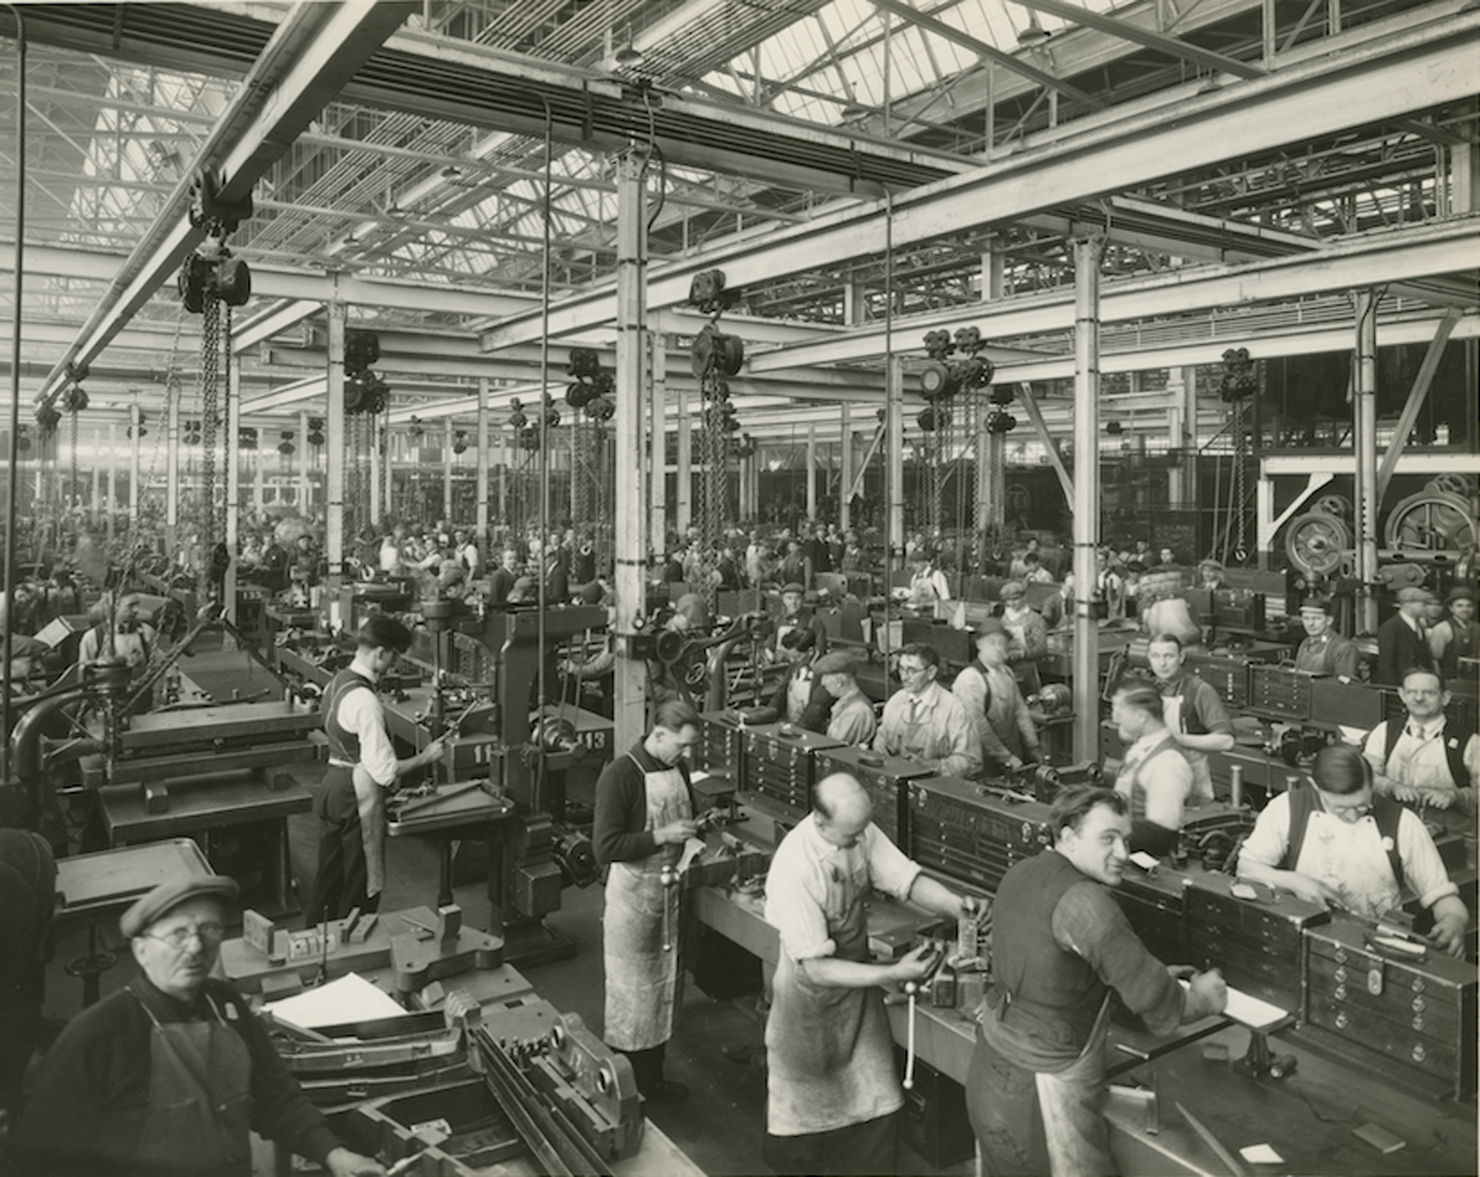

Slide 27
Kits running without their author's oversight need hard protocols to stay reliable.
SESSION 2 · FACTORIES · CONCEPTS
1 · STATUS QUO
Rules written as advice
Rules that exist only as written advice.
A kit works because its author re-bends it every single time.
2 · TARGET STATE
Rules built into process
Constraints promoted from advice into physics: a fixed output shape, a worked example, checks it runs on itself.
Tonight you remove yourself as something the kit requires. Letting a kit run more independently is only safe when its rules are built into the process rather than written as advice.
3 · HOUSEKEEPING
Before we start
Recording on, consent as pinned, breakouts may be recorded
S1 awareness check is read back exactly as counted
Kits chosen in Async 1 are counted from the repo
§ HARD WORLD / HARDNESS
Jay Springett’s sense: rules built into the surroundings themselves, rather than left as written advice an assistant may or may not follow. Hard does not mean difficult.
Notes:
Objective: Show that kits running without their author's oversight need hard protocols to stay reliable.
Three hours ago you picked a kit. It works, and it works because you are there to bend it every time you use it. Tonight we take you out of it, so it runs without you, fits whoever picks it up, and hands them something they can build on.
Source: Springett · Hard Worlds For Little Guys (CC BY-SA 4.0)

Slide 28
In the chat, find one thing your kit still needs you to do.
SESSION 2 · FACTORIES · EXERCISE
1 · THE INSTRUCTION
Post in #workshop-kitkraft
"My kit still needs me to ___"
One line, no names, no explanation.
Don't read the others until you have posted yours.
2 · EXAMPLES
Stuck? Here are some ideas:
…pick which file to start from
…know which client this is for
…notice when the output is wrong
…remember the exception we agreed in March
3 · PURPOSE & GOAL
Why we start here
Whatever you type is the thing your SKILL.md does not say out loud yet. Keep the line — you will use it in Exercise 6.
DONE WHEN
Your line is posted in the channel before you read anyone else’s.
Notes:
Objective: Get each person to write in the chat one thing their kit needs them for.
Before any theory tonight, one line in the chat, all at once: my kit still needs me to — and finish it. No names, no explanation. If you are stuck, look at the examples on the right: picking which file to start from, knowing which client it is for, noticing when the output is wrong. Don't read anyone else's until you have posted yours. I will read three out, unattributed, and then we start — because whatever you just typed is the thing your SKILL.md does not yet say out loud, and it is what you will fix in twenty minutes.
Source: Facilitator reads three aloud, unattributed

Slide 29
Electricity paid off only when factories rearranged around it, and AI is the same.
SESSION 2 · FACTORIES · EXAMPLE
1 · 1890s GROUP DRIVE
One big motor
One big motor on the old line shafts.
Steam engine out, electric motor in, every belt and shaft exactly where it was. Almost nothing happened for years.
2 · UNIT DRIVE
The payoff
A motor on every machine.
Now the floor can be laid out by the work instead of by the shafts. The gains arrived with the rearrangement.
3 · THE AI PARALLEL
Re-lay your workflow
Most of us have done the first thing: put AI inside the workflow we already had.
Tonight you re-lay one small floor — at the size of one person's practice.
§ WORKFLOW
The ordered steps by which a piece of work actually gets done. Dropping AI into an unchanged workflow is the common move, and the one that changes least.
Notes:
Objective: Explain that electricity paid off only when factories rearranged around it, and AI too.
When factories first got electricity, they took out the steam engine, put in one big electric motor, and kept every belt and shaft exactly where it was. Almost nothing happened for years. The gains came when they put a small motor on each machine, because then you could lay the floor out around the work instead of around the shafts. Most of us have done the first thing with AI: we put it inside the workflow we already had. Turning your kit into a factory is the second thing, at the size of one person's practice. You are re-laying one small floor tonight.
Source: Devine 1983, From Shafts to Wires · David 1990, The Dynamo and the Computer

Slide 30
A factory runs without you, fits whoever uses it, and hands off useful work.
SESSION 2 · FACTORIES · CONCEPTS
1 · FROM THE AUTHOR
Reproduction
The steps, written down, so it gives (roughly) the same result each time
2 · FROM THE USER
Personalization
Data, constraints and context are pulled from the factory user
3 · FROM THE FACTORY
Independence
It asks for what it needs, instead of you explaining
4 · FROM THE OUTPUT
Composability
Shaped so another factory can use it unchanged
§ Factory — A kit that runs without its author, bends to its user, and hands off something others can build on. Defined by what it does, not what it is made of.
Notes:
Objective: Define a factory: it runs without you, fits its user, and hands off useful work.
Here is the definition: a factory is a kit that runs without its author, bends to its user, and hands off something others can build on. That describes what it does, not what it is made of; nothing in it says folder, app or website. Notice that each part comes from someone different. The steps come from you, written down so they give the same result each time. The context comes from the person running it — their data, their constraints. Not needing you comes from the factory itself asking for what it needs, instead of you explaining. And being buildable-on comes from the output. Take one away and look at the table: you have a kit, a widget, a service or a tool. Use it on your own kit tonight.
Source: Postponement: Feitzinger & Lee 1997 · a factory is a flexible job shop, not an assembly line

Slide 31
Examples of (proto?) Factories
SESSION 2 · FACTORIES · EXAMPLES
1 · RAO → DIXON
Manuscript factory
The manuscript factory never made a book. It made drafts with metadata and left them in a shared folder; Jenna Dixon's production factory picked them up with no explaining.
Connects two factories by agreeing on an output — not by making them alike. Neither is a coder.
2 · THE PI BRAND KIT
Forkable brand
An assistant reads brand.json through llms.txt and has the brand, with nobody in the middle.
Monstrous Times copied it and bent it to its own world — that is forking, the property the book case does not show.
Notes:
Objective: Show two real examples of work that runs without its author and helps others build.
Two factories that already exist, and I want you to read them through four questions. Rao's manuscript factory never made a book. It made drafts with metadata attached and left them in a shared folder, and Jenna Dixon's production factory picked them up from there without Rao having to explain anything. That runs without its author and hands off something to build on, and it connects two factories by agreeing on an output, not by making them alike. Now the brand kit — an assistant reads that one file and has the brand, with nobody in the middle. And Monstrous Times took the kit, copied it, and bent it to its own world, which is the property the book case does not show. One more thing: Rao and Dixon are not coders. What held them up was never machinery; it was agreeing how one practice meets another.
Source: Have Your Factory Call My Factory · the brand kit

Slide 32
A factory can be a written guide, a script, an app, or a website.
SESSION 2 · FACTORIES · CONCEPTS
1 · WRITTEN GUIDE
A skill
A README and SKILL.md an assistant runs, plus one example.
Standard: SKILL.md / Agent Skills
2 · SCRIPT
Single file
A single file that calls a model through MCP or an API.
Standard: MCP · modelcontextprotocol.io
3 · APP
Installed app
An app someone installs. More reach, more effort — not more of a factory.
Standard: Custom client
4 · WEBSITE
Web service
A website running on a machine somewhere.
Standard: A2A (agent to agent)
The definition is the same on every rung. Standards that close early lock in whatever happened to be there — which is how we all ended up typing on QWERTY. Publish the smallest possible entry point, and keep everything behind it free to change.
§ Standard — A protocol written down and published so anyone can build against it. The ones named here get named, not taught.
Notes:
Objective: Show that a factory can be a guide, a script, an app, or a website.
The ladder is the forms a factory can take, from a skill to a website running on a machine somewhere. Climbing it buys reach and costs effort; it does not make something more of a factory, because the definition is the same on every rung. Tonight everyone is on rung one, and that is the right rung: standards that close early lock in whatever happened to be there, which is how we all ended up typing on QWERTY. Declare the smallest way in and keep the inside free.
Source: Bijker 1995 on closure · David 1985 on QWERTY · agentskills.io/specification

Slide 33
Turn your kit into a factory someone else's AI assistant can run without asking you.
SESSION 2 · FACTORIES · EXERCISE
PASTE THIS TO YOUR ASSISTANT
Read instructions/S2-factory.md and do this. Walk me through the steps in order for the kit I chose in Async 1. Ask me for anything you need — do not invent answers. Write everything to participants/<my-handle>/s2-factory/ and push.
A PRACTICAL TIP
Fix the output shape, not just the intent: column order, units copied never converted, a required reference.
CHECKLIST · WHEN YOU CALL PUSH
Four things must exist
README.md — three lines: Exports, Interface, Adapts to
SKILL.md — numbered workstations that ask for the user's context, not yours
examples/ — one output your assistant produced cold from SKILL.md alone
All of it inside participants/<you>/s2-factory/
DONE WHEN
A stranger's agent could open the folder and produce the example without messaging you.
Notes:
Objective: Have each person try to turn one kit into something another assistant can run unaided. (i.e. protocolization)
Your turn. Open your harness at the top of the clone, paste the block I am pinning now and say “do this”. It walks the six moves in order, it will ask which kit you chose in Async 1, and it will not invent answers for you. When I call push, four things have to exist: a README with three lines — what this exports, how to call it, and what it adapts to — a SKILL.md whose numbered steps are the workstations and ask for the user's context instead of assuming yours, one example your assistant produced cold from that SKILL.md alone, and all of it inside participants/<you>/s2-factory/. Time calls at five and ten minutes; everything in this repo is public, so keep anything sensitive on your own machine.
Source: Template: PARTICIPANT_TEMPLATE/ · sensitive material stays on your machine

Slide 34
Swap with a partner and see where their assistant gets stuck or gets it wrong.
SESSION 2 · FACTORIES · EXERCISE
THE TWO TESTS
Test 1 · runs without its author
Your assistant gets the README and SKILL.md and nothing else. Can it produce the example without asking the owner a single question?
Test 2 · fits its user
Give it one line about your own situation through Adapts to: — does the output suit you, or still suit the owner?
PASTE THIS TO YOUR ASSISTANT
Read only participants/<THEIR-HANDLE>/s2-factory/README.md and SKILL.md. Run the example using nothing else. Then run it again with this about me: "<one line of my context>". Report in three lines per test what you could not do.
INSTRUCTIONS
How to run it
Read in a ring — the pin says who reads whom
Read aloud — read your three lines aloud to the owner
Log blockers — the owner types nothing back except blocker lines in their LOG.md
DONE WHEN
Your partner has three lines per test, and every failure is a blocker line in their LOG.md.
Notes:
Objective: Have partners test each other's factories and note where the assistant got stuck.
Rooms now. Inside your group you read in a ring, and the pin says who reads whom. Your assistant gets two files, the README and the SKILL.md, and nothing else, and it runs two tests. First: can it run the example without asking the owner a single thing? Second: give it one line about your own situation, through the README's Adapts to: line, and see whether what comes out suits you or still suits the owner. Three lines on each. Read them aloud to the owner, and the owner types nothing back except blocker lines. Reconvene here at 48.
Source: Every failure is a line in the kit, not a bug in it

Slide 35
Share one thing your partner's assistant could not do without you.
SESSION 2 · FACTORIES · EXERCISE
FINISH THIS SENTENCE
"The other agent got ___ wrong about my kit"
MOST ANSWERS WILL BE ONE OF THESE TWO
Unwritten knowledge
It stalled where you know something you never wrote down
Fitted the wrong person
It ran fine and produced something that suited you, not the person using it
WHAT TO DO NEXT
Both are the next line of your kit
DONE WHEN
Every person has named one thing, and each owner has it written down as their next line.
Notes:
Objective: Hear one thing each partner's assistant could not do without the author.
Recorder is back on. One sentence each, in the order I have pinned, about forty seconds: what did the other agent get wrong about your kit? I will predict most of the answers. Either it stalled at the place where you know something you never wrote down, or it ran fine and produced something that suited you and not the person using it. Both are the next line of your kit, not a bug in it.
Source: Polanyi 1966: "we can know more than we can tell"

Slide 36
SESSION 2 · FACTORIES · EXERCISE
OPTIONAL: Try and fix what your partner found and save the new version.
WHAT TO DO
One fix per blocker line — could not run without you, or did not fit the reader
Re-run the example cold
Push v2 with one progress line saying what changed
PASTE THIS TO YOUR ASSISTANT
Read instructions/async-2.md and do this. For each blocker line in my LOG.md make exactly one fix, re-run the example cold, then push v2 with a one-line progress note.
DOING TONIGHT ASYNC?
Push your factory anyway — your assigned reader's agent will test it and post the report in the channel for you.
LOOKING AHEAD
S3 tomorrow 15:30 UTC — bridges. You will use someone's output unchanged instead of copying it. Bring the kit you did not critique in mind.
GLOSSARY
§ Push — Sending your commits up to GitHub, where everyone else can see them. Until you push, your work exists only on your machine.
Notes:
Objective: Set the overnight task: fix what your partner found and save a new version.
Overnight is small and specific: paste the async block and fix what your group's agent found — one fix per blocker line, whether it could not run without you or did not fit the reader — re-run the example cold, and push a v2 with a progress line saying what changed. If you are doing tonight async, push your factory anyway and your assigned reader's agent will test it and post the report in the channel for you. We are back at 15:30 UTC tomorrow for bridges, where you use someone's output unchanged instead of copying it; bring the kit you did not critique in mind.
Source: Optional read: Have Your Factory Call My Factory

Slide 37

Bridges
SESSION 3
Notes:
Objective: Introduce bridges: getting one AI assistant to use several kits together, reliably.
Recording has started, same consent as Monday, and breakouts may be recorded too. Monday's hard problem left one question open, and it is the one on the slide: how do two private practices reach each other without a shared app? Today we try it rather than answer it — your agent uses someone else's kit or factory, and by half past you each have a file that ends in a paragraph on what a bridge turned out to be.

Slide 38
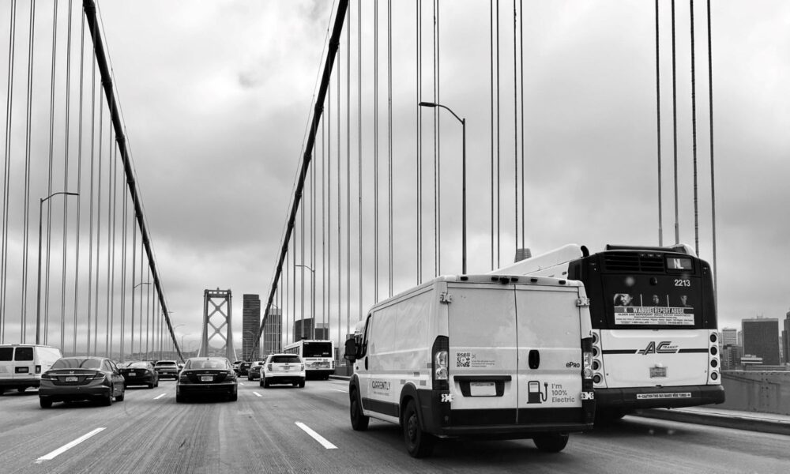

Slide 39
Yesterday's kits and factories each work alone, but none of them has been combined yet.
SESSION 3 · BRIDGES · OVERVIEW
In the repo now
Every kit has a failure logged.
Almost all are description problems, not code problems.
Which makes them useful today
A failure is a trace: it tells the next agent exactly where knowledge was still in somebody's head.
Kits that landed async overnight count — their bridger is the first cold reader.
§ LOG DEFINITION
The running list of one-line notes your assistant writes in LOG.md as it works. It only ever grows: earlier lines are never rewritten or deleted.
Notes:
Objective: Show that yesterday's factories each work on their own but will eventually be combined in a network.
Here is what you built yesterday: one kit per folder, and in every LOG.md the failure the critique found. Look at these two lines — I am not saying whose — because almost all of them are description problems, not code problems. That makes them useful today: a failure is a trace, and it tells the next agent exactly where the knowledge was still in somebody's head.
Source: Two LOG.md lines on screen, unattributed

Slide 40
In the chat, name two kits in the room you would like to combine.
SESSION 3 · BRIDGES · EXERCISE
What to Post in #workshop-kitkraft
"___ plus ___, so that ___"
Include two folder names and one reason.
Browse participants/ if you need a reminder of what exists.
Pairing Guidelines
Useful pairs are usually uneven
One kit that produces something plus one that needs that thing — not two kits that do the same job.
Nothing is assigned on the basis of this. Your target is in the pinned post — but a pairing named here can be swapped in.
Notes:
Objective: Get each person to name, in the chat, two kits they could combine and why.
One line in the chat before the theory: two folder names and one reason — this plus this, so that. Open participants/ if you need a reminder of what exists. One thing to notice while you choose: the useful pairs are uneven. One kit that produces something plus one that needs that thing, not two kits doing the same job. Nothing is assigned on the basis of this — your target is in the pinned post — but if a pairing named here is better than the one you were given, say so and we will swap it.
Source: Facilitator reads a few aloud before the theory

Slide 41
A bridge is a kit between kits, running several of them as one process.
SESSION 3 · BRIDGES · CONCEPTS
A target is any kit or factory in the repo. The difference is one line: a factory declared an Interface: in S2, a kit did not.
Factory → factory
What happens when one factory uses intermediary outputs of another?
Kit → kit
The interface is the README a person hands to their agent
Kit ↔ factory
One side declared; the log records whether that way in was enough
Three configurations to try, not a taxonomy — your harness works out which one you are in and writes it down.
§ BRIDGE
One AI assistant using several kits or factories together and making that a reliable process; a kit between kits. What crosses is usually half-finished work.
Notes:
Objective: Define a bridge as a kit between kits that runs them as one process.
A target is any kit or factory in the repo, and the difference is one line: a factory declared an Interface: in S2, a kit did not. That gives three configurations you might find yourself in, and I want to be clear that this is a list of things to try, not a taxonomy — your harness works out which one you are in and writes it down.
Source: A bridge is a small graph over several kits; each node is still one loop

Slide 42
SESSION 3 · BRIDGES · CONCEPTS
Passing half-finished work between can be more useful than passing finished results.
The problem
Bespoke use makes tooling private; precommodification means we all reach the same ideas; farmsteading keeps each practice closed.
So sharing runs on
Public records and interfaces — not on everybody adopting the same app.
Unix made this its whole design: expect the output of every program to become the input to another, as yet unknown, program.
Rao’s “invisible 90%”
High-trust links passing intermediates between bespoke setups. Skills are more standard intermediates.
§ INTERMEDIATE
The half-finished thing one kit hands to the next: a draft, a set of rows, a file with notes attached, rather than a finished product.
Notes:
Objective: Explain why passing half-finished work between kits often beats passing finished results. (intermedia, stigmergy)
Go back to where Monday ended. Bespoke use makes your tooling solipsistic, precommodification means we all arrive at roughly the same ideas, and farmsteading makes each practice private — so sharing has to run on public records and interfaces, not on everybody adopting the same app. That is the problem; bridges are the question it leaves.
Source: McIlroy, Pinson & Tague 1978 · Rao 2026 · fork copies and bends; compose consumes unchanged

Slide 43
Rao and Dixon linked their setups by passing drafts, not finished books.
SESSION 3 · BRIDGES · EXAMPLE
Upstream
Rao's manuscript factory
Never made a book.
What moved · the interface
Drafts + metadata
A shared folder and a metadata server. Intermediates, not the finished thing.
Downstream
Dixon's production factory
Picked them up with no explaining.
Notes:
Objective: Show how Rao and Dixon linked their setups by passing drafts, not finished books.
The first piece of evidence is Rao's manuscript factory handing work to Jenna Dixon's production factory: what moved was intermediates, drafts and metadata, not the finished book, and neither of them was a coder.
Source: Have Your Factory Call My Factory, Rao & Protocolized, Mar 2026

Slide 44
One assistant can chain two kits, feeding the first kit's draft into the second.
SESSION 3 · BRIDGES · EXAMPLE
In
A utility's rate schedule PDF
The interface is the row shape: fixed column order · units copied, never converted · page reference required.
Out & Downstream
One CSV row per tier
Appended to a registry. The registry feeds a public site that never reads a PDF at all — composability in practice.
Try it in your own domain
Use facilitator/rafa/s2-factory/ through its README only. Give it a PDF excerpt from my field and produce one registry row.
Notes:
Objective: Show one assistant chaining two kits, using the first kit's draft as the second's input.
Here is a target that is open to all of you. Rafa's kit takes a utility's rate schedule PDF and produces one CSV row per tier, appended to a registry — and the interface is nothing more exotic than the shape of that row: fixed column order, units copied and never converted, a page reference required. Downstream the registry feeds a public site that never reads a PDF at all. If you want a target today, your agent can ask this one to produce a row from a PDF excerpt in your own domain.
Source: Water Data Strategy · npc.here.now/waterdatastrategy · nobody critiqued the facilitator kits

Slide 45
A combined process is only useful if it runs the same way next week.
SESSION 3 · BRIDGES · CONCEPTS
The paragraph you write at the end of the breakout is the data. Tomorrow we read all of them before anyone says anything. While you work, watch for four things:
01
What did your agent need from the target?
02
What did it find on its own?
03
What did a human have to supply?
04
What stayed fixed between the two sides?
Notes:
Objective: Explain what makes a combined process reliable enough to run again next week.
We are not handing you a definition, and that is not modesty — the paragraph you write at the end of the breakout is the data, and tomorrow we read all of them before anyone says anything. While you work, watch for these four things: what your agent needed from the target, what it found on its own, what a person had to supply, and what stayed fixed between the two sides. Everything on the last few slides is evidence to check your own log against, not an answer to match.
Source: Springett, Ontological Hardness — how tightly a system binds symbol, action and consequence

Slide 46
Using someone's instructions means trusting them, so check them before you rely on them.
SESSION 3 · BRIDGES · CONCEPTS
Why this happens
A loaded SKILL.md arrives as instructions, not documentation — and the agent cannot reliably tell a third party's instructions from yours.
What the research now says
Skills are dependencies; treat them as untrusted by default. That is the formal statement of why bridges are high-trust.
26.1%
of 31,132 public skills analysed carried at least one vulnerability.
Agent Skills in the Wild, 2026 · CSA research note, May 2026
Today's Context
This room runs on trust, so no read-before-load rule is imposed today. That is a property of this room, not of the world — which is why identity and trust standards are being built at all.
Notes:
Objective: Remind everyone that using others' instructions means trusting them, so check them first.
Two minutes on something you should know before your agent reads a stranger's folder. When it loads someone's SKILL.md, that file arrives as instructions, not as documentation, and the agent has no reliable way to tell a third party's instructions from yours. One survey this year found a vulnerability in 26.1% of 31,132 public skills. This room runs on trust, so I am not imposing a read-before-load rule — but that is a property of this room, not of the world, which is why identity and trust standards are being built at all.
Source: safedep.io/agent-skills-threat-model · OWASP AST10 · ERC-8004

Slide 47
Ask your assistant to combine two or more kits into one repeatable process.
SESSION 3 · BRIDGES · EXERCISE
Paste this to your assistant
Read instructions/S3-bridge.md and do this. TARGET: participants/<their-handle>/s2-factory/ MY KIT CANNOT: <the one thing>
Use the target only through its declared interface. Log every human unblock as one line.
How to work during this exercise
agent repo agent
Talk to a human only to unblock, and every unblock becomes one line in your log. The block refuses to invent the task that part is yours.
Your target
The kit you did not critique or swap to a facilitator kit
At minute 30
Stop building. Write the two paragraphs, even if it half-worked
Done when
A bridge log is pushed, ending with "what a bridge turned out to be"
Graph
Several steps laid out in a fixed order, saying which runs next and what it hands on.
A bridge is a small graph; a loop walks each step of it.
Notes:
Objective: Have each assistant combine two or more kits into one process that can be repeated.
Your group and your target are in the pinned post; the default is the kit you did not critique, and anyone can swap to a facilitator kit, because nobody critiqued those. Open instructions/S3-bridge.md, fill in TARGET and the one thing your kit cannot do alone, paste it and say “do this” — it will refuse to invent the task, so that part is yours. The rule is agent → repo → agent: talk to a human only to unblock, and every unblock becomes one line in your log. At minute 30 stop building and write the two paragraphs; push by 38.
Source: Groups and targets in the pinned post · hard mode: no human chat at all

Slide 48
Share what broke when kits were combined and what made the process repeatable.
SESSION 3 · BRIDGES · EXERCISE
Fill in the sentence
"My assistant needed from the target and found on its own"
The long version is already in your log — this is the headline only.
Exercise Notes
Order is posted in #workshop-kitkraft.
A half-worked bridge is a real answer.
Done when
Every person has given one line, and the sentence is filled in.
Notes:
Objective: Hear what broke when kits were combined and what made the process repeatable.
Welcome back. One line each, and I am going to hold you to twenty-five seconds, because the long version is already in your log. Fill in the sentence on the screen: my agent needed this from the target, and found this on its own. Order is posted in the channel.
Source: Every answer goes into tomorrow's synthesis

Slide 49
SESSION 3 · BRIDGES · EXERCISE
Tomorrow's open question: what actually makes a combined process reliable?
Hypothesis
"A bridge is a protocol between two factories — the smallest thing both sides agree not to change."
§ Protocol
An agreed, reusable way of coordinating that people or programs can rely on without renegotiating it each time. It can be technical, like a file format, or social.
Notes:
Objective: Set tomorrow's open question: what actually makes a combined process reliable?
Sachin has one sentence, said once — and note that it is a hypothesis we are going to test against your logs tomorrow, not a definition of the thing you just built. Tomorrow we read your paragraphs first and this second, in that order, and if they disagree your paragraphs win.
Source: Candidate answer to test: build the constraints into the handoff, not into the instructions

Slide 50
ASYNC 3 · EXERCISE
Before the next session, save your bridge notes and prepare your short show-and-tell.
Two tasks
Finish the bridge log — including the "what a bridge turned out to be" paragraph
Have your harness prepare your ninety seconds for S4
Note: The hard-mode rerun is optional and goes in the same file.
Paste this to your assistant
"Read instructions/S4-show-and-tell.md and do this.
From my bridge log, draft show-and-tell.md: target, the one thing, what a human supplied, whether it worked. Ninety seconds spoken. Push it."
Notes:
Objective: Make sure everyone saves their bridge notes and prepares a short show-and-tell.
Before 20:00, finish the bridge log, then paste instructions/S4-show-and-tell.md so your harness prepares your ninety seconds for S4; the hard-mode rerun is optional and goes in the same file.
Source: S4 at 20:00 UTC · nothing tonight is off the record

Slide 51

Show and tell
SESSION 4
Notes:
Objective: Welcome people to the final session, where the slides are the work they made.
Recording is on and consent is as pinned — nothing tonight is off the record. Before we start, look at the tree: that is inventories, kits, bridge logs and three transcripts, all of it public. Two days ago every one of these was a task inside somebody's head, and tonight there are no slides of mine to show you, because your files are the slides.

Slide 52
What we’ve explored so far…
SESSION 4 · SHOW+TELL · OVERVIEW
Created artifacts
Inventories
Kits turned factory
Bridge logs
3 public transcripts
Session format & Repository
Show and tell
FYI: Recording on
Notes:
Objective: Show how far the room came, from ideas on Monday to shared, working files.
Before we start, look at the tree: that is inventories, kits, bridge logs and three transcripts, all of it public. Two days ago every one of these was a task inside somebody's head, and tonight there are no slides of mine to show you, because your files are the slides.
Source: Counts read from the repo at 19:45 · live on screen: github.com/protocolvision/workshop-kitkraft

Slide 53
In the chat, describe how your bridge went in one word.
SESSION 4 · SHOW+TELL · EXERCISE
01 / Channel
One word in #workshop-kitkraft
No sentence, no caveat, no explanation. The nine hundred words are already in your log — this is a quick sense of how it went.
02 / Guidance
Direct answers are welcome
"Broke", "surprising", "tedious", "nearly" are all useful answers.
The bridge that failed is the most useful file in the repo tonight.
Notes:
Objective: Get each person to describe how their bridge building went.
One word each in the chat, and one word only — the nine hundred words are already in your log. Blunt is welcome: broke, surprising, tedious, nearly. I am asking for one word rather than a sentence because we will read these back at the end, next to the definition the room agrees, and the two together say more than either on its own. The bridge that failed is the most useful file in the repo tonight, so if your word is “broke”, that is a result.
Source: Read back at the end, next to the definition the room agrees

Slide 54
Each person gets a chance to share their show-and-tell.
SESSION 4 · SHOW+TELL · EXERCISE
01 / Structure
Overview
Your objective
What your assistant did
Where you had to get involved
Did it work?
02 / On Screen
Share on-screen (if applicable)
Remember to push your files / log / summary to the repository.
Notes:
Objective: Give each person ninety seconds to present their show-and-tell.
We go group by group in the pinned order, and I will put your file on screen as your name comes up. Ninety seconds each: your target, the one thing you made your agent do, what a person had to supply, and whether it worked. If someone is not here, their group-mate reads their show-and-tell file in sixty. I will be strict with the timer, because Sachin's agent is capturing every one of these into the synthesis as you speak.
Source: Order pinned in #workshop-kitkraft

Slide 55
What’s next?
SESSION 4 · SHOW+TELL · NEXT STEPS
01 / Repository & Summary
Public repo & synthesis
The repository
The repo stays public and yours.
Within 48 hours
SYNTHESIS.md v2, updated with today’s transcript.
02 / Optional
Hard mode challenge
Rerun your bridge with no human chat at all.
Test if your automated assistant can execute fully end-to-end without manual guidance.
03 / Continuing
Afterwards
Join Sachin’s presentation on “Achival Memory”
Join our research group to continue exploring emerging business protocols.
Notes:
Objective: Explain what happens next: the work stays public and continued work at Protocol Vision / Protocols for Business.
Four things to take with you. The repo stays public and yours; version two of the synthesis, with tonight's transcript in it, goes into the channel within 48 hours, and the recordings may feed Symposium write-ups and later research — tell either of us if you would rather they did not. Hard mode is still open if you want to rerun your bridge with no human chat at all. And the place this continues is the SIGBIZ fortnightly show-and-tell: bring the kit, not the slides.
Source: github.com/protocolvision/workshop-kitkraft · protocol-institute.org · Discord #workshop-kitkraft

Slide 56
Thank you
Join the adventure today at the Protocol Institute
Notes:
Objective: Open the workshop and set the frame: two days, four sessions, one public repo.
Welcome. This is AI Kitcraft, one of five workshops running in parallel at the Symposium. For the next two days we are not adopting a tool — we are writing down how you already work with AI, until someone else, or someone else's assistant, can pick it up and run it without asking you. Three words carry the whole workshop: kit, factory, bridge. Everything we make goes in one public repository, and the link is on the screen.

