Slide 1
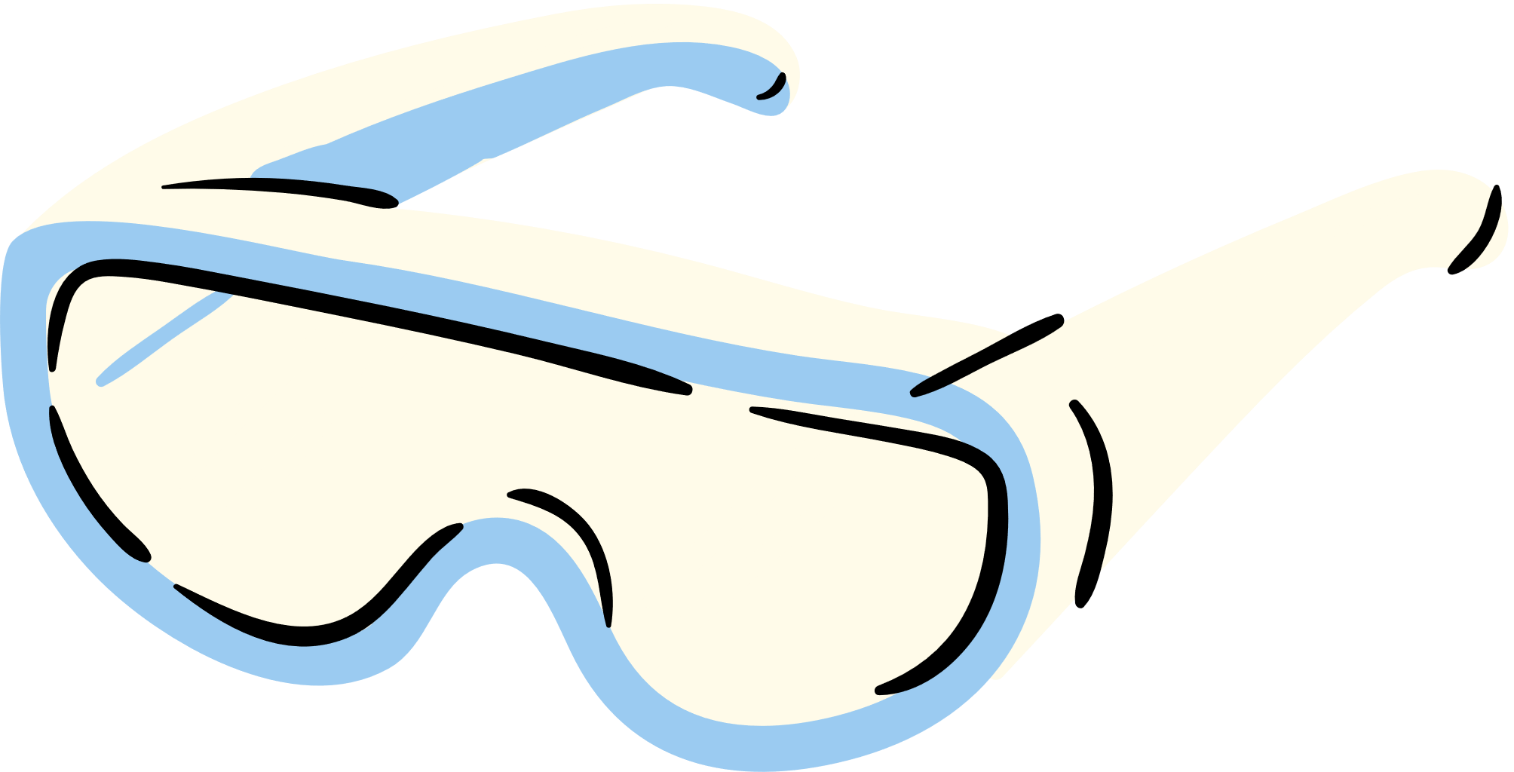

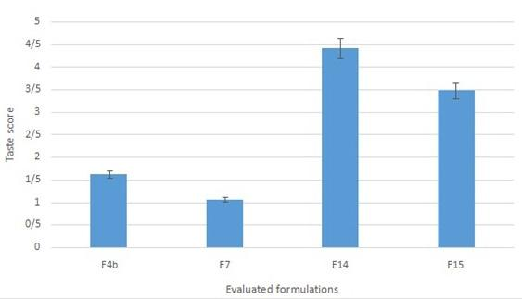
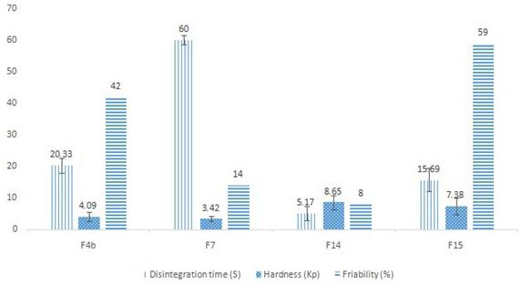

Formulation and Taste Masking of Ranitidine Orally Disintegrating
An ODT is a solid dosage form that disintegrates and dissolves in the mouth without water. Ranitidine is a histamine H2-receptor that inhibits stomach acid production
RESULTS
Ranitidine orally disintegrating tablet (ODT) has growing higher interests among pharmaceutical companies and medical society members. The target communities in ODT consumption are children, the elderly, hospitalized patients, those with mastication and deglutition problems, patients with resistant chronic nausea.
CONCLUSION:
Formulation F14 was selected as the ultimate formulation, based on its better taste and shorter disintegration time (around 5 seconds) Flowability of all formulations was improved, due to the addition of property modifying excipients such as sodium benzoate (ANOV A, p < 0.05)

