Slide 1


REACTIVE RUBY ON RAILS
YYC RUBY MEETUP
with KRIS READ.
“Post-Technical Entrepreneur”

Slide 2
WHAT YOU’RE GOING TO LEARN
What is React – Quick Version
How To Integrate React with Rails
Building a React + Rails App Hands On
CODE: github.com/protokris/react_rails_demo

Slide 3
WHAT IS REACT?
Facebook’s library for rich JavaScript + HTML interfaces.
Simple with a low learning curve.
Based on composable components.
High performance.

Slide 4
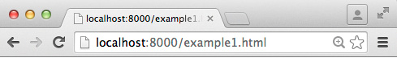
WHAT IS A“COMPONENT?”
MENU COMPONENT
PARENT COMPONENT
LIST
COMPONENT
VIEW COMPONENT

Slide 5
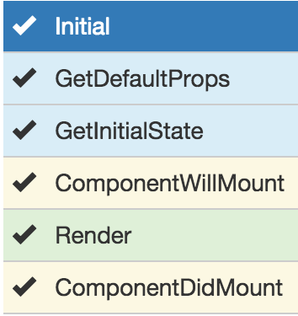
VS TEMPLATE FRAGMENTS
Are rendered client-side*
Have a lifecycle
Have state
Are responsive to data changes

Slide 6
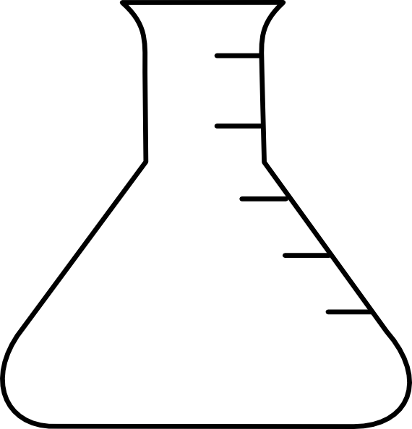
RAILS READY INTEGRATIONS
VS
react-rails
react_on_rails

Slide 7
REACT-RAILS
PROS
Simple.
Easy to learn.
Add to an existing app.
Follows the Rails way.
Uses Rails tooling.
Includes React automatically.
Transforms JSX components via asset pipeline.
Comes with React view helpers.
CONS
You just get React, not:
Flux
Redux
React-Router
React-Bootstrap
Webpack
NPM
Easier to slip into bad React habits.

Slide 8
REACT_ON_RAILS
PROS
You get the most popular React stack and tools.
Webpack is nice to use.
Scales better to complex apps.
Includes React + React_Router + Redux automatically.
You need to run bundle install + NPM install and have a package.json file etc.
CONS
Steeper learning curve.
Build and Tooling is more Node than Rails. You need Node.js.
Harder to change an existing team or app to use this gem.
You get a lot of stuff you might not need depending on your app.

Slide 9
WHY I WENT WITH REACT-RAILS
You’ll leave knowing how it ALL works.
You’ll pickup core React concepts.
We’ll do everything with familiar Rails tooling.
You will be able to add React to your own project.
Much of this carries over to react_on_rails as well.

Slide 10

DEMO TIME

Slide 11
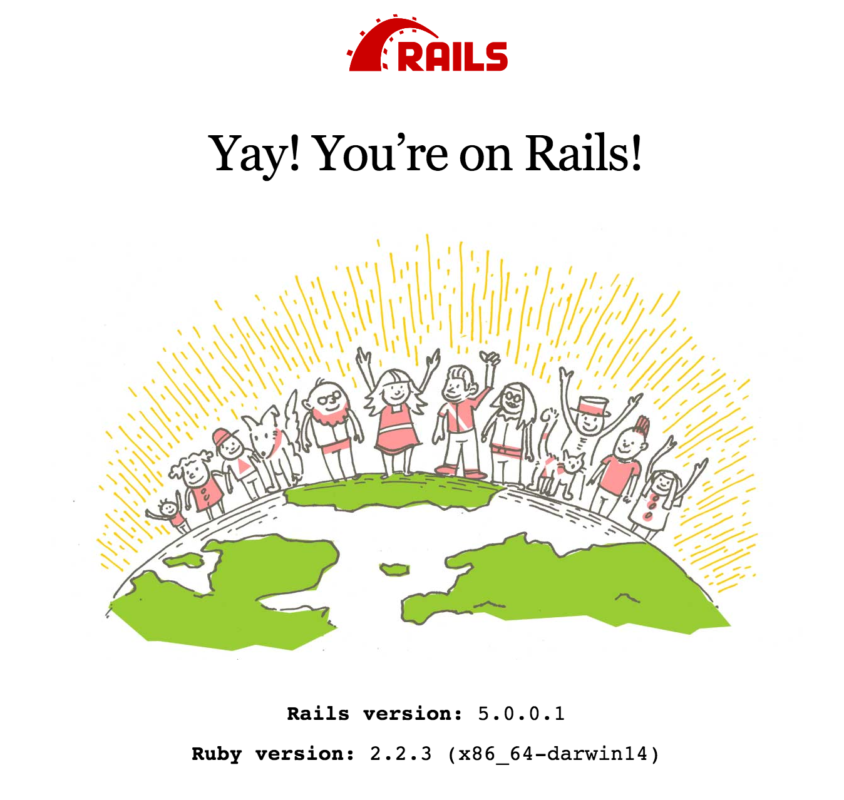
START A RAILS PROJECT
If you already have a rails project you obviously skip this step.
1. Make sure you have Rails
gem update rails '5.0.0.1'
2. Create a rails project
rails new .
3. Fire it up
rake db:setup
rake db:migrate
rails s

Slide 12
ADD REACT-RAILS GEM
Add the gem
echo -e "gem 'react-rails'\n" >> Gemfile
bundle install
Run the install generator
rails g react:install

Slide 13
WHAT YOU GET
React inserted into the assets pipeline via application.js
//= require react //= require react_ujs //= require components
Components folder to build your first component.
.js.jsx files will be transformed in the build pipeline.
react-rails includes a view helper (react_component).

Slide 14
RAILS UP A QUICK APP
Lets scaffold up a quick demo app:
rails g scaffold Author name:string age:integer
rails g scaffold Book title:string author:references
rake db:migrate
Start it up again and make sure it works:
rails s
http://localhost:3000/authors (add an author)
http://localhost:3000/books (add a book)

Slide 15
PROBLEM
We can’t see books on the author page.
Let’s create a REACT component!
rails g react:component Book book:object
Notes:
var Book = React.createClass({
propTypes: {
book: React.PropTypes.object
},
render: function() {
return (
<div>
<div>Title: {this.props.book.title}</div>
</div>
);
}});

Slide 16
ADD THE COMPONENT TO VIEW
Edit:
app/views/authors/show.html.erb
Check if it works!
Notes:
<p>
<strong>Books:</strong>
<% Book.where(author: @author).each do |b| %>
<%= react_component('Book', book: b ) %>
<% end %>
</p>

Slide 17
PROBLEM: DATA
Data is being rendered into the view instead of fetched on demand.
We decide we’d prefer a component to load it’s own data about books by contacting the REST API.
http://localhost:3000/books/1.json

Slide 18
CREATE A LAZY COMPONENT
Edit:
app/assets/javascripts/components/lazy_book.js.jsx
In the view, pass the API URL instead of the book object.
<%= react_component( ‘LazyBook’, url: url_for(b) ) %>
Notes:
var LazyBook = React.createClass({
getInitialState: function() {
return {data: {} };
},
componentDidMount: function() {
$.ajax({
url: this.props.url,
dataType: 'json',
cache: false,
success: function(data) {
this.setState({data: data});
}.bind(this),
error: function(xhr, status, err) {
console.error(this.props.url, status, err.toString());
}.bind(this)
});
},
render: function() {
return (
<div>
<div>Title: {this.state.data.title}</div>
</div>
);
}
});

Slide 19
IT WORKS!
React inserts the component onto the page.
The component runs it’s “lifecycle”.
The component updates it’s data.
The component renders the UI.

Slide 20

CHALLENGES FOR THE READER
Compose components: a component in another component.
Build a component with internal state.
Try with Redux, React_Router, React-Bootstrap

Slide 21
THANK YOU
PLEASE GO HOME
THERE WILL BE NO ENCORE

