Slide 1
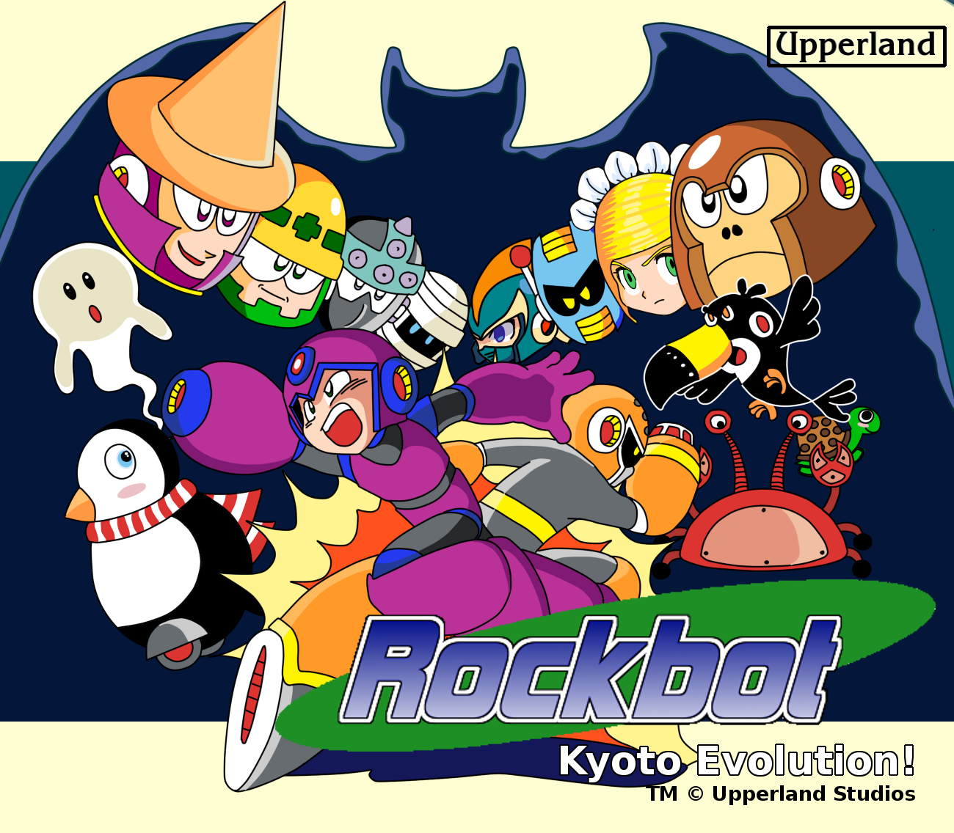

Slide 2

[Introduction]
Thank you for downloading a copy of the Upperland's Family Computer Cassette Simulation: ROCKBOT1 (UPP-XU).
Please read this “Instruction Manual” carefully before operating to ensure correct handling and use of this product. Additionally, keep this “Instruction Manual” stored properly in a safe place.
Health Warning:
Take a 15 minute break every 2 hours of play, avoid static shock, don’t yank the power with the game on, don’t get it wet, don’t feed it after midnight and don't play it with a dancing pad.

Slide 3

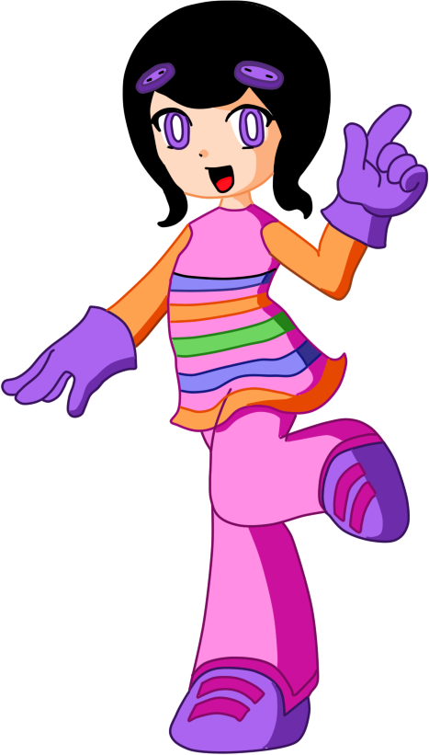
[Contents]
STORY.........................................................................................................................................
USING THE CONTROLLER & COMMANDS................................................................................
GAME START..............................................................................................................................
SCREEN EXPLANATION.............................................................................................................
ABOUT CHANGING WEAPONS.......................................................................
FROG AND EAGLE WONDER MASCOTS..........................................................
SLIDING, CHARGED SHOT AND SHIELD.........................................................
ABOUT ITEMS..................................................................................................
THE CHARACTERS OF ROCKBOT ...................................................................
THE STORY OF ROCKBOT...............................................................................
ABOUT THE PASSWORD..................................................................................
LEGAL NOTICE ….............................................................................................
04
05
09
10
11
12
15
13
14
25
28
29

Slide 4


[Story]
WAR HAS COME TO THE WORLD!
In the year 20XX, the city of Kyoto rests peacefully, but danger casts a shadow in the horizon as news from Tokyo speak of robots going berserk
Suddenly, explosions plague the city, marking the start of a war. An army of robots with unknown origin is attacking! The city defense forces are unable to stop their advance. Facing an eminent defeat, the army calls for help from the city university's scientists. They need to create weapons to defeat the new enemy.
Inspirited by news of a robot hero in Tokyo, young professor Kanotus creates a robot warrior project. But his first creation, called Beta, is too temperamental and unstable; he then creates a second robot, called Rockbot, with improved design, to fight along. Now, both robots need to rush to save the city and try become heroes.

Slide 5

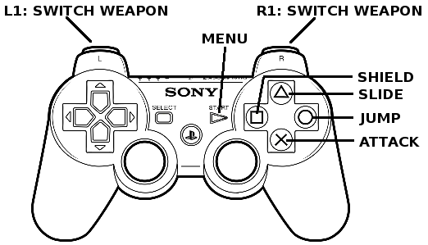
[Using the control & Commands]
Playstation 2
O Button — Jump
X Button — Attack
∆ Button — Dash (Beta)/Slide(Rockbot)
Button — Shield (Rockbot)
Start Button — Open Weapon Select Menu & Make Selection
Directional Key Pad up to grasp and climb ladders. (Press the O Button to let go.)
Directional Key Pad down + O Button — Sliding
Hold down key and press jump to dash with Betabot or slide with Rockbot.
With Rockbot, hold attack button to charge and release it to fire a powerful attack.
Rockbot have use shield to reflect projectiles coming in his direction.

Slide 6

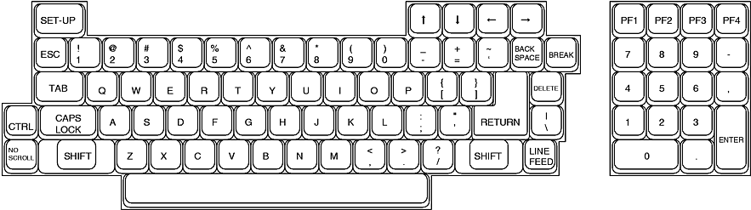
[Using the control & Commands]
PC Keyboard
X Button — Jump
A Button — Attack
C Button — Dash (Beta)/Slide(Rockbot)
Z Button — Shield (Rockbot)
Enter Key — Open Weapon Select Menu & Make Selection
PSP
O Button — Jump
X Button — Attack
∆ Button — Dash (Beta)/Slide(Rockbot)
Button — Shield (Rockbot)
Start Button — Open Weapon Select Menu & Make Selection

Slide 7
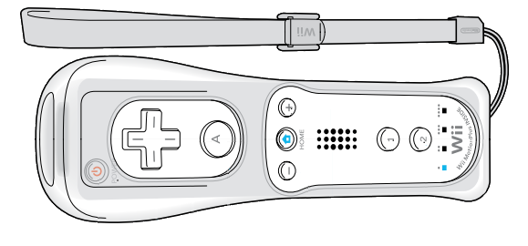
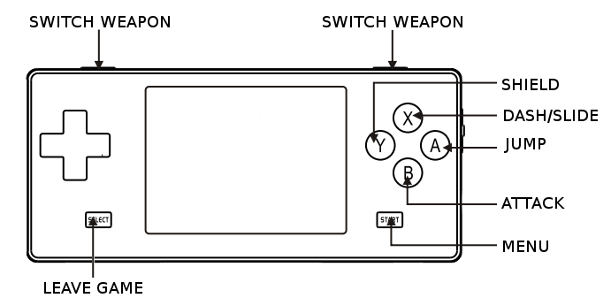
[Using the control & Commands]
Wii
X Button — Jump
A Button — Attack
C Button — Dash (Beta)/Slide(Rockbot)
Z Button — Shield (Rockbot)
Enter Key — Open Weapon Select Menu & Make Selection
Dingoo A320 (Dingux)
O Button — Jump
X Button — Attack
∆ Button — Dash (Beta)/Slide(Rockbot)
Button — Shield (Rockbot)
Start Button — Open Weapon Select Menu & Make Selection

Slide 8
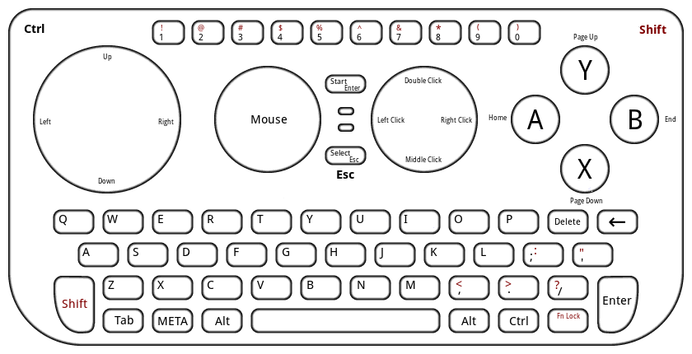
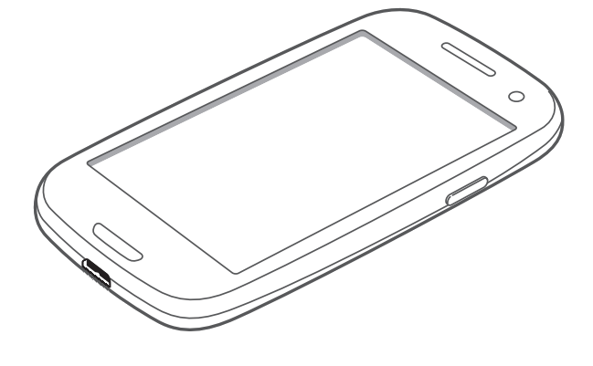
[Using the control & Commands]
Pandora
X Button — Jump
A Button — Attack
C Button — Dash (Beta)/Slide(Rockbot)
Z Button — Shield (Rockbot)
Enter Key — Open Weapon Select Menu & Make Selection
Android
Touch Controls*:
A Button — Jump
B Button — Attack
Start — Open Weapon Select Menu & Make Selection
* You can also configure a bluetooth or USB joystick, or use built-in controls if your hardware have any.

Slide 9
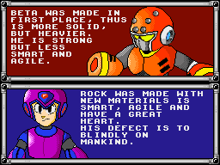
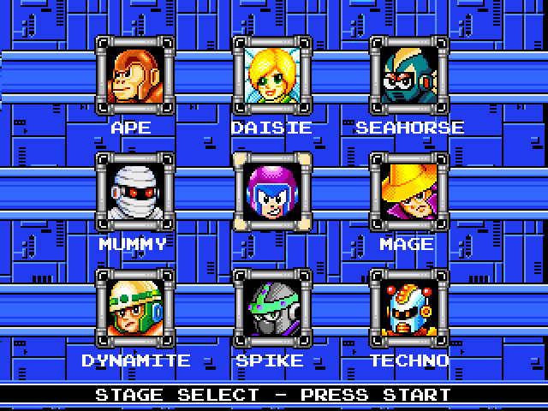
[Game Start]
When starting the game, a player selection screen allows you to pick between Rockbot and Betabot. Rock is easier to play with due to bigger jump and charged shot, while Beta matches classic Mega Man (tm Capcom) play.
After defeating the introduction stage, the 8 boss characters of each stage are displayed on the screen. Begin playing any stage by moving the cursor over that character’s image and pressing the Start Button.
After defeating the boss of each stage, you will obtain the weapon wielded by that boss.

Slide 10
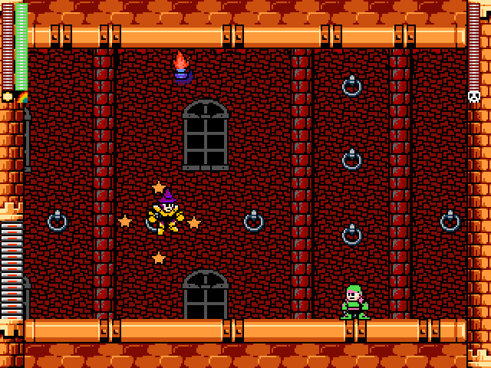
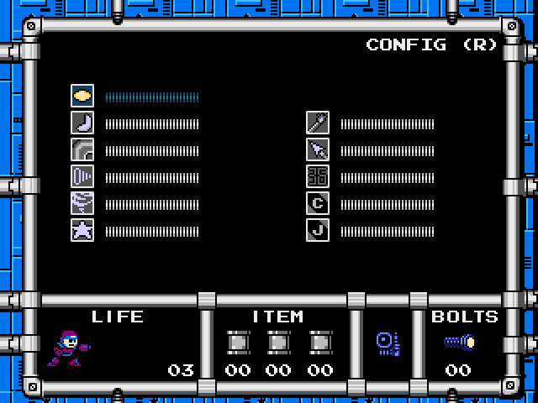
[Screen Explanation]
Enemy Energy Gauge (BOSS only)
Life Energy Gauge
Weapon Energy Gauge
Life Energy Gauge
Configuration (press R button)
Weapon Select Area
Usable items (Energy tanks)
Player Count

Slide 11
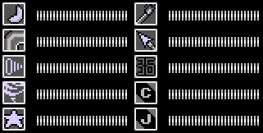
[ABOUT CHANGING WEAPONS]
Cockpit
After defeating a boss and acquiring its weapon, pressing the Start Button during the game will enable switching weapons by opening the weapon display area.
By moving the Directional Key Pad up down left and right, select the initials of the weapon you wish to use and press start to confirm your selection!

Slide 12
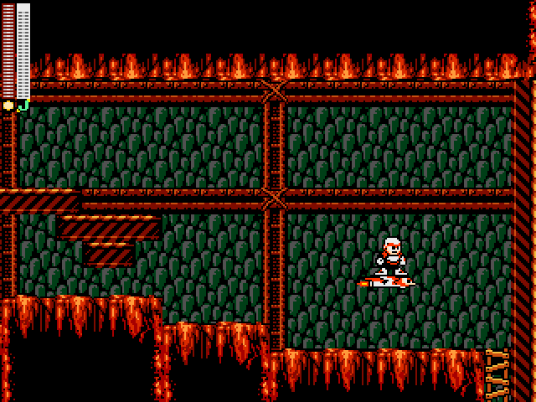
[Frog and Eagle Mascots]
Rockbot and Betabot have two companion friends which can be selected for use in the same manner as choosing a weapon.
Coil Frog helps you to reach high places and Eagle Jet helps to fly over obstables or pits.The two friends can only be acquired by defeating certain bosses.
In both cases, they cannot appear on the screen more than once at a time.

Slide 13
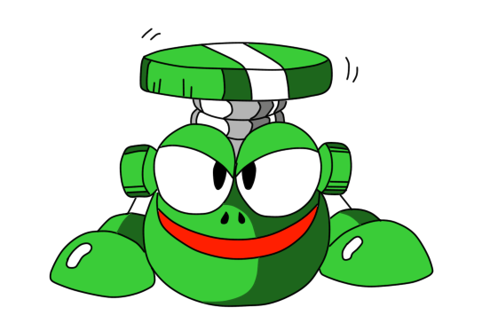
[Frog Coil]
This ability is availableafter beating Ape Bot's stage.
Get atop Frog to perform a super jump and reache higher areas.
Frog Coil

Slide 14
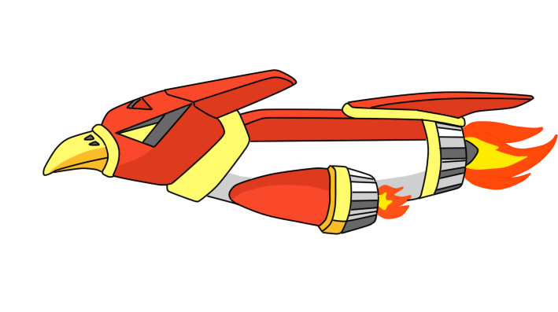
[Eagle Jet]
Soars freely through the air.
Watch its energy usage carefully or you can fall!!
(WARNING)
Cancelling Eagle while moving over a danger zone or an area without footholds will cause the player to drop and fall. Please use caution.
Eagle Jet

Slide 15
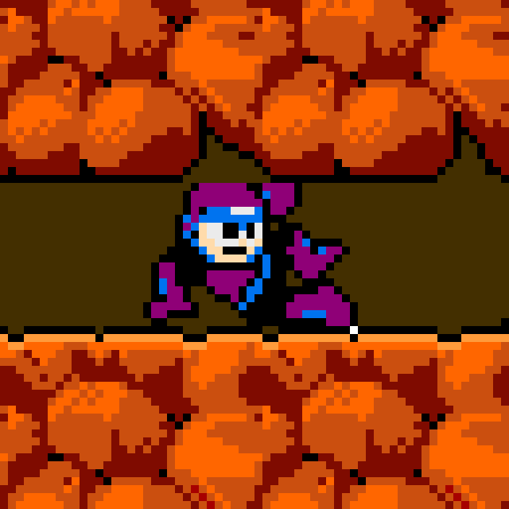
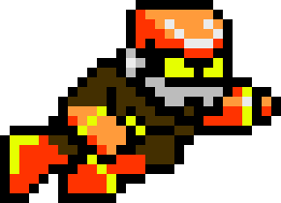
[Using Slide/Dash]
By holding the Directional Key Pad down and pressing the JUMP button, the player can perform a slide to get out of many tough situations!!
By using this nimble burst of speed, you can slide underneath and slip past your enemies, and that’s not all!!
There are some narrow passageways that can only be traversed by sliding!!

Slide 16
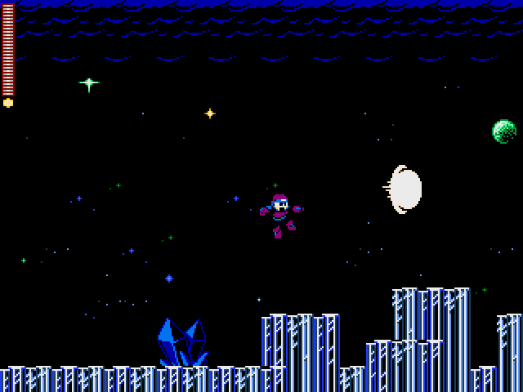
[Rockbot's Charged Shot]
When playing with Rockbot, press and hold down the Attack button and he will start charging his weapon. Release the button to fire up a powerful attack that can defeat strong enemies on a single shot!
Betabot can't charge, but fires two shots at once, making easier to hit difficult target.

Slide 17
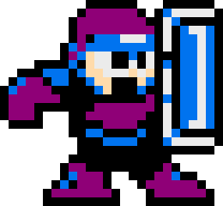
[Using Rockbot's Shield]
When pressing the shield button with Rockbot, he will raise his shield to protect himself from enemies projectiles by reflecting those.
Betabot is not equipped with a shield.
Warning
You are still vulnerable if a projectile comes from the opposite direction you are facing and also from damage from contact with enemy body.

Slide 18







[About Items]
1UP
Energy Can
Player count increases by 1 man.
When this item is used, all life energy is fully recovered.
Weapons Can
Special Can
When this item is used, all weapons energy are fully recovered.
When this item is used, all life and weapons energy are fully recovered.
Life Energy
Weapon Energy
Recovers the player’s life.
(Large/Small)
Recovers weapon energy.
(Large/Small)

Slide 19
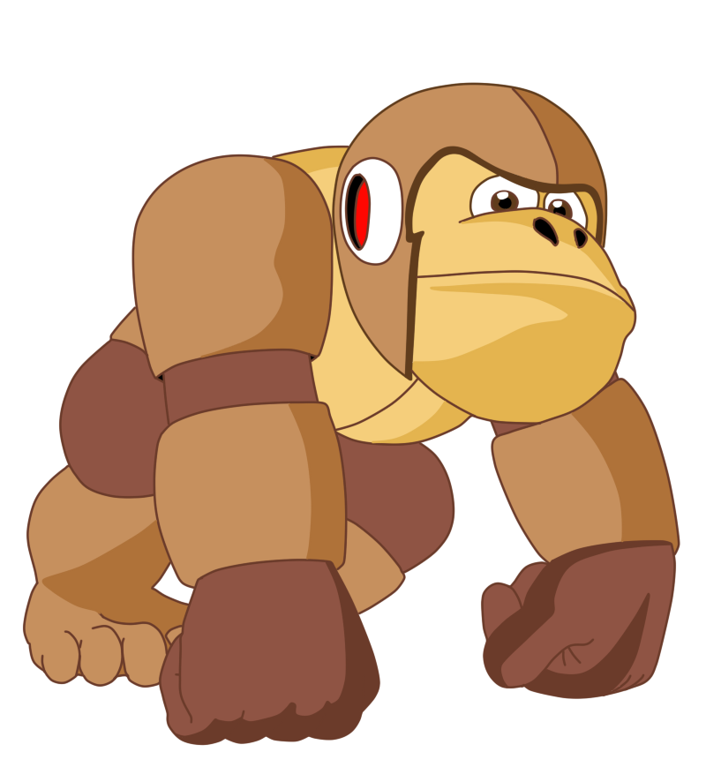
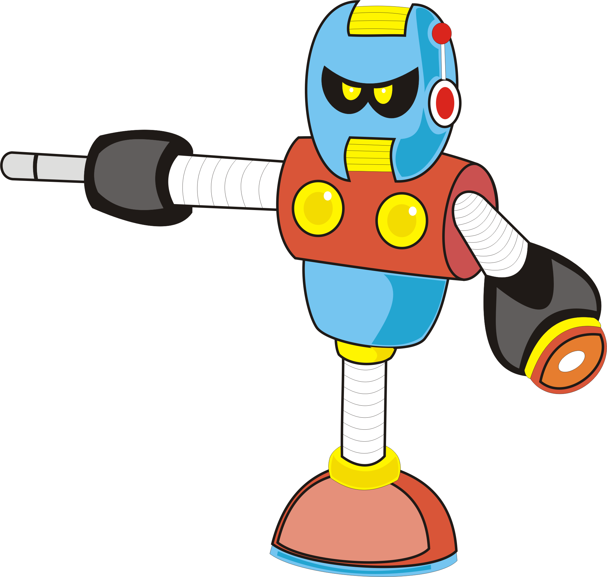
[The Characters of Rockbot 1]
No. 001
Ape Bot
● Ivan Fiedoruk
● Iuri Fiedoruk
No. 002
Techno Bot
● Fabiano “Chikago” Saccol
● Iuri Fiedoruk

Slide 20
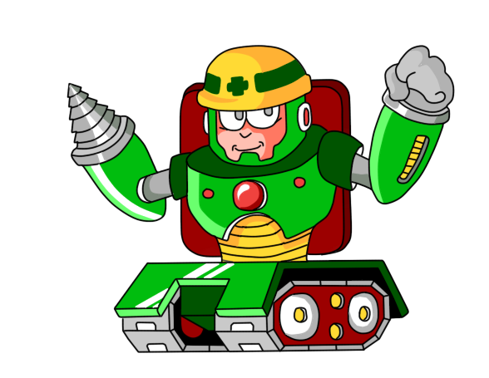
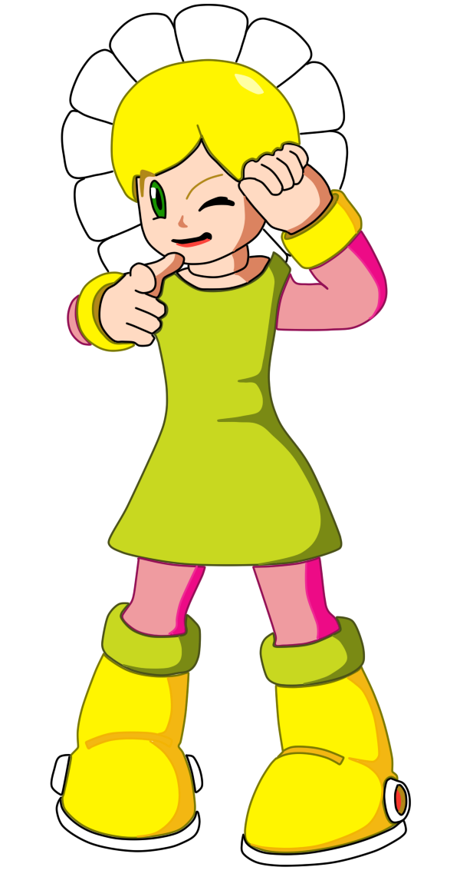
No. 003
Dynamite Bot
● Giuliano “Kobold” Saccol
● Iuri Fiedoruk
No. 004
Daisie Bot
● Arismeire Kümmer Silva Fiedoruk

Slide 21
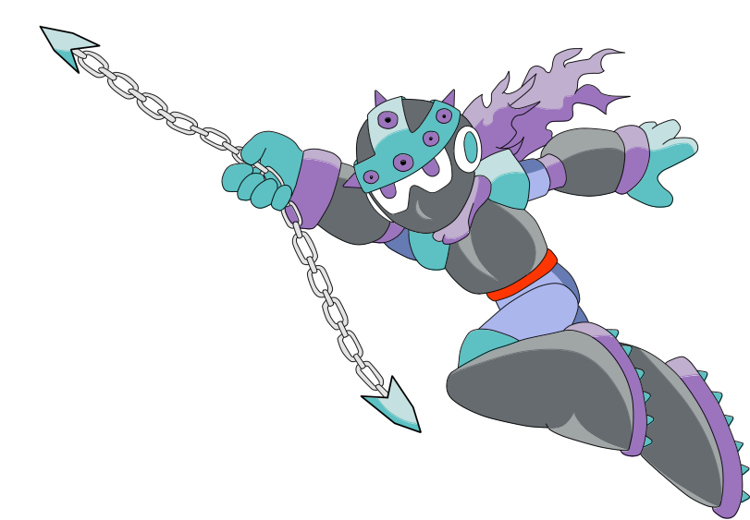
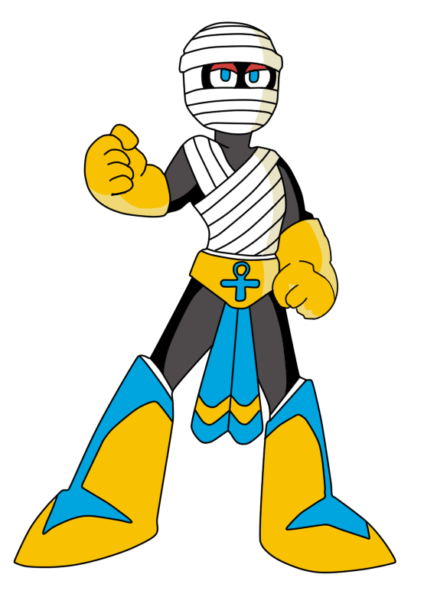
No. 005
Spike Bot
● Iuri Fiedoruk
No. 006
Mummy Bot
● Arismeire Kümmer Silva Fiedoruk

Slide 22
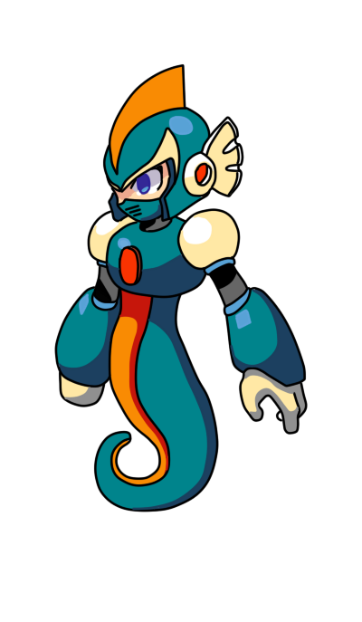
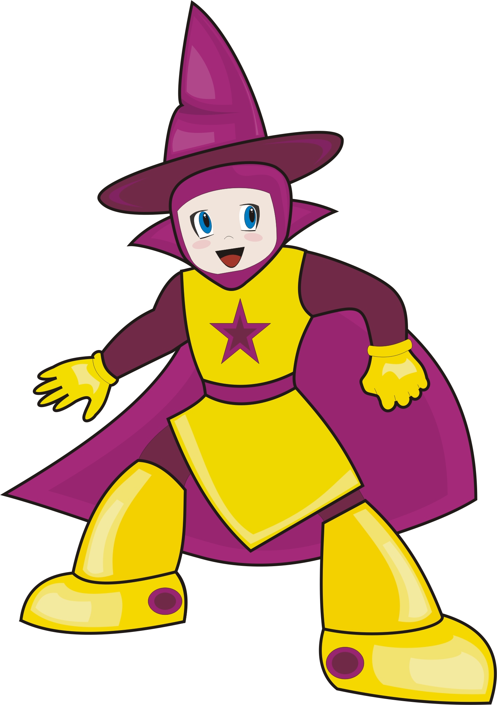
No. 007
Seahorse Bot
● Arismeire Kümmer Silva Fiedoruk
● Iuri Fiedoruk
No. 008
Mage Bot
● Arismeire Kümmer Silva Fiedoruk

Slide 23


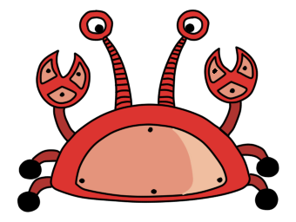

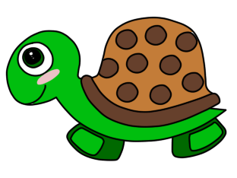
Ghost
Tucano
Siri
Penguin
Turtle

Slide 24
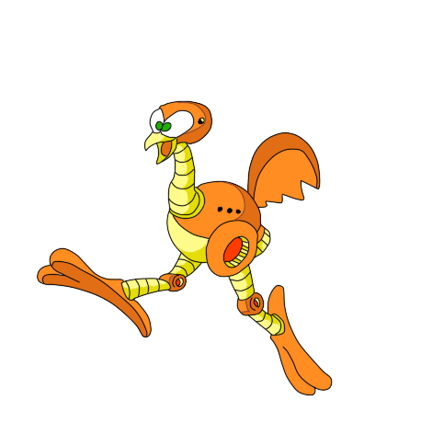
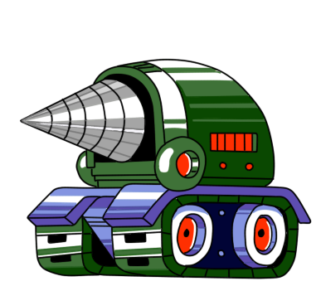
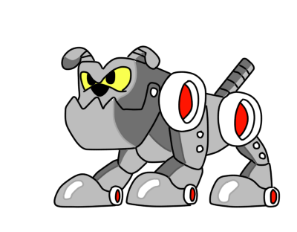

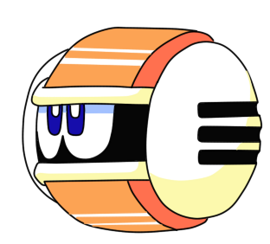
Ema
Driller
Bulldog
Fat Bee
Cannon Ball

Slide 25
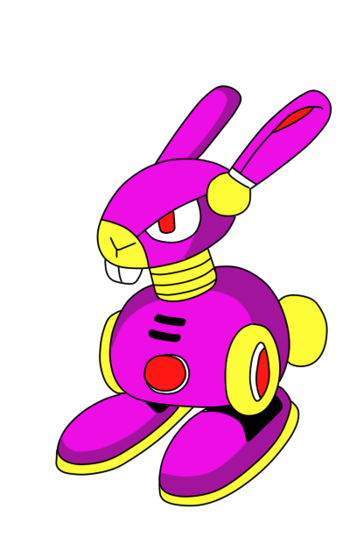
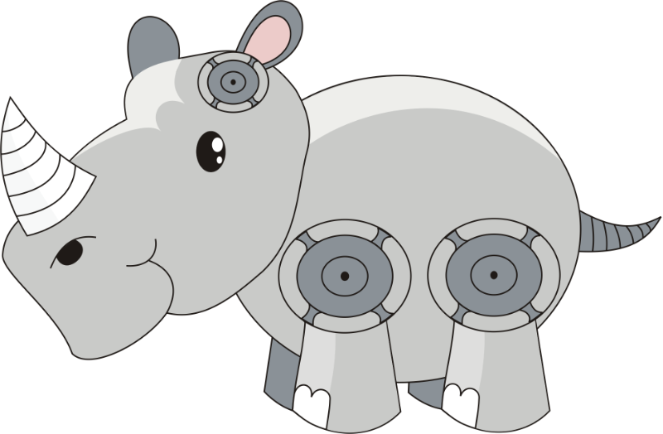
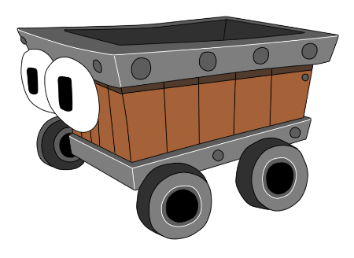

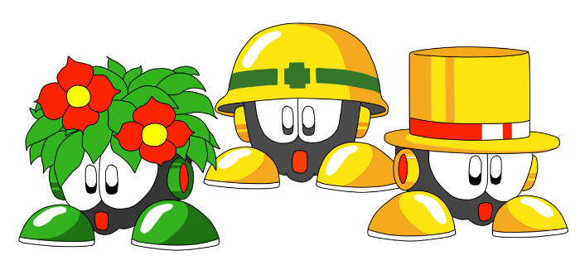
Trick Rabbit
Rhino
Mine Cart
Spinning Blade
Metools

Slide 26

THE STORY
OF
ROCKBOT

Slide 27
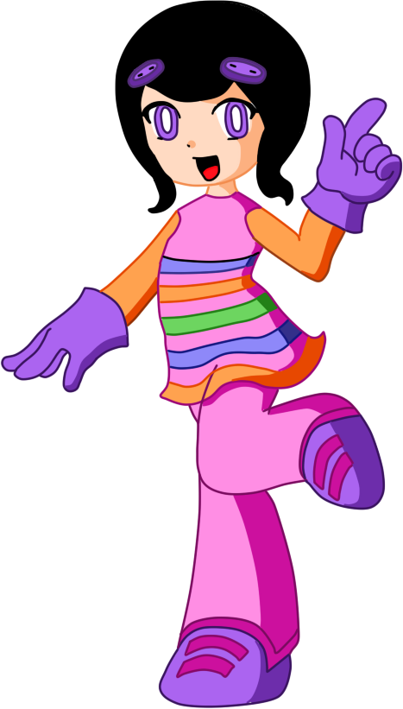
ROCKBOT STORY
In the year 200X, industrial use humanoid robots have been created thanks to the steady progress of science. These robots can work round the clock tirelessly 24 hours a day, at a superhuman rate.
Then one day, some shocking news arise in Tokyo: “The robots have begun going out of control one after another! At this rate, mankind will be ruled by robots!”
Fearing to have the same destiny, the city of Kyoto prepare for the worse. One night, the fear becomes truth, an horde of unknown robots attack.
Being unable to stop the enemies, the city security forces call for help from the university's scientists in order to create warrior that match the enemies strength One professor comes with a project for fighter robots. After his first construct is unstable and unwary, he improves the project and build other one to fight along.
Now, even without being fully tested and stable, both robots, born to fight, will have to prove their value and become heroes saving the city.
Go! Go! BETABOT and ROCKBOT!! Only you can defeat the 8 robot masters, and find out who is responsible for this violence!

Slide 28
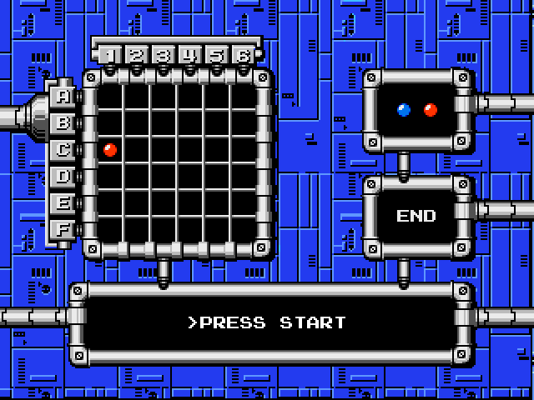
[About Password]
After clearing a stage or getting a Game Over, a password like the one in the image above will be displayed. The bosses you’ve defeated, as well as the weapons and items you’ve obtained will be stored in the password according to the location of the chips. (The player count is not saved, however.)
Come time to input the password, use the A Button to select a chip color, then move the cursor to the proper location and press the A Button again to place each chip.
The A Button can also be used to remove a chip that’s already been placed.

Slide 29
This product is based on characters from the Mega Man (Rockman) game that is trademark and copyright of Capcom Inc.
The source code is licensed under the GPL2 and is freely available at http://www.sf.net/projects/rockbot-game.
All sound effects are copyright of Capcom Inc.
Music was obtained from http://modarchive.org and is licensed under Mod Archive Distribution.
Mega Man character graphics is copyright of Capcom Inc.
Original Rockbot graphics are licensed under CC Share Alike and copyright of Upperland Studios.
Upperland Studios
Condomínio Jardim América, bl. 34.
Bairro Santo Antônio, Porto Alegre, RS, Brasil.
CEP 90640-190.
protoman@upperland.net
http://rockbot.upperland.net/
For use in all countries in the world.
Have fun and create more games!

Slide 30
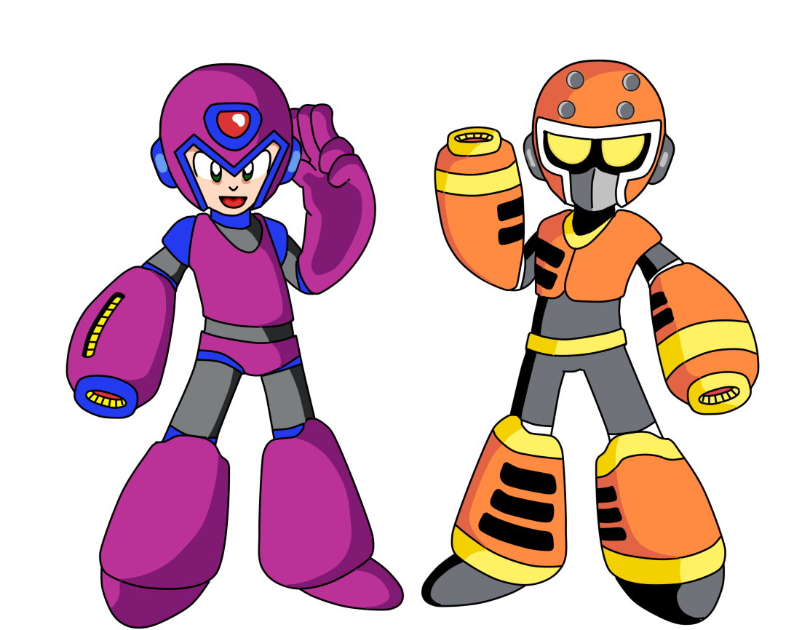

© 2009-2014 Upperland Studios. All rights reserved.

