Slide 1

Умные часы
с использованием машинного обучения

Slide 2
Описание продукта
Название рынка
But I must explain to you how all this mistaken idea of denouncing pleasure and praising pain was born and I will give you a complete account of the system, and expound the actual teachings of the great explorer of the truth, the master-builder of human happiness. No one rejects, dislikes, or avoids pleasure itself, because it is pleasure, but because those who do not know how to pursue pleasure rationally encounter consequences that are extremely painful.
But I must explain to you how all this mistaken idea of denouncing pleasure and praising pain was born and I will give you a complete account of the system, and expound the actual teachings of the great explorer of the truth, the master-builder of human happiness. No one rejects, dislikes, or avoids pleasure itself, because it is pleasure, but because those who do not know how to pursue pleasure rationally encounter consequences that are extremely painful.

Slide 3
Конкуренты
Конкуренты: But I must explain to you how all this mistaken idea of denouncing pleasure and praising pain was born and I will give you a complete account of the system, and expound the actual teachings of the great explorer of the truth, the master-builder of human happiness.
уникальность продукта: But I must explain to you how all this mistaken idea of denouncing pleasure and praising pain was born and I will give you a complete account of the system, and expound the actual teachings of the great explorer of the truth, the master-builder of human happiness.
Почему мы лучше? But I must explain to you how all this mistaken idea of denouncing pleasure and praising pain was born and I will give you a complete account of the system, and expound the actual teachings of the great explorer of the truth, the master-builder of human happiness.

Slide 4
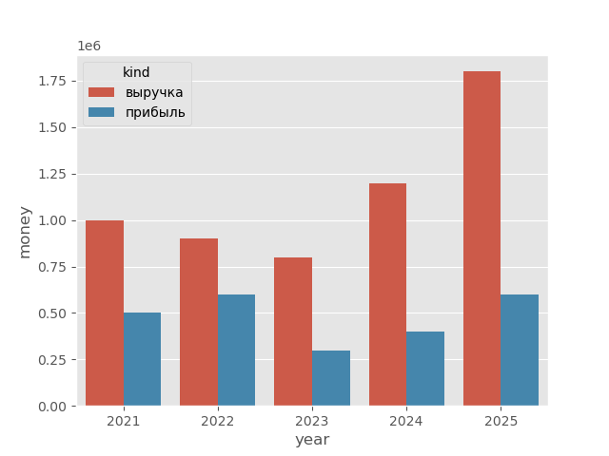
Финансовые показатели
выручка(2024) - 1200_000.045
прибыль(2024) - 400_123.43
прогн. выручка(2025) - 1800_000.045
прогн. прибыль(2025) - 600_123.43

Slide 5
Описание сделки
Описание сделки
But I must explain to you how all this mistaken idea of denouncing pleasure and praising pain was born and I will give you a complete account of the system, and expound the actual teachings of the great explorer of the truth, the master-builder of human happiness.
Цель инвестиций
But I must explain to you how all this mistaken idea of denouncing pleasure and praising pain was born and I will give you a complete account of the system, and expound the actual teachings of the great explorer of the truth, the master-builder of human happiness.

Slide 6
Команда
• Ivan Ivanov position: Senior DevOps experience: 10
• Boris Ivanov position: Senior Frontend experience: 8
• Ivan Borisov position: Senior Backend experience: 11
• Boris Borisov position: Senior MLE experience: 6
• BIvan BIvanov position: Product Manager experience: 15

Slide 7

Контакты
ФИО: Иванов Григорий Никовлаевич
Номер телефона: +7 995 192 29 21
Электронная почта: ivanov@gmail.com
Телеграмм: @ivanov

