Slide 1
Continuous Carbon Cycle
The Open Impact Toolchain

Slide 2
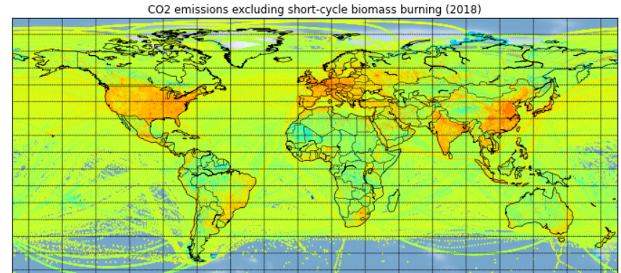
True Sustainability is Open
Acceleration
Emissions Database for Global Atmospheric Research
Climate change needs a massive acceleration of innovation in the next year to transform technology. The open source movement has fast-tracked the most innovative areas such as AI, robotics, cloud or blockchain.
Transparency and Trust
Sustainability is massively misused for marketing purposes. By publishing life cycle assessments, data sets and models, we can create an open measure of what is actually sustainable.
Collaborative
Openness enables organizations, individuals, and companies around the world to participate in finding solutions together.

Slide 3

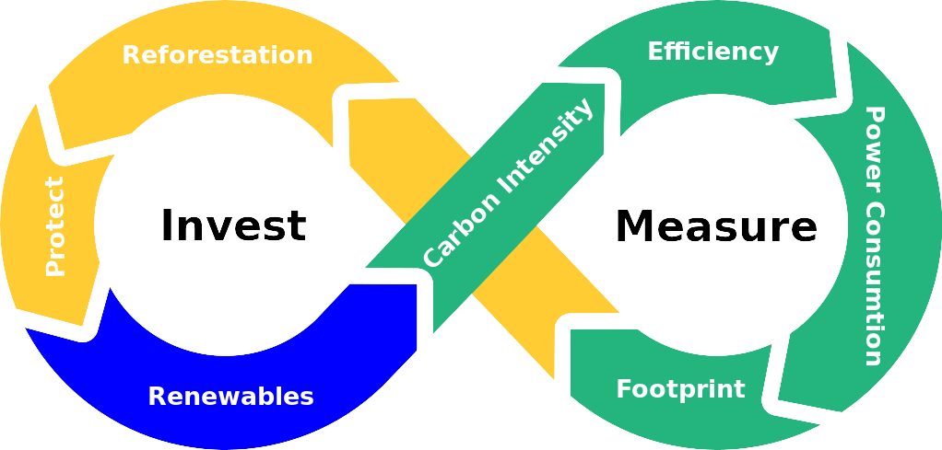
Continuous Carbon Cycle
Creating an open toolchain to measure and reduce the environmental impact of your organization.
Measure the power consumption and carbon intensity
Estimate the efficiency within your work processes
Create a public investment strategy to reduce your environment footprint
Publish data, dashboard, roadmap and models of your impact
Collaborative and open definition of standards based on software tools

Slide 4


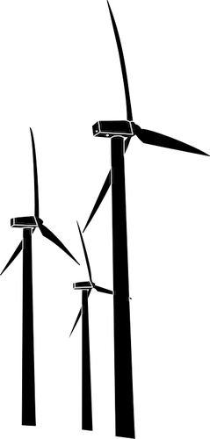



Open Climate Pledge
Impact
Measurement
Transition
Strategy
Invest and Act
Biodiversity
Power consumption
Energy efficiency
GHG emissions
Ecostress
Assessment of buildings for renewables
Optimize energy efficiency within your company
Invest into renewable energy
Invest into protection and recovery of nature
Software
Models
CO2 intensity
Energy mix
CO2 per tree
Social impact

Slide 5
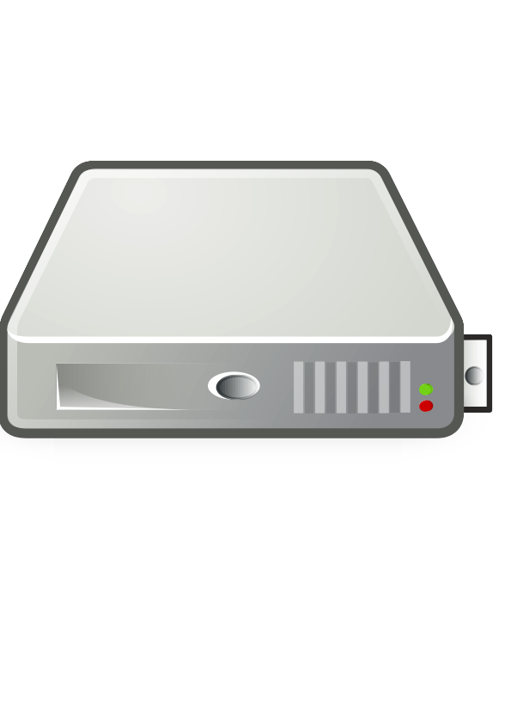



Minimal Viable Product
Visualize power consumption and optimization potential
Total power consumption of digital infrastructure
After optimization, offset remaining carbon emissions by planting trees accordingly
Schedule power intense computations
Real time and predicted carbon intensity for server location

Slide 6
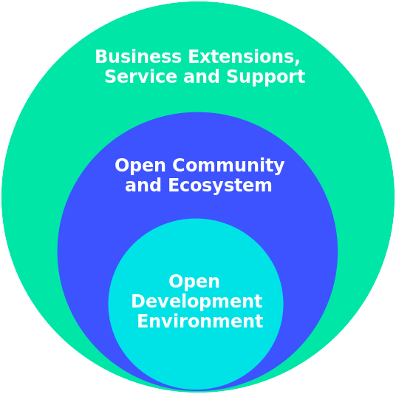


Open Core Ecosystem
Open Core Business Models
Open Toolchain and Knowledge Base
Independent Support, Consulting and Application

Slide 7
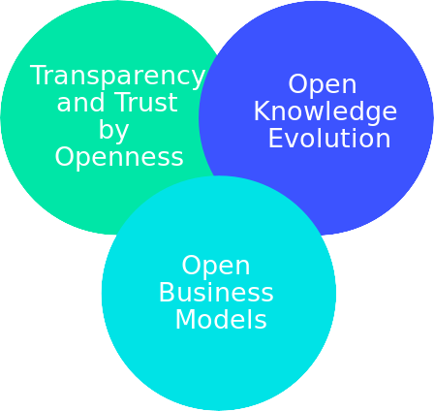




Contact us:
Tobias Augspurger: tobias.augspurger@protontypes.eu
Tjark Döring: tjark.doering@protontypes.eu

