Slide 1
Open Accelerator for Free and Sustainable Innovation

Slide 2


Who we are
„We believe that independent and open innovation offers a real chance to reach our climate goals together.“
Arne, Dennis, Felix, Johannes, Nick, Tobias, Tjark

Slide 3

Standing in the shoulders of giants
70 % of the worldwide code base is open source [1]
Fast Innovation in Software Development
  Cloud Computing [2]
  High Performance Computing [3]
  Artificial Intelligence [4]
  Robotics [5]
  Web Technology [6]
  Blockchain [7]
"If I have seen further it is by standing on the shoulders of Giants."
- Isaac Newton
Wikipedia

Slide 4
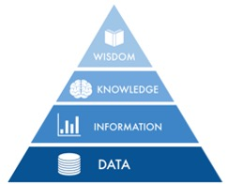
Why is Modern Software Development so Innovative?
Closed Knowledge
30 %
70 %
Open Knowledge
Open knowledge is preserved in industries, research and education. Even if organizations or projects fail, they contribute to knowledge growth.
Others can build upon this knowledge.

Slide 5



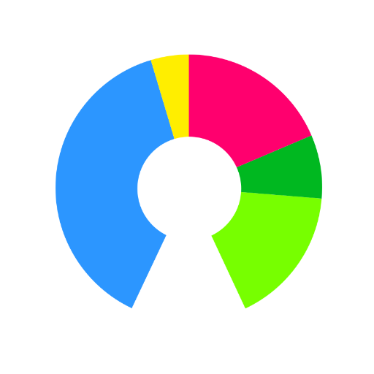
What is the Secret?
Open (Core) Business Models [1]
Open Standards
Inner Source -
Open Source Culture
within Organizations [2]
Open Data
Sustainble technology needs to be developed with sustainable methods.

Slide 6

Mapping Open Sustainable Technology
Open source projects sustaining stable climate, energy supply and vital natural resources
Provision of the first global list mapping all sustainable, active and open technology projects.
Everyone can contribute and extand the list.
All projects are free and open and are sustable for professional usage
Only in this way can the access to vital resources such as stable climate, soil or water be secured for everyone in the long term.

Slide 7
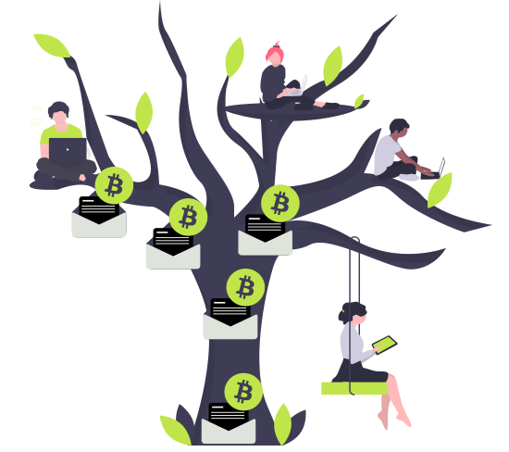
Open and Automated Funding Pool
protontypes will provide a globally transparent and open funding pool for sustainable technology.
Projects on the list will have the opportunity to apply for continuous funding.
LibreSelery will distribute the donations on the list selectively and randomly.

Slide 8
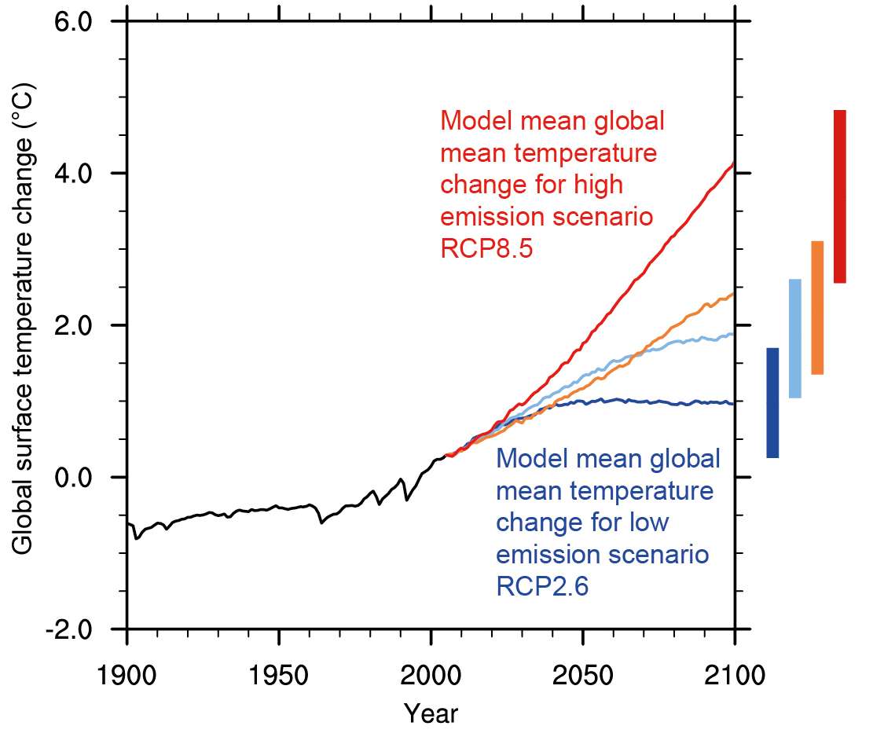
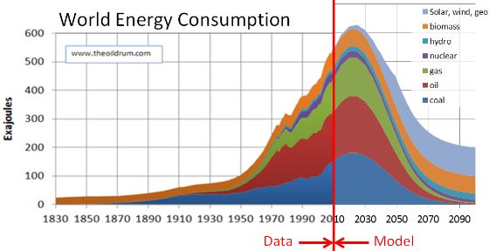
A real chance to reach global climate targets
By spreading knowledge in this domain with open software, design, standards, tools, and platforms a sustainable economy can be reached in a short timespan.

Slide 9

What can you contribute?
Don’t make a patent, but license smartly
Talk about it
Use open technology
Donate
Write source code, report and fix bugs, add features, …
Create and label datasets
Don’t be afraid do make mistakes, experiment and be creative!

Slide 10

Get support from us!
Building and empowering communities around innovative ideas
Providing simple and direct donation distribution to developers
Consulting for business models and strategies in research and industry
Development and application of sustainable funding concepts
Initiating ideas and concepts

Slide 11
Thank you for your attention!
Contact us:
contact@protontypes.eu
Tobias Augspurger: …
Tjark Döring: ...

