Slide 1
The distribution of financial resources
in open source projects

Slide 2



Standing on the shoulders of giants
Open source is the cooperative, open and global demonstration of technology combined with knowledge transfer and proof.
The scientific consensus on which our prosperity is built upon, uses the same principle.
“Knowledge is a collective tradition”
- Dr. Vandana Shiva
"If I have seen further it is by standing on the shoulders of Giants."
- Isaac Newton

Slide 3
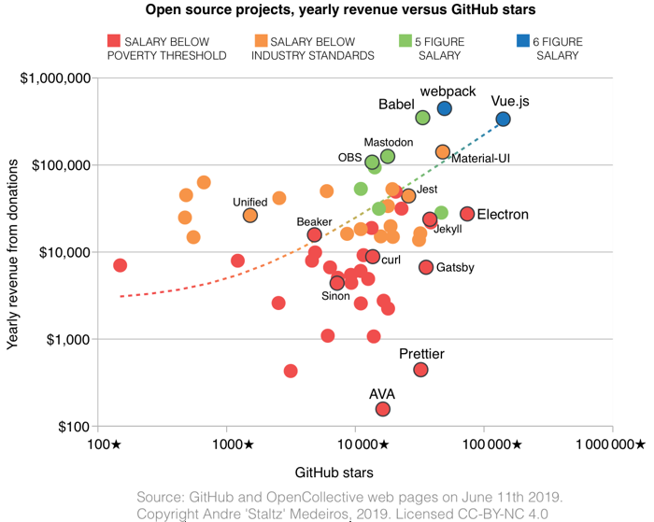

Distribution Problem in Open Source
Open Source is a billion dollar business. [1]
Around 70% of the code base in software product is today open source. [2]
Profit from open source creates a distribution problem between product developers and the open source community:
"Food chain of open source", where the product-producing company takes all the profit. Dependencies are usually not included in the profit.
Donations and funds are only distributed to individuals. The rest of the community usually goes away empty-handed.
Platforms such as Github threaten the freedom of open source users by traping them on the platform. Changing the platform without loosing all "sponsors" get impossible

Slide 4









Tools vs. Platform
Decentralised approach
Use requires more knowledge
User is empowered
Full transparency
Low fees
Dependent projects are included in the financing
Community can determine integration, design and function.
Centralised approach
Very simple to use
User / community has no influence on integration, design or function
Intransparent for the user
High fees

Slide 5
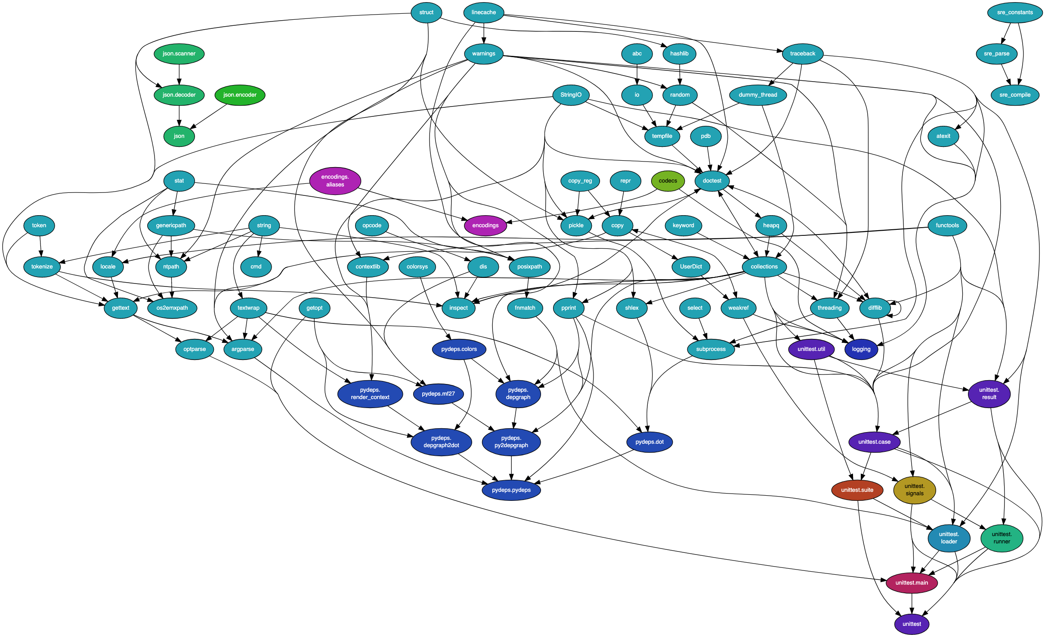
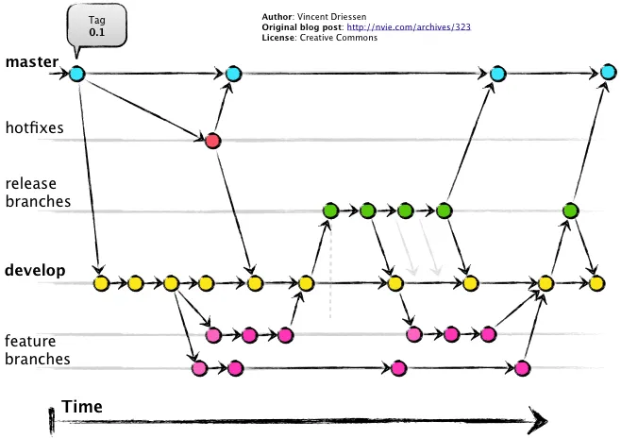











Distribution through a Transparent Algorithm
+
Execution trigger
LibreSelery
Configuration selery.yml
Version controlled project
files and dependencies
Payment system
Transaction history and log files
Project / development team

Slide 6

Running LibreSelery in Continuous Integration
Payout is executed in a complete transparent and public way
Can be intregrated into different Git and CI/CD platforms.
Tokens of payout methods are stored in a safe way.
Abuse of the system is visible for everyone.

Slide 7

The Power of Free Tools
LibreSelery is a tool and thus allows creative applications, platforms, services and products to be built on top of it. Here are some examples:
One-time or recurring personal donation to any open source project.
Distribution of salaries within companies through a monthly trigger.
Automated distribution of collected donations and profits using Continuous Integration within open source projects.
Building open, transparent and automated investment funds.
Companies create a list of open source projects they use and distribute money to them.
Project managers describe a project with work packages, tests and goals and let the open source community work for them.
[1]

Slide 8




Integration of the Project Dependencies
Project Repository
Bibliothecary
Libraries.io API via Pybraries
Github API via PyGithub
https://github.com/librariesio/bibliothecary
https://github.com/pybraries/pybraries
https://github.com/PyGithub/PyGithub
setup.py
Gemfile
...
package platform
+ project name
Project URL
Contributer Name
+ Email

Slide 9
Lessons Learned
Feedback from projects like GNU or Debian:
Only programming languages with packing systems like Python can be integrated. Other languages like C++ cannot be scanned for dependencies. Dependencies need to be manually declared.
The individual projects should decide how to distribute the funding. They cannot decide how to distribute the funds among the dependent contributors
Each project should be able to create their own plugin / metric on how to measure contribution.
Bitcoin is not a good payment method: Not stable value and very high energy demand that make the global usage as payment method impossible
Contributors should have an op-in option, rather than opt-out for receiving emails. The email scanning and sending could be considered as spam.
LibreSelery is like a bank. It describes a system for distributing money between parties. Since nobody knows the contributors to LibreSelery, most people do not trust our software solution.
Distribution between dependencies and projects contributors should be separated into two different projects / tools.

Slide 10

Contribution Credit Standard
Each project self-declares how the funds within the project are distributed.
5 %
foo
5 %
5 %
EMACS
bar
GNU GCC
5 %
Python Plugin
2 %
Project A
10 %
3 %
git
Project B
Project “wallet” address:
Dependencies URL:
Weights to distribute between dependencies and main project.
20 %
Tar
Proposed by Jose E. Marchesi of GNU:
https://github.com/protontypes/LibreSelery/issues/189#issuecomment-717203735

Slide 11
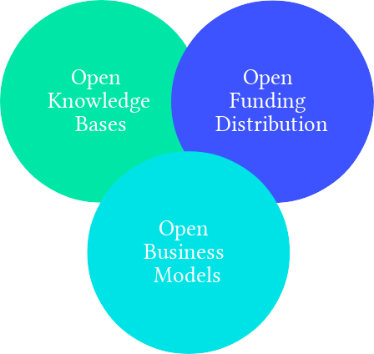



An independent and non-profit organisation that supports sustainable research and business development based on free and open technology.
Follow or Join us:
Contact us:
Tobias Augspurger: tobias.augspurger@protontypes.eu
Tjark Döring: tjark.doering@protontypes.eu

