Slide 1
Open Accelerator for Free and Sustainable Innovation

Slide 2

Who are we?
Bilder vom Team
(Felix, Johannes, Tobias, Tjark)
Logo LibreCelery, Protontypes

Slide 3
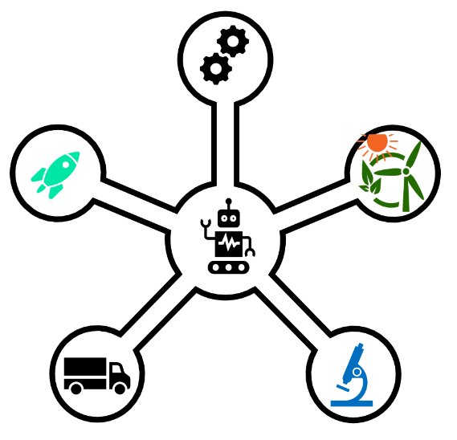
Knowledge Transfer by FOSS
Change image
Free SVGs!!

Slide 4
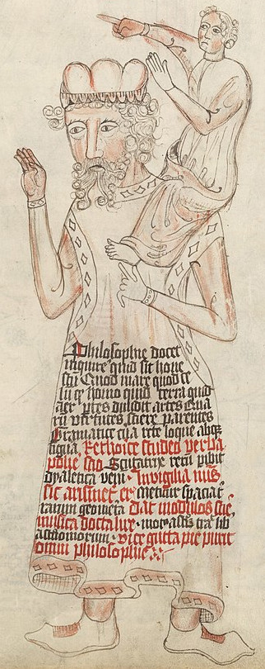
Standing in the shoulders of giants
Examples for areas dominated by Open Technology:
  Cloud Computing
  High Performance Computing
  Artificial Intelligence
  Robotics
  Web technology
"If I have seen further it is by standing on the shoulders of Giants."
- Isaac Newton
wikipedia

Slide 5
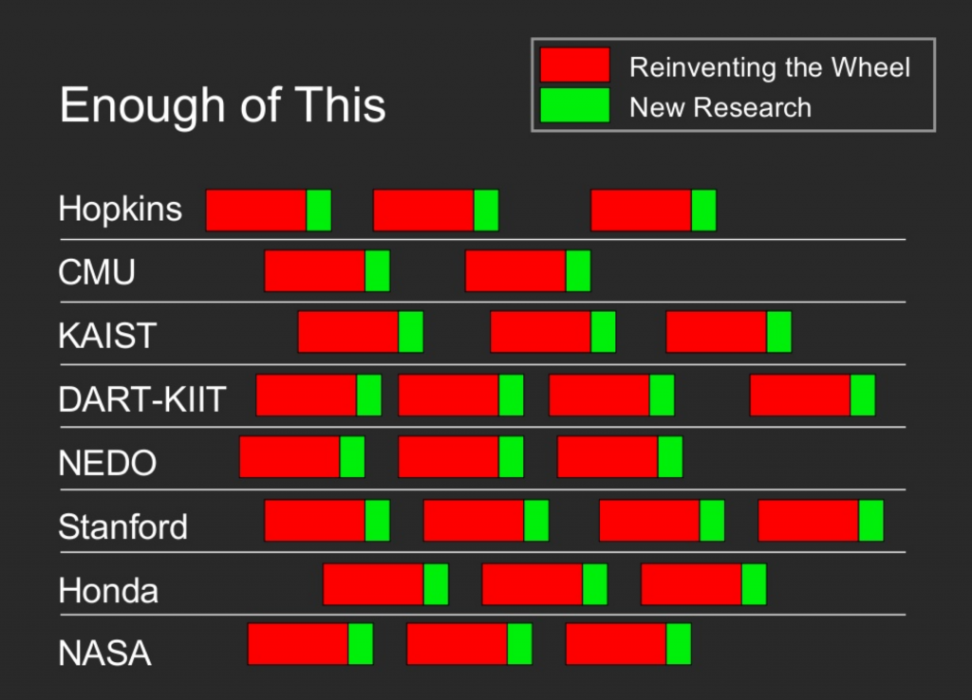
Stop Reinventing the Wheel
Reinventing the wheel is one of the major stumbling blocks
Up to 70 % of the dev costs can be saved

Slide 6

Awesome List – Sustainable Tech
Awesome List to facilitate these goals
Curated for recency
Please contribute
Hyperlink zur Liste

Slide 7
What can you contribute?
Don’t make a patent, but license smartly
Talk about it
Use open technology
Donate
Write source code, report and fix bugs, add features, …
Create and label datasets
Don’t be afraid do make mistakes, try yourself. Have fun!

Slide 8
Get support from protontypes
Consulting for education, research and industry
Investigations on open technologies
Development of sustainable funding concepts (LibreSelery)
Initiating ideas/concepts

Slide 9
Thank you for your attention!
Contact us:
team@protontypes.eu
Tobias Augspurger: …
Tjark Döring: ...

Slide 10
Our Message
Diese Folie später löschen!
Offene Technologien bestimmen schon wesentliche Teile unser Leben
  Innovativ
  Weit verbreitet
Open Sustainable technology allows everyone access to it and enables them to adapt it to their needs.
  And everybody can contribute to help shape the world

