Slide 1
protontypes Roadmap

Slide 2


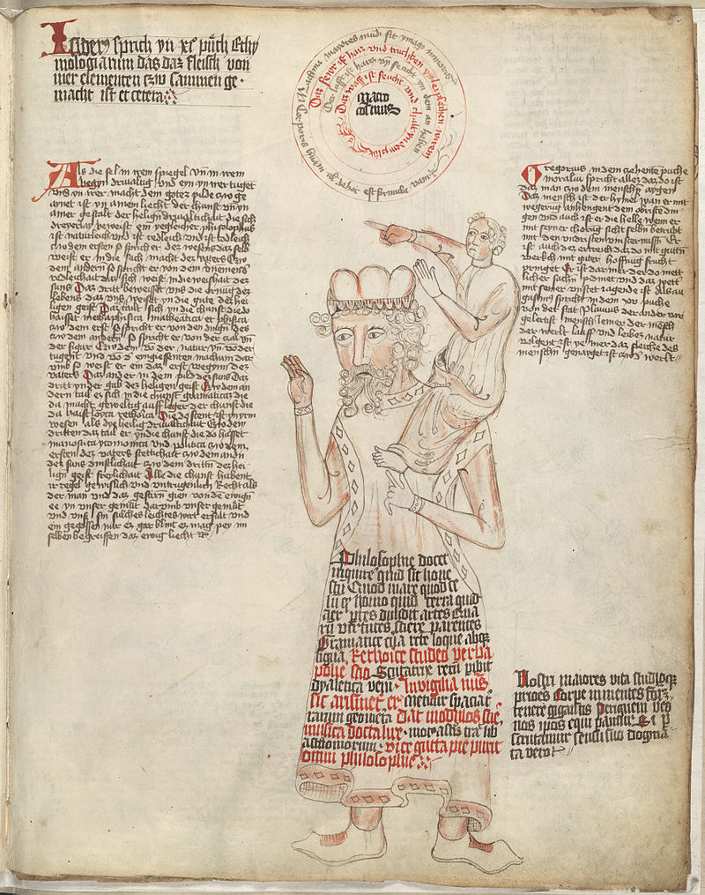
Standing on the shoulders of giants
Open source is the cooperative, open and global demonstration of technology combined with knowledge transfer and proof.
The scientific consensus on which our prosperity is built upon, uses the same principle.
“Knowledge is a collective tradition”
- Vandana Shiva
"If I have seen further it is by standing on the shoulders of Giants."
- Isaac Newton

Slide 3
Monetization of Open Source
LibreSelery, Flossbank and FairOSS Joint Venture
Contribution Credit Standard
Open Source Business Models
OpenSustain.fund
OpenSustain.Academy
Spread the Idea of OpenSustain
Hackerthons
An Open Example School about Sustainability Technology with Open Tools and Courseware
Modular School Framework
  Jitsi (Videocall)
  Excalidraw (Whiteboard)
  Markdown & Hackmd (Cooperative Writing)
  LibreOffice
  Jupyter Notebook ( Simple Coding)
  Gitter (Open Chat)
  Videoediting ( Course Creation)
  …..
OpenSustain.tech
Blog Posts about humans and technology on OpenSustain.tech
Marketing of OpenSustain.tech
Branding, Hoodie, Badge,…
OpenSustain.fund: Run LibreSelery on OpenSustain.tech + Continuous Reforestation

Slide 4
OpenSustain.Academy
1. Awesome List for Academy
2.Hackerthons
3.Networking and Partnering
GNU and FSF

Slide 5
Continuous Reforestation
PR Request with one new Projects X on Github
Simulation run of LibreSelery
LibreSelery on Project X
Approval from Maintainer and Reviewer
Donation Pool
Donation Website

Slide 6

Contribution Credit Standard
Each project self-declares how the funds within the project are distributed.
5 %
foo
5 %
5 %
EMACS
bar
GNU GCC
5 %
Python Plugin
2 %
Project A
10 %
3 %
git
Project B
Project “wallet” address:
Dependencies URL:
Weights to distribute between dependencies and main project.
20 %
Tar
Proposed by Jose E. Marchesi of GNU:
https://github.com/protontypes/LibreSelery/issues/189#issuecomment-717203735

Slide 7



An independent and non-profit organisation that supports sustainable research and business development based on free and open technology.
Follow or Join us:
Contact us:
Tobias Augspurger: tobias.augspurger@protontypes.eu
Tjark Döring: tjark.doering@protontypes.eu

