Slide 1
Open Accelerator for Free and Sustainable Innovation

Slide 2


Who we are
„We believe that independent and open innovation offers a real chance to reach our climate goals together.“
Arne, Dennis, Felix, Johannes, Nick, Tobias, Tjark

Slide 3

Knowledge Transfer by FOSS

Slide 4
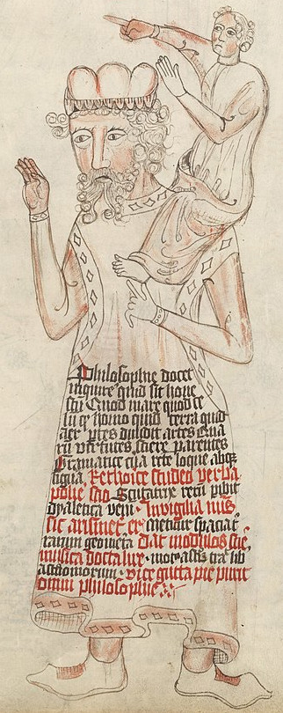
Standing in the shoulders of giants
Exp. for areas dominated by Open Technology
  Cloud Computing
  High Performance Computing
  Artificial Intelligence
  Robotics
  Web Technology
"If I have seen further it is by standing on the shoulders of Giants."
- Isaac Newton
wikipedia

Slide 5
Building on free and existing knowledge
Intelectual property
Physics
Patents
All Knowledge
Closed Knowledge
Open Knowledge
70:30 Rule – Open:Business

Slide 6

Awesome List – Sustainable Tech
Awesome List to facilitate these goals
Curated for recency
Feel free to contribute
Awesome List

Slide 7
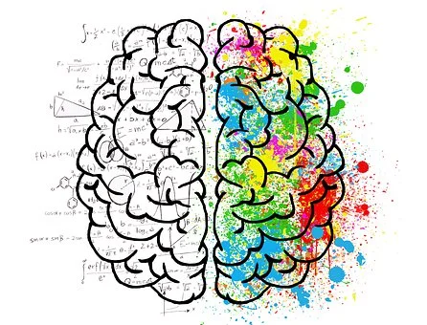
What can you contribute?
Don’t make a patent, but license smartly
Talk about it
Use open technology
Donate
Write source code, report and fix bugs, add features, …
Create and label datasets
Don’t be afraid do make mistakes, experiment and be creative!

Slide 8

Get support from us!
Consulting for education, research and industry
Building and empowering communities around innovative ideas
Development and application of sustainable funding concepts
Initiating ideas and concepts

Slide 9
Thank you for your attention!
Contact us:
contact@protontypes.eu
Tobias Augspurger: …
Tjark Döring: ...

