Slide 1
Standing on the Shoulders of Giants
Independent and open technology gives us a real chance to reach global climate targets

Slide 2
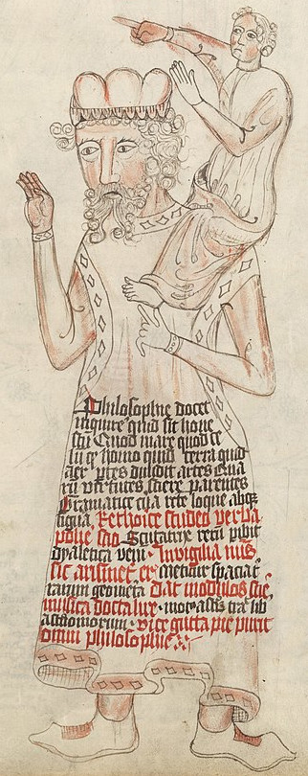
Standing in the shoulders of giants
Examples for areas dominated by Open Technology:
  Cloud Computing
  High Performance Computing
  Artificial Intelligence
  Robotics
  Web technology
"If I have seen further it is by standing on the shoulders of Giants."
- Isaac Newton
wikipedia

Slide 3
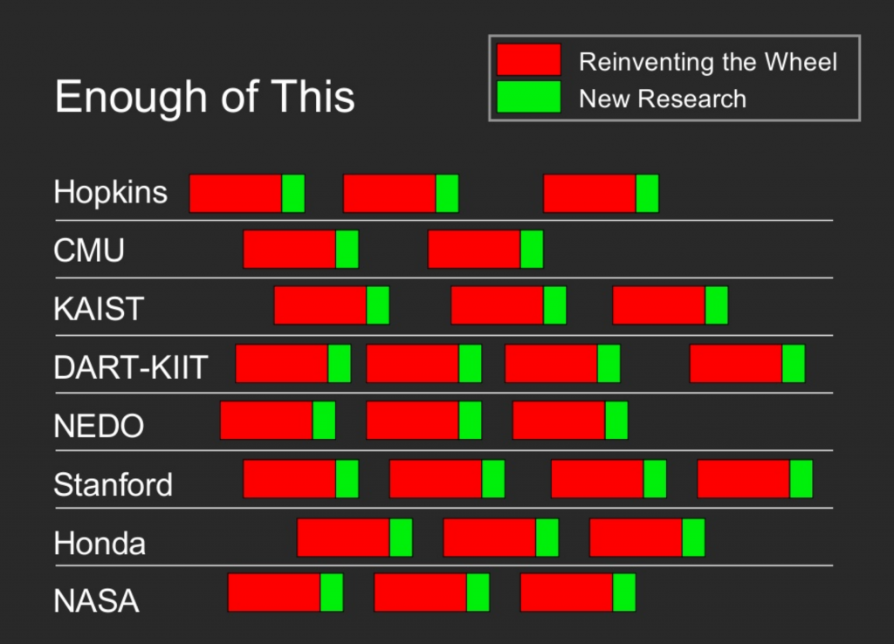
Stop Reinventing the Wheel
Reinventing the wheel is one of the major stumbling blocks
Up to 70 % of the dev costs can be saved

Slide 4

Awesome List – Sustainable Tech
Awesome List to facilitate these goals
Curated for recency
Please contribute
Hyperlink zur Liste

Slide 5
What can you contribute?
Don’t make a patent, but license smartly
Talk about it
Use open technology
Donate
Write source code, report and fix bugs, add features, …
Create and label datasets
Don’t be afraid do make mistakes, try yourself. Have fun!

Slide 6

Sustainable and Open Technology
Truly sustainable technology grants access to everyone
Everyone can adapt and improve it.
Together we can be fast and efficient.
By spreading free knowledge a sustainable economy can be achieved quickly.

Slide 7
Get support from protontypes
Consulting for education, research and industry
Investigations on open technologies
Development of sustainable funding concepts (LibreSelery)
Initiating ideas/concepts

Slide 8
Thank you for your attention!
Contact us:
team@protontypes.eu
Tobias Augspurger: …
Tjark Döring: ...

