Slide 1
Openness as a Measure for Sustainability

Slide 2

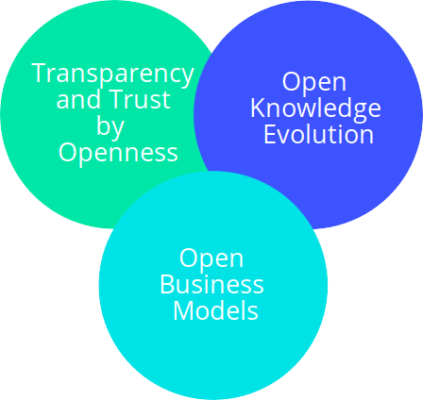

Open Community Accelerating Free and Sustainable Technology
Open Source Principles
Innovation Incubator

Slide 3

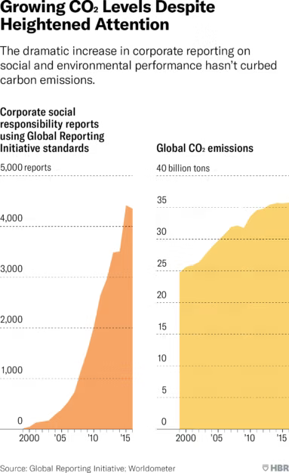
The Broken Climate Pledge
“One can claim net-zero emissions by only buying carbon offsets without actually reducing emissions at all.”
The World Needs Better Climate Pledges
“If the quality of that offset credit is identical to a reduction inside the program, you have no change in emissions, you just have lower costs.”
Carbon offsets aren't working, and probably can't
“The real danger is when politicians and CEOs are making it look like real action is happening when in fact almost nothing is being done.”
Overselling Sustainability Reporting

Slide 4
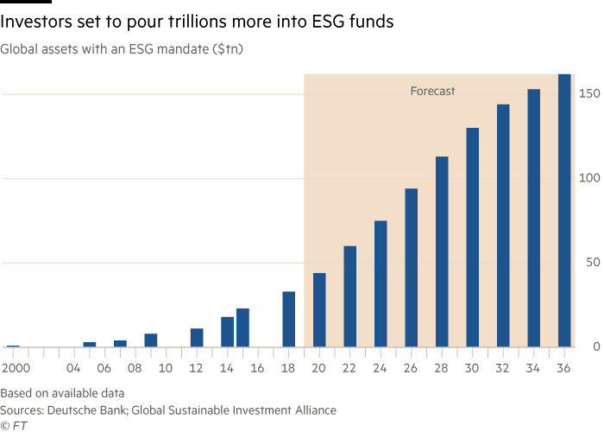
The Rise of Sustainable Investment

Slide 5
Hidden Knowledge Creation
What is the carbon footprint of my electric car?
Black Box
100 Grams CO₂ per kilometer driven
Political interests
Corporate interests

Slide 6


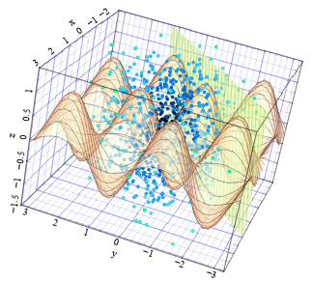




Traceable Knowledge Pipeline
Open principles create reproducible
and traceable knowledge creation.
Open Data
Open Server
Execution
Open
Results
Open
Science, Access and Conclusions
Open Install and run Description
Open
Discussion
Open Source
Models
and Tools

Slide 7






Open Climate Pledge
Impact
Measurement
Impact Modeling
Transition
Strategy
Invest and Act
Optimize energy efficiency within your company
Invest into renewable energy
Invest into protection and recovery of nature
Biodiversity
Power consumption
Energy efficiency
GHG emissions
Ecostress
Consumption of Resources
CO2 intensity
Used Energy mix
CO2 compensation
per tree
Social impact
Product Life Cycle
Assessment of
buildings for renewables
Definition of Goals and Milestones
Collaboration and Cooperation
Identification of economic and ecological measures

Slide 8

Attract Sustainable Investors by Open Sustainability

Slide 9
Open Climate Intelligence
Supporting your organization to demonstrate sustainability through openness.
Sustainability Measurement | Scientific Traceability
Open Science | Community Building and Open Business Models
Open Source Software Development | Licensing of Data and Software
Open Technology Scouting | Open Cooperation

Slide 10




Contact me:
Tobias Augspurger: tobias.augspurger@protontypes.eu

