Slide 1
Open Principles for
Sustainable Business Development

Slide 2

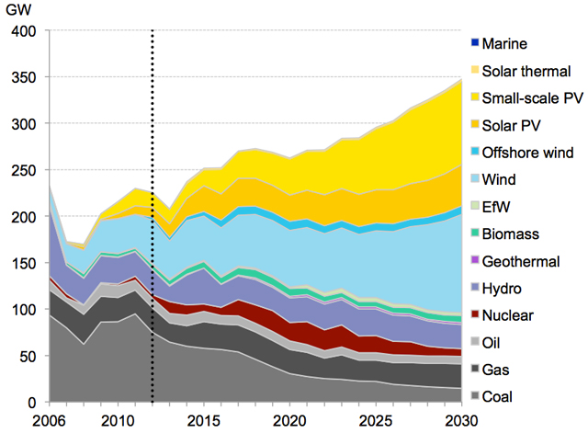
Climate Change - A Challenge in Collaboration
epa.gov
motherjones.com
How can we spread knowledge, accelerate innovation and increase cooperation in sustainable business development?

Slide 3

Evolution in Open Knowledge Creation
70 % of the worldwide code base is based on open source [1]
Open Collaborative Innovation in Software Development
  Cloud Computing [2]
  High Performance Computing and Big Data [3]
  Artificial Intelligence [4]
  Robotics [5]
  Web Technology [6]
  Blockchain [7]
  Embedded Operation Systems [8]
"If I have seen further it is by standing on the shoulders of Giants."
- Isaac Newton
Wikipedia

Slide 4
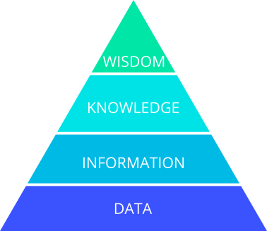
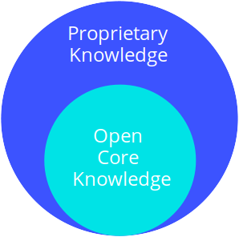
Why is Modern Software Development so Innovative?
Through the disclosure of information and knowledge, an innovative, resilient and independent business ecosystem has evolved within the software industry.

Slide 5





What is the Secret of Open Cooperation?
Open and Transparent Business Models [1]
Open Standards and Data
Reproducible Science and Knowledge
Inner Source -
Agile and Open Culture
within Organizations [2]
Open Community and Trust

Slide 6
Our Services
Open Research and Technology Scouting
Marketing and Support of Open Projects
Open and Sustainable Business Models
Knowledge Bases
Technology and Data
Partner and Community
Users and Contributors
Grants and Funding
Community Building
Open Core
Licencing
Cooperation

Slide 7
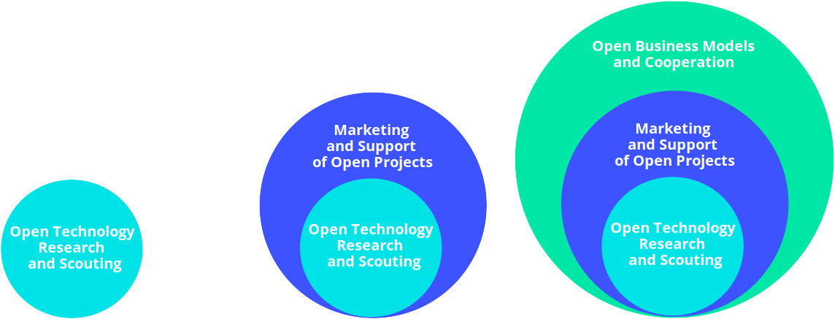
Our Open Core Business Model
Public Blog Post or Review Article about our Collaboration
Consulting Contract with a Freelancer of protontypes
Free of Charge

Slide 8
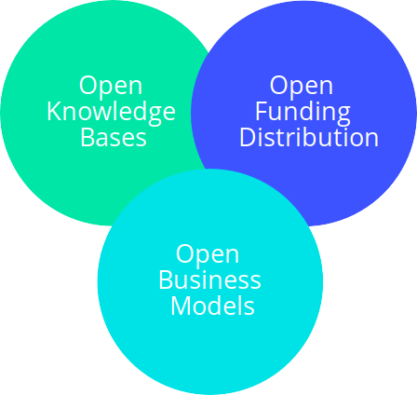




Join the Community
Contact us:
Tobias Augspurger: tobias.augspurger@protontypes.eu
Tjark Döring: tjark.doering@protontypes.eu

