Slide 1
An Open Accelerator for
Sustainable Business Development

Slide 2
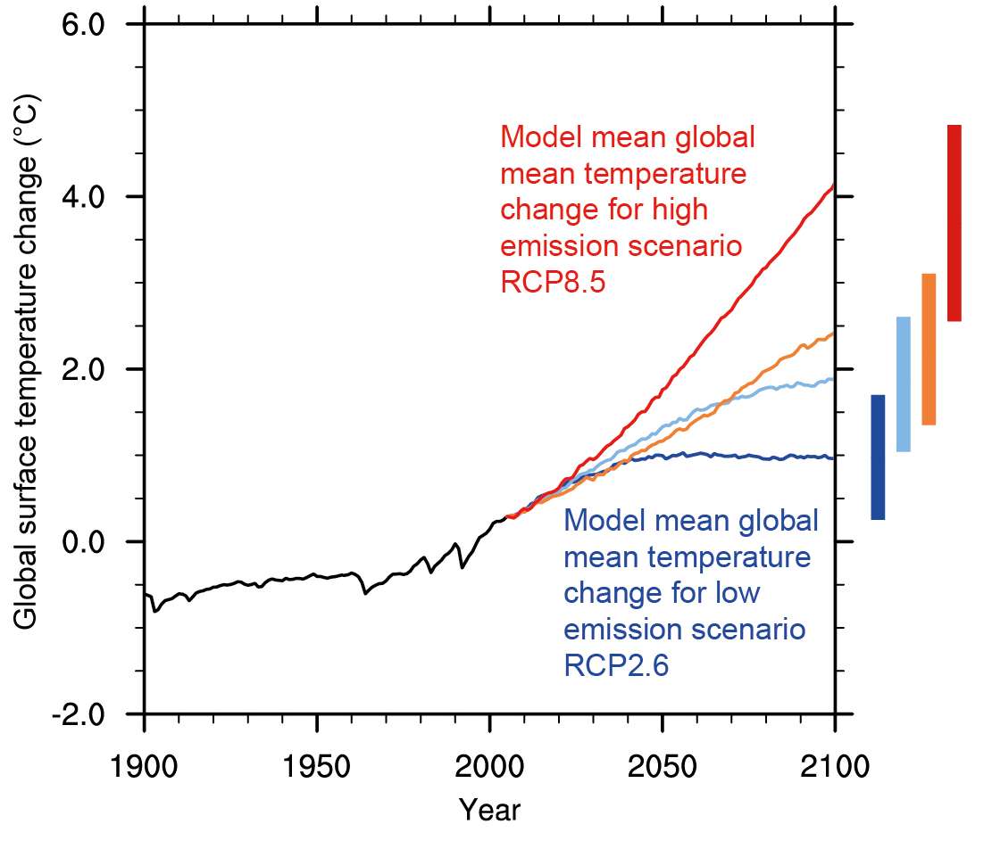
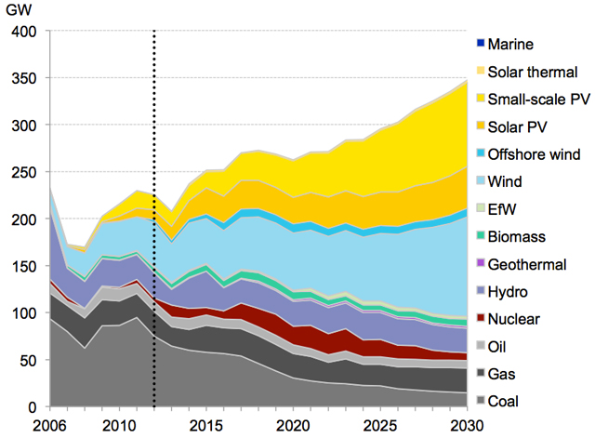
Climate Change - A Challenge in Collaboration
epa.gov
motherjones.com
How can we spread knowledge, accelerate innovation and increase cooperation in sustainable business development?

Slide 3
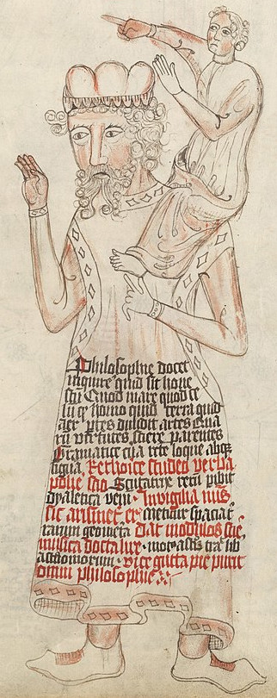
Evolution in Open Knowledge Creation
70 % of the worldwide code base is based on open source [1]
Open Collaborative Innovation in Software Development
  Cloud Computing [2]
  High Performance Computing and Big Data [3]
  Artificial Intelligence [4]
  Robotics [5]
  Web Technology [6]
  Blockchain [7]
  Embedded Operation Systems [8]
"If I have seen further it is by standing on the shoulders of Giants."
- Isaac Newton
Wikipedia

Slide 4

OpenSustain.tech
A global "button up" approach to map all worldwide resources for sustainable technology innovation and business development.
We support your organization to
„Stand on the Shoulders of Giants“

Slide 5
How can we accelerate Open and Sustainable Transition with limited Resources?
  Listing and Technology Scouting
    Hoodie
  Creating Blog Posts, Podcasts and Articles on different mediums to spread the idea
    OpenSource.com
    Medium
    ...
  Supporting Climathons and Hackethons worldwide
    ClimateHack
  Attending Conferences and Public Speaking to spread the idea
    ?
  Training and Education with summer schools or online schools / training
    Similar to https://www.apex.ai/autoware-course
  Building our own Open Climathon Event to support startups and people to be innovative
  Consulting for Startups and Companies for Open Technology and Methods Usage
    Brightmerge

Slide 6
OpenSustain.tech
How can we complete the list?
How can we self sustain the list?
How to motivate people to put projects by there own on the list?
OpenSustain.tech Hoddie
Contributor of the List get a Hoddie that is of very high quality and of good design.
What are the rulez to get a hoddie. How to avoid trash commits?
How to automate the distribution?
Who designs the Hoddie? Do we need a trademarke until then?
Girly vs Boys

Slide 7





What is protontypes?
Open and Transparent Business Models [1]
Open Source Standards and Data
Reproducible Science and Knowledge
Inner Source -
Agile and Open Culture
within Organizations [2]
Open Community and Trust

Slide 8
Our Services
Open Research and Technology Scouting
Marketing and Support of Open Projects
Open and Sustainable Business Models
Knowledge Bases
Technology and Data
Partner and Community
Users and Contributors
Grants and Funding
Community Building
Open Core
Licensing
Cooperation

Slide 9
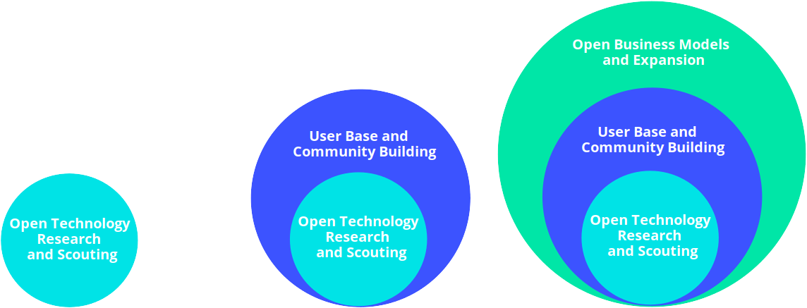
Our Open Core Business Model
Open and Free of Charge
Public Blog Post or Review Article about our Collaboration
Consulting Contract with a Freelancer of protontypes

Slide 10
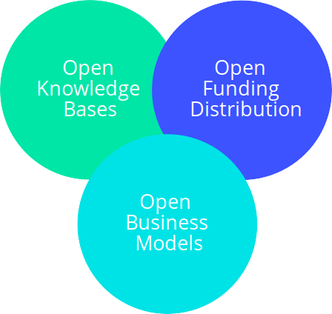




True sustainabilty is open
Join the Community
Contact us:
Tobias Augspurger: tobias.augspurger@protontypes.eu
Tjark Döring: tjark.doering@protontypes.eu

