Slide 1
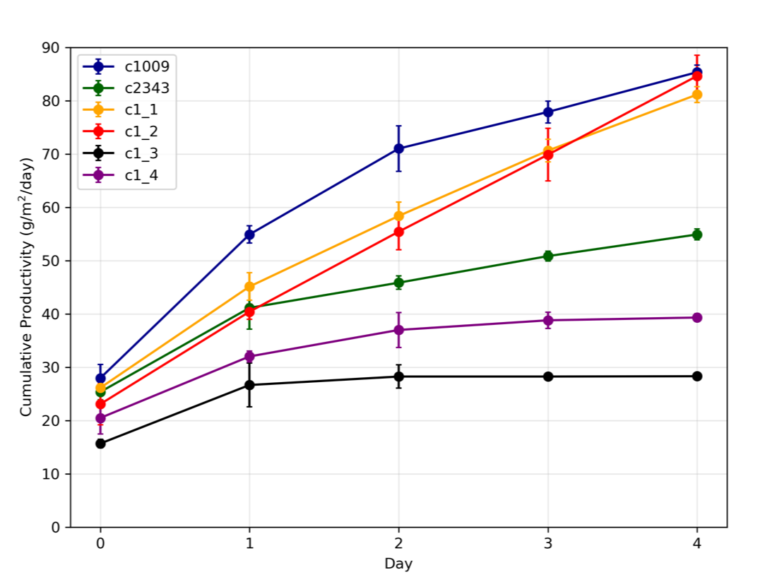
sealed sheath
Figure 3
fragmented sheath

