Slide 1
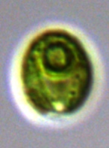
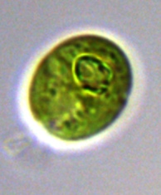
CC-1009
CC-1010
CC-1373
CC-1690
CC-2290
CC-2343
CC-2344
Supplementary Material Figure 1

