Slide 1
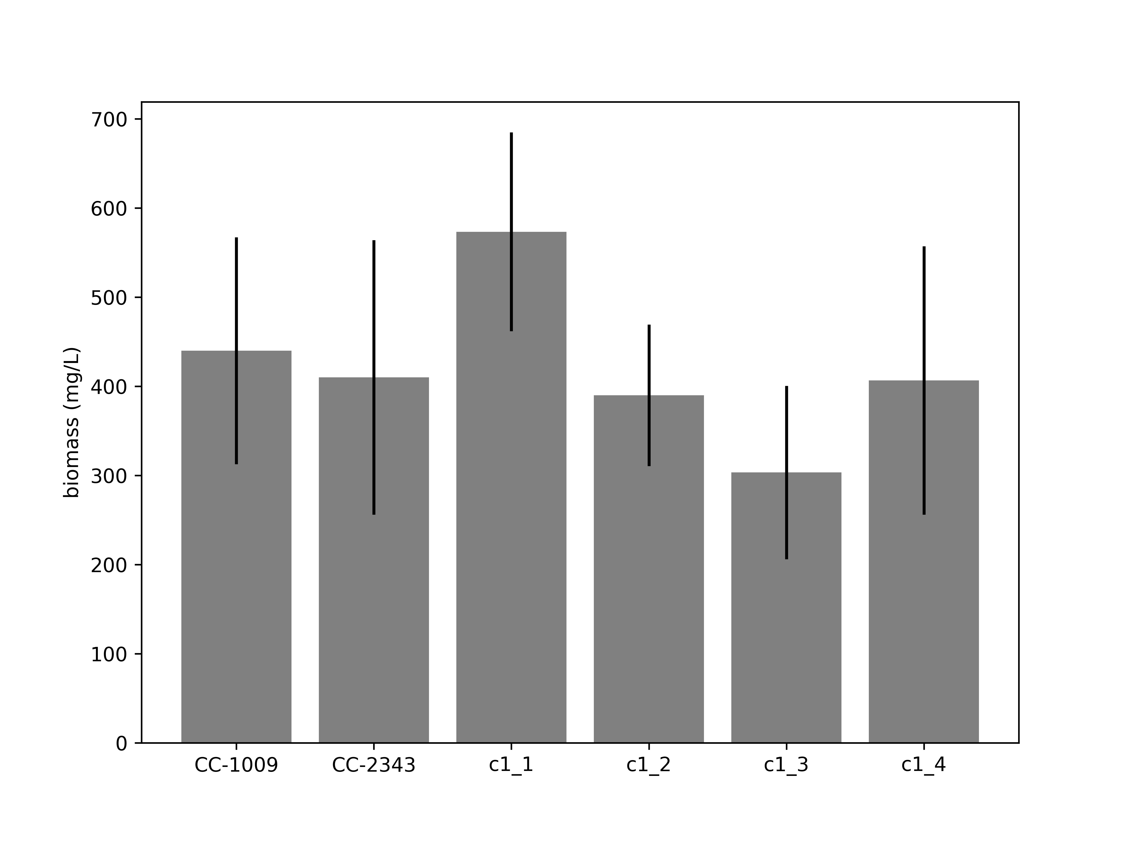
Supplementary Material Figure 12

