Slide 1
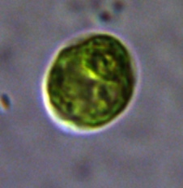
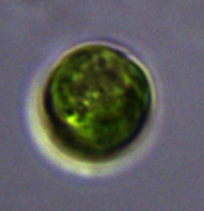
5% CO₂ in Bioreactors at Steady State
CC-1009
TAP Plate
B
Supplementary Material Figure 21

