Slide 1
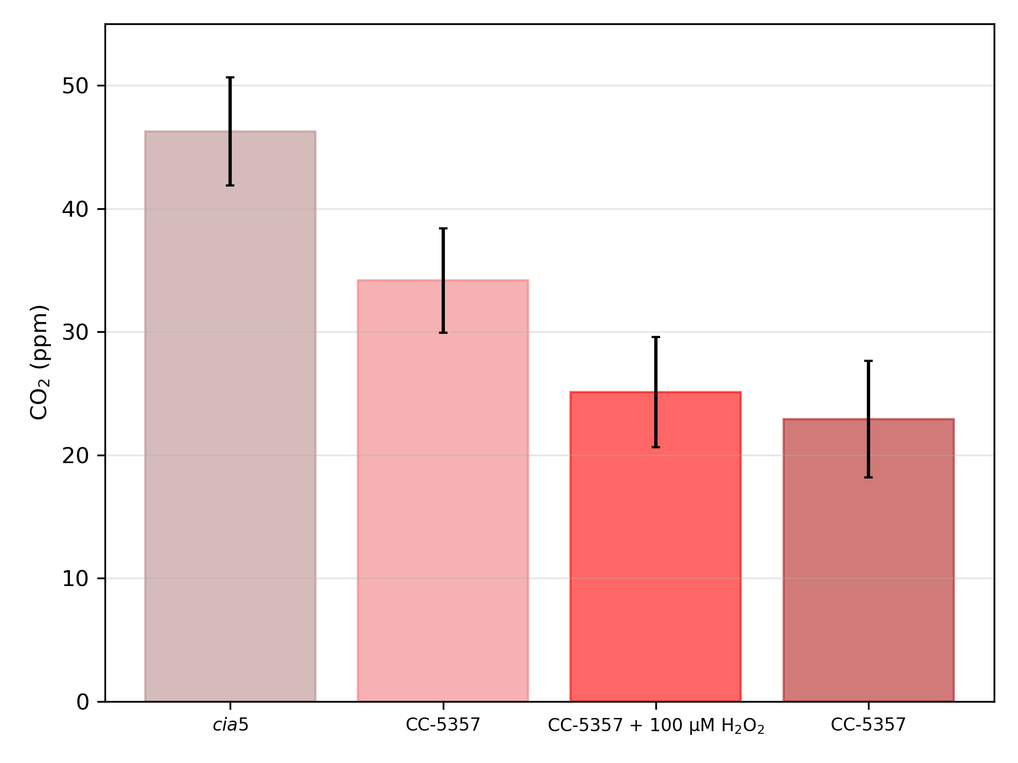
*
*
*
Supplementary Material Figure 22
cia5
CC-5357
CC-5357 + 100 μM H₂O₂
CC-5357
Low Light, High CO₂
High Light, Low CO₂

