Slide 1
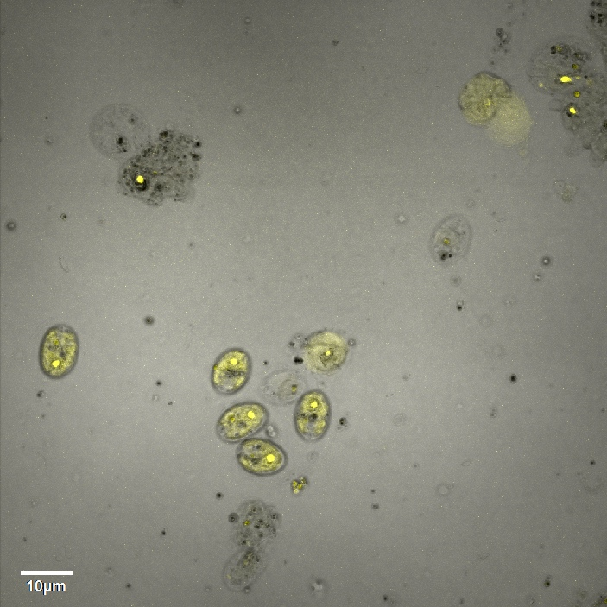
A
B
C
Supplementary Material Figure 18

