Slide 1
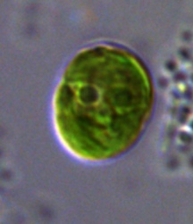
5% CO₂ in Bioreactors at Steady State
CC-2343
TAP Plate
A
Supplementary Material Figure 21

