Slide 1
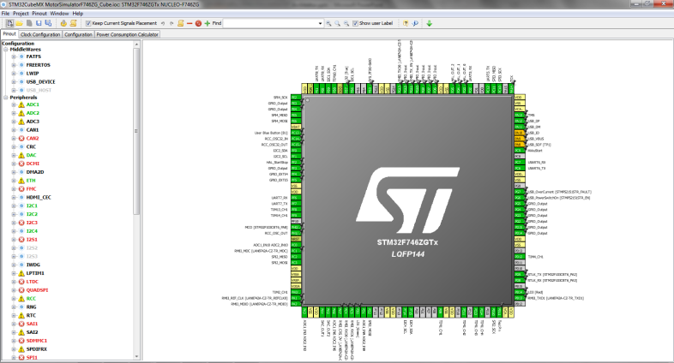
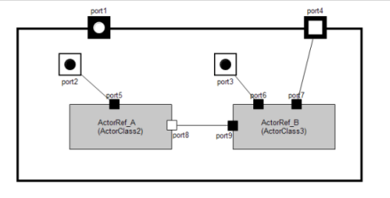

Hilti Simulation Platform

Slide 2
Agenda
1
Idea
1.1
Initial Position
1.2
Basic Idea
2
Archtiecture/Features
2.1
HW Architecture
2.2
Development Environment
2.3
SW-Architechture
2.4
Live Demo
3
Actual Status

Slide 3
Initial Position
Currently the development support concerning test- and simulation- utilities is almost zero. Each project spends a non negligible effort to develop utilities to test the target SW during the development phase.
There are some small proprietary non coupled tools to provide simple utilities like UART communication or HALL generation.
All the utilities need an own eval board, there is no possility to coordinate the actions.
Hard to reproduce and to maintain

Slide 4
Basic Idea
Provide a simple simulation platform for all typical JDS projects to reduce development effort and increase SW quality by continuously developing stimuli scenarios beside the appropriate target SW.
Test Utilities/Components should be reusable accross projects and teststages to further reduce effort.
The usage of the simulation platform should be as simple as possible.

Slide 5
HW-Architecture
The basic HW-Architecture is to connect two Evalboards on the uC-Pin level. One Eval Board to provide all necessaries signals to stimulate the target SW.
Power supply
Signal conditioning
Debug output
Manual control/debug
Simulationplatform NUCLEO-144F7xx
(STM32 Cortex M7)
Connection Matrix (possibility to connect SALEA/Oszi/Multimeter)
analog
Target SW running on Eval XY
(no instrumentation)
digital IOs
PWM
HALL-Gen
SPI/I2C/
UART

Slide 6
HW-Architecture (detailed features)
Power Supply 5V 1A / 3,3V 500mA
Optional Supply 40V
Up to 18 analog outpts (0..3,3V, 2*internal DAC; 16*external DAC)
2*SPI / 2*I2c / 2*UART
10 Digital I/Os
8*OPV Channels for analog signal conditioning
4*3,3V=>5V level shifter for UART adaption
4*5v=>3,3V level shifter
4* level shifter up 40V (controlled via analog output)
1* 3 phase PWM input to measure PWM Duty
1* 3 phase HALL generation
1* dedicated UART for Akku communication
4* poti for manual testing
4* switch for manual testing
4* Jumper for manual testing
4* LED status output

Slide 7
Development Environment (simulator development)
To provide a high level SW interface the modeling tool eTrice will be used to generate the simulation code.
For driver development the Cube Tool is used to minimize simulation development effort.
eTrice
Cube
Manual Code
ST-Libraries
C-Code Gen
C-Code Gen
GNU Compiler/Linker
ST-Link2 Debugger
Eclipse CDT + ST-Device Support + eTrice Plugin

Slide 8
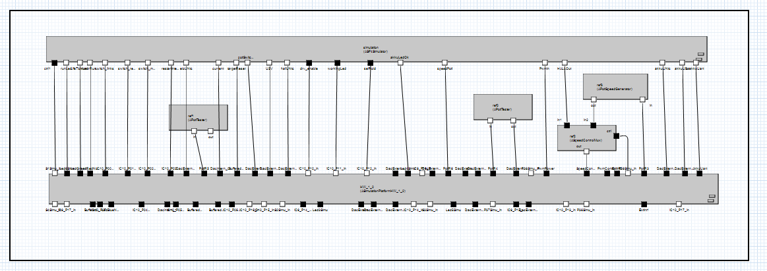
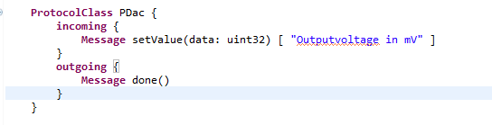
SW-Architecture (simulator usage)
To make access as easy as possible a basic SW layer will be provided.
User responsibility
SW-Component representing the
simulation HW platform
Port with associates Protocol
to provide high level access to the HW functionality

Slide 9
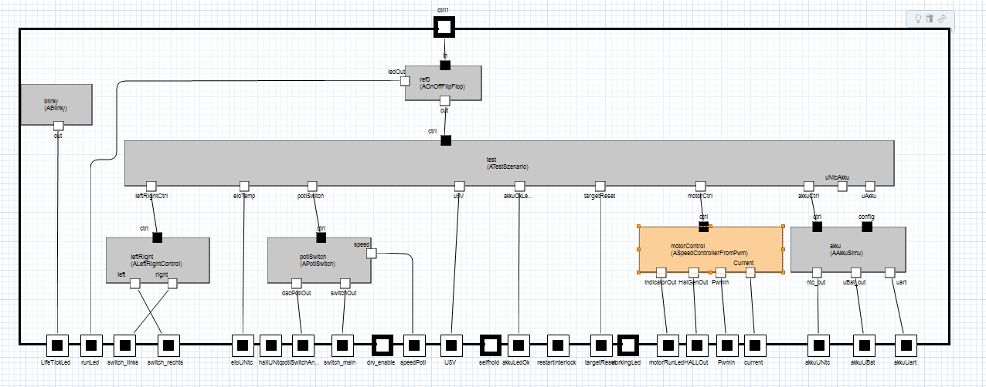
SW-Architecture (simulator usage)
To make access as easy as possible a basic SW layer will be provided.
User Testscenario
Additional reusable components

Slide 10
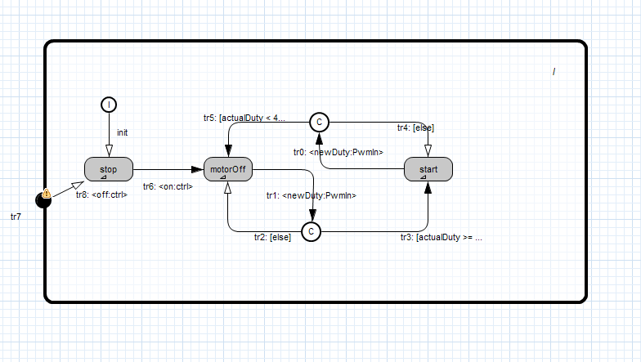
SW-Architecture (simulator usage)
SW-Components can be designed as hierarchical FSM e.g. Motor-Simulation:

Slide 11
Demo
DEMO
www.eclipse.org/etrice

Slide 12
Actual Status (29.01.2017)
Two hand mande boards and two layouted boards available (Dgate small, SF6, SF4)
Allready supported tasks:
Support for SF6 performance measurement
SW verifcation for SF6 EOL-Test commands (simulation of testadapter)
Bugreport verification (SF6 overcurrent detection)
Akku simulation for Dgate testing under development.
Automated DGate SW Verification (stand alone Version)
Semi Automated DGate SW Verification (ODA-Version)
SF4 Support for porting SF6 code to SF4 Cortex M0
Basic platform SW available
NUCLEO F767 basic drivers
PWM Duty measurement
HALL generation variable speed
Simple Motorsimulation (PWM Duty * X => HAL speed)
Akku simulation for Dgate testing
Simulation of Testadapter
Poti Switch

Slide 13
eTrice
Hilti Simulation Platform powered by eTrice.
www.eclipse.org/etrice

Slide 14
Thank you

Slide 15
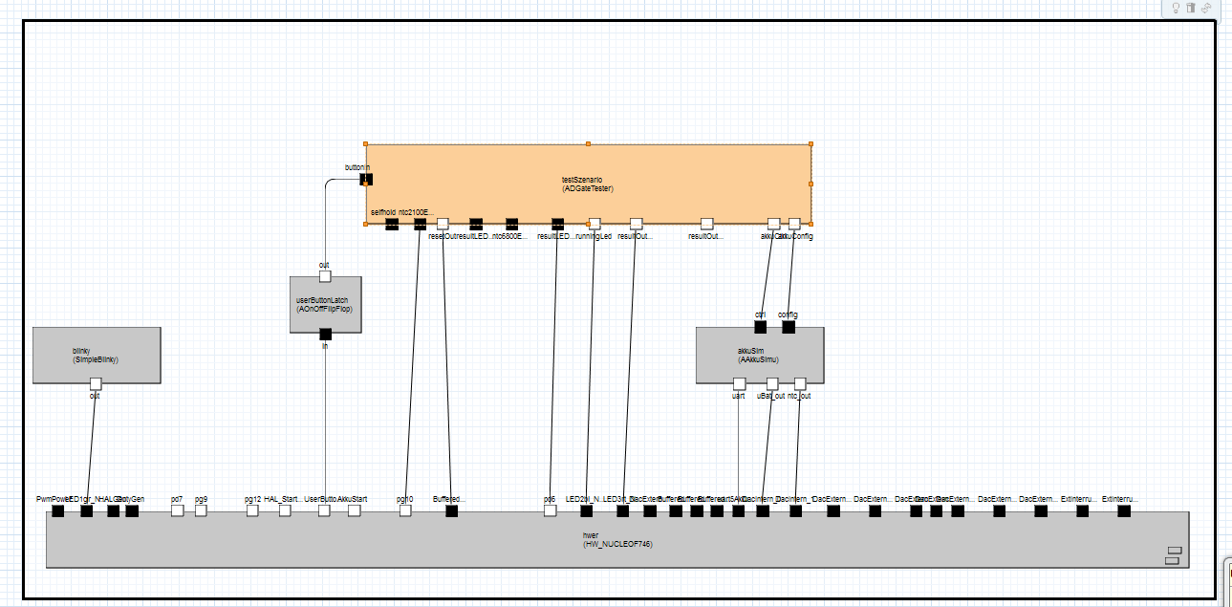
SW-Architecture (simulator usage)
To make access as easy as possible a basic SW layer will be provided.
User Testscenario
Additional reusable components
User responsibility
SW-Component representing the simulation HW platform
Port with associates Protocol
to provide high level access to the HW functionality

