Slide 1
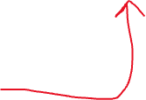
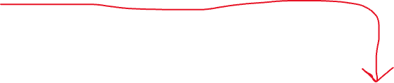


mgannotate
input reads (post-qc)
MEGAHIT ([co]-assembly)
MetaEuk (gene prediction)
MMSeqs2 (clustering gene
predictions)
coverm (quantify genes)
MMSeqs2 (optional filtering
host contigs)
eggnog-mapper (annotation of gene clusters)
Gene ontology (GO)
term abundance summaries

Slide 2













mgannotate
input reads
(post-qc)
MEGAHIT ([co]-assembly)
eggnog-mapper (annotation of genes)
coverm (quantify genes)
MMSeqs2 (clustering genes
across assembles)
input assemblies
assemblies
Gene ontology (GO)
term abundance summaries
MMSeqs2 (filter contigs
by taxonomy)
mandatory
MetaEuk (gene prediction)
optional

