Slide 1
Hawaii
From Wikipedia, the free encyclopedia
https://en.wikipedia.org/wiki/Hawaii
Licensed under CC BY-SA 3.0:
https://en.wikipedia.org/wiki/Wikipedia:Text_of_Creative_Commons_Attribution-ShareAlike_3.0_Unported_License

Slide 2
Hawaii
Hawaii (/həˈwaɪi/ (listen) hə-WY-ee; Hawaiian: Hawaiʻi [həˈvɐjʔi]) is the 50th and most recent state to have joined the United States, having received statehood on August 21, 1959.
Hawaii is the only U.S. state geographically located in Oceania, although it is governed as a part of North America, and the only one composed entirely of islands.
Hawaii is the 8th-smallest and the 11th-least populous, but the 13th-most densely populated of the 50 U.S. states.

Slide 3
Etymology
The state of Hawaii derives its name from the name of its largest island, Hawaiʻi.
A common Hawaiian explanation of the name of Hawaiʻi is that it was named for Hawaiʻiloa, a legendary figure from Hawaiian myth.

Slide 4
Spelling of state name
A somewhat divisive political issue arose in 1978 when the Constitution of the State of Hawaii added Hawaiian as a second official state language.
The title of the state constitution is The Constitution of the State of Hawaii.
Article XV, Section 1 of the Constitution uses The State of Hawaii.
In the Hawaii Admission Act that granted Hawaiian statehood, the federal government recognized Hawaii as the official state name.

Slide 5
Geography and environment
There are eight main Hawaiian islands, seven of which are permanently inhabited.

Slide 6
Topography
Hawaii is the southernmost U.S. state and the second westernmost after Alaska.
Hawaii, like Alaska, does not border any other U.S. state.
It is the only U.S. state that is not geographically located in North America, the only state completely surrounded by water and that is entirely an archipelago, and the only state in which coffee is commercially cultivable.
In addition to the eight main islands, the state has many smaller islands and islets.

Slide 7
Geology
The Hawaiian islands were formed by volcanic activity initiated at an undersea magma source called the Hawaii hotspot.
Because of the hotspot's location, all currently active land volcanoes are located on the southern half of Hawaii Island.
The newest volcano, Lōʻihi Seamount, is located south of the coast of Hawaii Island.
Hawaii Island has the second-highest point among the world's islands.

Slide 8
Flora and fauna
Because the islands of Hawaii are distant from other land habitats, life is thought to have arrived there by wind, waves (i.e.
Hawaii has more endangered species and has lost a higher percentage of its endemic species than any other U.S. state.

Slide 9
Protected areas
Several areas in Hawaii are under the protection of the National Park Service.
Hawaii has two national parks: Haleakalā National Park located near Kula on the island of Maui, which features the dormant volcano Haleakalā that formed east Maui, and Hawaii Volcanoes National Park in the southeast region of the Hawaiʻi Island, which includes the active volcano Kīlauea and its rift zones.

Slide 10
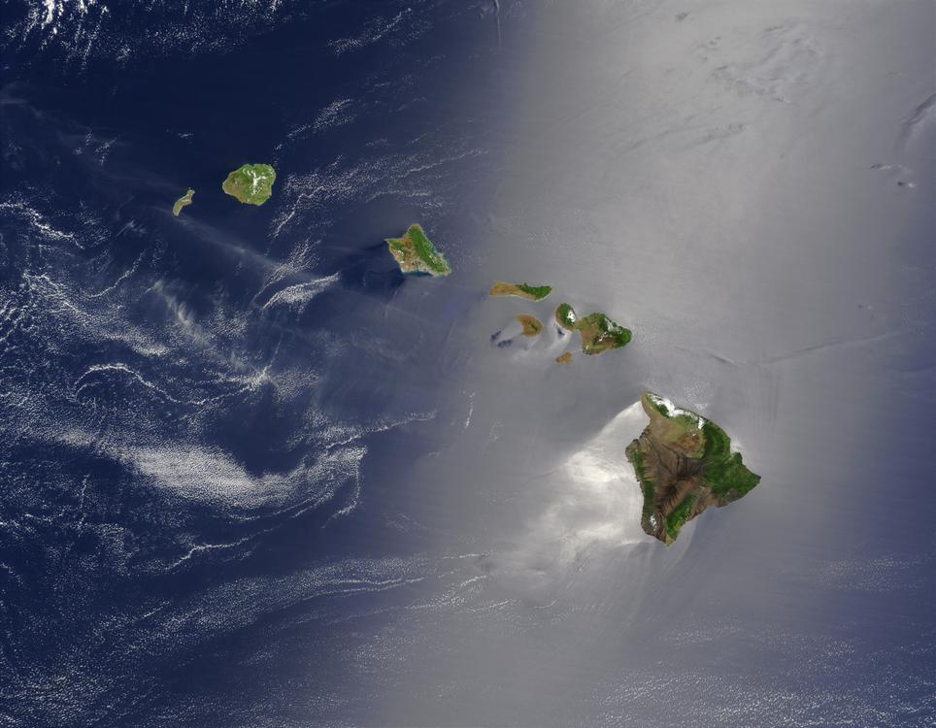
A true-color satellite view of Hawaii shows that most of the vegetation on the islands grows on their northeast sides, which face the wind.

Slide 11
Climate
Most of Hawaii experiences only two seasons; the dry season runs from May to October and the wet season is from October to April.
Hawaii's record low temperature is 12 °F (−11 °C) observed in May 1979, on the summit of Mauna Kea.
Hawaii is the only state to have never recorded sub-zero Fahrenheit temperatures.

Slide 12
History
Along with Texas, Hawaii had formal, international diplomatic recognition as a nation.
Hawaii was an independent republic from 1894 until August 12, 1898, when it officially became a territory of the United States.
Hawaii was admitted as a U.S. state on August 21, 1959.

Slide 13
First human settlement – Ancient Hawai ʻ i (800–1778)
Based on archaeological evidence, the earliest habitation of the Hawaiian Islands dates to around 300 CE, probably by Polynesian settlers from the Marquesas Islands.
The date of the human discovery and habitation of the Hawaiian Islands is the subject of academic debate.
Ancient Hawaii was a caste-based society, much like that of Hindus in India.

Slide 14
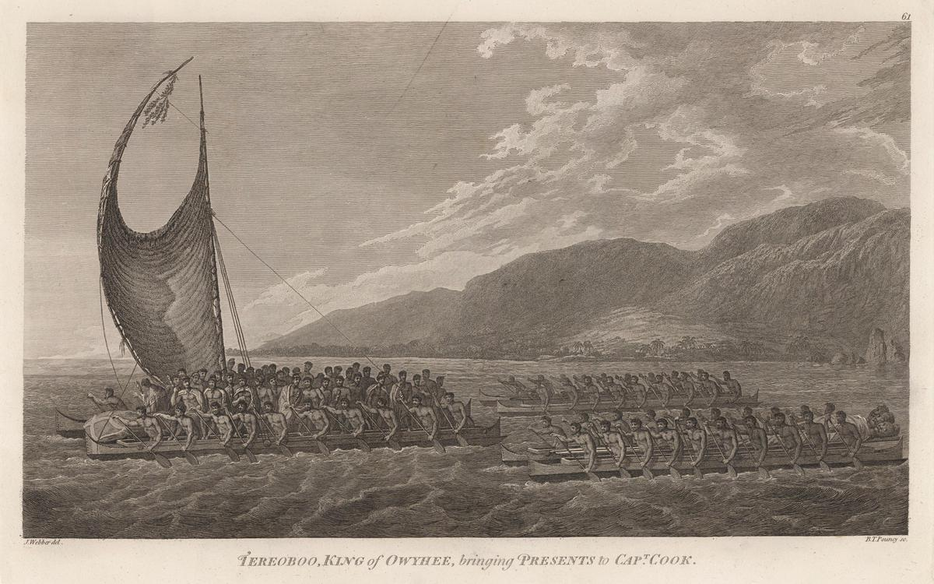
Kalaniʻōpuʻu, King of Hawaiʻi, brings presents to Captain Cook.

Slide 15
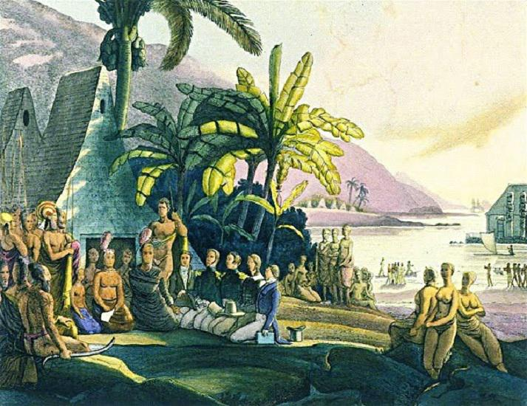
King Kamehameha receiving the Russian naval expedition of Otto von Kotzebue.

Slide 16
European arrival
Despite such contested claims, Cook is generally credited as being the first European to land at Hawaii, having visited the Hawaiian Islands twice.
During the 1850s, measles killed a fifth of Hawaii's people.
Historical records indicated the earliest Chinese immigrants to Hawaii originated from Guangdong Province; a few sailors had arrived in 1778 with Captain Cook's journey, and more arrived in 1789 with an American trader who settled in Hawaii in the late 18th century.

Slide 17
House of Kamehameha
After Kamehameha II inherited the throne in 1819, American Protestant missionaries to Hawaii converted many Hawaiians to Christianity.
Catholic and Mormon missionaries were also active in the kingdom, but they converted a minority of the Native Hawaiian population.
After riots broke out, the United States and Britain landed troops on the islands to restore order.

Slide 18
1887 Constitution and overthrow preparations
In 1887, Kalākaua was forced to sign the 1887 Constitution of the Kingdom of Hawaii.

Slide 19
Overthrow of 1893 – Republic of Hawaii (1894–1898)
The United States Minister to the Kingdom of Hawaii (John L. Stevens) conspired with U.S. citizens to overthrow the monarchy.
After the overthrow, Lawyer Sanford B. Dole, a citizen of Hawaii, became President of the Republic when the Provisional Government of Hawaii ended on July 4, 1894.
The Apology Resolution also "acknowledges that the overthrow of the Kingdom of Hawaii occurred with the active participation of agents and citizens of the United States and further acknowledges that the Native Hawaiian people never directly relinquished to the United States their claims to their inherent sovereignty as a people over their national lands, either through the Kingdom of Hawaii or through a plebiscite or referendum".

Slide 20
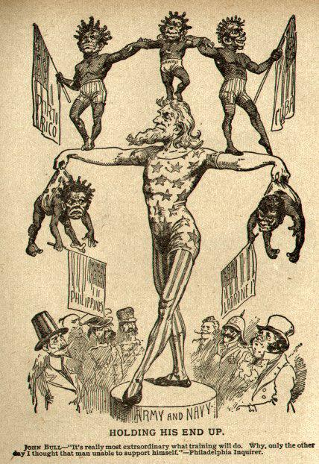
The figures are Puerto Rico, Hawaii, Cuba, Philippines and "Ladrones" (the Mariana Islands).

Slide 21
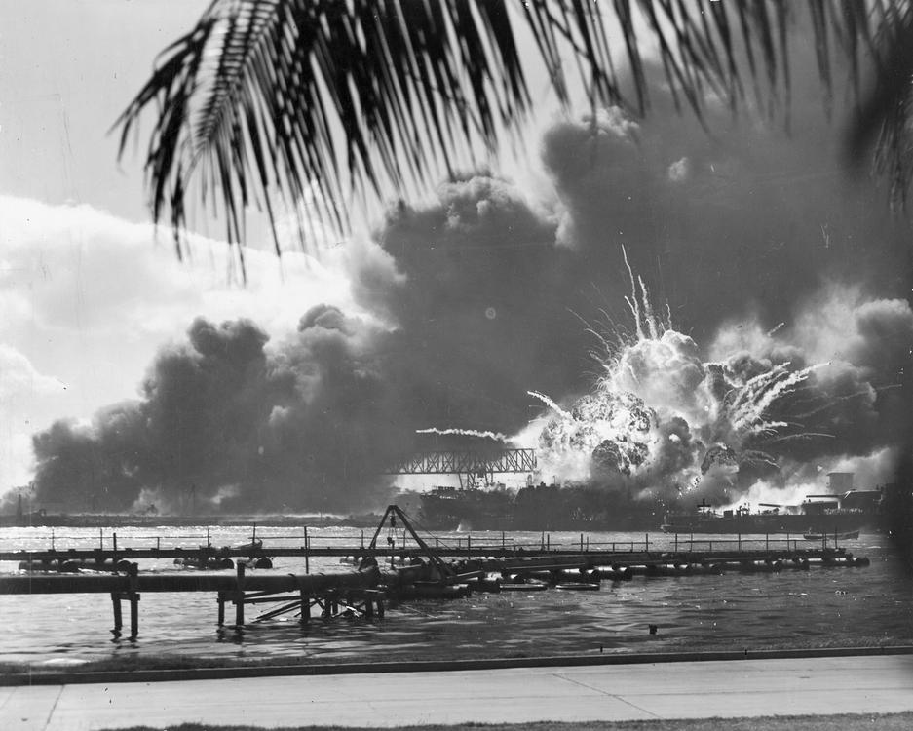
The Japanese attack on Pearl Harbor in 1941 was the primary event that caused the United States to enter World War II.

Slide 22
Annexation – Territory of Hawaii (1898–1959)
Despite several attempts to become a state, Hawaii remained a territory for 60 years.
Puerto Rican immigration to Hawaii began in 1899, when Puerto Rico's sugar industry was devastated by a hurricane, causing a worldwide shortage of sugar and a huge demand for sugar from Hawaii.
Two waves of Korean immigration to Hawaii occurred in the 20th century.

Slide 23
Prior to the postwar labor movement, Hawaii was governed by plantation owners.

Slide 24
Political changes of 1954 – State of Hawaii (1959–present)
They voted against the Hawaii Republican Party, strongly supported by plantation owners.
The new majority voted for the Democratic Party of Hawaii, which dominated territorial and state politics for more than 40 years.
The Hawaii State Constitutional Convention of 1978 created institutions such as the Office of Hawaiian Affairs to promote indigenous language and culture.

Slide 25
Population
After Europeans and mainland Americans first arrived during the Kingdom of Hawaii period, the overall population of Hawaii, until that time composed solely of indigenous Hawaiians, fell dramatically.
The United States Census Bureau estimates the population of Hawaii was 1,420,491 on July 1, 2018; an increase of 4.42% since the 2010 United States Census.
The center of population of Hawaii is located on the island of O'ahu.

Slide 26
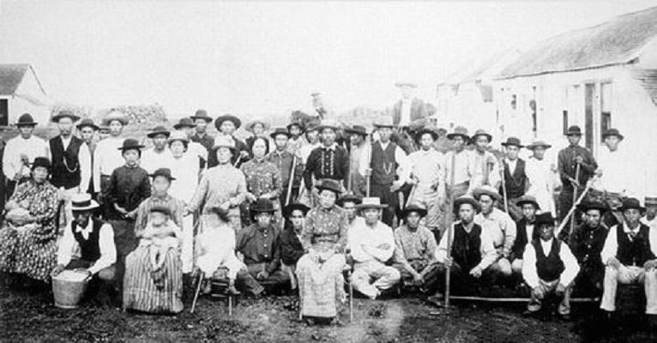
Japanese immigration to Hawaii was largely fueled by the high demand for plantation labor in Hawaii post-annexation.

Slide 27
Ancestry
According to the 2010 United States Census, Hawaii had a population of 1,360,301.
Over 120,000 (8.8%) Hispanic and Latino Americans live in Hawaii.
Hawaii is a majority-minority state.
The third group of foreigners to arrive in Hawaii were from China.
By 1901, over 5,000 Puerto Ricans were living in Hawaii.

Slide 28
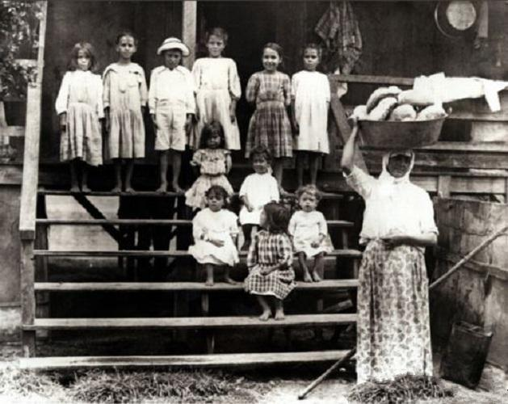
Many Portuguese immigrants were Azorean or Madeiran. They brought with them Roman Catholicism and Portuguese language and cuisine

Slide 29
Languages
English and Hawaiian are listed as Hawaii's official languages in the state's 1978 constitution, in Article XV, Section 4.
As of the 2000 Census, 73.4% of Hawaii residents aged five and older exclusively speak English at home.
According to the 2008 American Community Survey, 74.6% of Hawaii's residents over the age of five speak only English at home.

Slide 30
Hawaiian
According to the United States Census, there were over 24,000 total speakers of the language in Hawaii in 2006–2008.
These Polynesians remained in the islands; they eventually became the Hawaiian people and their languages evolved into the Hawaiian language.
The University of Hawaii developed a Hawaiian language graduate studies program.

Slide 31
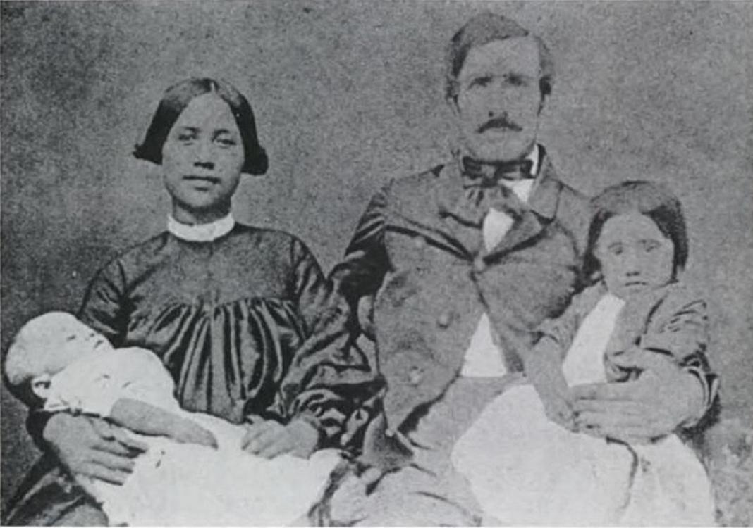
Mixed Hawaiian/European-American family in Honolulu, 1860s

Slide 32
Hawaiian Pidgin
Some residents of Hawaii speak Hawaiʻi Creole English (HCE), endonymically called pidgin or pidgin English.
During the surfing boom in Hawaii, HCE was influenced by surfer slang.

Slide 33
The Makiki Christian Church in Honolulu heavily draws upon Japanese architecture.

Slide 34
Religion
When the Hawaiian Reformed Catholic Church, a province of the Anglican Communion, was merged into the Episcopal Church in the 1890s following the overthrow of the Kingdom of Hawaii, it became the seat of the Episcopal Diocese of Hawaii.
According to data provided by religious establishments, religion in Hawaii in 2000 was distributed as follows:

Slide 35
Birth data
1) Until 2016, data for births of Asian origin, included also births of the Pacific Islander group.
2) Since 2016, data for births of White Hispanic origin are not collected, but included in one Hispanic group; persons of Hispanic origin may be of any race.

Slide 36
LGBT
Hawaii has had a long history of LGBT identities.
A 2012 poll by Gallup found that Hawaii had the largest proportion of lesbian, gay, bisexual and transgender (LGBT) adults in the U.S., at 5.1%, comprising an estimated adult LGBT population of 53,966 individuals.
In 2013, Hawaii became the fifteenth U.S. state to legalize same-sex marriage; a University of Hawaii researcher reported at the time that the law may have been able to boost tourism by $217 million.

Slide 37
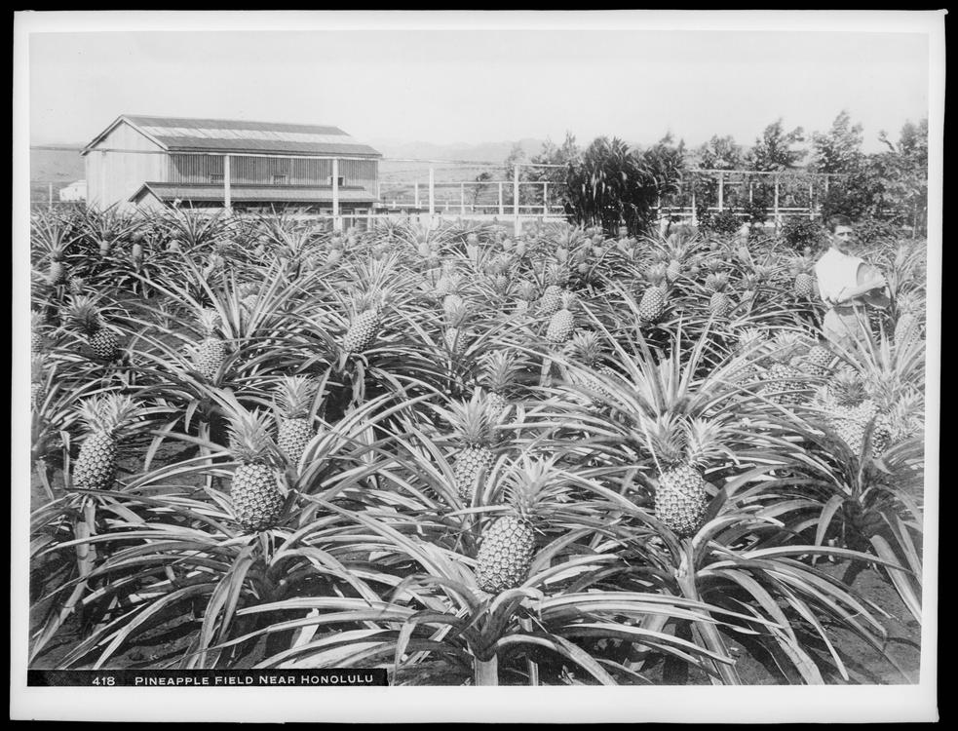
Post-annexation, Hawaii's economy and demographic changes were shaped mostly by the agricultural sector's growth.

Slide 38
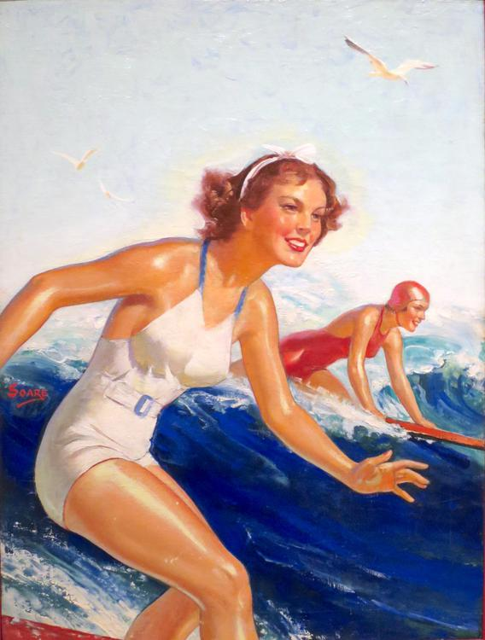
From the end of World War II onwards, depictions and photographs, such as this, of Hawaii as a tropical, leisure paradise encouraged the growth of tourism in Hawaii, which eventually became the largest industry of the islands.

Slide 39
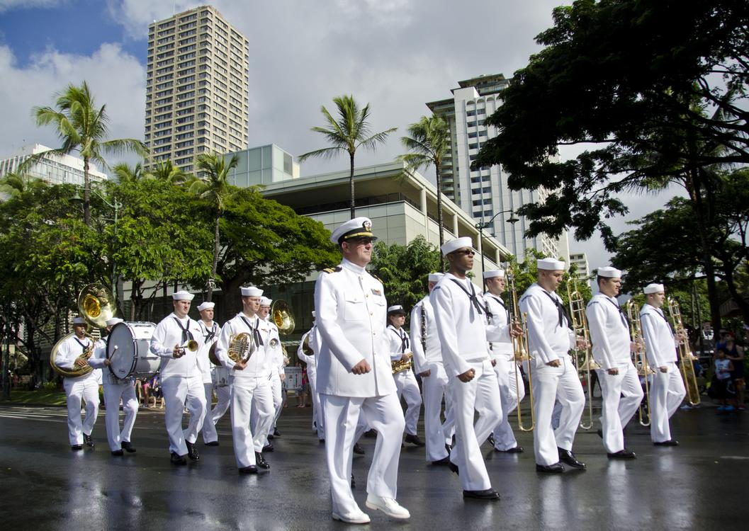
The U.S. federal government's spending on Hawaii-stationed personnel, installations and materiel, either directly or through military personnel spending, amounts to Hawaii's second largest source of income, after tourism.

Slide 40
Economy
The state's gross output for 2003 was US$47 billion; per capita income for Hawaii residents in 2014 was US$54,516.
In 2009, the United States military spent US$12.2 billion in Hawaii, accounting for 18% of spending in the state for that year.
75,000 United States Department of Defense personnel live in Hawaii.

Slide 41
Taxation
Hawaii residents pay the most per person in state taxes in the United States.
The Hawaii Tax Foundation considers the state's tax burden too high, which it says contributes to higher prices and the perception of an unfriendly business climate.
State Senator Sam Slom says state taxes are comparatively higher than other states because the state government handles education, health care, and social services that are usually handled at a county or municipal level in most other states.

Slide 42
Cost of living
While some online stores offer free shipping on orders to Hawaii, many merchants exclude Hawaii, Alaska, Puerto Rico and certain other U.S. territories.
pilot and port fees), the market size of Hawaii, and the economics of using ever-larger ships that cannot be handled in Hawaii for transoceanic voyages.

Slide 43
Culture
The aboriginal culture of Hawaii is Polynesian.
Hawaii represents the northernmost extension of the vast Polynesian Triangle of the south and central Pacific Ocean.
While traditional Hawaiian culture remains as vestiges in modern Hawaiian society, there are re-enactments of the ceremonies and traditions throughout the islands.

Slide 44
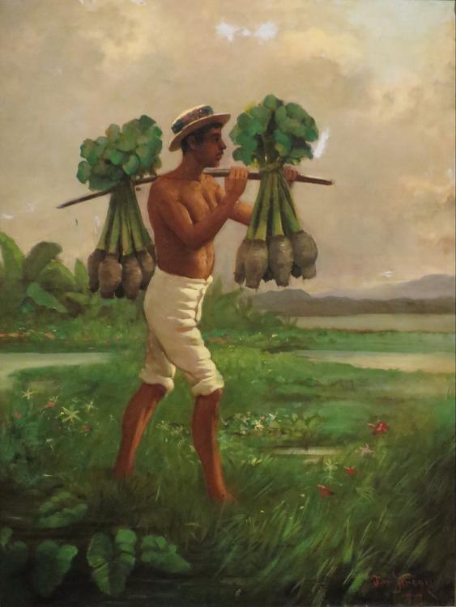
Taro, or in Hawaiian kalo, was one of the primary staples in Ancient Hawaii and remains a central ingredient in Hawaiian gastronomy today.

Slide 45
Cuisine
The cuisine of Hawaii is a fusion of many foods brought by immigrants to the Hawaiian Islands, including the earliest Polynesians and Native Hawaiian cuisine, and American, Chinese, Filipino, Japanese, Korean, Polynesian, Puerto Rican, and Portuguese origins.
Plant and animal food sources are imported from around the world for agricultural use in Hawaii.

Slide 46
Customs and etiquette
Print media and local residents recommend that one refer to non-Hawaiians as "locals of Hawaii" or "people of Hawaii".

Slide 47
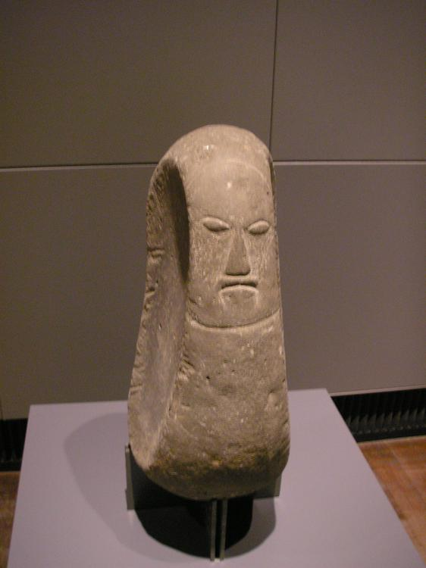
A stone carving of a Hawaiian deity, housed at a German museum.

Slide 48
Hawaiian mythology
Hawaiian mythology comprises the legends, historical tales, and sayings of the ancient Hawaiian people.
It is associated with the Hawaiian religion, which was officially suppressed in the 19th century but was kept alive by some practitioners to the modern day.

Slide 49
Polynesian mythology
Prior to the 15th century, Polynesian people migrated east to the Cook Islands, and from there to other island groups such as Tahiti and the Marquesas.
Their descendants later discovered the islands Tahiti, Rapa Nui and later the Hawaiian Islands and New Zealand.

Slide 50
List of state parks
There are many Hawaiian state parks.
Kauaʻi has the Ahukini State Recreation Pier, six state parks, and the Russian Fort Elizabeth State Historical Park.
Maui has two state monuments, several state parks, and the Polipoli Spring State Recreation Area.
Oʻahu has several state parks, a number of state recreation areas, and a number of monuments, including the Ulu Pō Heiau State Monument.

Slide 51
Literature
The literature of Hawaii is diverse and includes authors Kiana Davenport, Lois-Ann Yamanaka, and Kaui Hart Hemmings.
Hawaiian magazines include Hana Hou!, Hawaii Business Magazine and Honolulu, among others.

Slide 52
Music
The music of Hawaii includes traditional and popular styles, ranging from native Hawaiian folk music to modern rock and hip hop.
Hawaii's musical contributions to the music of the United States are out of proportion to the state's small size.
Hawaii also made a major contribution to country music with the introduction of the steel guitar.

Slide 53
Sports
Since the late 19th century, Hawaii has become a major site for surfists from around the world.
The only NCAA Division I team in Hawaii is the Hawaii Rainbow Warriors and Rainbow Wahine, which competes at the Big West Conference (major sports), Mountain West Conference (football) and Mountain Pacific Sports Federation (minor sports).
Notable college sports events in Hawaii include the Maui Invitational Tournament, Diamond Head Classic (basketball) and Hawaii Bowl (football).

Slide 54
Tourism
Tourism is an important part of the Hawaiian economy.
In 2003, according to state government data, there were over 6.4 million visitors, with expenditures of over $10 billion, to the Hawaiian Islands.
Hawaii hosts numerous cultural events.
The Hawaii International Film Festival is the premier film festival for Pacific rim cinema.

Slide 55
Health
As of 2009[update], Hawaii's health care system insures 92% of residents.
[citation needed] Proponents of universal health care elsewhere in the U.S. sometimes use Hawaii as a model for proposed federal and state health care plans.

Slide 56
Public schools
Hawaii has the only school system within the U.S. that is unified statewide.
Public elementary, middle and high school test scores in Hawaii are below national averages on tests mandated under the No Child Left Behind Act.
The Hawaii Board of Education requires all eligible students to take these tests and report all student test scores.

Slide 57
Private schools
Hawaii has the highest rates of private school attendance in the nation.
During the 2011–2012 school year, Hawaii public and charter schools had an enrollment of 181,213, while private schools had 37,695.
Pacific Buddhist Academy, the second Buddhist high school in the U.S. and first such school in Hawaii, was founded in 2003.
In 2005, Kamehameha enrolled 5,398 students, 8.4% of the Native Hawaiian children in the state.

Slide 58
Colleges and universities
The largest institution of higher learning in Hawaii is the University of Hawaii System, which consists of the research university at Mānoa, two comprehensive campuses at Hilo and West Oʻahu, and seven community colleges.
Private universities include Brigham Young University–Hawaii, Chaminade University of Honolulu, Hawaii Pacific University, and Wayland Baptist University.

Slide 59
Pūnana Leo
"Nest of Voices") were the first indigenous language immersion schools in the United States.
Modelled after the Māori language Kōhanga reo of New Zealand, they provide preschool aged children the opportunity to engage in early education through a Hawaiian language medium, generally taught by elders.
As of 2006, there were a total of eleven Pūnana Leo preschools, with locations on five of the islands.

Slide 60
Transportation
A system of state highways encircles each main island.
Honolulu International Airport (IATA: HNL), which shares runways with the adjacent Hickam Field (IATA: HIK), is the major commercial aviation hub of Hawaii.
The Hawaii Superferry operated between Oʻahu and Maui between December 2007 and March 2009, with additional routes planned for other islands.

Slide 61
Rail
At one time Hawaii had a network of railroads on each of the larger islands that transported farm commodities and passengers.

Slide 62
Political subdivisions and local government
Hawaii comprises five counties: the City and County of Honolulu, Hawaii County, Maui County, Kauai County, and Kalawao County.
Hawaii has the fewest local governments among U.S. states.
County executives are referred to as mayors; these are the Mayor of Hawaii County, Mayor of Honolulu, Mayor of Kauaʻi, and the Mayor of Maui.

Slide 63
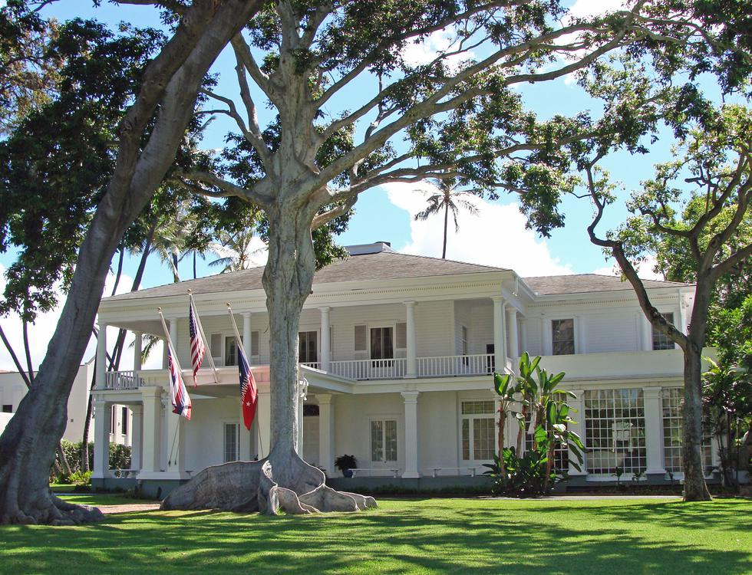
The Governor of Hawaii officially resides at Washington Place.

Slide 64
State government
The executive branch is led by the Governor of Hawaii, who is assisted by the Lieutenant Governor of Hawaii, both of whom are elected on the same ticket.
The legislative branch consists of the bicameral Hawaii State Legislature, which is composed of the 51-member Hawaii House of Representatives led by the Speaker of the House, and the 25-member Hawaii Senate led by the President of the Senate.
The unified judicial branch of Hawaii is the Hawaii State Judiciary.

Slide 65
Federal government
Hawaii is represented in the United States Congress by two senators and two representatives.
Brian Schatz is the senior United States Senator from Hawaii.
The Federal Bureau of Investigation, Internal Revenue Service and the Secret Service maintain their offices there; the building is also the site of the federal District Court for the District of Hawaii and the United States Attorney for the District of Hawaii.

Slide 66
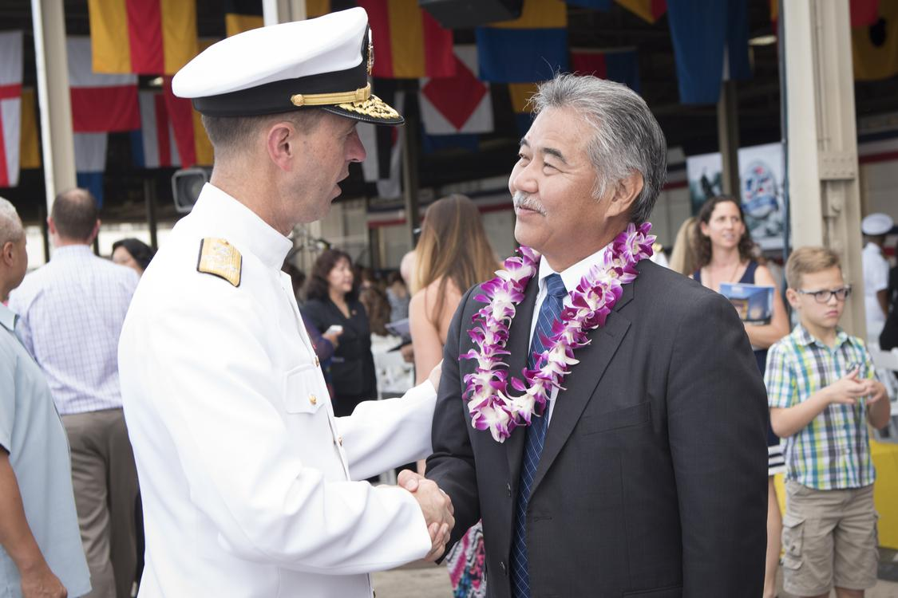
Governor David Ige with U.S. Navy admiral John Richardson at the 75th Commemoration Event of the attacks on Pearl Harbor and Oahu, 2016

Slide 67
Politics
The 2016 Cook Partisan Voting Index ranks Hawaii as the most heavily Democratic state in the nation.
Hawaii hasn't elected a Republican to represent the state in the U.S. Senate since Hiram Fong in 1970; since 1977, both of the state's U.S.
Obama had won the Hawaii Democratic caucus on February 19, 2008, with 76% of the vote.

Slide 68
Hawaiian sovereignty movement
The Hawaiian sovereignty movement views the overthrow of the Kingdom of Hawaii in 1893 as illegal, and views the subsequent annexation of Hawaii by the United States as illegal; the movement seeks some form of greater autonomy for Hawaii, such as free association or independence from the United States.

Slide 69
International sister cities
Ehime, Japan
Fukuoka, Japan
Hiroshima, Japan
Hokkaido, Japan
Okinawa, Japan

Slide 70
See also
Outline of Hawaii – organized list of topics about Hawaii
Puerto Rican immigration to Hawaii

Slide 71
Bibliography
University of Hawaii Press.
The Specter of Communism in Hawaii.
University of Hawaii Press.
"The 1897 Petition Against the Annexation of Hawaii".
"Spaniards and the Sweet Potato in Hawaii and Hawaiian-American Contacts".

Slide 72
External links
Hawaii State Guide from the Library of Congress
Hawaii at Curlie
USGS real-time, geographic, and other scientific resources of Hawaii
Energy Data & Statistics for Hawaii
Documents relating to Hawaii Statehood, Dwight D. Eisenhower Presidential Library
Geographic data related to Hawaii at OpenStreetMap

