Slide 1
Israel
From Wikipedia, the free encyclopedia
https://en.wikipedia.org/wiki/Israel
Licensed under CC BY-SA 3.0:
https://en.wikipedia.org/wiki/Wikipedia:Text_of_Creative_Commons_Attribution-ShareAlike_3.0_Unported_License

Slide 2
Israel
Israel has evidence of the earliest migration of hominids out of Africa.
The Neo-Assyrian Empire destroyed Israel around 720 BCE.
Israel's occupation of the Palestinian territories is the world's longest military occupation in modern times.
However, peace treaties between Israel and both Egypt and Jordan have been signed.
In its Basic Laws, Israel defines itself as a Jewish and democratic state.

Slide 3
Etymology
The names Land of Israel and Children of Israel have historically been used to refer to the biblical Kingdom of Israel and the entire Jewish people respectively.
Jacob's twelve sons became the ancestors of the Israelites, also known as the Twelve Tribes of Israel or Children of Israel.
'Palestine [Eretz Israel]').

Slide 4
Prehistory
The oldest evidence of early humans in the territory of modern Israel, dating to 1.5 million years ago, was found in Ubeidiya near the Sea of Galilee.
The oldest fossils of anatomically modern humans found outside Africa are the Skhul and Qafzeh hominins, who lived in the area that is now northern Israel 120,000 years ago.

Slide 5
Antiquity
There is debate about the earliest existence of the Kingdoms of Israel and Judah and their extent and power, but historians agree that a Kingdom of Israel existed by ca.
The Kingdom of Israel was destroyed around 720 BCE, when it was conquered by the Neo-Assyrian Empire.

Slide 6
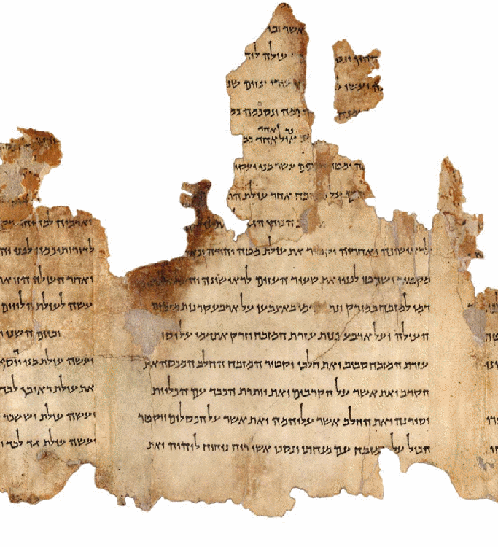
Portion of the Temple Scroll, one of the Dead Sea Scrolls, written during the Second Temple period

Slide 7
Classical period
The conflict erupted in 167 BCE with the Maccabean Revolt, which succeeded in establishing an independent Hasmonean Kingdom in Judah, which later expanded over much of modern Israel, as the Seleucids gradually lost control in the region.
The Mishnah and part of the Talmud, central Jewish texts, were composed during the 2nd to 4th centuries CE in Tiberias and Jerusalem.

Slide 8
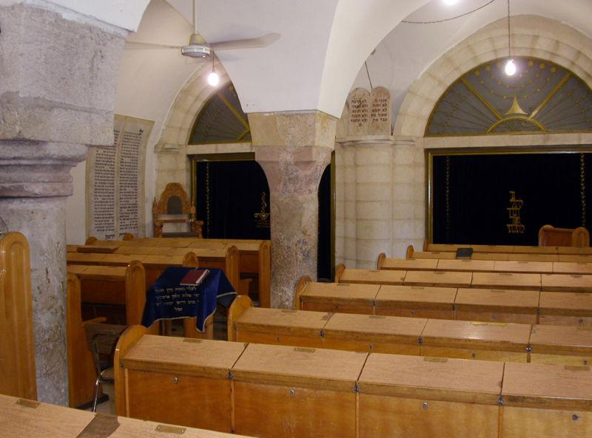
The 13th-century Ramban Synagogue in Jerusalem

Slide 9
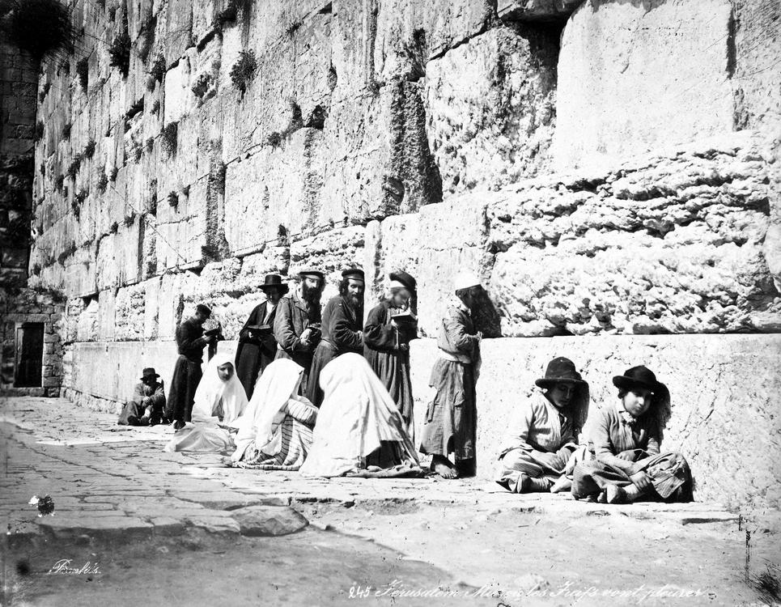
Jews at the Western Wall, 1870s

Slide 10
Middle Ages and modern history
In 1141, the Spanish-Jewish poet Yehuda Halevi issued a call for Jews to migrate to the Land of Israel, a journey he undertook himself.
Nachmanides (Ramban), the 13th-century Spanish rabbi and recognised leader of Jewry, greatly praised the Land of Israel and viewed its settlement as a positive commandment incumbent on all Jews.
The ban remained in place until Israel took control of the building in 1967.

Slide 11
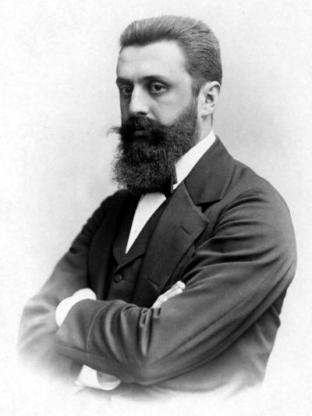
Theodor Herzl, visionary of the Jewish state

Slide 12
Zionism and British Mandate
Since the existence of the earliest Jewish diaspora, many Jews have aspired to return to "Zion" and the "Land of Israel", though the amount of effort that should be spent towards such an aim was a matter of dispute.
Although the Zionist movement already existed in practice, Austro-Hungarian journalist Theodor Herzl is credited with founding political Zionism, a movement that sought to establish a Jewish state in the Land of Israel, thus offering a solution to the so-called Jewish question of the European states, in conformity with the goals and achievements of other national projects of the time.

Slide 13
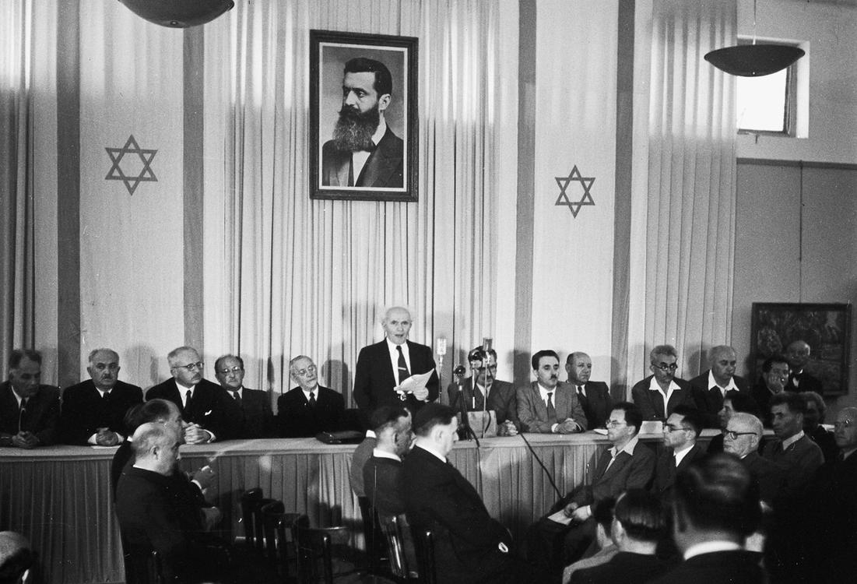
David Ben-Gurion proclaiming the Israeli Declaration of Independence on 14 May 1948

Slide 14
After World War II
On 14 May 1948, the day before the expiration of the British Mandate, David Ben-Gurion, the head of the Jewish Agency, declared "the establishment of a Jewish state in Eretz-Israel, to be known as the State of Israel."
The only reference in the text of the Declaration to the borders of the new state is the use of the term Eretz-Israel ("Land of Israel").
Some 156,000 remained and became Arab citizens of Israel.

Slide 15
Early years of the State of Israel
By 1958, the population of Israel rose to two million.
Between 1948 and 1970, approximately 1,150,000 Jewish refugees relocated to Israel.
In the early 1960s, Israel captured Nazi war criminal Adolf Eichmann in Argentina and brought him to Israel for trial.
Jordan, Syria and Iraq responded and attacked Israel.

Slide 16
Further conflict and peace process
The PLO soon resumed its policy of attacks against Israel.
Israel's population diversity expanded in the 1980s and 1990s.
At the end of 2008, Israel entered another conflict as a ceasefire between Hamas and Israel collapsed.
In what Israel described as a response to more than a hundred Palestinian rocket attacks on southern Israeli cities, Israel began an operation in Gaza on 14 November 2012, lasting eight days.
In September 2010, Israel was invited to join the OECD.

Slide 17
Geography and environment
Israel is located in the Levant area of the Fertile Crescent region.
The sovereign territory of Israel (according to the demarcation lines of the 1949 Armistice Agreements and excluding all territories captured by Israel during the 1967 Six-Day War) is approximately 20,770 square kilometers (8,019 sq mi) in area, of which two percent is water.
Unique to Israel and the Sinai Peninsula are makhteshim, or erosion cirques.

Slide 18
Tectonics and seismicity
While stringent construction regulations are currently in place and recently built structures are earthquake-safe, as of 2007[update] the majority of the buildings in Israel were older than these regulations and many public buildings as well as 50,000 residential buildings did not meet the new standards and were "expected to collapse" if exposed to a strong earthquake.

Slide 19
Climate
Temperatures in Israel vary widely, especially during the winter.
From May to September, rain in Israel is rare.
For this reason, the flora and fauna of Israel are extremely diverse.
There are 2,867 known species of plants found in Israel.
Field of Anemone coronaria, national flower of Israel
Flowers of Israel

Slide 20
Demographics
By June 2012, approximately 60,000 African migrants had entered Israel.
Israel was established as a homeland for the Jewish people and is often referred to as a Jewish state.
Jewish emigration from Israel (called yerida in Hebrew), primarily to the United States and Canada, is described by demographers as modest, but is often cited by Israeli government ministries as a major threat to Israel's future.

Slide 21
Major urban areas
Israel's largest municipality, in population and area, is Jerusalem with 901,302 residents in an area of 125 square kilometres (48 sq mi).
Tel Aviv and Haifa rank as Israel's next most populous cities, with populations of 443,939 and 281,087, respectively.
Israel has 16 cities with populations over 100,000.

Slide 22
Language
Israel has one official language, Hebrew.
Arabic previously had been considered an official language of the State of Israel; in 2018 it was classified as having a 'special status in the state' with its use by state institutions to be set in law.
More than one million Russian-speaking immigrants arrived in Israel from the post-Soviet states between 1990 and 2004.

Slide 23
Religion
Haredi Jews are expected to represent more than 20% of Israel's Jewish population by 2028.
Making up 17.6% of the population, Muslims constitute Israel's largest religious minority.
Out of more than one million immigrants from the former Soviet Union, about 300,000 are considered not Jewish by the Chief Rabbinate of Israel.

Slide 24
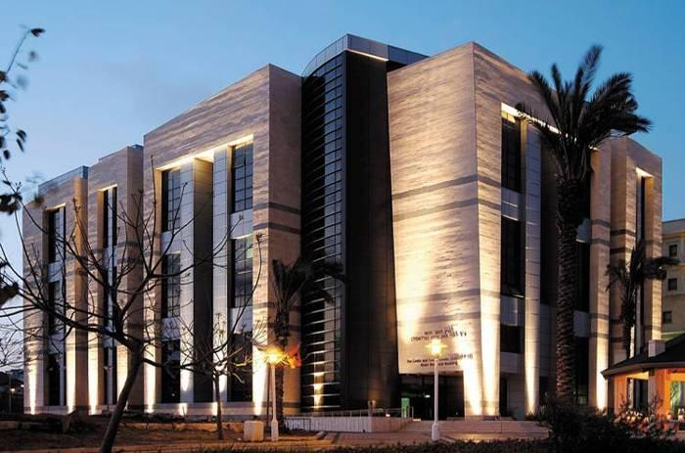
Multidisciplinary Brain Research Center at Bar-Ilan University

Slide 25
Education
Education is compulsory in Israel for children between the ages of three and eighteen.
Israel has nine public universities that are subsidized by the state and 49 private colleges.
The Hebrew University of Jerusalem, Israel's second-oldest university after the Technion, houses the National Library of Israel, the world's largest repository of Judaica and Hebraica.

Slide 26
Government and politics
Israel is a parliamentary democracy with universal suffrage.
Israel is governed by a 120-member parliament, known as the Knesset.
The Basic Laws of Israel function as an uncodified constitution.
The president of Israel is head of state, with limited and largely ceremonial duties.
On 19 July 2018, the Israeli Parliament passed a Basic Law that characterizes the State of Israel as principally a "Nation State of the Jewish People," and Hebrew as its official language.

Slide 27
Legal system
Israel has a three-tier court system.
Israel's legal system combines three legal traditions: English common law, civil law, and Jewish law.
Administration of Israel's courts (both the "General" courts and the Labor Courts) is carried by the Administration of Courts, situated in Jerusalem.
Israel's Basic Law: Human Dignity and Liberty seeks to defend human rights and liberties in Israel.

Slide 28
Administrative divisions
The State of Israel is divided into six main administrative districts, known as mehozot (Hebrew: מחוזות‎; singular: mahoz) – Center, Haifa, Jerusalem, North, South, and Tel Aviv districts, as well as the Judea and Samaria Area in the West Bank.
All of the Judea and Samaria Area and parts of the Jerusalem and Northern districts are not recognized internationally as part of Israel.
^b Israeli citizens only.

Slide 29
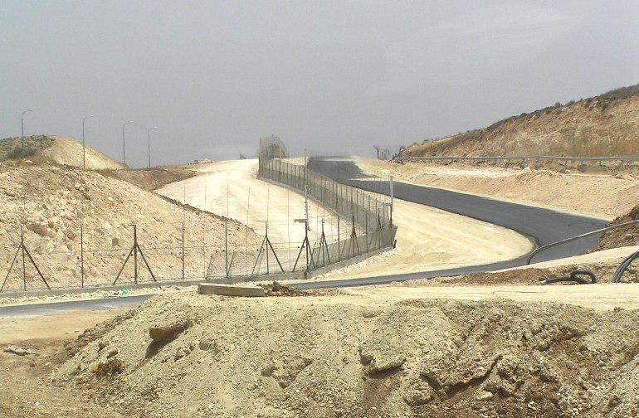
Israeli West Bank barrier separating Israel and the West Bank

Slide 30
Israeli-occupied territories
The Golan Heights and East Jerusalem have been fully incorporated into Israel under Israeli law, but not under international law.
The international community maintains that Israel does not have sovereignty in the West Bank, and considers Israel's control of the area to be the longest military occupation is modern history.

Slide 31
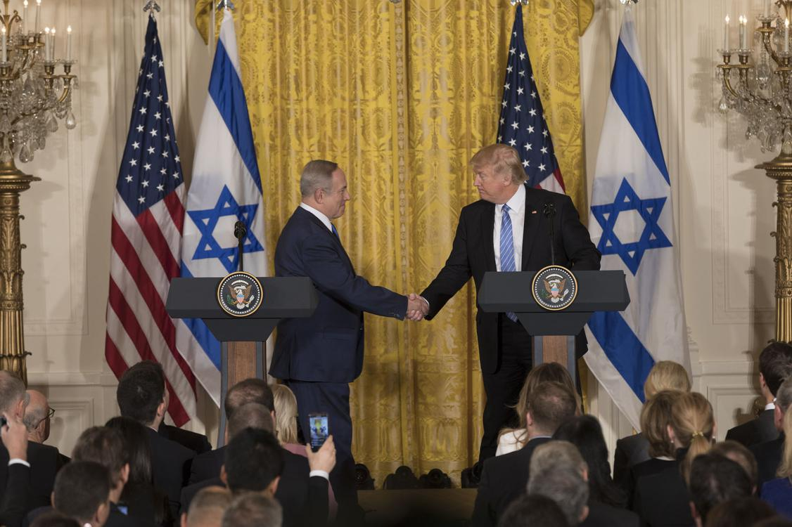
U.S. President Donald Trump and Israeli Prime Minister Benjamin Netanyahu during their press conference in the White House, 2017.

Slide 32
Foreign relations
Iran had diplomatic relations with Israel under the Pahlavi dynasty but withdrew its recognition of Israel during the Islamic Revolution.
Relations between Turkey and Israel took a downturn after the 2008–09 Gaza War and Israel's raid of the Gaza flotilla.
Israel provides expertise to Ethiopia on irrigation projects and thousands of Ethiopian Jews live in Israel.

Slide 33
Military
Since the Yom Kippur War, Israel has developed a network of reconnaissance satellites.
Since the Gulf War in 1991, when Israel was attacked by Iraqi Scud missiles, all homes in Israel are required to have a reinforced security room, Merkhav Mugan, impermeable to chemical and biological substances.
Israel ranked 5th globally for arms exports in 2017.
The majority of Israel's arms exports are unreported for security reasons.

Slide 34
Economy
Israel was also ranked 5th in the world by share of people in high-skilled employment.
Israeli economic data covers the economic territory of Israel, including the Golan Heights, East Jerusalem and Israeli settlements in the West Bank.
The Bank of Israel holds $113 billion of foreign-exchange reserves.

Slide 35
Science and technology
In 2012, Israel was ranked ninth in the world by the Futron's Space Competitiveness Index.
Some of Israel's satellites are ranked among the world's most advanced space systems.
By 2014, Israel's desalination programs provided roughly 35% of Israel's drinking water and it is expected to supply 40% by 2015 and 70% by 2050.

Slide 36
Transportation
Israel has 19,224 kilometres (11,945 mi) of paved roads, and 3 million motor vehicles.
Israel has 5,715 buses on scheduled routes, operated by several carriers, the largest of which is Egged, serving most of the country.
Ben Gurion, Israel's largest airport, handled over 15 million passengers in 2015.

Slide 37
Tourism
Tourism, especially religious tourism, is an important industry in Israel, with the country's temperate climate, beaches, archaeological, other historical and biblical sites, and unique geography also drawing tourists.
Israel's security problems have taken their toll on the industry, but the number of incoming tourists is on the rebound.
In 2017, a record of 3.6 million tourists visited Israel, yielding a 25 percent growth since 2016 and contributed NIS 20 billion to the Israeli economy.

Slide 38
Energy
Israel began producing natural gas from its own offshore gas fields in 2004.
In 2009, a natural gas reserve, Tamar, was found near the coast of Israel.
In 2013, Israel began commercial production of natural gas from the Tamar field.
In early 2017, Israel began exporting natural gas to the Kingdom of Jordan.
Ketura Sun is Israel's first commercial solar field.

Slide 39
Culture
Israel's diverse culture stems from the diversity of its population.
Israel is the only country in the world where life revolves around the Hebrew calendar.

Slide 40
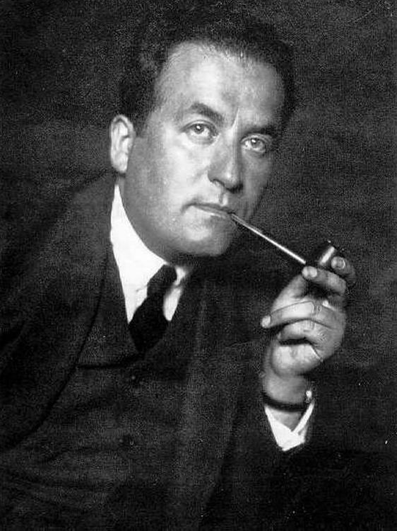
Shmuel Yosef Agnon, laureate of the Nobel Prize in Literature

Slide 41
Literature
By law, two copies of all printed matter published in Israel must be deposited in the National Library of Israel at the Hebrew University of Jerusalem.
[citation needed] Israel has also been the home of Emile Habibi, whose novel The Secret Life of Saeed: The Pessoptimist, and other writings, won him the Israel prize for Arabic literature.

Slide 42
Music and dance
Among Israel's world-renowned orchestras is the Israel Philharmonic Orchestra, which has been in operation for over seventy years and today performs more than two hundred concerts each year.
The nation's canonical folk songs, known as "Songs of the Land of Israel," deal with the experiences of the pioneers in building the Jewish homeland.

Slide 43
Cinema and theatre
Ten Israeli films have been final nominees for Best Foreign Language Film at the Academy Awards since the establishment of Israel.
Continuing the strong theatrical traditions of the Yiddish theatre in Eastern Europe, Israel maintains a vibrant theatre scene.
Founded in 1918, Habima Theatre in Tel Aviv is Israel's oldest repertory theater company and national theater.

Slide 44
Media
The 2017 Freedom of the Press annual report by Freedom House ranked Israel as the Middle East and North Africa's most free country, and 64th globally.
In the 2017 Press Freedom Index by Reporters Without Borders, Israel (including "Israel extraterritorial" since 2013 ranking) was placed 91st of 180 countries, first in the Middle East and North Africa region.

Slide 45
Museums
The Israel Museum in Jerusalem is one of Israel's most important cultural institutions and houses the Dead Sea Scrolls, along with an extensive collection of Judaica and European art.
Israel has the highest number of museums per capita in the world.
A cast of the skull is on display at the Israel Museum.

Slide 46
Cuisine
Israeli cuisine includes local dishes as well as Jewish cuisine brought to the country by immigrants from the diaspora.
Schnitzel, pizza, hamburgers, French fries, rice and salad are also common in Israel.

Slide 47
Sports
Israel hosted and won the 1964 AFC Asian Cup; in 1970 the Israel national football team qualified for the FIFA World Cup, the only time it participated in the World Cup.
The 1974 Asian Games, held in Tehran, were the last Asian Games in which Israel participated, plagued by the Arab countries that refused to compete with Israel.
The 1968 Summer Paralympics were hosted by Israel.

Slide 48
See also
Outline of Israel
Israel – Wikipedia book

Slide 49
External links
About Israel at the Israel Ministry of Foreign Affairs
"Israel".
Israel at the Encyclopædia Britannica
Israel at the Jewish Virtual Library
Israel at the OECD
Israel at Curlie
Wikimedia Atlas of Israel

