Slide 1
Sweden
From Wikipedia, the free encyclopedia
https://en.wikipedia.org/wiki/Sweden
Licensed under CC BY-SA 3.0:
https://en.wikipedia.org/wiki/Wikipedia:Text_of_Creative_Commons_Attribution-ShareAlike_3.0_Unported_License

Slide 2
Sweden
Sweden (Swedish: Sverige [ˈsværjɛ] (listen)), formal name: the Kingdom of Sweden (Swedish: Konungariket Sverige (help·info)), is a Scandinavian Nordic country in Northern Europe.
Sweden is part of the geographical area of Fennoscandia.
Sweden was formally neutral through both world wars and the Cold War, albeit Sweden has since 2009 openly moved towards cooperation with NATO.

Slide 3
Etymology
The name Sweden was loaned from Dutch in the 17th century to refer to Sweden as an emerging great power.
Before Sweden's imperial expansion, Early Modern English used Swedeland.

Slide 4
Prehistory
Sweden's prehistory begins in the Allerød oscillation,[according to whom?]
Sweden is first described in a written source in Germania by Tacitus in 98 AD.
The Icelandic historian Snorri Sturluson also wrote that the Swedish king Adils (Eadgils) had the finest horses of his day.

Slide 5
The Vikings
The Swedish Viking Age lasted roughly from the 8th century to the 11th century.
The Swedish Vikings, called Rus are believed to be the founding fathers of Kievan Rus'.
The actions of these Swedish Vikings are commemorated on many runestones in Sweden, such as the Greece runestones and the Varangian runestones.

Slide 6
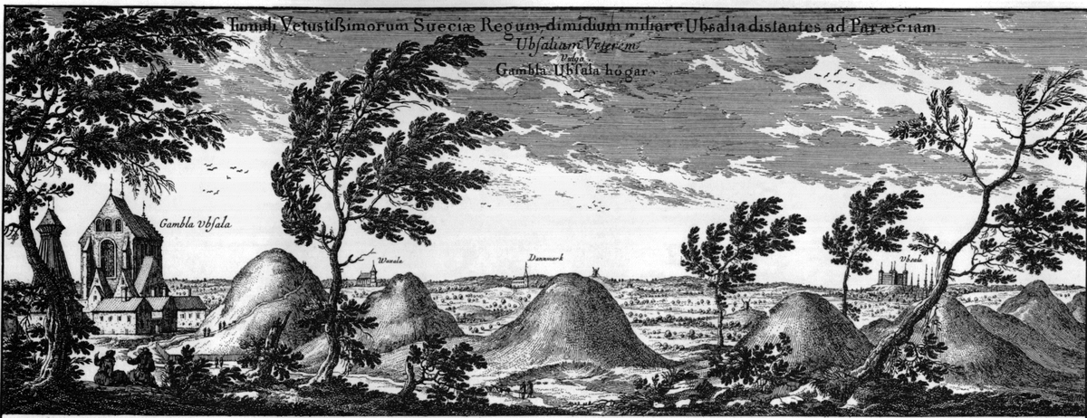
Gamla Uppsala (Old Uppsala), a site of religious and political importance in the early days of Sweden

Slide 7
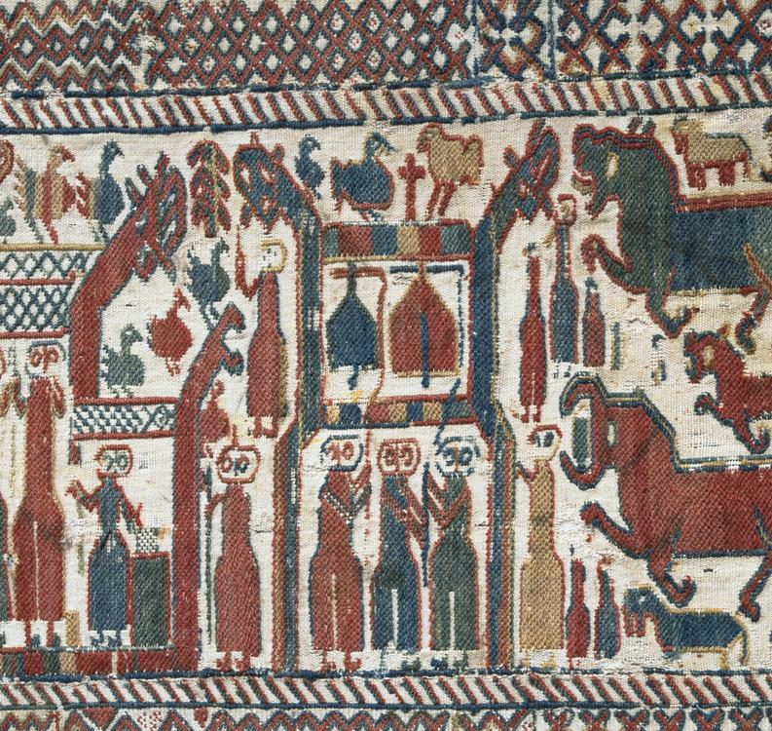
Skog tapestry, made most probably during the late 13th century.

Slide 8
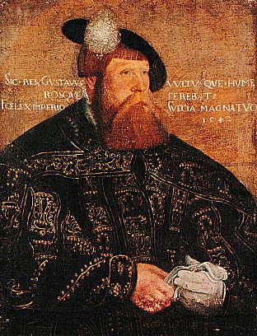
Under his reign the House of Vasa ruled Sweden and successively Poland for over 100 years.

Slide 9
The Kingdom of Sweden
It is not known when and how the kingdom of Sweden was born, but the list of Swedish monarchs is drawn from the first kings known to have ruled both Svealand (Sweden) and Götaland (Gothia) as one province, beginning with Eric the Victorious.
In the middle of the 14th century, Sweden was struck by the Black Death.
The population of Sweden and most of Europe was seriously decimated.
This is sometimes considered as the foundation of modern Sweden.
The main exports from Sweden were iron and copper.

Slide 10
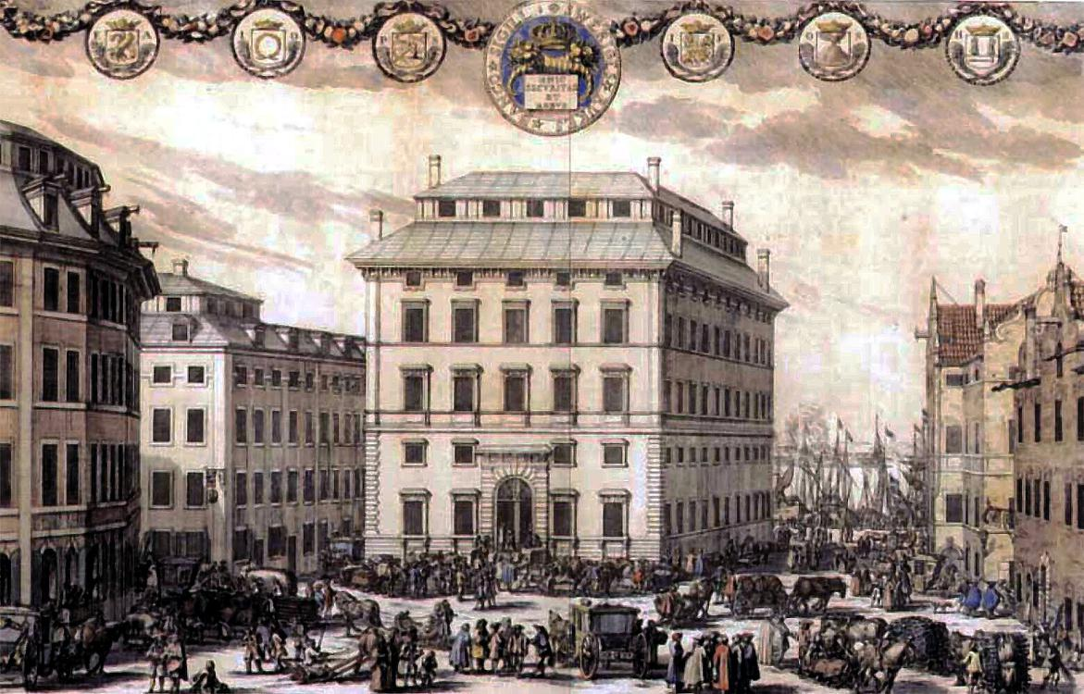
Stockholm in mid-17th century

Slide 11
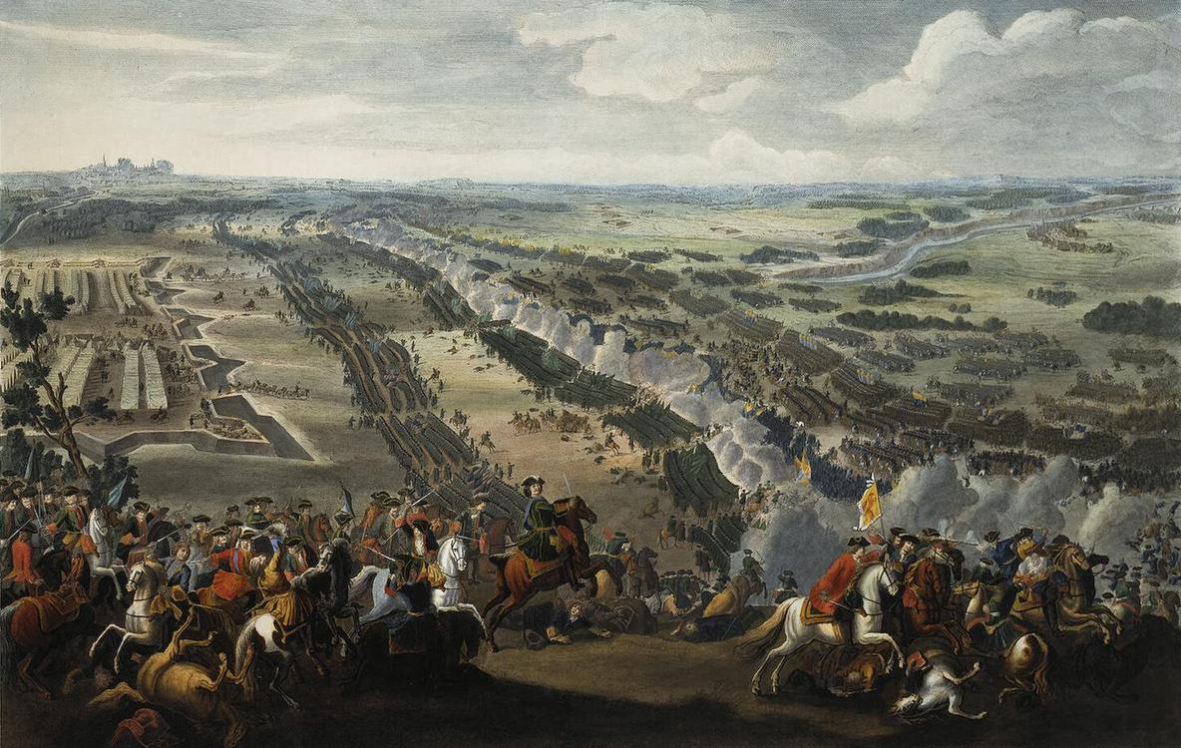
In the years following Poltava, Russia and her allies occupied all the Swedish dominions on the Baltic coast and even Finland.

Slide 12
Swedish Empire
These German provinces excluded themselves from Swedish power one by one, leaving Sweden with only a few northern German territories: Swedish Pomerania, Bremen-Verden and Wismar.
Famine also hit Sweden, killing roughly 10% of Sweden's population.
As the war finally ended in 1721, Sweden had lost an estimated 200,000 men, 150,000 of those from the area of present-day Sweden and 50,000 from the Finnish part of Sweden.

Slide 13
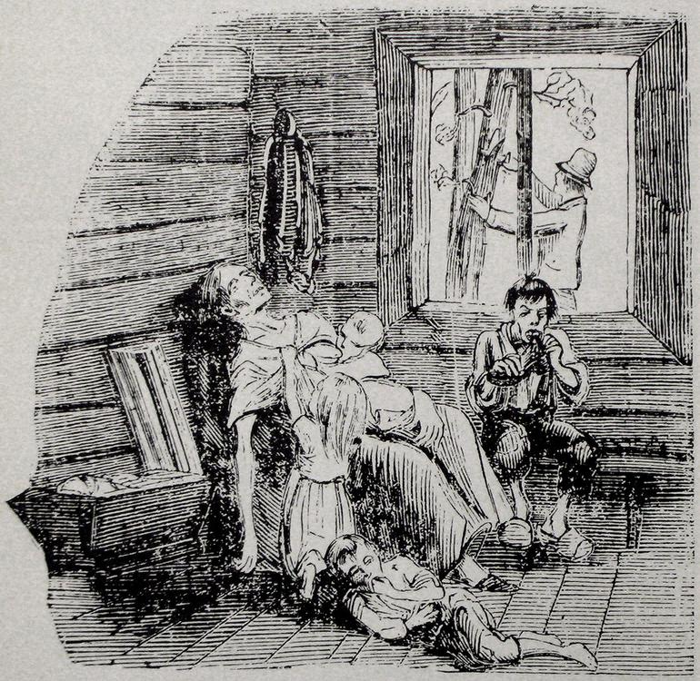
Illustration of starvation in northern Sweden, Famine of 1866–1868

Slide 14
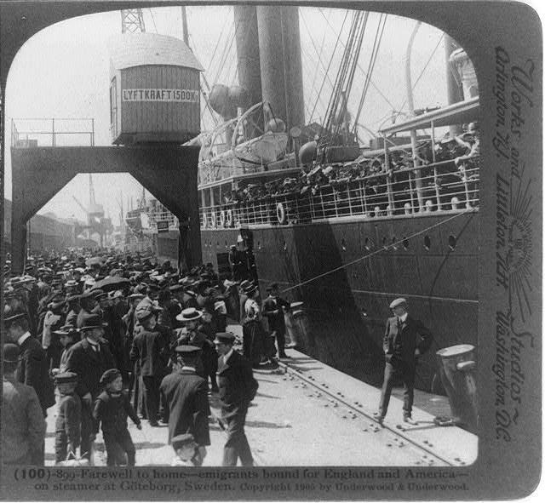
Swedish emigrants boarding ship in Gothenburg in 1905

Slide 15
Modern history
The trade continued into the 19th century, and caused the little town to become Sweden's second city.
Between 1750 and 1850, the population in Sweden doubled.
Between 1870 and 1914, Sweden began developing the industrialised economy that exists today.
These movements precipitated Sweden's migration into a modern parliamentary democracy, achieved by the time of World War I.

Slide 16
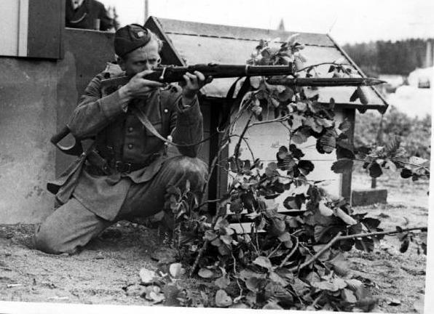
A Swedish soldier during World War II. Sweden remained neutral during the conflict.

Slide 17
World War I and World War II
As in the First World War, Sweden remained officially neutral during World War II, although its neutrality during World War II has been disputed.
Sweden was under German influence for much of the war, as ties to the rest of the world were cut off through blockades.
Sweden also supplied steel and machined parts to Germany throughout the war.

Slide 18
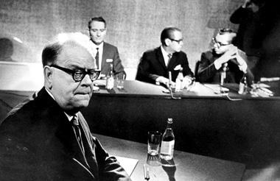
Prime Minister Tage Erlander (left) was Prime Minister under the ruling Swedish Social Democratic Party from 1946 to 1969.

Slide 19
Post-war era
Sweden was officially a neutral country and remained outside NATO and Warsaw Pact membership during the Cold War, but privately Sweden's leadership had strong ties with the United States and other western governments.
Sweden received aid under the Marshall Plan and participated in the OECD.
Sweden was one of the founding states of the European Free Trade Area (EFTA).

Slide 20
Recent history
Sweden's GDP declined by around 5%.
Sweden joined the European Union on 1 January 1995.
In 2006 Sweden got its first majority government for decades as the centre-right Alliance defeated the incumbent Social Democrat government.
Sweden also participated in enforcing a UN mandated no-fly zone over Libya during the Arab Spring.
Sweden held the chair of the European Union from 1 July to 31 December 2009.

Slide 21
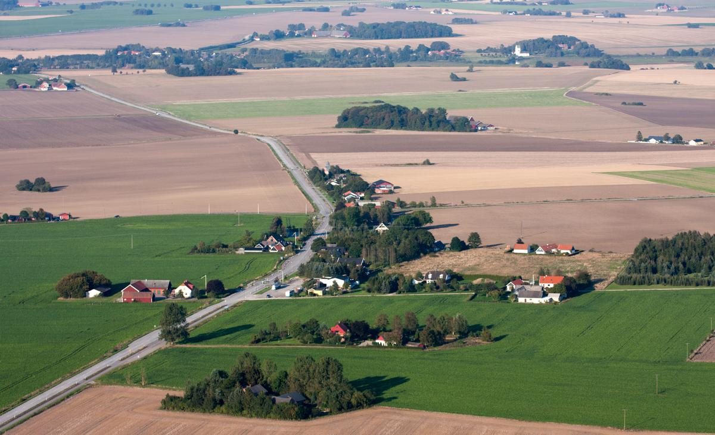
Scania in southern Sweden

Slide 22
Geography
Sweden has 25 provinces or landskap, based on culture, geography and history.
About 15% of Sweden lies north of the Arctic Circle.
Southern Sweden is predominantly agricultural, with increasing forest coverage northward.
Around 65% of Sweden's total land area is covered with forests.
Gotland and Öland are Sweden's largest islands; Vänern and Vättern are its largest lakes.

Slide 23
Climate
Because of Sweden's high latitude, the length of daylight varies greatly.
Sweden receives between 1,100 and 1,900 hours of sunshine annually.
Temperatures expected in Sweden are heavily influenced by the large Fennoscandian landmass, as well as continental Europe and western Russia, which allows hot or cool inland air to be easily transported to Sweden.
Most of Sweden is located in the rain shadow of the Scandinavian Mountains through Norway and north-west Sweden.

Slide 24
Vegetation
Sweden has a considerable south to north distance (stretching between the latitudes N 55:20:13 and N 69:03:36) which causes large climatic difference, especially during the winter.
Sweden is divided in five major vegetation zones.
Please see the map to the right, Vegetation Zones in Sweden.

Slide 25
Constitutional framework
Sweden has four fundamental laws (Swedish: grundlagar) which together forms the Constitution: the Instrument of Government (Swedish: Regeringsformen), the Act of Succession (Swedish: Successionsordningen), the Freedom of the Press Act (Swedish: Tryckfrihetsförordningen), and the Fundamental Law on Freedom of Expression (Swedish: Yttrandefrihetsgrundlagen).

Slide 26
Political parties and elections
It was not until elections in 2010 that an eighth party, the Sweden Democrats, gained Riksdag seats.
Nevertheless, neither the Alliance, nor the left block, chose to form a coalition with the Sweden Democrats.
The non-aligned Sweden Democrats more than doubled their support and won the remaining 49 seats.
Election turnout in Sweden has always been high by international comparison.

Slide 27
Administrative divisions
Municipal and county council government in Sweden is similar to city commission and cabinet-style council government.
The Swedish government has 21 County Administrative Boards (Swedish: länsstyrelser), which are responsible for regional state administration not assigned to other government agencies or local government.

Slide 28
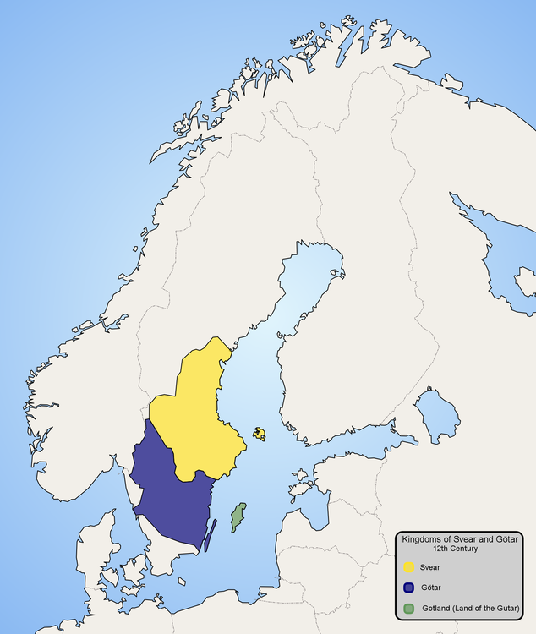
Kingdoms of Svear (Sweonas) and Götar (Geats) in the 12th century, with modern borders in grey

Slide 29
Political history
The actual age of the kingdom of Sweden is unknown.
Earlier kings, for which no reliable historical sources exist, can be read about in mythical kings of Sweden and semi-legendary kings of Sweden.
Up until the beginning of the 1920s, all laws in Sweden were introduced with the words, "We, the king of Sweden, of the Goths and Wends".

Slide 30
Judicial system
The Supreme Court of Sweden (Swedish: Högsta domstolen) is the third and final instance in all civil and criminal cases in Sweden.
The decrease in the number of Swedish prisoners was considered "out-of-the-ordinary" by the head of Sweden's prison and probation services, with prison numbers in Sweden falling by around 1% a year since 2004.

Slide 31
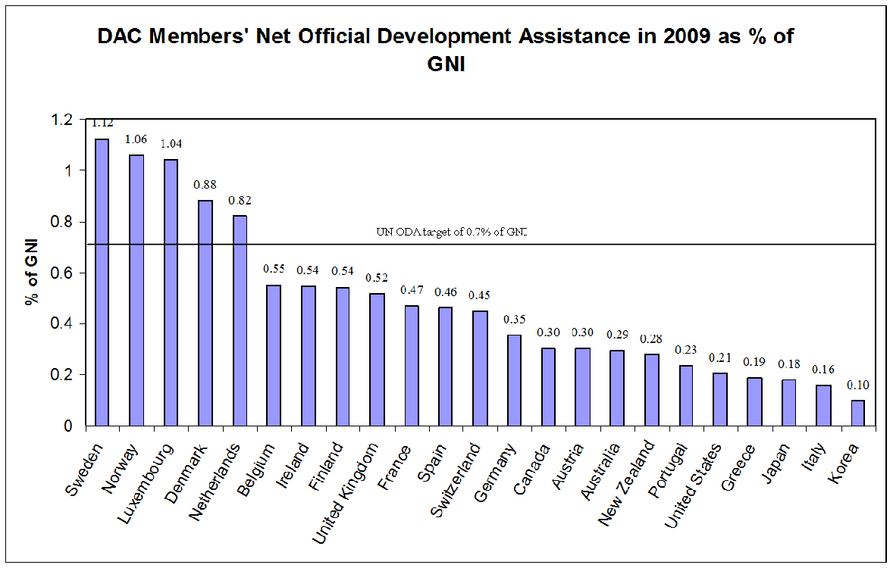
As a percentage Sweden is the largest donor.

Slide 32
Foreign relations
During World War II Sweden joined neither the allied nor axis powers.
However, Sweden also indirectly contributed to the defence of Finland in the Winter War, and permitted the training of Norwegian and Danish troops in Sweden after 1943.
The incident triggered a diplomatic crisis between Sweden and the Soviet Union.

Slide 33
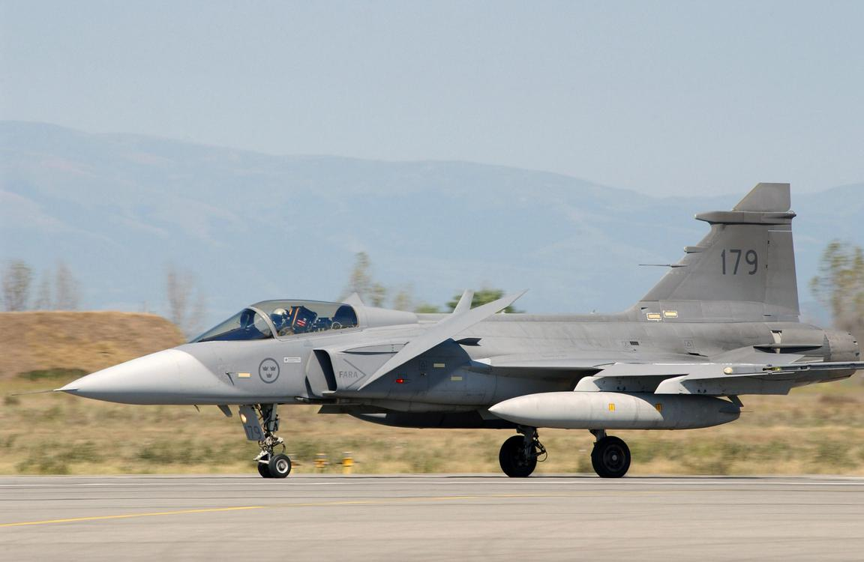
The Saab JAS 39 Gripen is an advanced Swedish multi-role fighter aircraft of the Swedish Air Force.

Slide 34
Military
The law is enforced in Sweden by several government entities.
Försvarsmakten (Swedish Armed Forces) is a government agency reporting to the Swedish Ministry of Defence and responsible for the peacetime operation of the armed forces of Sweden.
On 2 March 2017 the Swedish Government decided to reintroduce the remaining part of the Swedish conscription system, the Basic Military Training.

Slide 35
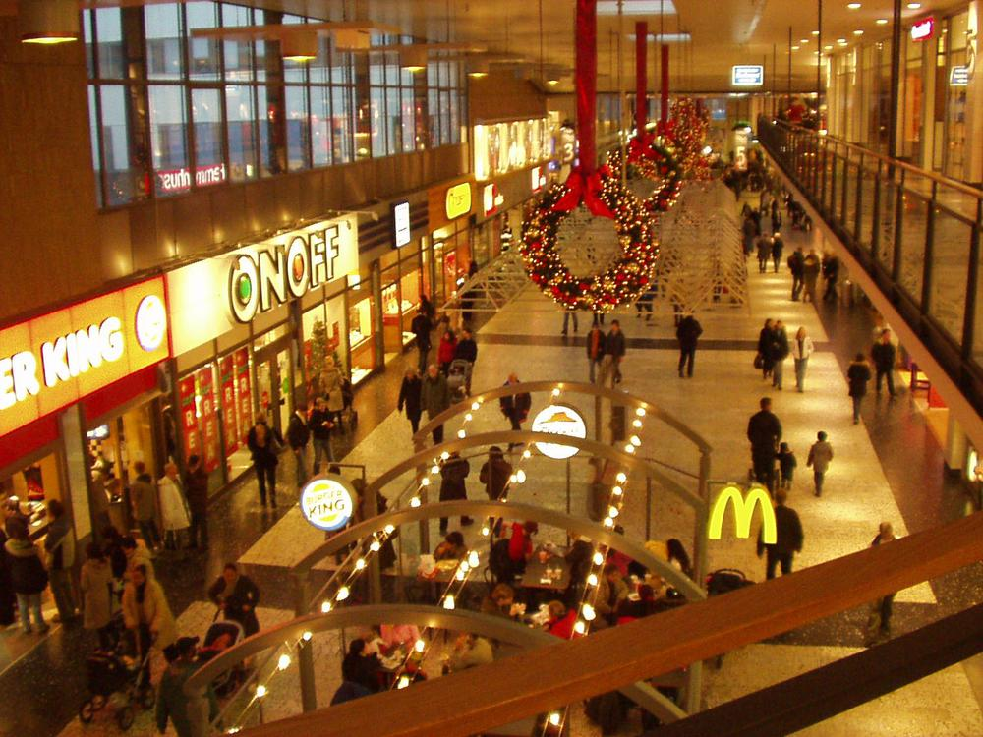
Nordstan is one of the largest shopping malls in northern Europe

Slide 36
Economy
Sweden is an export-oriented mixed economy.
Sweden is the ninth-largest arms exporter in the world.
Sweden is the top performing country in the 2014 Global Green Economy Index (GGEI).
Sweden is ranked fourth in the IMD World Competitiveness Yearbook 2013.
Sweden maintains its own currency, the Swedish krona (SEK), a result of the Swedes having rejected the euro in a referendum.

Slide 37
Energy
Sweden's energy market is largely privatised.
Sweden was a net importer of electricity by a margin of 6 TWh.
The 1973 oil crisis strengthened Sweden's commitment to decrease dependence on imported fossil fuels.
Sweden was in 2014 a net exporter of electricity by a margin of 16 TWh; the production from windpower mills had increased to 11.5 TWh.

Slide 38
Transport
Motorways run through Sweden and over the Øresund Bridge to Denmark.
Sweden had left-hand traffic (Vänstertrafik in Swedish) from approximately 1736 and continued to do so well into the 20th century.
Most tram nets were closed in 1967, as Sweden changed from left-side to right-side driving.
Sweden also has a number of car ferry connections to several neighbouring countries.

Slide 39
Public policy
Sweden has one of the most highly developed welfare states in the world.
During this period Sweden's economic growth was also one of the highest in the industrial world.
Sweden is starting to look like the USA."
Sweden adopted free market agricultural policies in 1990.
Sweden has state-supported union unemployment funds (Ghent system).

Slide 40
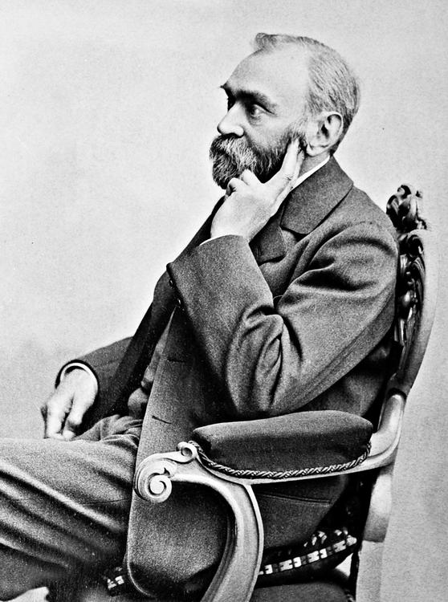
Alfred Nobel, inventor of dynamite and institutor of the Nobel Prize

Slide 41
Science and technology
In the 18th century Sweden's scientific revolution took off.
A large portion of the Swedish economy is to this day based on the export of technical inventions, and many large multinational corporations from Sweden have their origins in the ingenuity of Swedish inventors.
As a nation, only ten other countries hold more patents than Sweden.

Slide 42
Taxes
On average, 27% of taxpayer's money in Sweden goes to education and healthcare, whereas 5% goes to the police and military, and 42% to social security.
Total tax collected by Sweden as a percentage of its GDP peaked at 52.3% in 1990.
Since 1990, taxes as a percentage of GDP collected by Sweden have been dropping, with total tax rates for the highest income earners dropping the most.

Slide 43
Pensions
Every Swedish resident receives a state pension.
Swedish Pensions Agency is responsible for pensions.
People who have worked in Sweden, but relocated to another country, can also receive the Swedish pension.
There are several types of pensions in Sweden: national retirement, occupational and private pensions.

Slide 44
Demographics
The total resident population of Sweden was 10,223,505 on 30 November 2018.
There are no official statistics on ethnicity, but according to Statistics Sweden, around 3,193,089 (31.5%) inhabitants of Sweden were of a foreign background in 2017, defined as being born abroad or born in Sweden with at least one parent born abroad.

Slide 45
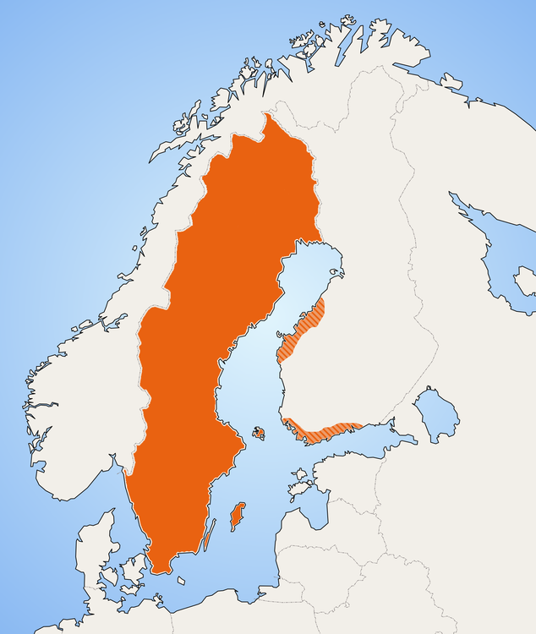
Distribution of speakers of the Swedish language

Slide 46
Language
The official language of Sweden is Swedish, a North Germanic language, related and very similar to Danish and Norwegian, but differing in pronunciation and orthography.
Sweden Finns are Sweden's largest linguistic minority, comprising about 5% of Sweden's population, and Finnish is recognised as a minority language.
Swedish became Sweden's official language on 1 July 2009, when a new language law was implemented.

Slide 47
Religion
In 2000, the Church of Sweden was disestablished.
Sweden was the second Nordic country to disestablish its state church (after Finland did so in the Church Act of 1869).
Islam's presence in Sweden remained marginal until the 1960s, when Sweden started to receive migrants from the Balkans and Turkey.
18% of Swedish citizens responded that "they believe there is a god".

Slide 48
Health
Healthcare in Sweden is similar in quality to other developed nations.
Sweden ranks in the top five countries with respect to low infant mortality.
The health care is governed by the 21 landsting of Sweden and is mainly funded by taxes, with nominal fees for patients.

Slide 49
Education
School lunch is free for all students in Sweden, and providing breakfast is also encouraged.
There are a number of different universities and colleges in Sweden, the oldest and largest of which are situated in Uppsala, Lund, Gothenburg and Stockholm.
The large influx of immigrants to Swedish schools has been cited as a significant part of the reason why Sweden has dropped more than any other European country in the international PISA rankings.

Slide 50
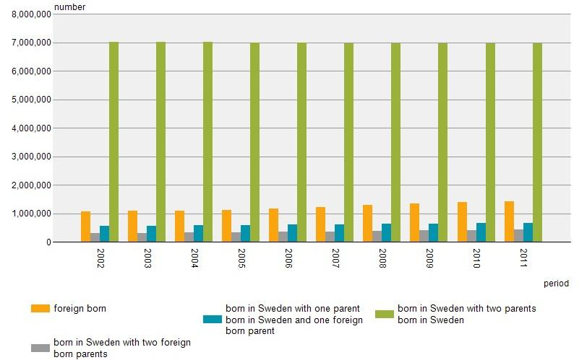
Population by ancestry, Sweden 2002–2011

Slide 51
Immigration
There are no exact numbers on the ethnic background of migrants and their descendants in Sweden because the Swedish government does not base any statistics on ethnicity.
Of these inhabitants, 1,955,569 persons living in Sweden were born abroad.
According to an official investigation by The Swedish Pensions Agency on order from the government, the immigration to Sweden will double the state's expenses for pensions to the population.

Slide 52
Crime
Figures from the 2013 Swedish Crime Survey (SCS) show that exposure to crime decreased from 2005 to 2013.

Slide 53
Culture
Sweden has also become very liberal towards homosexuality, as is reflected in the popular acceptance of films such as Show Me Love, which is about two young lesbians in the small Swedish town of Åmål.
Since 1 May 2009, Sweden repealed its "registered partnership" laws and fully replaced them with gender-neutral marriage, Sweden also offers domestic partnerships for both same-sex and opposite-sex couples.
As of 2009, Sweden is experiencing a baby boom.

Slide 54
Music
Sweden has a significant folk-music scene.
Sweden also has a prominent choral music tradition.
With ABBA, Sweden entered into a new era, in which Swedish pop music gained international prominence.
Sweden has a rather lively jazz scene.
The Centre for Swedish Folk Music and Jazz Research has published an overview of jazz in Sweden by Lars Westin.

Slide 55
Architecture
Cathedrals in other parts of Sweden were also built as seats of Sweden's bishops.
In the next two centuries, Sweden was designated by Baroque architecture and later the rococo.

Slide 56
Media
The ad-financed, free international morning paper, Metro International, was founded in Stockholm, Sweden.
The public broadcasting companies held a monopoly on radio and television for a long time in Sweden.
Digital terrestrial television in Sweden started in 1999 and the last analogue terrestrial broadcasts were terminated in 2007.

Slide 57
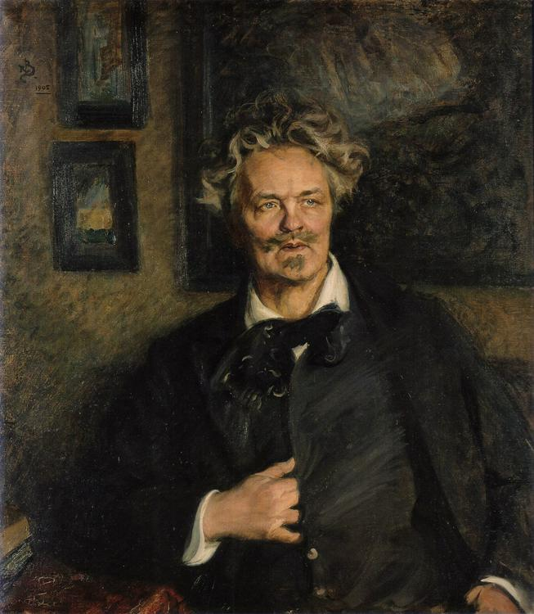
The writer and playwright August Strindberg

Slide 58
Literature
The first literary text from Sweden is the Rök Runestone, carved during the Viking Age c. 800 AD.
Therefore, there are only a few texts in the Old Swedish from that period.
Swedish literature only flourished when the Swedish language was standardised in the 16th century, a standardisation largely due to the full translation of the Bible into Swedish in 1541.

Slide 59
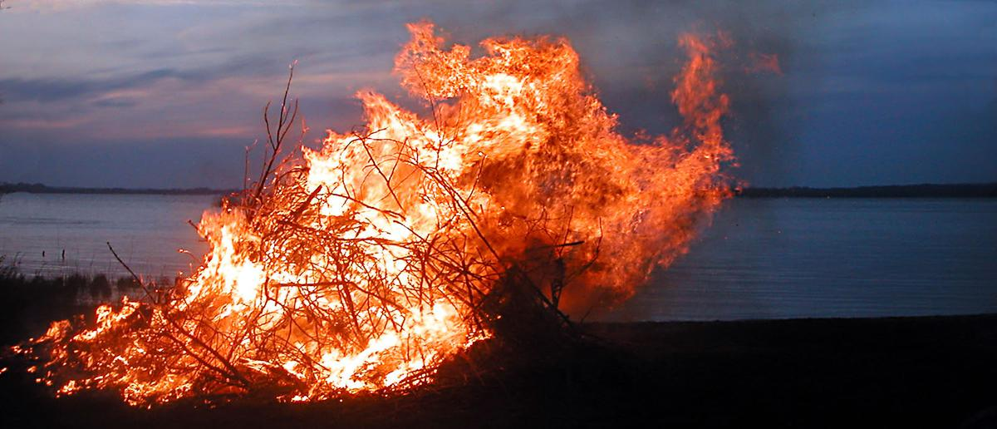
Walpurgis Night bonfire in Sweden

Slide 60
Holidays
Apart from traditional Protestant Christian holidays, Sweden also celebrates some unique holidays, some of a pre-Christian tradition.
6 June is the National Day of Sweden and has since 2005 been a public holiday.
Furthermore, there are official flag day observances and a Namesdays in Sweden calendar.

Slide 61
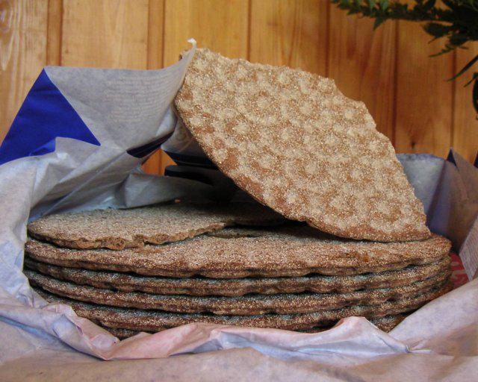
Swedish knäckebröd (crisp bread)

Slide 62
Cuisine
Regionally important foods are the surströmming (a fermented fish) in northern Sweden and eel in Scania in southern Sweden.
Swedish traditional dishes, some of which are many hundreds of years old, are still an important part of Swedish everyday meals, in spite of the fact that modern-day Swedish cuisine adopts many international dishes.

Slide 63
Cinema
A number of Swedish people have found success in Hollywood, including Ingrid Bergman, Greta Garbo and Max von Sydow.

Slide 64
Fashion
Interest in fashion is big in Sweden and the country is headquartering famous brands like Hennes & Mauritz (operating as H&M), J. Lindeberg (operating as JL), Acne, Lindex, Odd Molly, Cheap Monday, Gant, WESC, Filippa K, and Nakkna within its borders.
These companies, however, are composed largely of buyers who import fashionable goods from throughout Europe and America, continuing the trend of Swedish business toward multinational economic dependency like many of its neighbours.

Slide 65
Sports
The Swedish national men's ice hockey team, affectionately known as Tre Kronor (English: Three Crowns; the national symbol of Sweden), is regarded as one of the best in the world.
Sweden hosted the 1912 Summer Olympics, Equestrian at the 1956 Summer Olympics and the FIFA World Cup in 1958.
Due to its northerly latitude numerous world class winter sports athletes have come from Sweden.

Slide 66
International rankings
The following are links to international rankings of Sweden from selected research institutes and foundations including economic output and various composite indices.

Slide 67
See also
Outline of Sweden

Slide 68
External links
"Sweden".
Sweden entry at Encyclopædia Britannica
Sweden from UCB Libraries GovPubs
Sweden at Curlie
Wikimedia Atlas of Sweden
Study in Sweden – official guide to studying in Sweden
The Government of Sweden – official website

