Slide 1
Fantasy League Team Recommendation System
Done by,
Mayank (IMT2021073)
Rishi (IMT2021076)
Ashish (IMT2021085)
Prasad (IMT2021104)

Slide 2
Problem Description
Our Goal is to provide the users with the best fantasy league team to choose from the two teams playing a cricket match.
Given 22 players(as Input) to our recommendation system it would recommend a team of 11 players as well as positions of each of the players(batsman/bowler/all-rounder) to maximize the points they get on platforms like Dream11, My11Circle etc.

Slide 3
Dataset Used
Dataset Used for this project is the IPL complete dataset 2008-2020 available on Kaggle.
NOTE: The dataset has now been updated with more recent match data till 2023 (as of May 1st,2024)
We Used this dataset as it contained both Ball-To-Ball data as well as Match data.
We had also tried to extract data for more recent matches through different APIs and Web Scraping.
https://www.kaggle.com/datasets/patrickb1912/ipl-complete-dataset-20082020?select=deliveries.csv

Slide 4
Calculating Points For Each Player
Batting Points
Run | +1
Boundary Bonus | +1
Six Bonus | +2
Half-Century Bonus | +8
Century Bonus | +16
Dismissal for a Duck (Batter & All Rounder) | -2
Bowling Points
Wicket(Excluding Run Out) | +25
4 Wicket Bonus | +8
5 Wicket Bonus | +16
Maiden Over | +8
Century Bonus | +16
Fielding Points
Catch | +8
Stumping/Run Out (direct) | +12
Run Out (Thrower/Catcher) | +2

Slide 5
Calculating Points
We have used scoring mechanism similar to that of Dream11 to assign points to players based on their performance in a match.
Total Points of the players are calculated as follows
For a Batsman: Batting Points + Fielding Points
For a Bowler: Bowling Points + Fielding Points
For an All Rounder: Batting Points + Bowling Points + Fielding Points
https://www.dream11.com/games/point-system

Slide 6
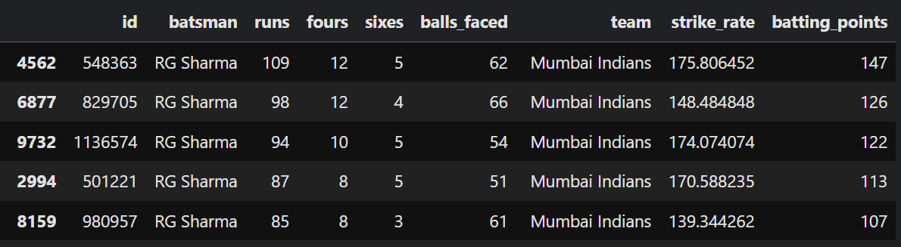
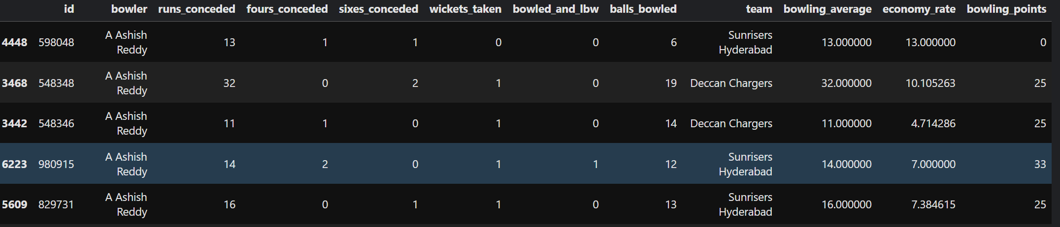
Creating Summaries
We Processed the ball-by-ball data for the dataset to summarize each player’s performance in a match as a batsman/bowler/fielder.
We kept track of stats that are used in assigning points to each player based on performance on Dream11.

Slide 7
Our Approach
Our approach to this problem is in 2 stages,
For each player we get in the input we predict the points they would score based on their performance in previous matches. We can do this prediction using any Supervised model.
Once we have the predicted points we have the predictions for batting, bowling and fielding points of all players we select the 11 that would give the highest points, keeping in mind the constraints on player selection posed by Dream11. This can reduced to a optimization problem(as shown later).

Slide 8
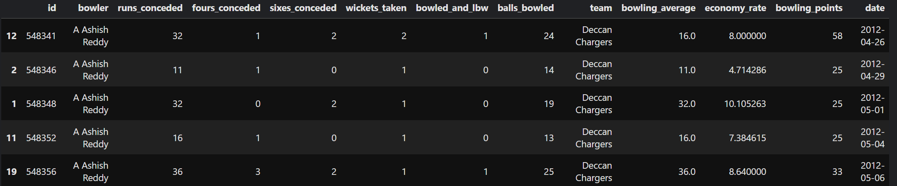
Generating Features
For our regression model we used the player performance in k previous matches as features, and their batting/bowling/fielding points in the next match as the target value.
To generate these features we
grouped the summaries by player and match
sorted them by date
Extracted their performance stats as features from a window of length k their performance in the very next match as the target.

Slide 9
Models Used
Random Forests
Linear Regression
Polynomial Regression
XGBoost
CatBoost
LSTM

Slide 10
Analysis of Models used
Model | Batsman Model MSE Error | Bowler Model MSE Error | Fielder Model MSE Error
Linear Regression | 854 | 764.7 | 22.64
Random Forests | 875.38 | 796.622 | 26.92
XGBoost | 997.49 | 886 | 27.7
CatBoost | 889 | 796 | 24.83
LSTM | 852 | 772 | 22.14

Slide 11
Choosing Players
We now have the predicted points for 22 players, and want to select the 11 that will maximize the total points. But platforms like Dream11 also place restrictions on how you choose players:
All players have a cost associated with them, the total cost must be less than the budget of 100.
You can choose each player as a batsman/bowler/allrounder.
You can choose 3-6 batsman.
You can choose 3-6 bowlers.
You can choose 1-4 allrounders.

Slide 12
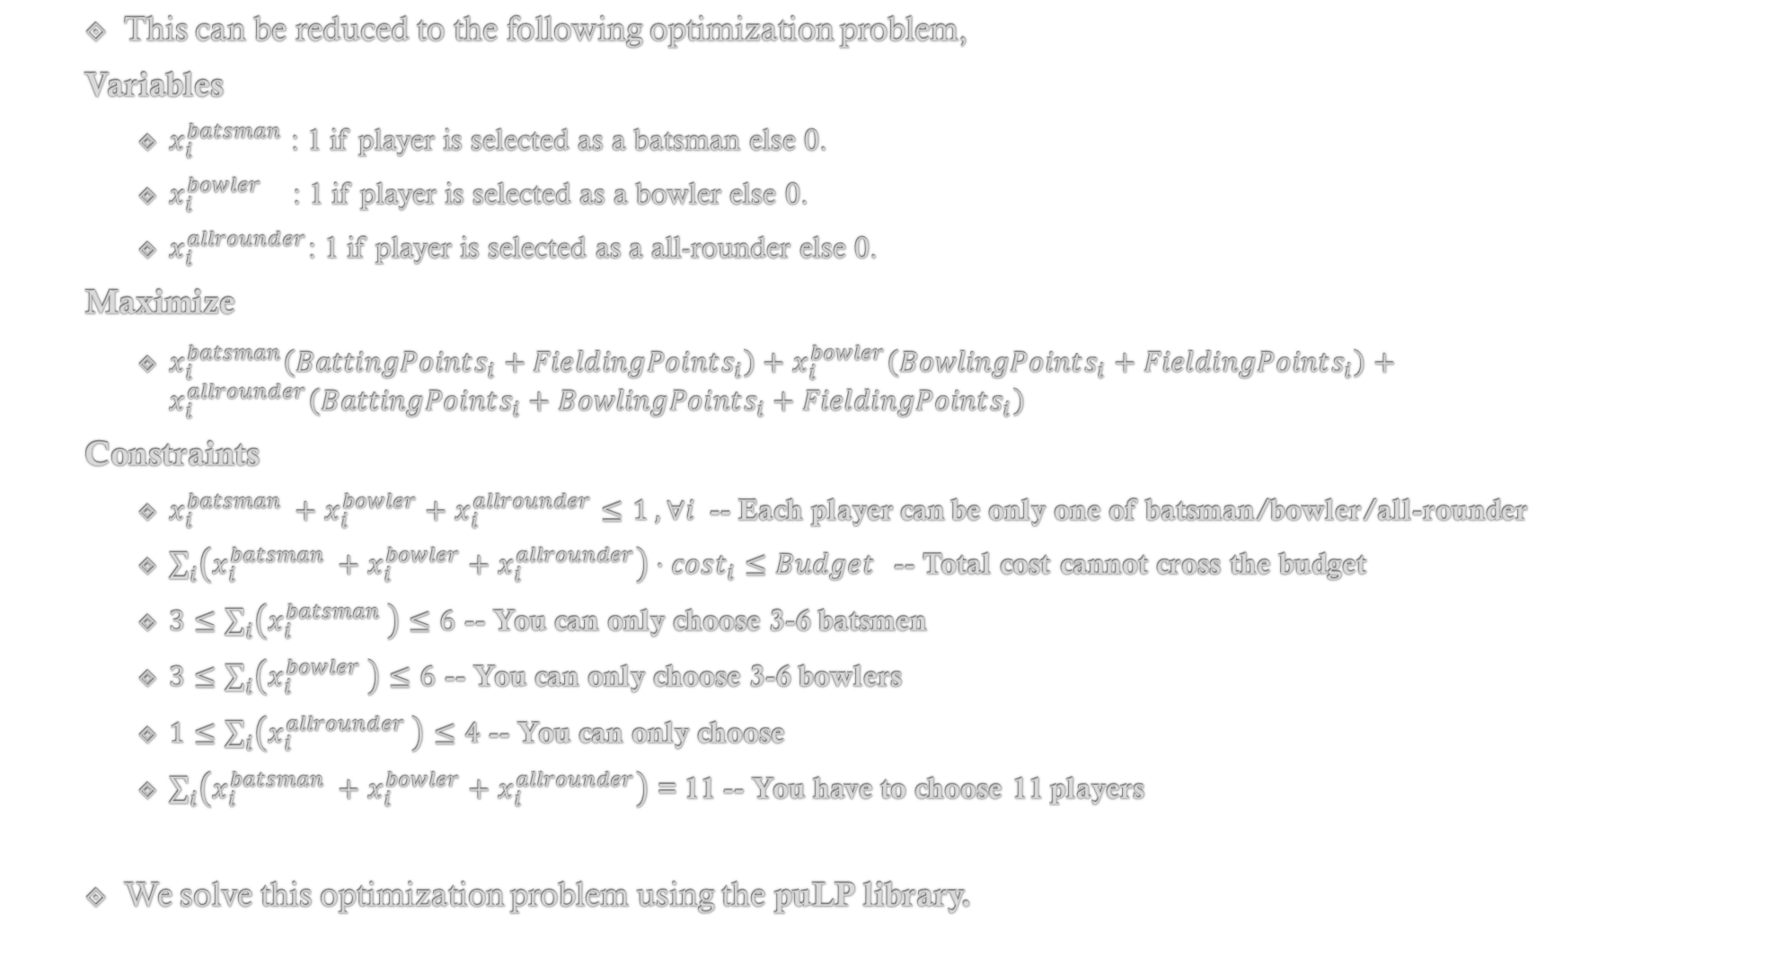
This can be reduced to the following optimization problem,
Variables
$x_{i}^{batsman}$ : 1 if player is selected as a batsman else 0.
$x_{i}^{bowler}$ : 1 if player is selected as a bowler else 0.
$x_{i}^{allrounder}$: 1 if player is selected as a all-rounder else 0.
$\text{Maximize}$
$x_{i}^{batsman}\left(BattingPoints_{i}+FieldingPoints_{i}\right)+x_{i}^{bowler}\left(BowlingPoints_{i}+FieldingPoints_{i}\right)+x_{i}^{allrounder}\left(BattingPoints_{i}+BowlingPoints_{i}+FieldingPoints_{i}\right)$
Constraints
$x_{i}^{batsman }+x_{i}^{bowler}+x_{i}^{allrounder}≤1 , ∀i$ -- Each player can be only one of batsman/bowler/all-rounder
$\sum_{i}{\left(x_{i}^{batsman }+x_{i}^{bowler}+x_{i}^{allrounder}\right)}⋅cost_{i}≤Budget$ -- Total cost cannot cross the budget
$3≤\sum_{i}{\left(x_{i}^{batsman }\right)}≤6$ -- You can only choose 3-6 batsmen
$3≤\sum_{i}{\left(x_{i}^{bowler }\right)}≤6$ -- You can only choose 3-6 bowlers
$1≤\sum_{i}{\left(x_{i}^{allrounder }\right)}≤4$ -- You can only choose
$\sum_{i}{\left(x_{i}^{batsman }+x_{i}^{bowler}+x_{i}^{allrounder}\right)}$ = 11 -- You have to choose 11 players
We solve this optimization problem using the puLP library.

Slide 13
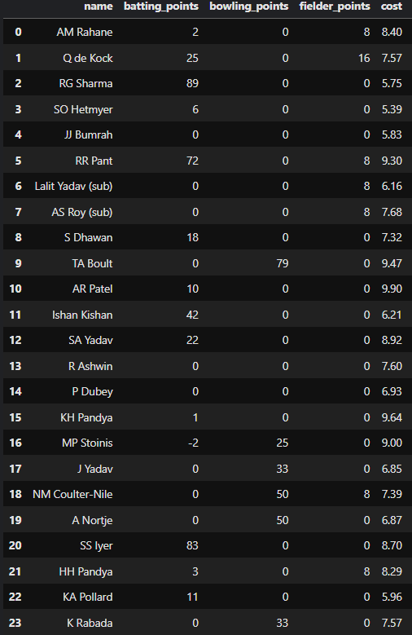
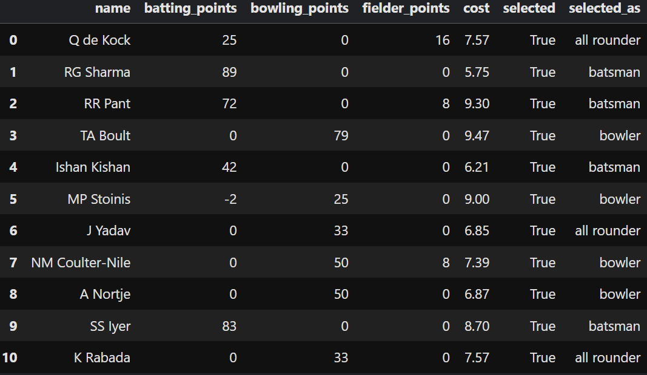
RESULT of puLP on Real match data
Best 11:

Slide 14
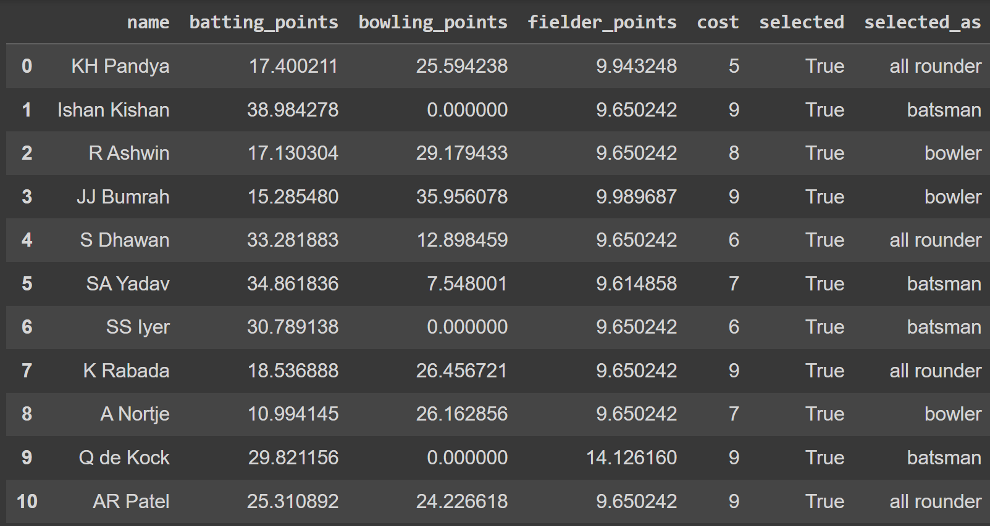
Result of PuLP on point predictions using Linear Regression

Slide 15
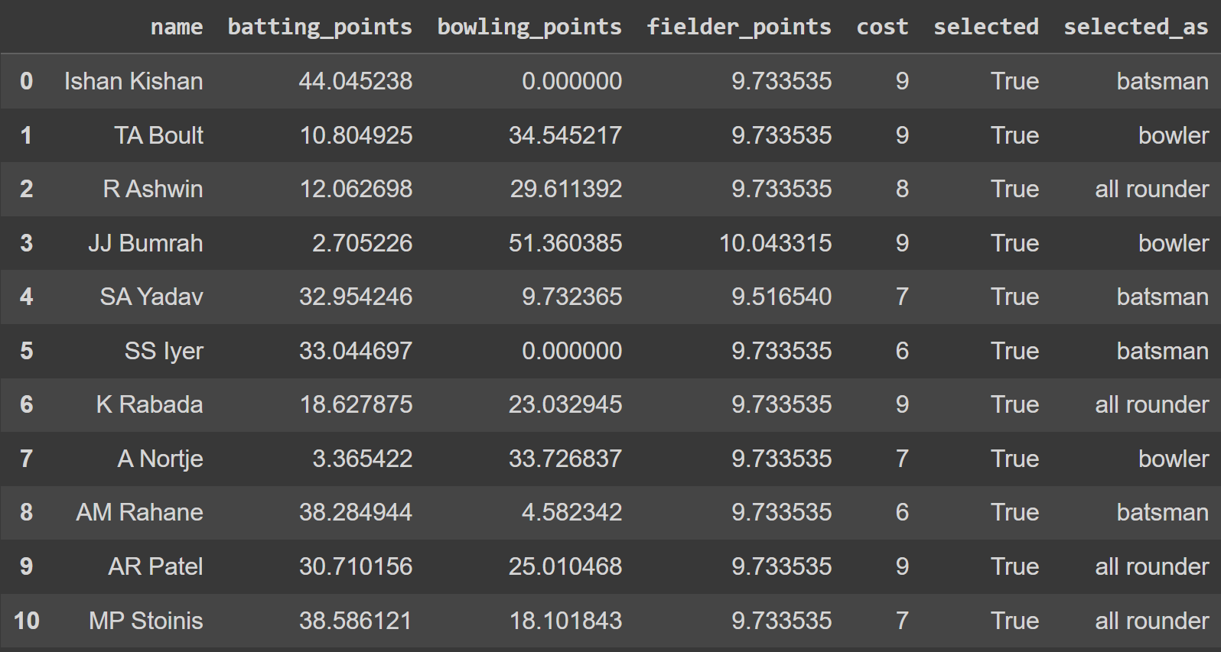
Result of PuLP on point predictions using CatBoost Algorithm

Slide 16
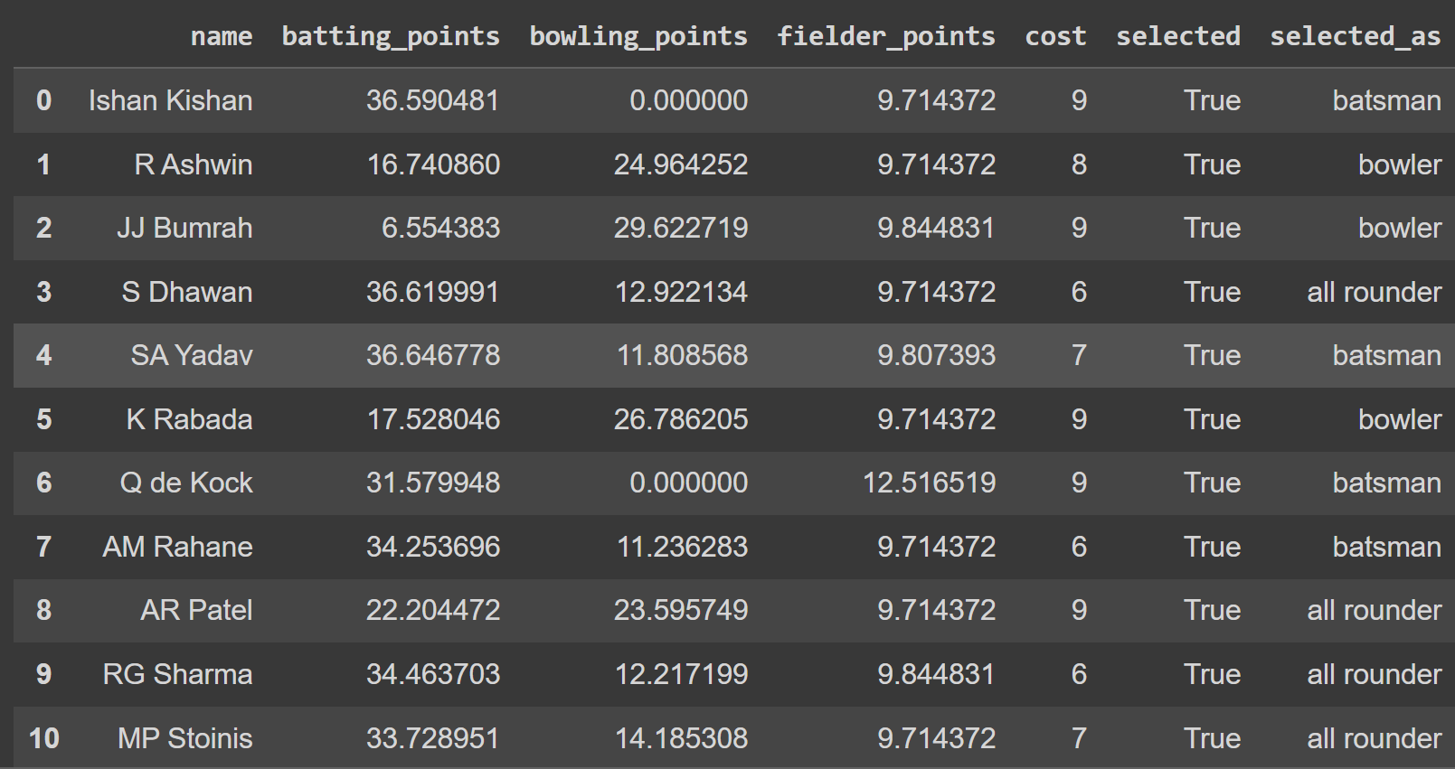
Result of PuLP on point predictions using LSTM

Slide 17
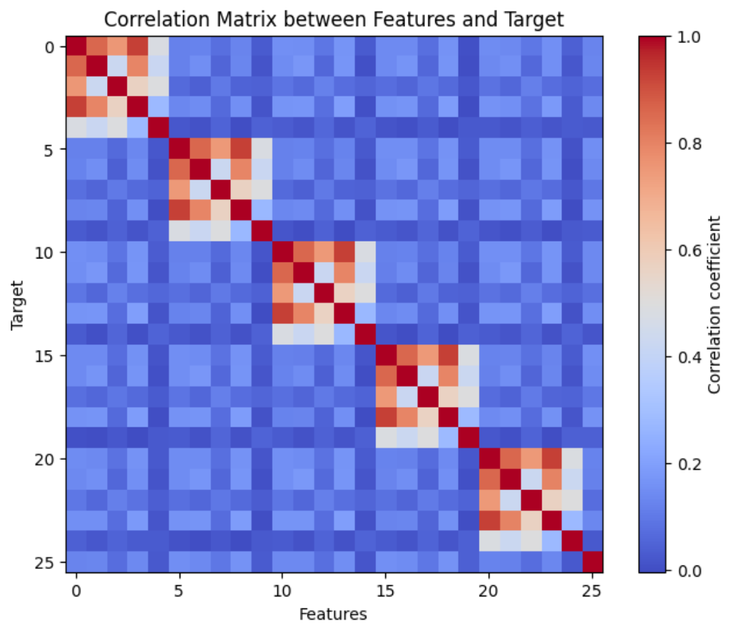
Limitations of our system
As we are considering the past 5 performances of each player, there can be instances where the player hasn't batted, bowled or fielded then we are replacing it with average values.
As we can see the features and not highly correlated with target variable.
We are not using the latest data.

Slide 18
Thank You

