Slide 1
SSA Analysis: A_LU vs Pt
Settings:
  Target : C
  Hadron : pi+
  z : 0.5
  thpq : -0.8, 2.0 and 5.2 (combined analysis)

Slide 2
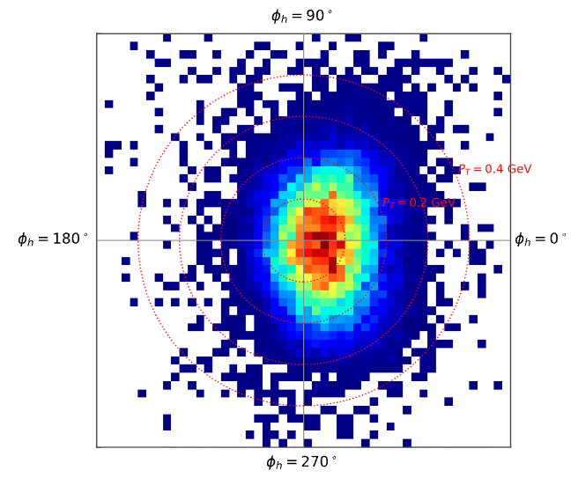
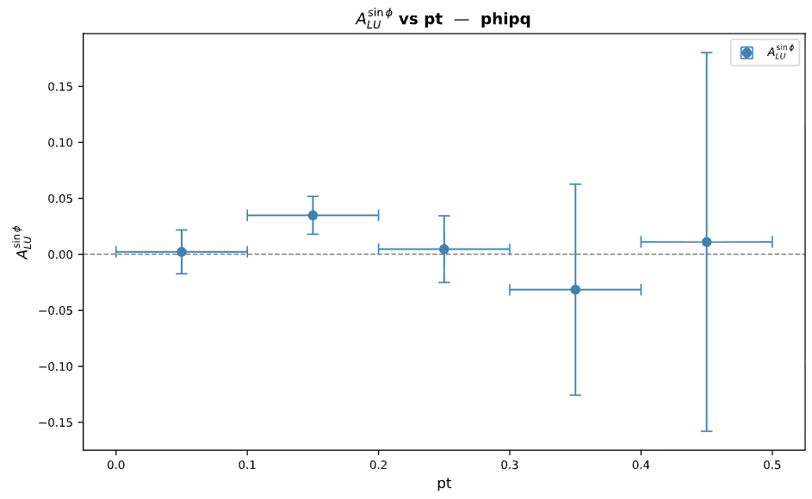
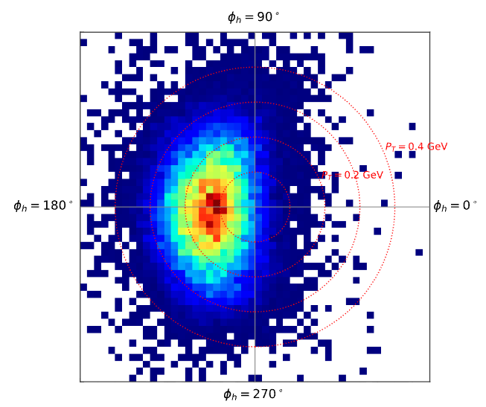
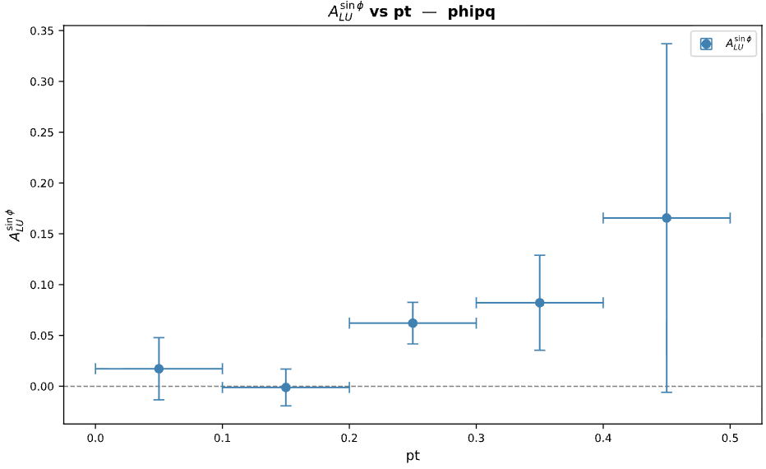
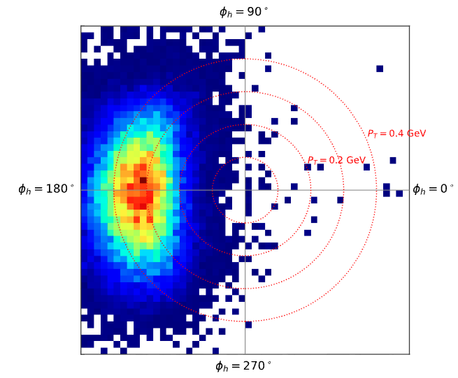
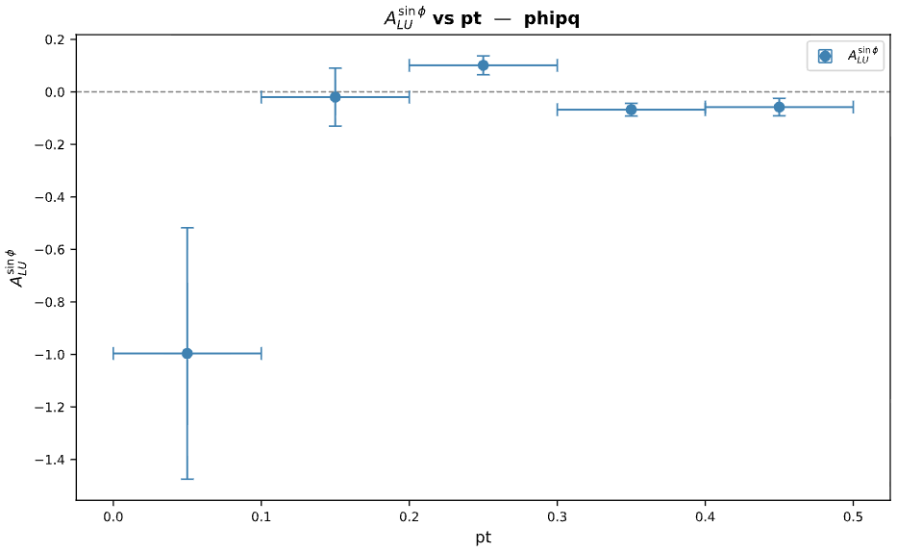
thpq = -0.8
thpq = 2.0
thpq = 5.2

Slide 3
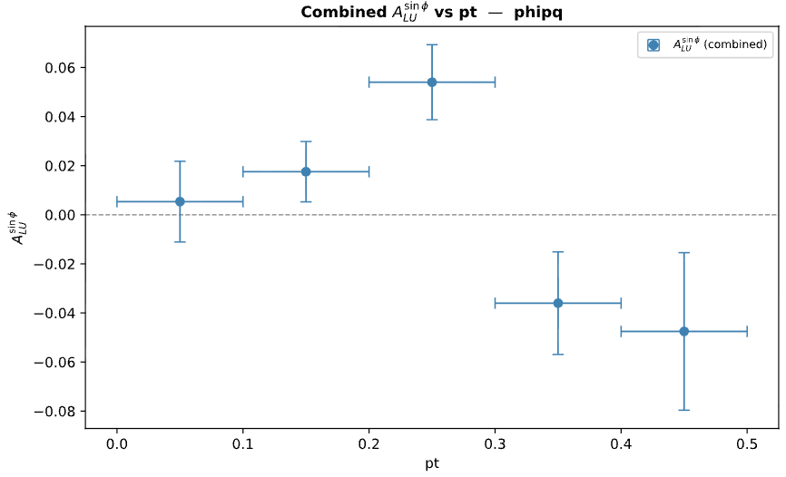
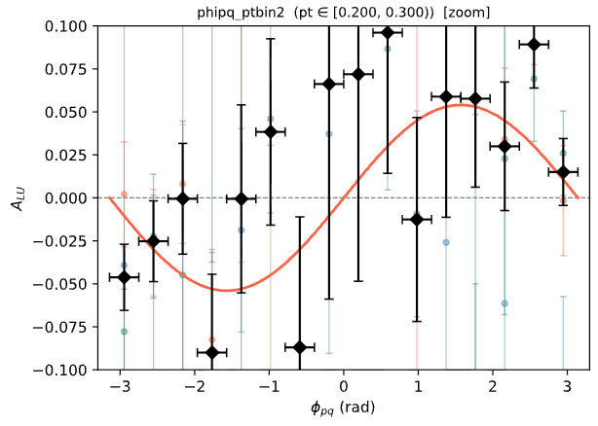

A_LU vs Pt for thpq = -0.8 and 2.0 combined
Bin [0.2,0.3) seems to give the best asymmetry, however, the statistics around phi = 0 is very poor!

Slide 4
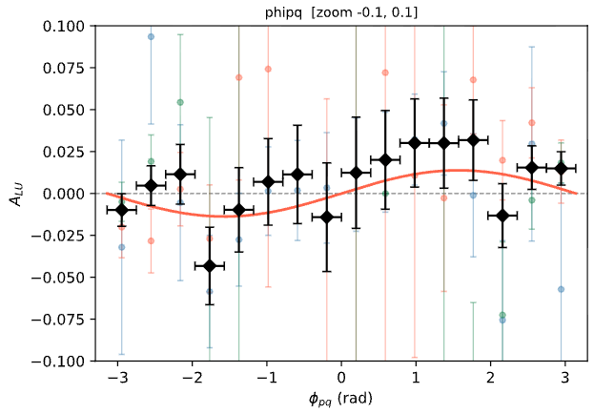

A_LU w/ and w/o Pt binning
Averaged over all Pt
0.2 <= Pt < 0.3
Binning in Pt increases A_LU from +0.0138 +/- 0.0074 to +0.0540 +/- 0.0153
The statistics is very poor near phi = 0 though.

Slide 5
SSA Analysis: A_LU vs Pt
Settings:
  Target : C
  Hadron : pi-
  z : 0.5
  thpq : -0.8 and 2.0 (combined analysis)

Slide 6
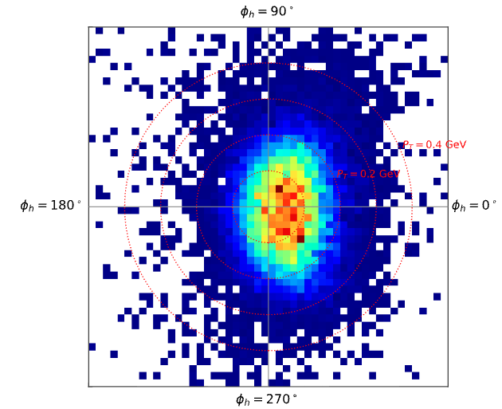
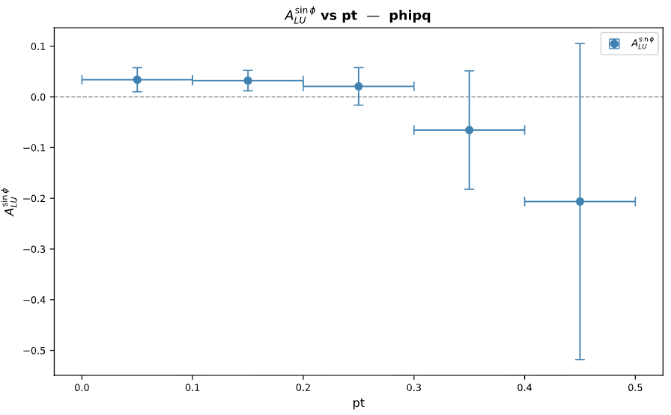
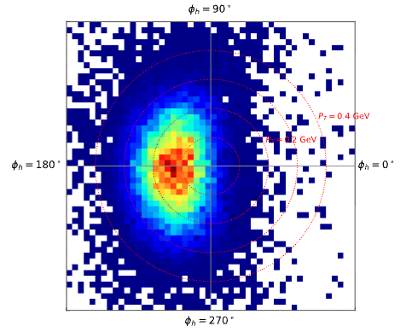
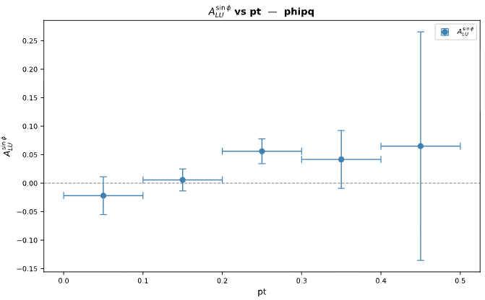
thpq = -0.8
thpq = 2.0

Slide 7
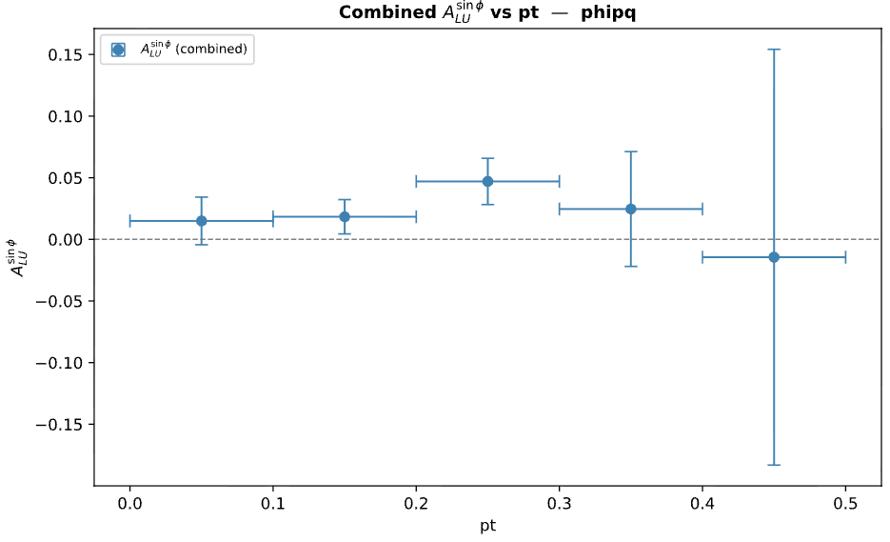
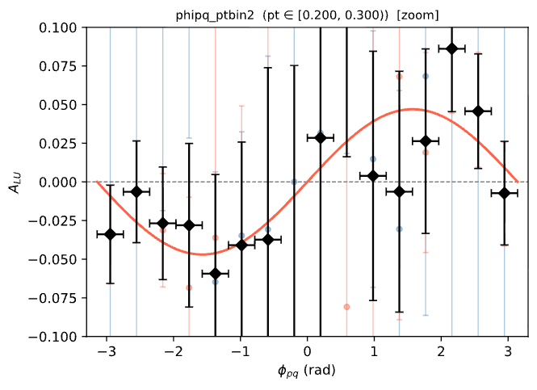

A_LU vs Pt for thpq = -0.8 and 2.0 combined
Bin [0.2,0.3) seems to give the best asymmetry.

Slide 8
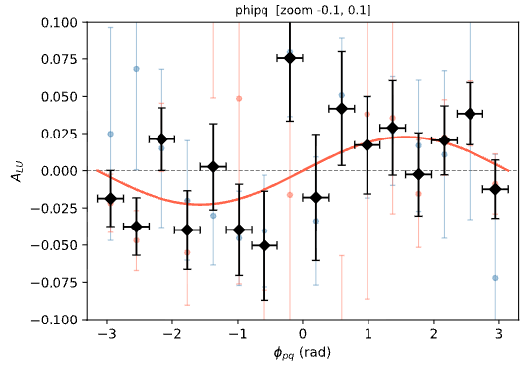

A_LU w/ and w/o Pt binning
Averaged over all Pt
0.2 <= Pt < 0.3
Binning in Pt increases A_LU from +0.0227 +/- 0.0095 to +0.0470 +/- 0.0188
Chi2/ndf becomes a lot worse though. Must be due to low stats near phi = 0

Slide 9
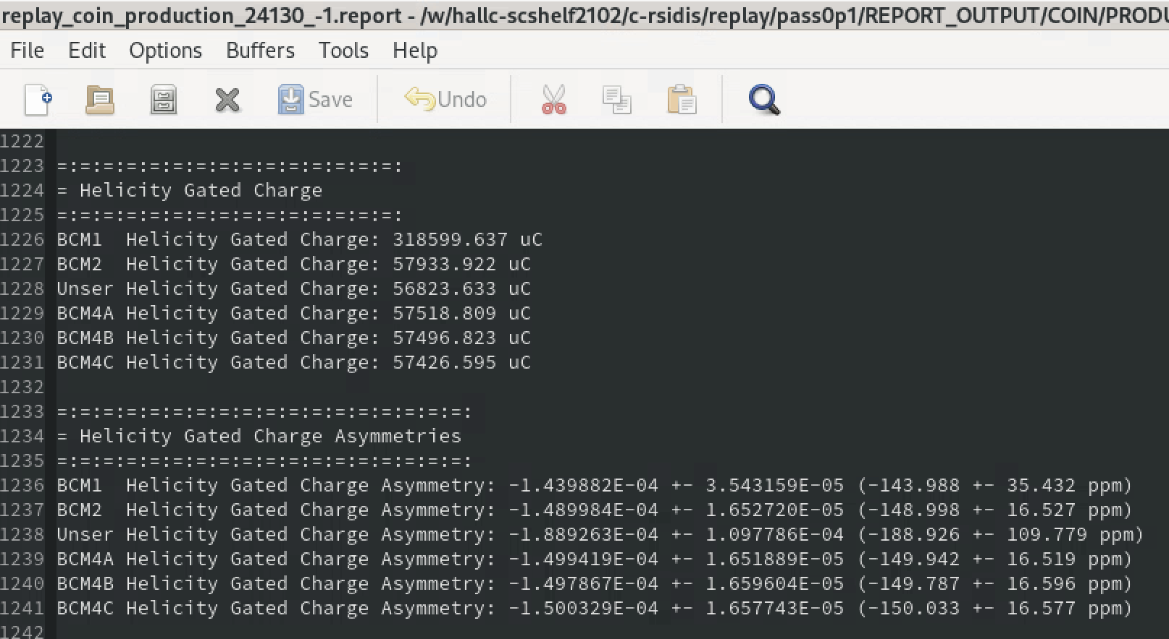


Helicity Based Charge
= C
BCM2_Q_hp = $\frac{C}{2}(1+A)$
= A
BCM2_Q_hm = $\frac{C}{2}(1−A)$
Available only for SIDIS & HEEP runs. Assign -999 for the rest.
Make sure to use all the available decimal places to minimize round off error.

Slide 10
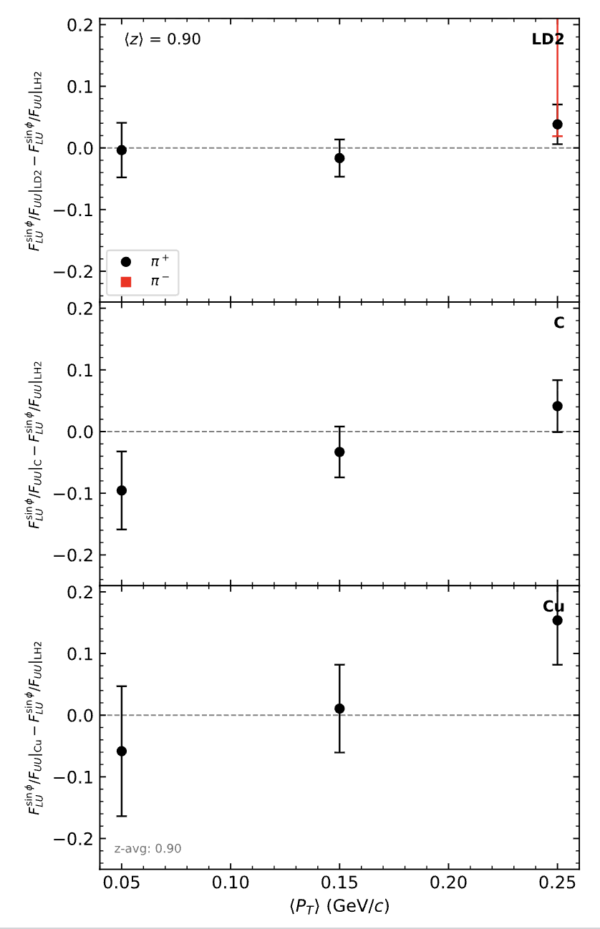
Exclusive (0.85 <= Mx <= 1.05)
Exclusive (Mx <= 1.05)

Slide 11
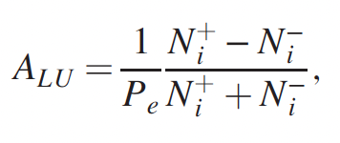
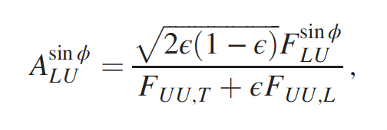
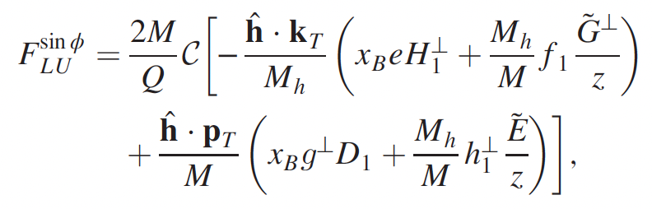
A-dependence of Beam Single Spin Asymmetry using Hall C R-SIDIS Data
Reference: PHYSICAL REVIEW LETTERS 128, 062005 (2022)

Slide 12
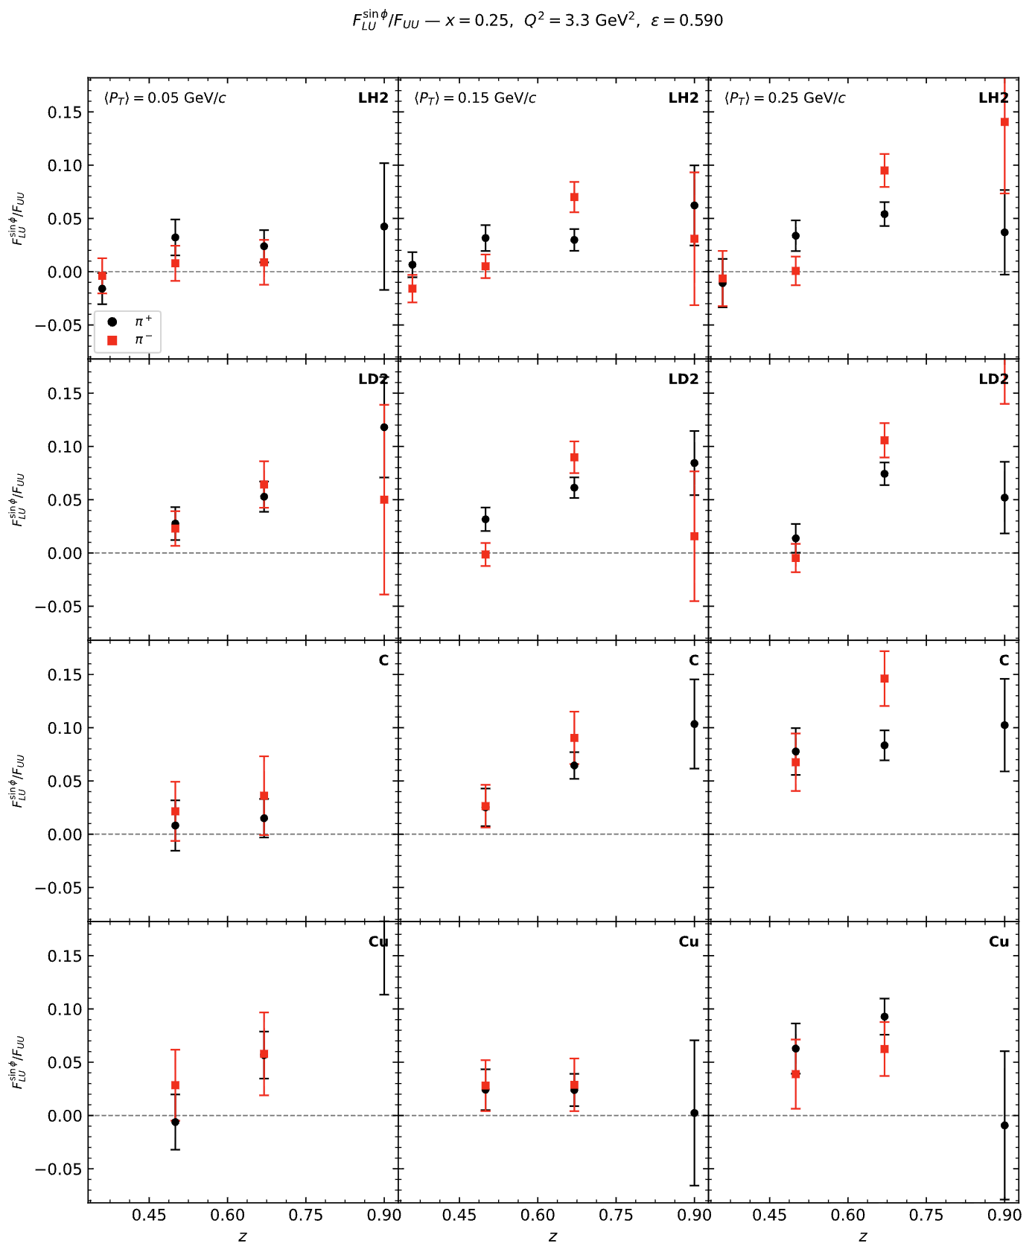
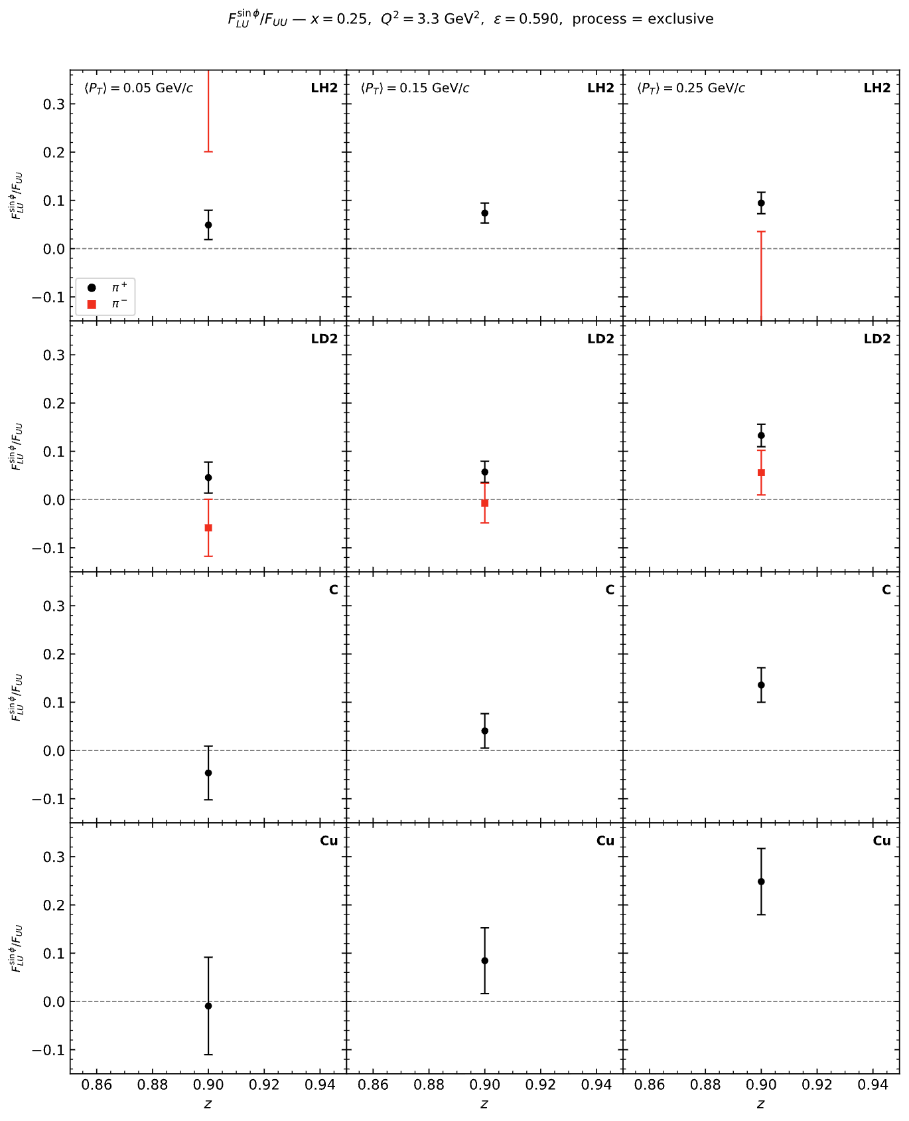
Beam Single Spin Asymmetry (SIDIS & Exclusive)
SIDIS (Mx >= 1.5 GeV)
Exclusive (Mx <= 1.05 GeV)

Slide 13
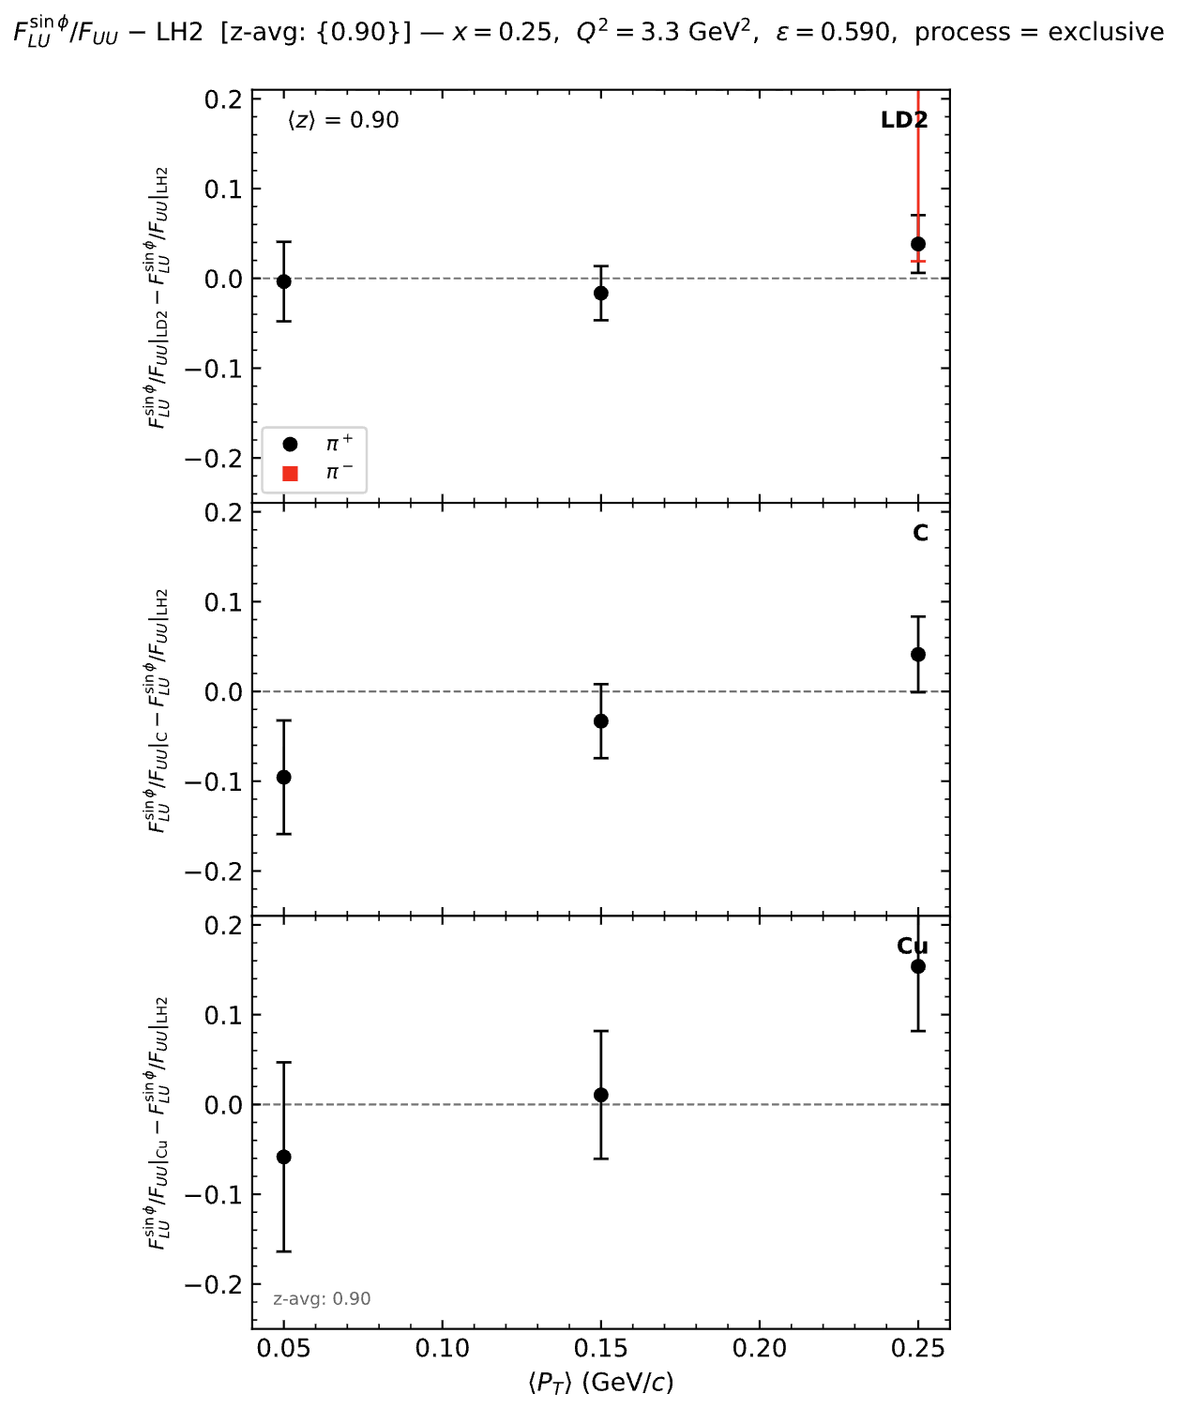
A-dependence of Beam Single Spin Asymmetry (SIDIS & Exclusive)
SIDIS (Mx >= 1.5 GeV)
Exclusive (Mx <= 1.05 GeV)

Slide 14
MC

Slide 15
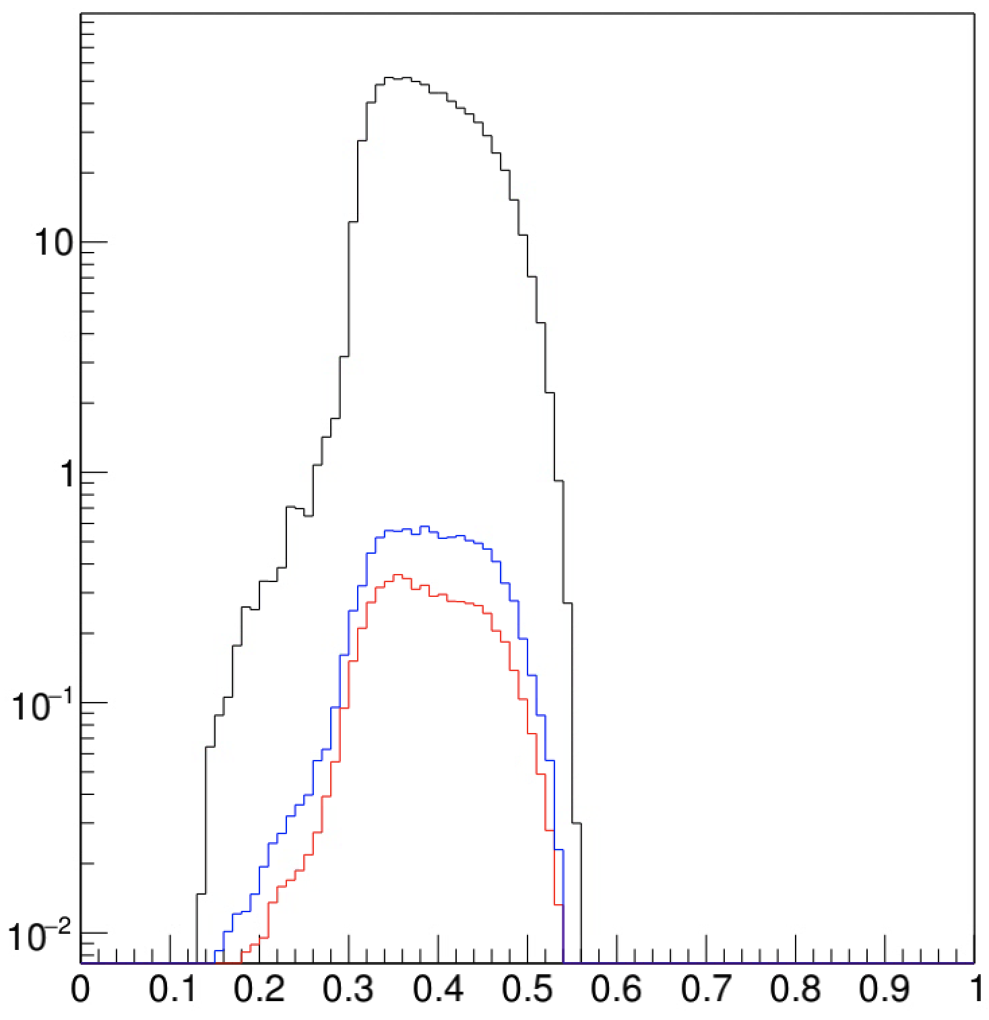
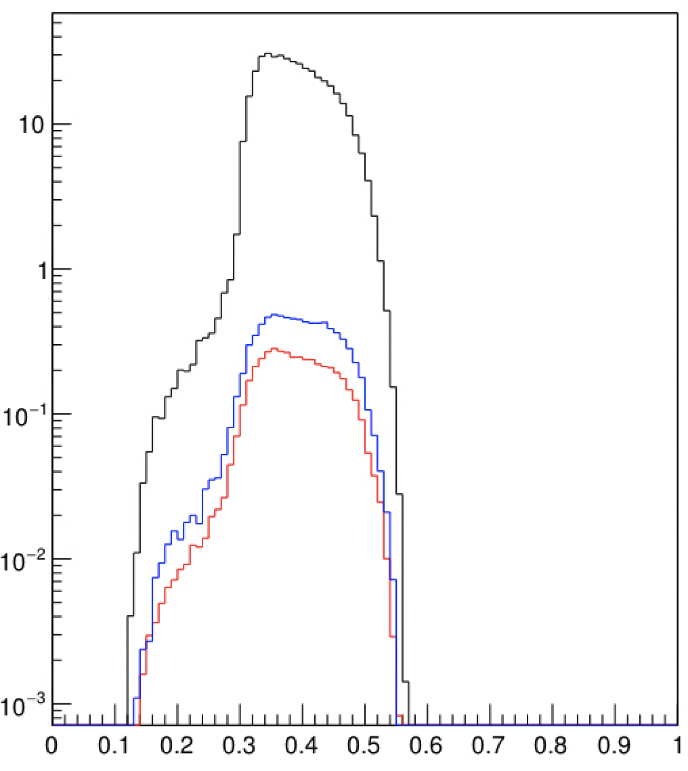
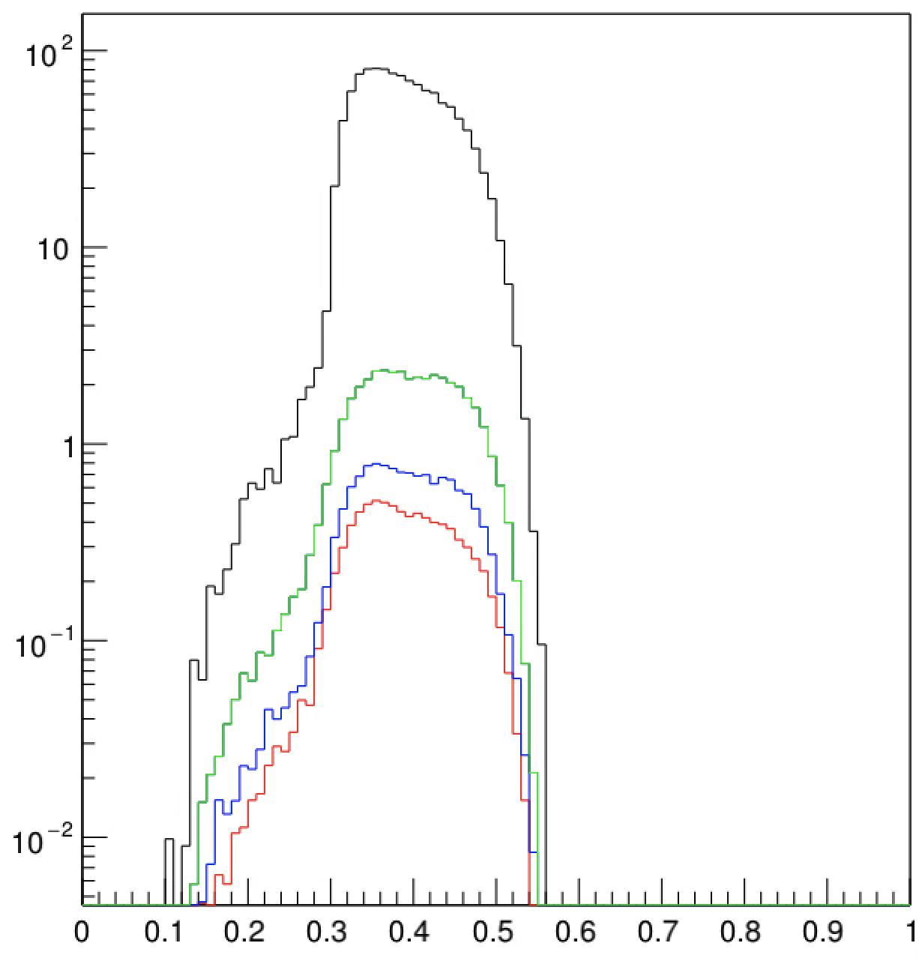
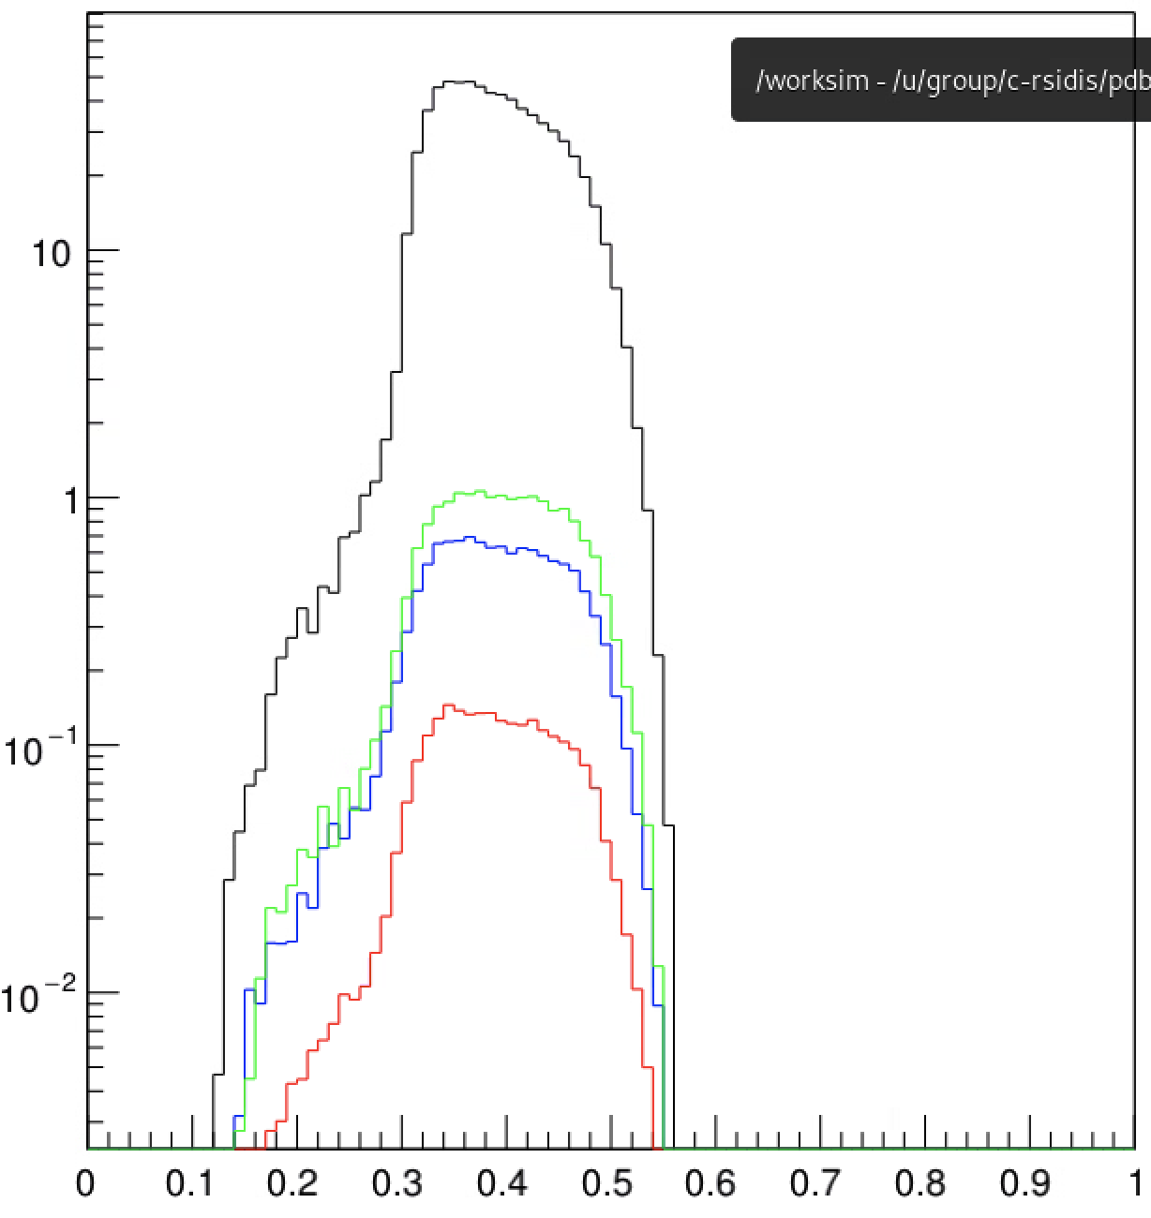
C
SIDIS
Delta (0.8%)
Exclusive (1.3%)
Cu
SIDIS
Delta (1.1%)
Exclusive (1.9%)
LD2
SIDIS
Delta (0.7%)
Exclusive (1.2%)
Rho (3.6%)
z
LH2
SIDIS
Delta (0.3%)
Exclusive (1.7%)
Rho (2.7%)
Z = 0.36, thpq = 2.0

Slide 16
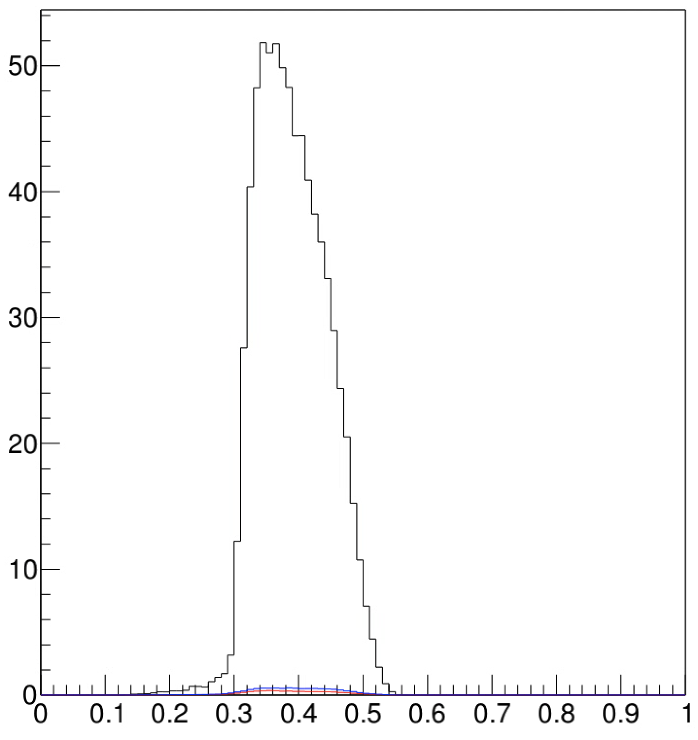

Slide 17
Updates during phaseII running - 08/02/2026

Slide 18
A-dependence of Beam Single Spin Asymmetry using Hall C R-SIDIS Data
Reference: PHYSICAL REVIEW LETTERS 128, 062005 (2022)

Slide 19
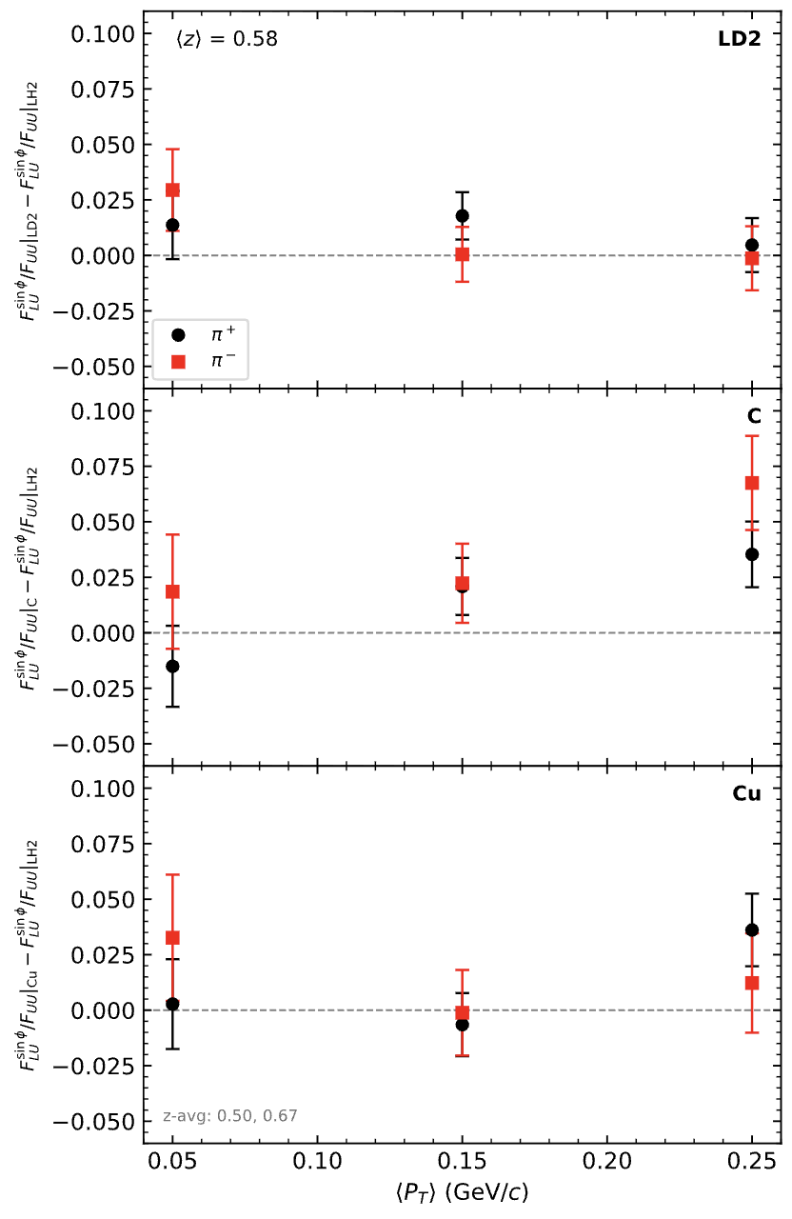
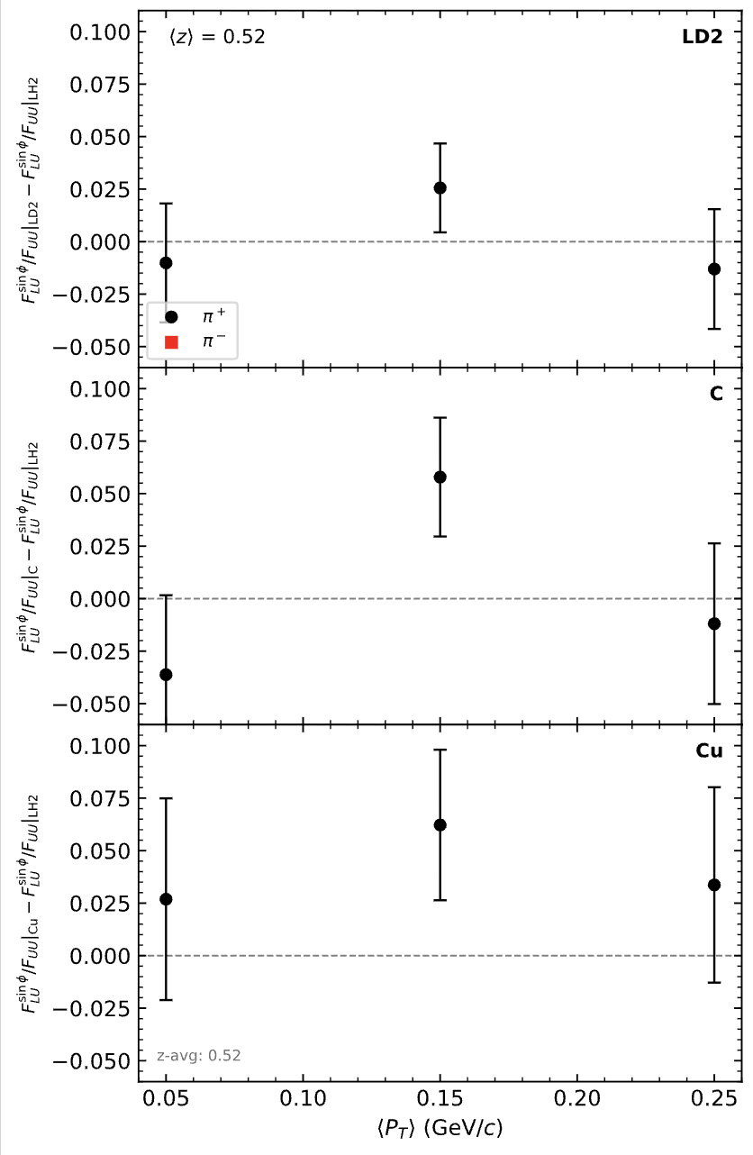
X=0.25
X=0.44

Slide 20
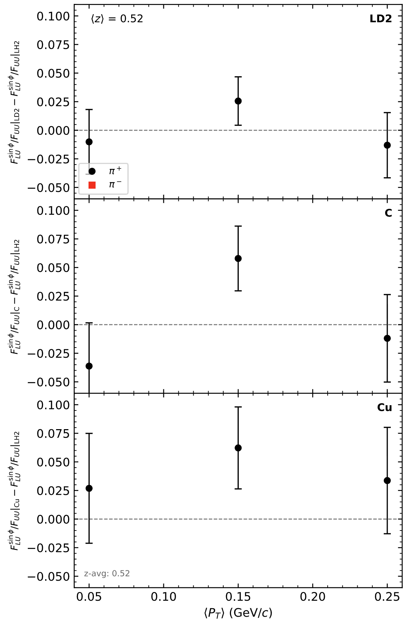
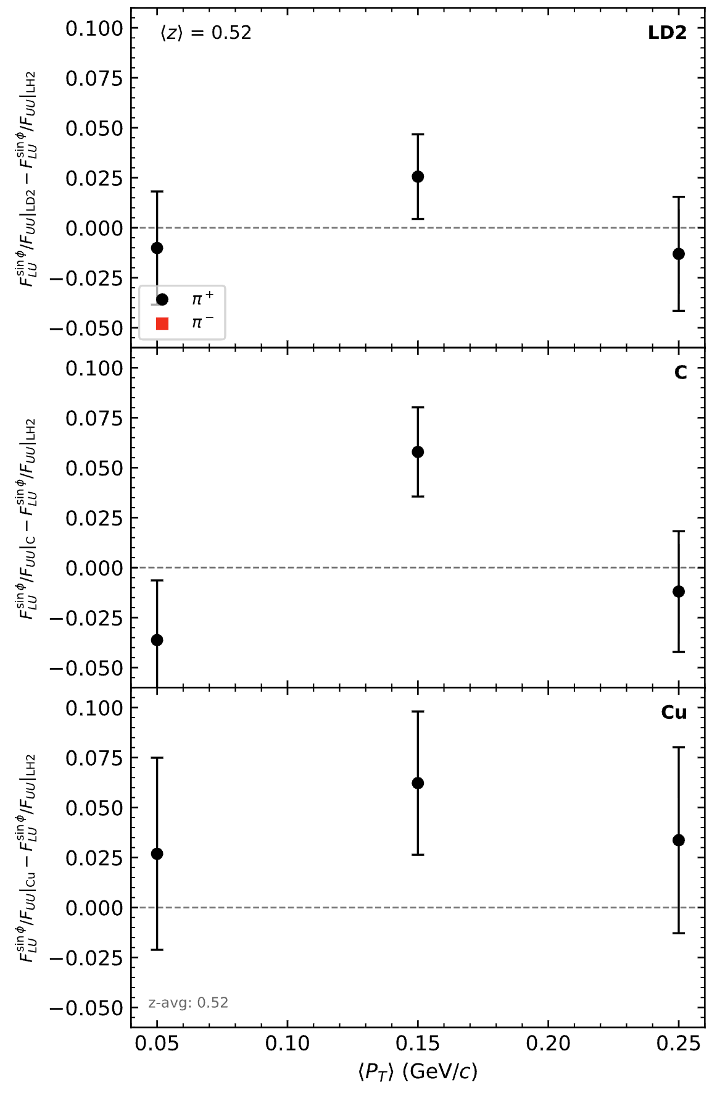
Using collected stats
Projection assuming double stats of C at all thpq settings

Slide 21
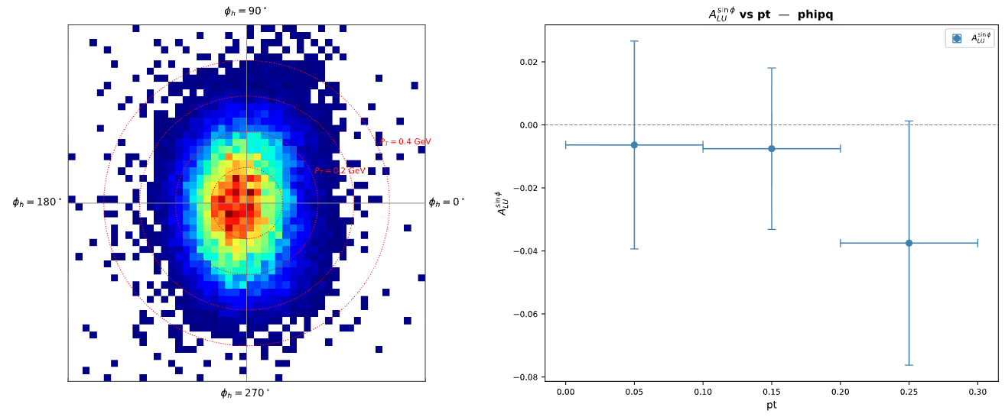
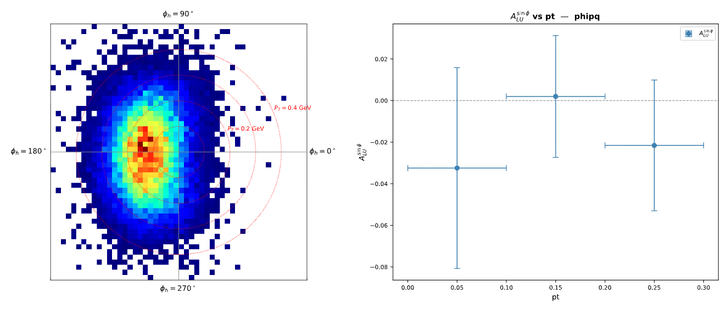
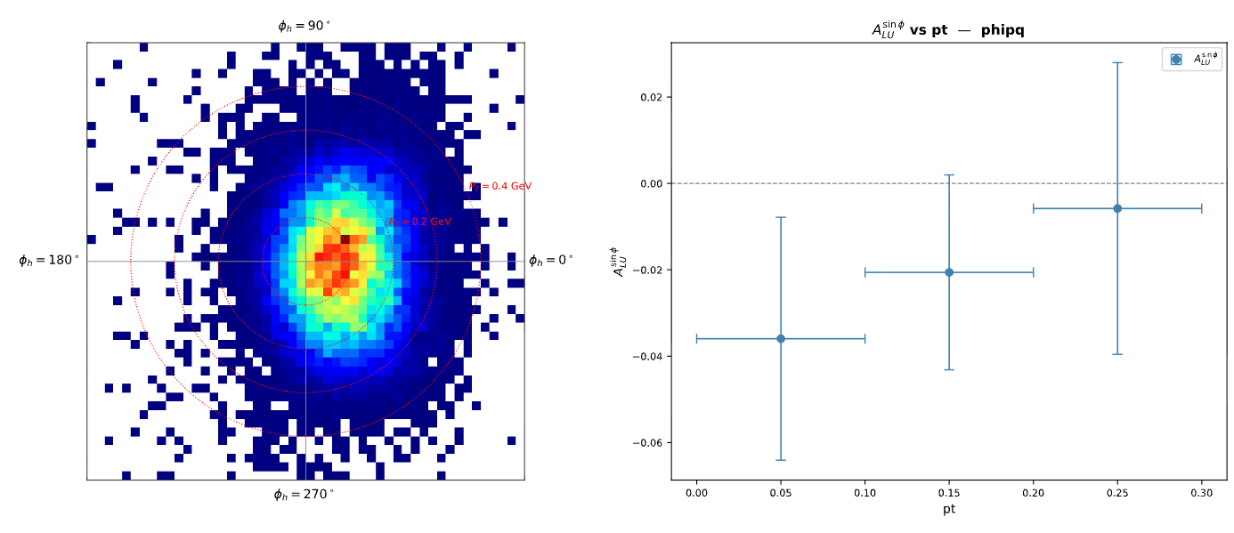
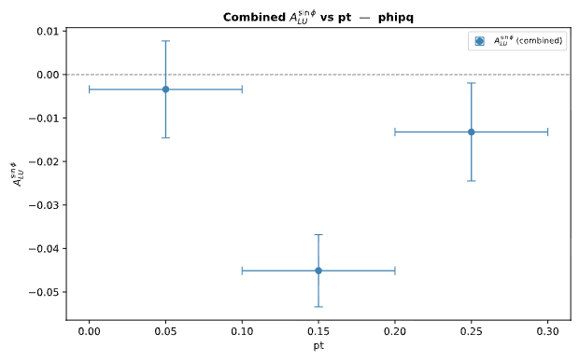
C, thpq = 0
C, thpq = 2.0
C, thpq = -2.0
LH2 (3 thpq combined)

Slide 22
BSA Analysis: A_LU vs Pt
Settings:
  Target : C
  Hadron : pi+
  x : 0.44
  z : 0.52
  thpq : -2.0, 0 and 2.0 (combined analysis)

Slide 23
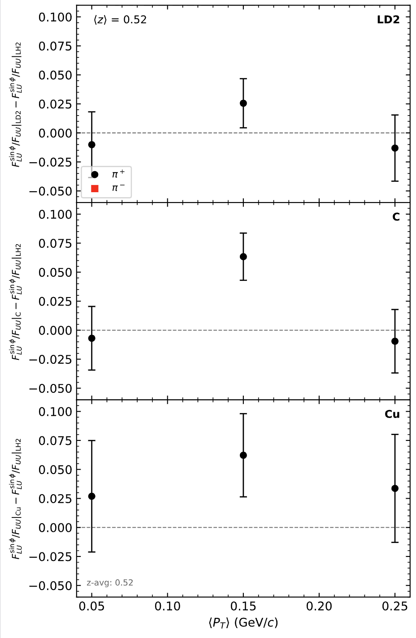
w/o Additional C Stats
w/ Additional C Stats

Slide 24
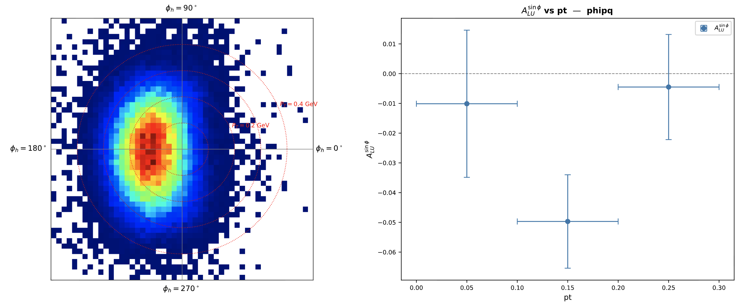
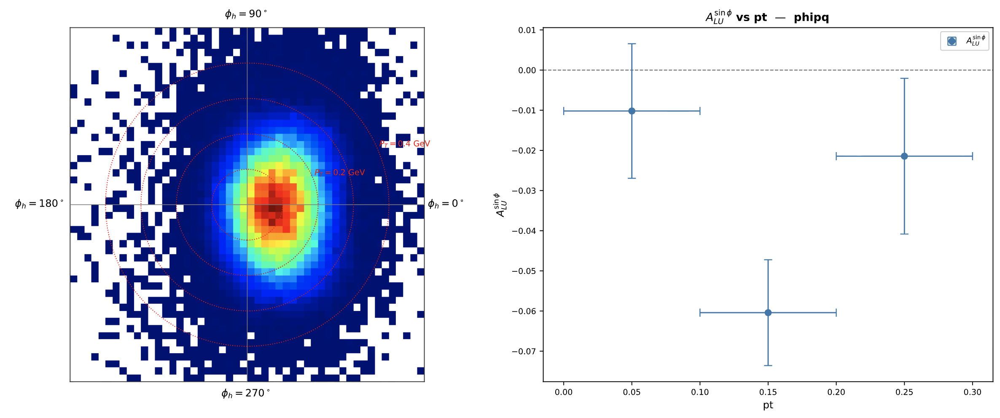
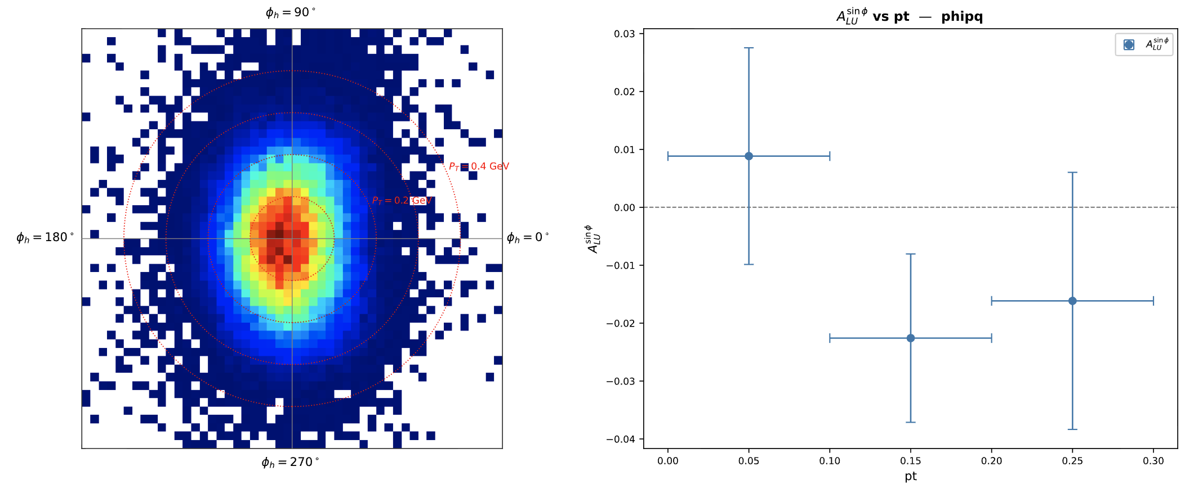
Pt Coverage at x=0.44 for LH2
thpq = 2.0
thpq = -2.0
thpq = 0

Slide 25
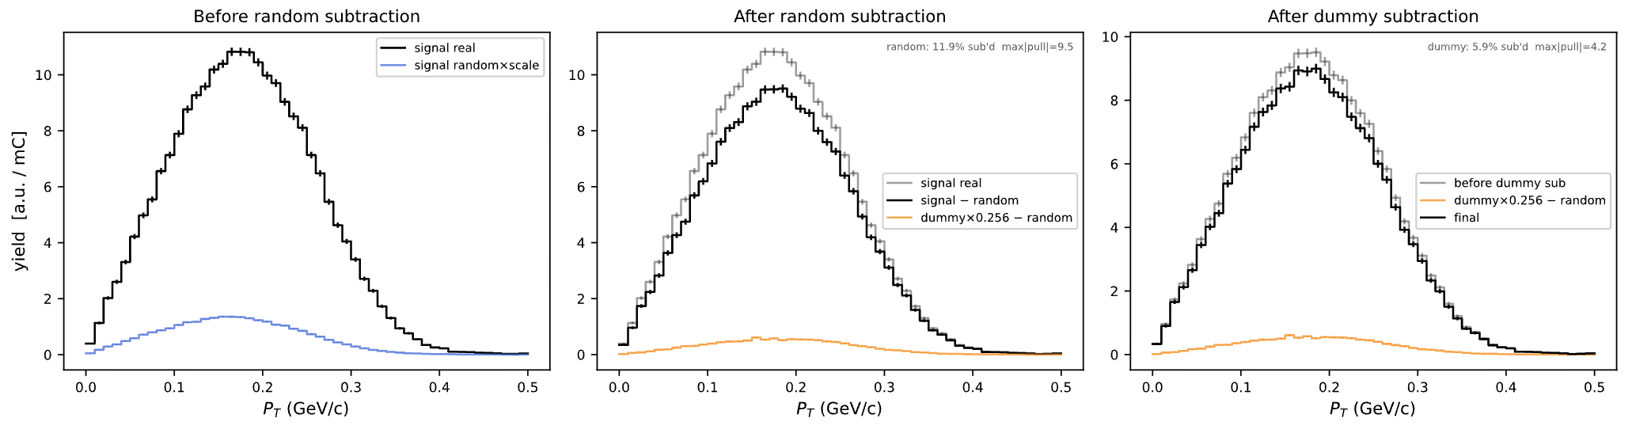
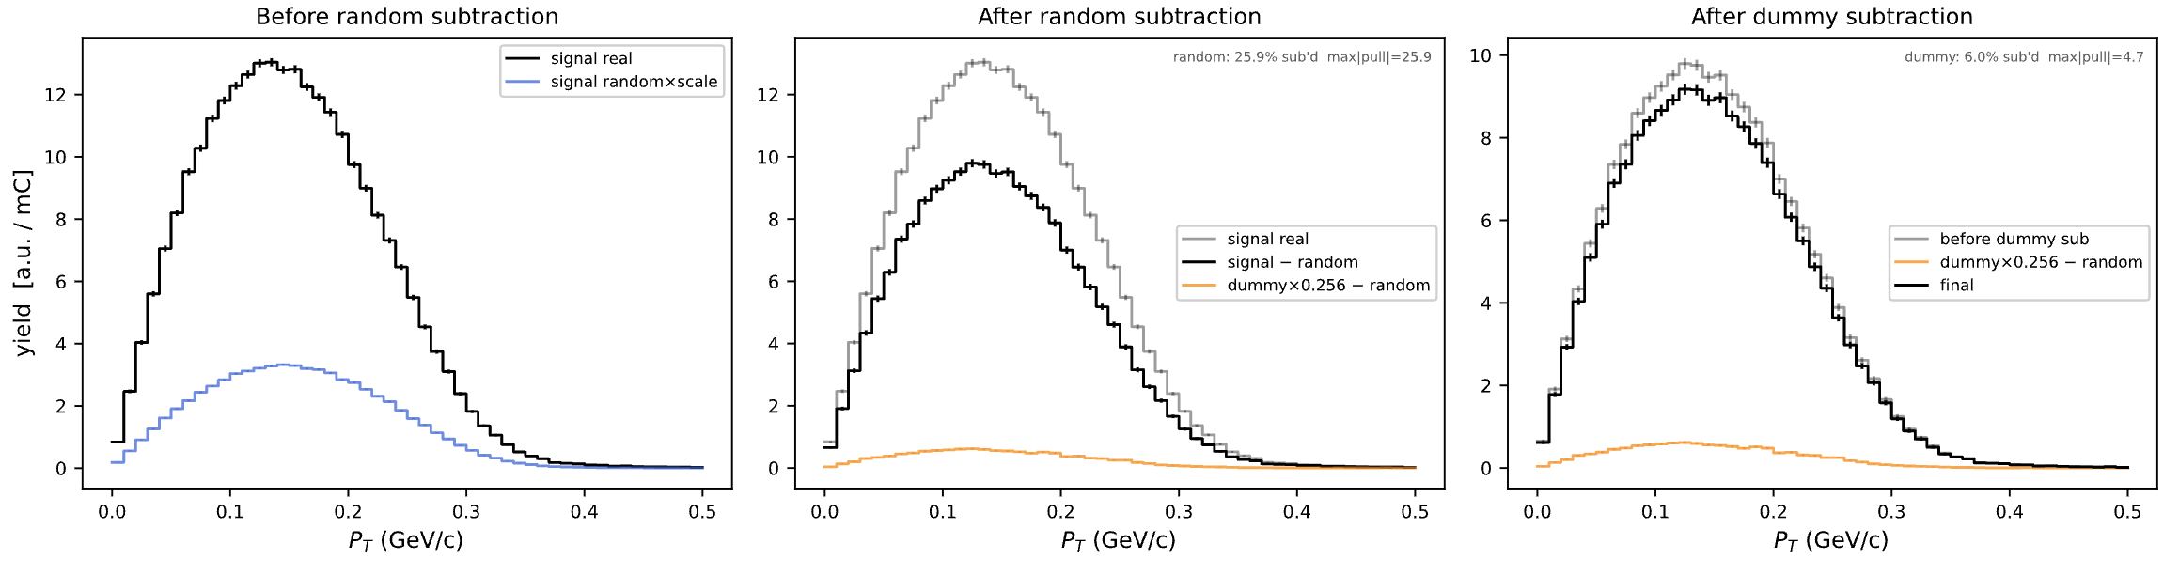
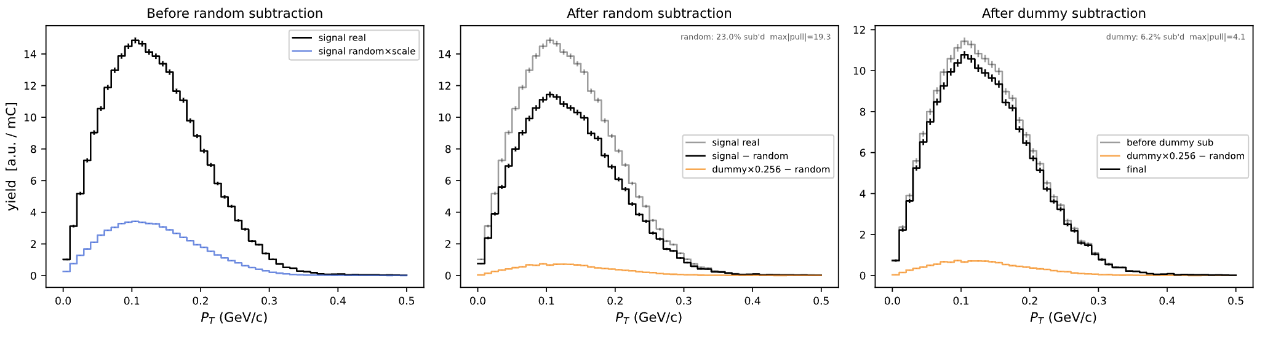
Pt Coverage at x=0.44 for LH2
thpq = 2.0
thpq = -2.0
thpq = 0

Slide 26
SIMC

Slide 27
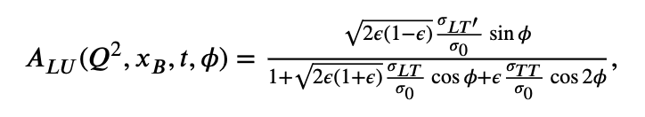
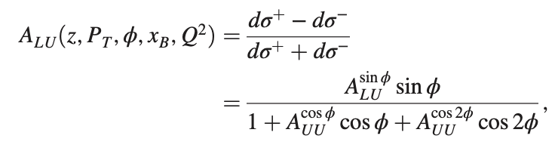
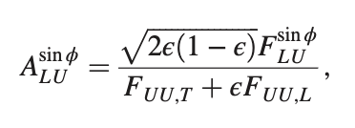


Slide 28

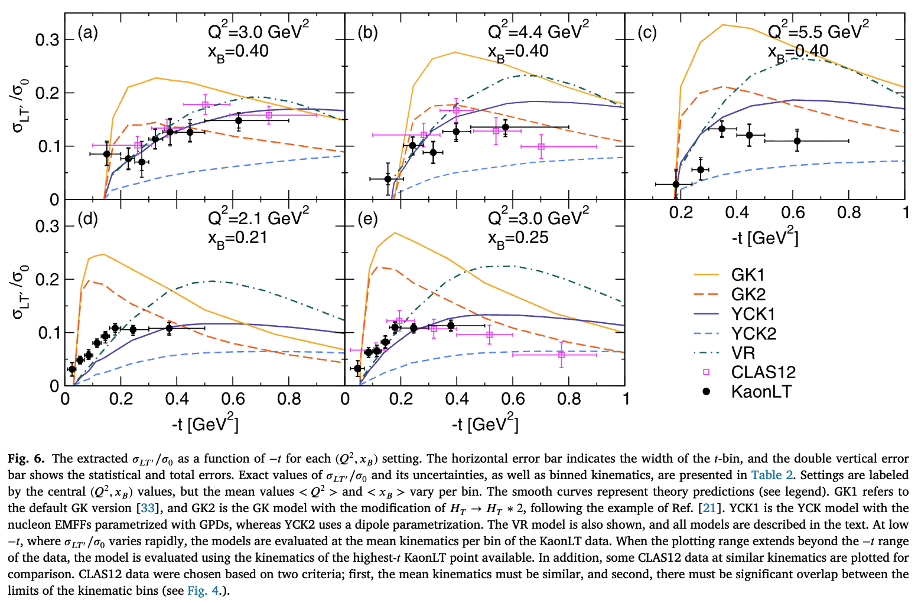

Slide 29
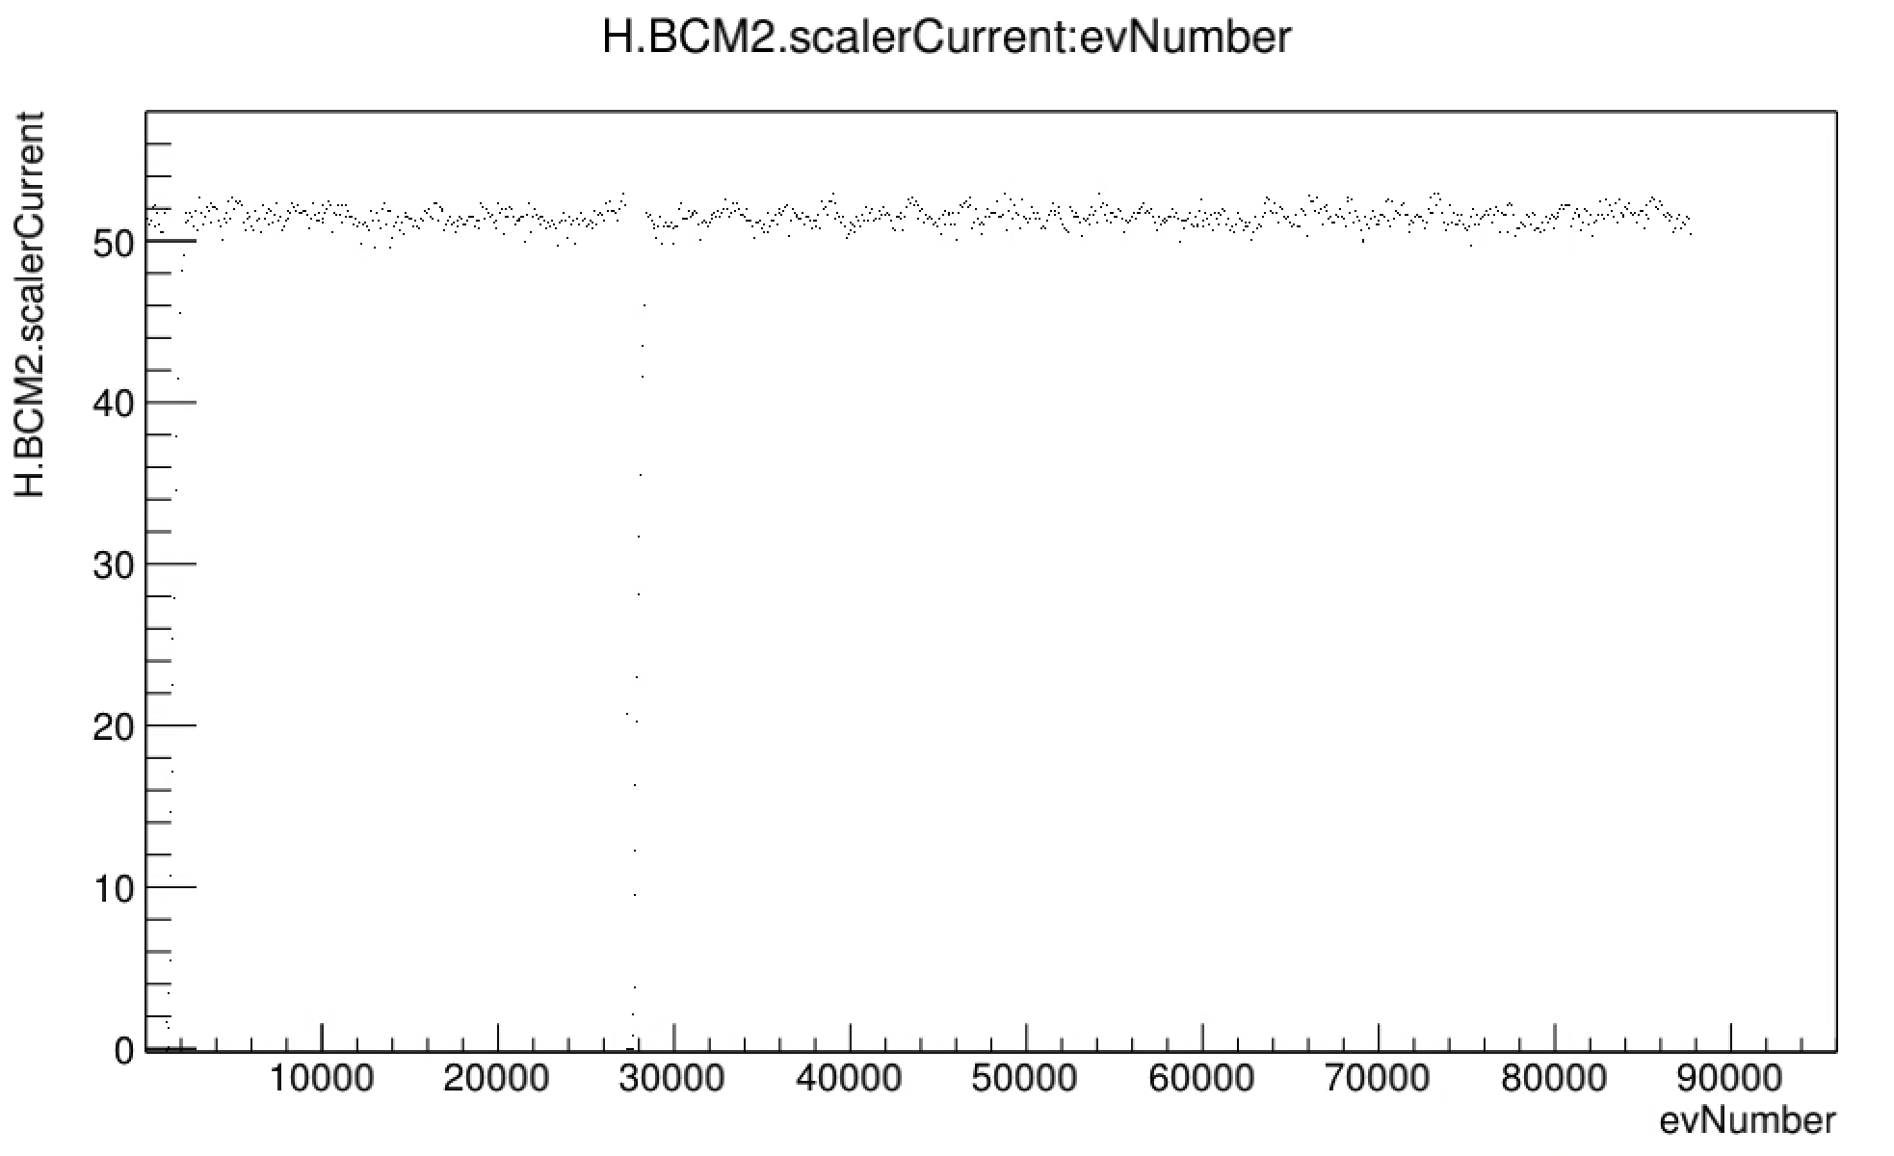
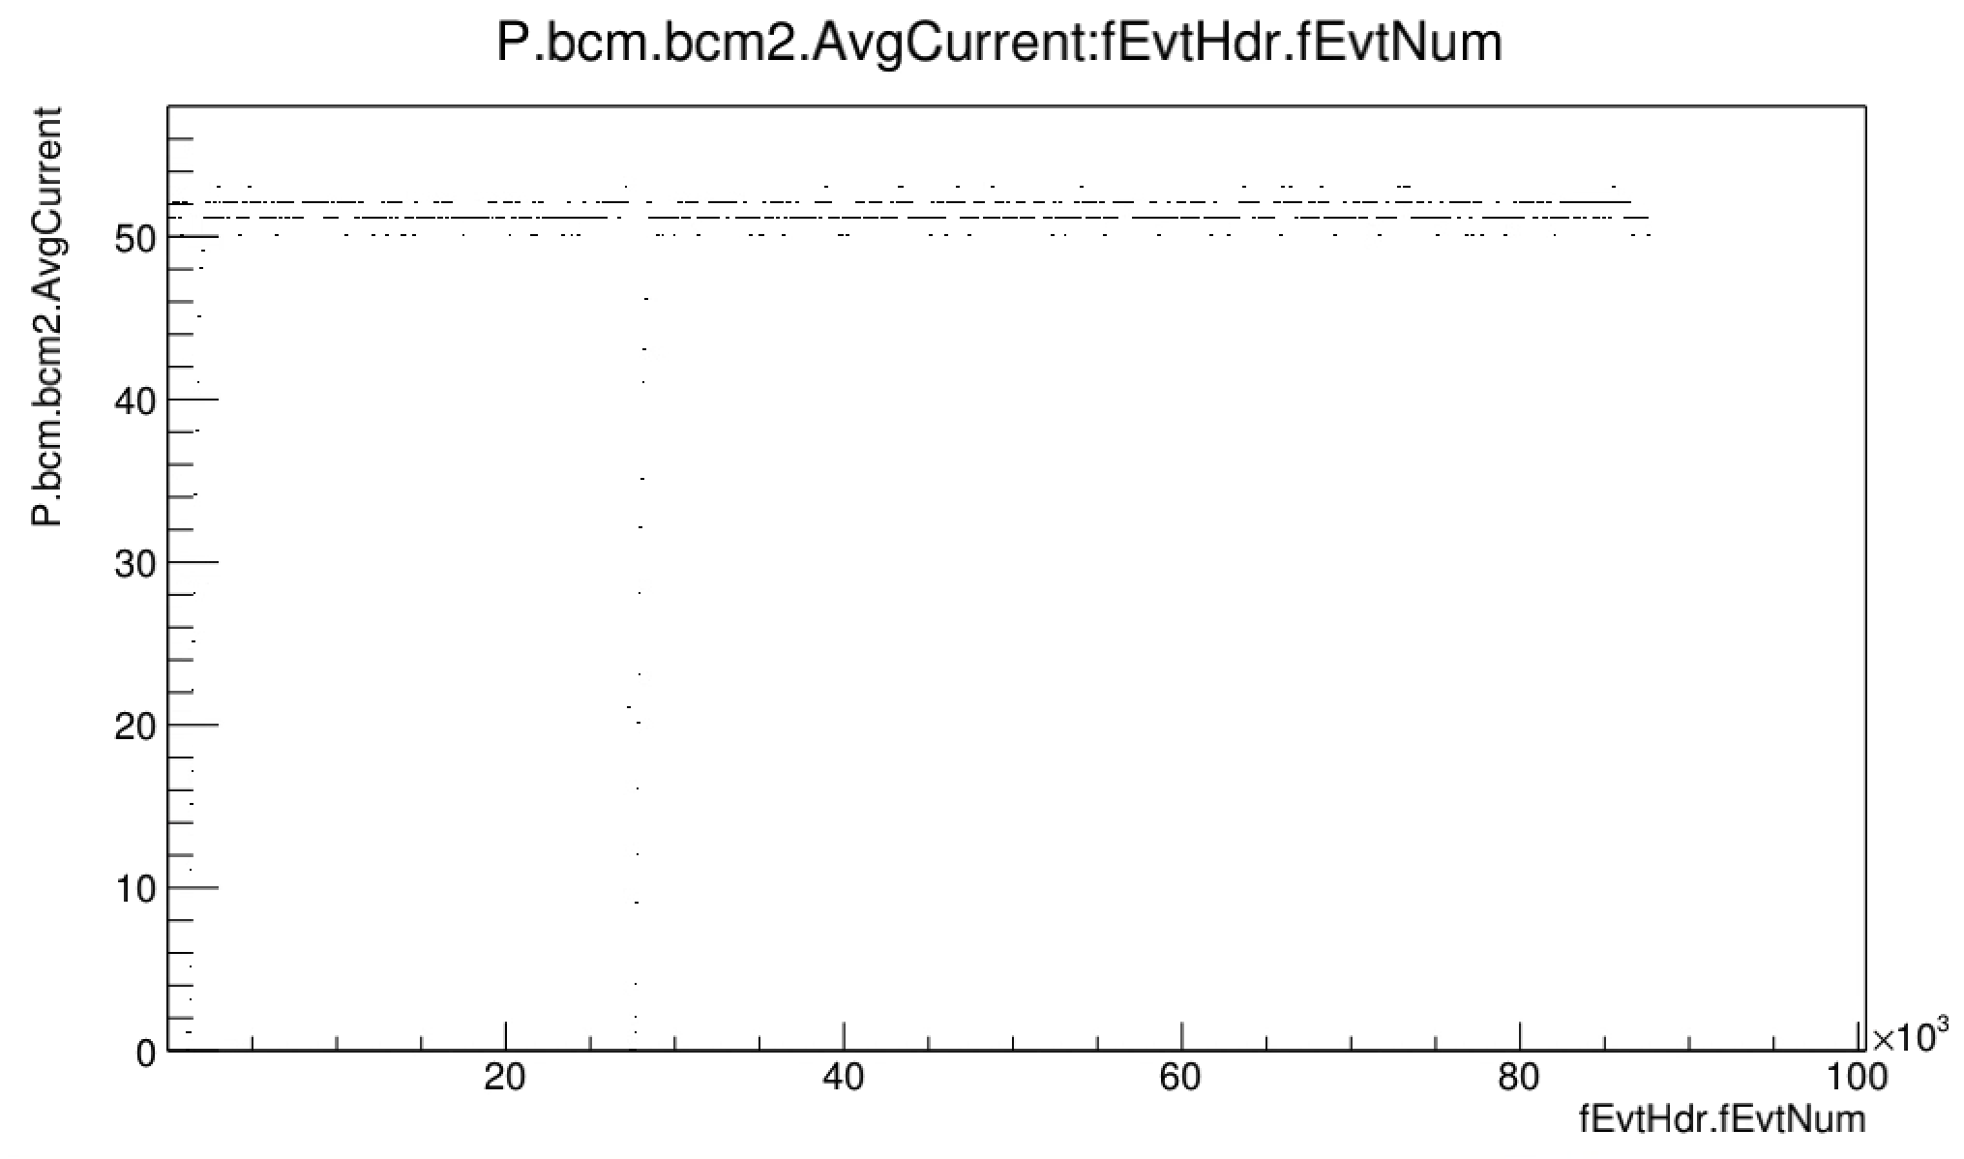

Run 28250 | Check of avg. BCM param | COIN

Slide 30






Looking at <ti> in 3 different Pt (and Pti) bins
Pt bins
Pti (i.e. vertex Pt) bins

